Slide 1


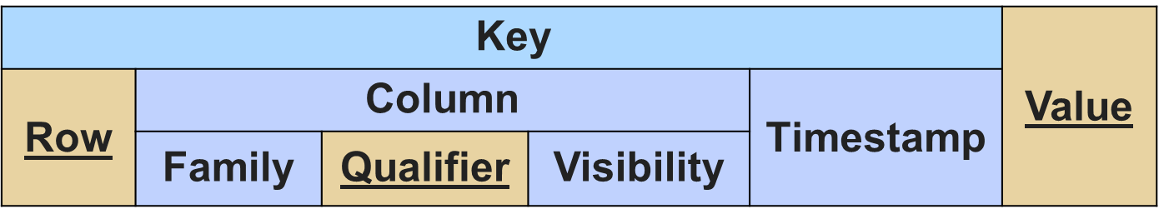
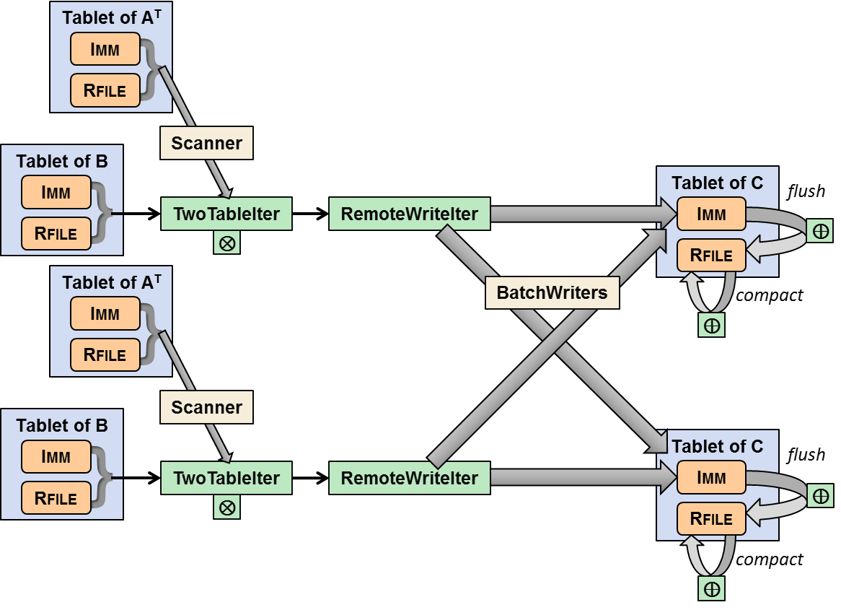
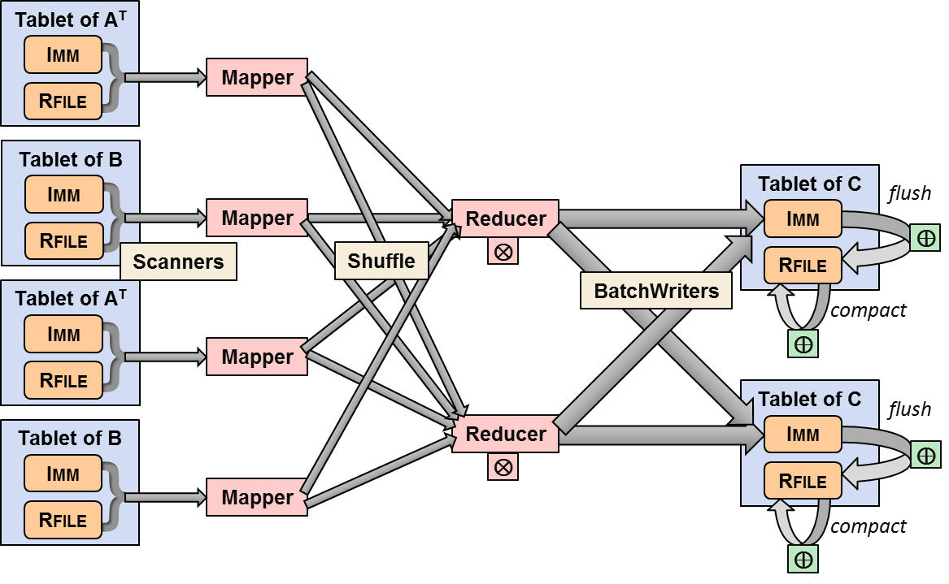


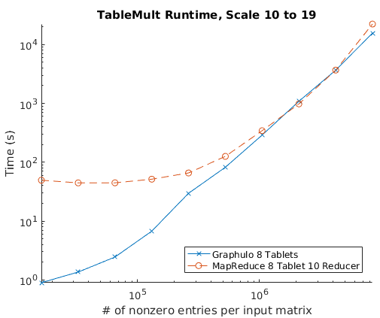
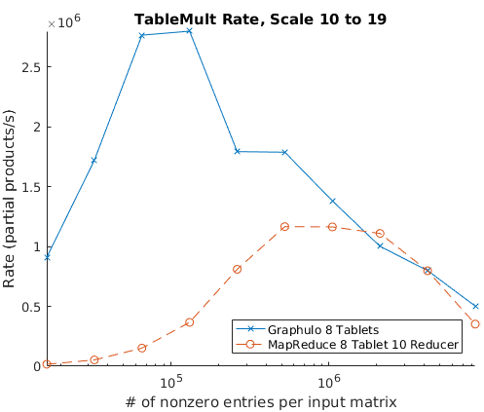

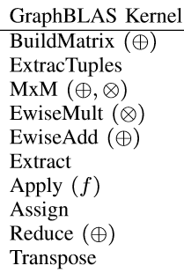


In-Database vs. External System Analytics on a Key-Value Store
Dylan Hutchison, Bill Howe, University of Washington; Vijay Gadepally, Jeremy Kepner, MIT Lincoln Laboratory
Background: Key-Value Analytics?
Experiment: Graphulo vs. MapReduce on Matrix Multiply
Key-Value stores used for
Scale-out to 1000s of machines
Transparent layout, performance
Fast key-value reads and writes
Problem: no support for complex analytics inside key-value stores
Goal: Compare Graphulo’s in-database approach to an external distributed system
Test assumptions: "Use Accumulo for low-latency queries on subgraphs";
"Use MapReduce for high-throughput analytics" ⬅ Are these true?
Example: Browser Sessions (e.g. browsing Amazon)
Graphulo Pipeline
C = A^{T} (⊕.⊗) B
MapReduce Pipeline
C = A^{T} (⊕.⊗) B
DATA TYPE | KEY | VALUE
Session | User/Session ID | Session Data (pages visited, shopping cart, …)
Key
External Process
Imm In-Memory Map
Rfile Hadoop File
Key
Accumulo
Iterator
Intra-process Data Flow
Fast read-writes perfect for low-latency web server
What if the website managers want to run analytics?
Network Data Flow
Experiment Details
Simple
filters, aggs
Query: find average session length
Query: for each page, find average viewing time (unless you build an index)
Query: build a histogram of users browsing certain pages, grouped by session age, over various time periods
Query: cluster users based on pages browsed. Recommend users to browse popular pages browsed in their cluster
12 x m3.large Amazon nodes, each 7.5 GB mem, 2 vCPU, 30 GB SSD
8 workers, 3 coordinators, 1 monitor
Graph500 power law matrix generator
2¹⁰ to 2¹⁹ rows, 16 nonzeros/row
Skew!
Requires
re-shuffle
Requires
iteration
Convergence at larger inputs
Sustained Ingest: compactions throttle Accumulo
Past Work
Burst Ingest
ML, matrix,
graph alg.
Showed Graphulo faster than single-node in-memory LA packages on MxM (HPEC '15)
Confirmed results for more complex I/O-bound, single-pass graph analytics (IPDPS '15, HPEC '16)
Verified Graphulo scales with Accumulo as cluster size increases (HPEC '16)
Huge YARN startup cost
= Supported inside key-value databases
= Requires external system
Yet in-database analytics have many benefits:
Data Locality
Reuse Infrastructure
Indexed access, distributed execution
Results
Analytics inside Key-Value Stores
Graphulo dominates at smaller problem sizes
Graphulo & MapReduce equivalent at larger problem sizes
Linear Algebra in the Apache Accumulo NoSQL key-value store
Guideline
RACO
Relational Algebra in the Apache Accumulo NoSQL key-value store (not this poster)
Graphulo best for I/O-bound single-pass analytics
External systems best for CPU-bound or multi-pass analytics

