Slide 1
Hyperparameter Study for Feedforward Neural Networks on Classifying Text Data
Marius Kleidl
06.07.2018

Slide 2
Motivation
Text classification is part of our daily life
Distinguish bills and ads in letters, e-mails, notifications on your smartphone
Computers use it to filter spam, grouping mails etc.

Slide 3
Motivation
Neural networks are commonly used for classification
However, optimizing neural networks is not easy
We conduct an experiment to see how different hyperparameters affect a neural networks’ accuracy

Slide 4
Agenda
Motivation
Experiment
Data Set
Results
Conclusion

Slide 5
Experiment
Setup simple feature selection for text data
Train feedforward neural network using different hyperparameter values
Evaluate accuracy using test data set

Slide 6
Experiment – Hyperparameters
We limit our experiment to three parameters:
Number of layers (1 or 2)
Number of perceptrons per layer (50 or 100)
Learning rate (1, 0.1, 0.01, 0.001, 0.0001)
→ In total: 20 different combinations

Slide 7
Data Set
20 Newsgroups
~ 18 000 posts from 20 different news groups with overlapping topics
comp.graphics comp.os.ms-windows.misc comp.sys.ibm.pc.hardware comp.sys.mac.hardware comp.windows.x | rec.autos rec.motorcycles rec.sport.baseball rec.sport.hockey | sci.crypt sci.electronics sci.med sci.space
misc.forsale | talk.politics.misc talk.politics.guns talk.politics.mideast | talk.religion.misc alt.atheism soc.religion.christian
Table from http://qwone.com/~jason/20Newsgroups/

Slide 8
Data Set – Example
From: JC924@uacsc2.albany.edu
Subject: Why are our desktop fonts changing?
Organization: University at Albany, Albany NY 12222
X-Newsreader: NNR/VM S_1.3.2
Lines: 17
One of our users is having an unusual problem. If she does an Alt/Tab to
a full-screen DOS program, when she goes back to Windows her desktop fonts
have changed. If she goes back to a full-screen DOS program and then goes
back to Windows, the font has changed back to its default font. It's not
a major problem (everything works and the font is legible), but it is
annoying. Does anyone have any idea why this happens. By the way, she
has a DEC 486D2LP machine.
++++++++++++++++++++++++++++++++++++++++++++++++++++++++++++++++++++++++++
Jeffrey M. Cohen Voice: 518-442-3510
Office for Research (AD 218) Fax: 518-442-3560
The University at Albany E-mail: JC924@uacsc2.albany.edu
State University of New York
1400 Washington Ave.
Albany, NY 12222
++++++++++++++++++++++++++++++++++++++++++++++++++++++++++++++++++++++++++++
Example from the comp.os.ms-windows.misc newsgroup

Slide 9
Neural Network
Remove English stopwords (e.g. ‘the’)
Text is represented as a Bag of Words
→ No sentence structure is preserved
Normalize count matrix using Tf-Idf
→ Limit impact of common words
No further text processing is done (e.g. stemming)

Slide 10
Training and Validation
Training is stopped if accuracy stops improving for 0.1 p.p. for two iterations
Each neural network is evaluated using four-folded cross-validation
Final accuracy score is determined using previously unused test set

Slide 11
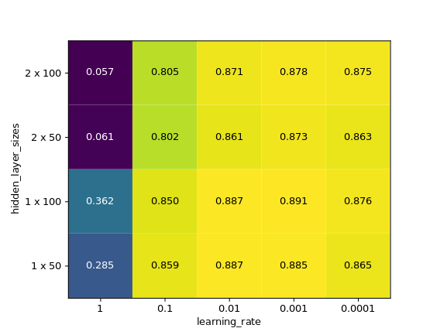
Results
Best combination: 1 layer with 100 perceptrons and learning rate of 0.001
Accuracy on unseen test set: 81.5%
Accuracy from cross-validation for different hyperparameters

Slide 12
Conclusion
Tuning hyperparameters is important for optimization
However, other network architectures and advanced text processing may be needed tor further increased accuracy

