Slide 1


Improving the GraphQL, JSON and RDF Representations of buildingSmart Data Dictionary Vladimir Alexiev, Mihail Radkov, Nataliya Keberle
11th Linked Data in Architecture and Construction Workshop, 15-16 June 2023, Matera, Italy"

Slide 2
Outline
Highlight the defects in the original GraphQL implementation of bSDD
Overview the refactored solution proposed by Ontotext
Overview data quality issues
Overview the proposed improvements
11th Linked Data in Architecture and Construction Workshop, 15-16 June 2023, Matera, Italy"

Slide 3
BSDD GRAPHQL SCHEMA: VOYAGER
11th Linked Data in Architecture and Construction Workshop, 15-16 June 2023, Matera, Italy"

Slide 4
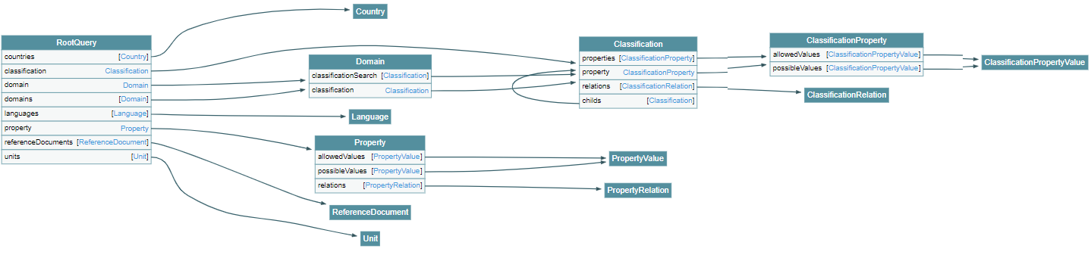
Voyager: Original Schema
11th Linked Data in Architecture and Construction Workshop, 15-16 June 2023, Matera, Italy"

Slide 5
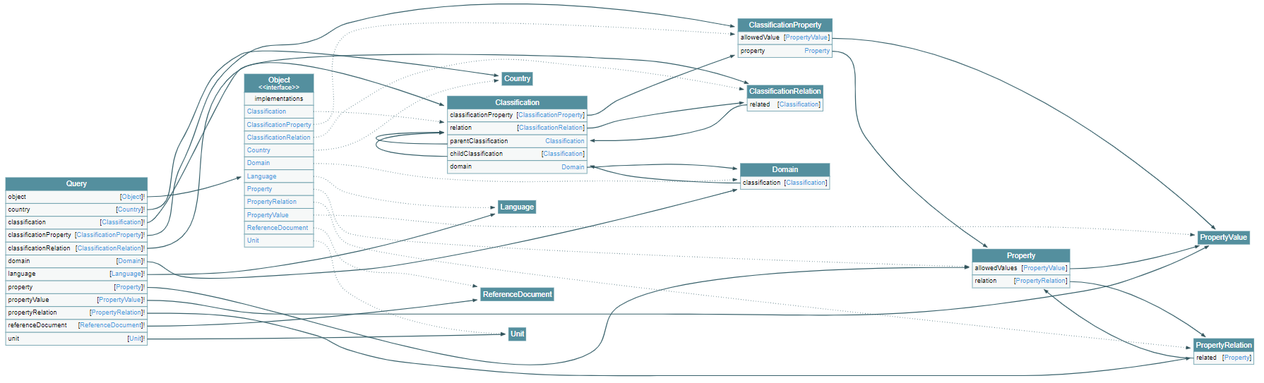
Voyager: Refactored Schema
11th Linked Data in Architecture and Construction Workshop, 15-16 June 2023, Matera, Italy"

Slide 6
Original GraphQL: Findings (1/3)
Reference entities ReferenceDocument, Country, Unit, Language are disconnected from the rest of the schema
Relation entities have only an incoming link but no outgoing link
Many entities cannot be queried directly from the Root
No backward arrows to get from a lower-level entity back to its “parent” entity
A number of parallel arrows. GraphQL schema can use parameters to distinguish between the different uses
11th Linked Data in Architecture and Construction Workshop, 15-16 June 2023, Matera, Italy"

Slide 7
Original GraphQL: Findings (2/3)
At the high level of detail:
Property and ClassificationProperty are very similar, but there’s no inheritance/relation between them
PropertyValue and ClassificationPropertyValue are exactly the same, so can be reduced to one entity
11th Linked Data in Architecture and Construction Workshop, 15-16 June 2023, Matera, Italy"

Slide 8
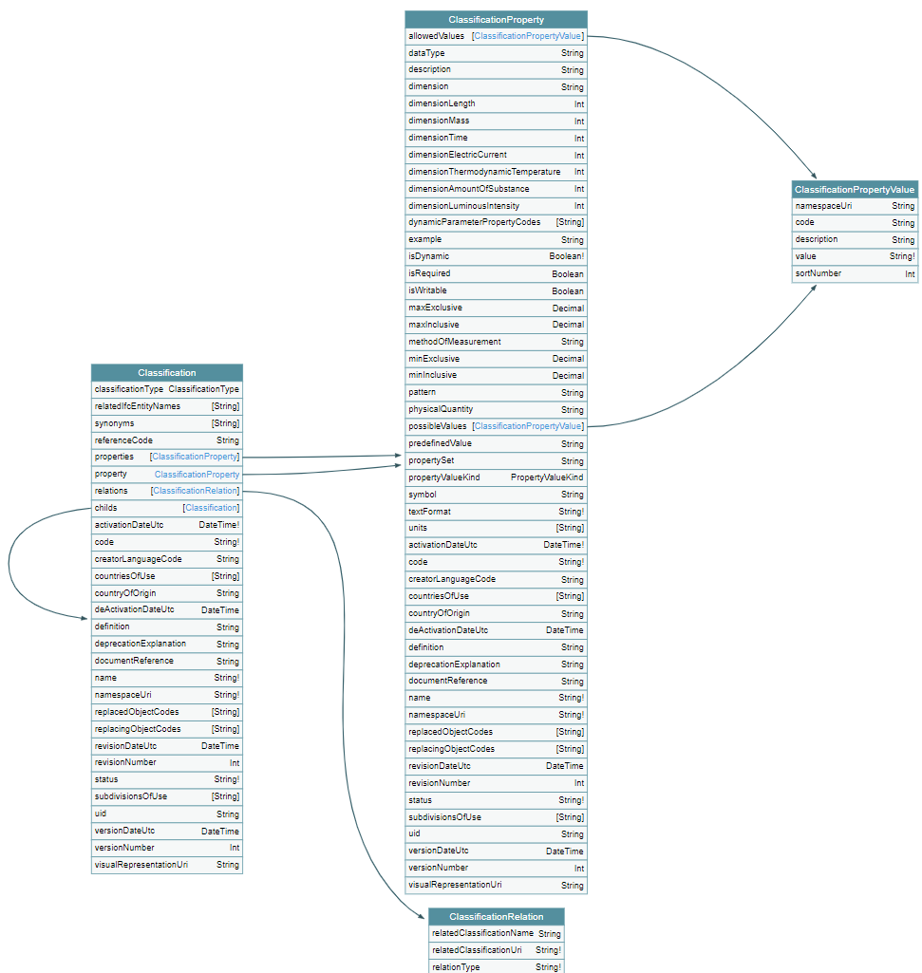
Original GraphQL: Findings (3/3)
Mixture of singular/plural in property names(*)
property/properties, relations, synonyms, countriesOfUse, relatedIfcPropertyNames, etc.
(*) - already discussing at forums.buildingsmart.org
11th Linked Data in Architecture and Construction Workshop, 15-16 June 2023, Matera, Italy"

Slide 9
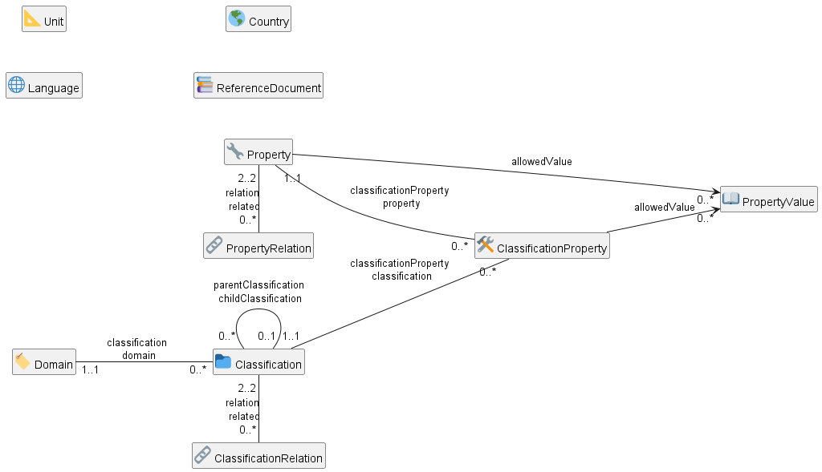
bSDD Refactored Schema: PlantUML
PlantUML is used with soml2puml convertor tool
11th Linked Data in Architecture and Construction Workshop, 15-16 June 2023, Matera, Italy"

Slide 10
Refactored GraphQL: Improvements
All entities are queryable directly from the Root
No parallel links, use GraphQL query parameters instead
Pagination for bulk query results
GraphQL syntax highlight, keyboard shortcuts, search in the query text, query response errors
Each link is named the same as target entity
Navigation between entities is bidirectional
A single entity PropertyValue is used by both Property and ClassificationProperty
Property names are in singular
11th Linked Data in Architecture and Construction Workshop, 15-16 June 2023, Matera, Italy"

Slide 11
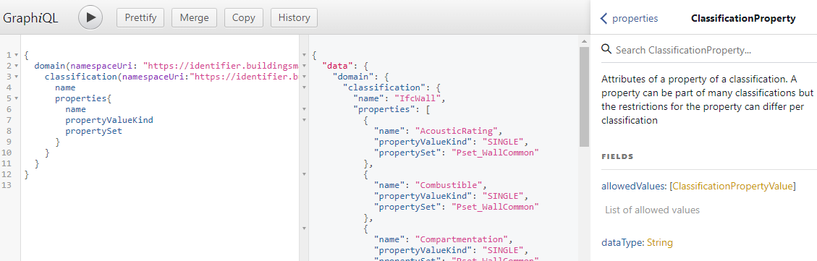
GraphiQL: Original
11th Linked Data in Architecture and Construction Workshop, 15-16 June 2023, Matera, Italy"

Slide 12
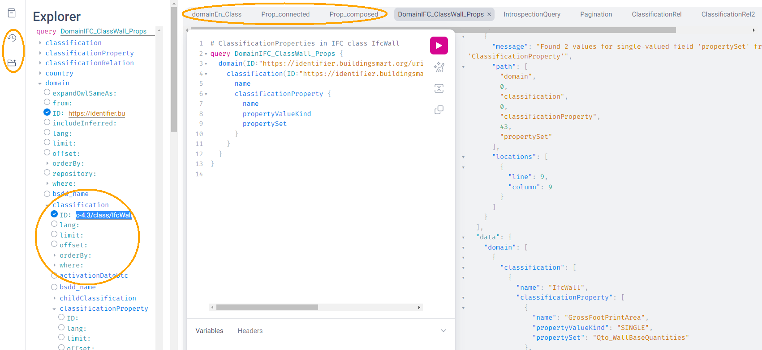
GraphiQL: Refactored
11th Linked Data in Architecture and Construction Workshop, 15-16 June 2023, Matera, Italy"

Slide 13
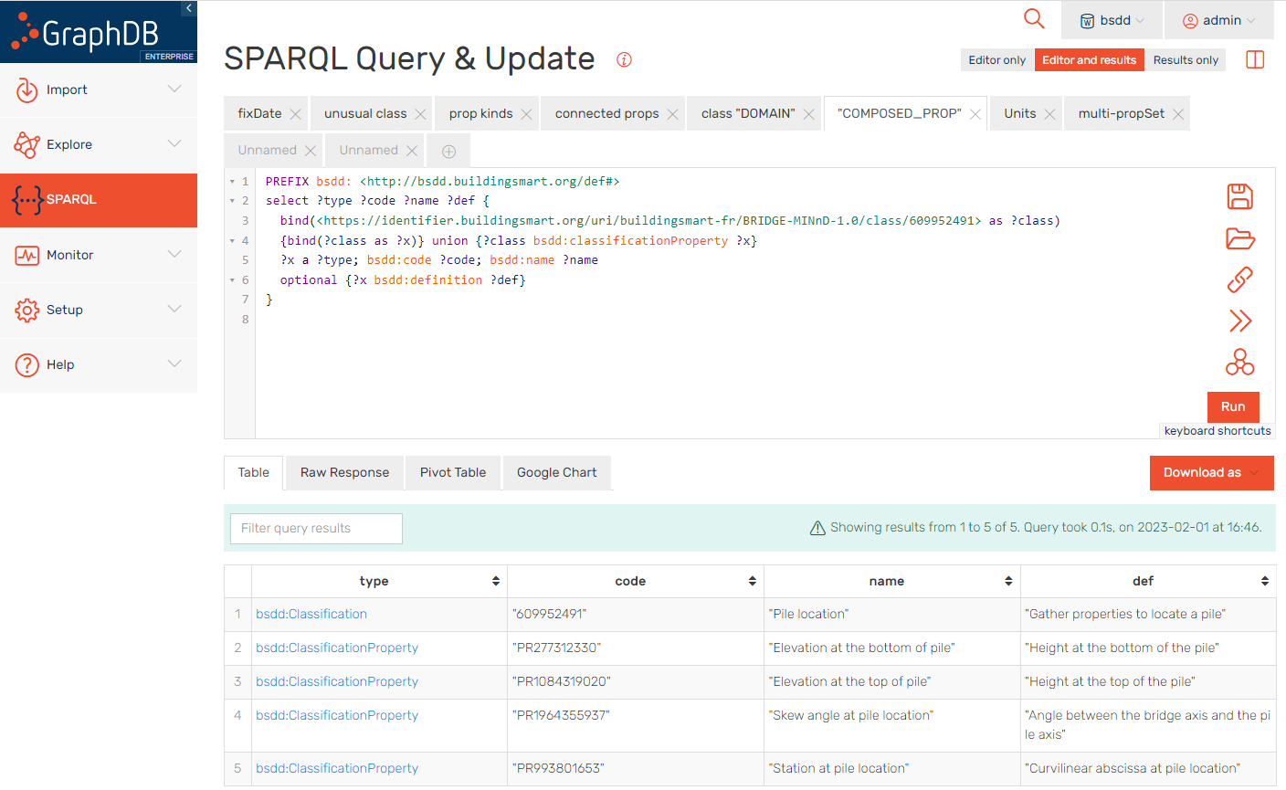
Refactored bSDD: SPARQL Endpoint
11th Linked Data in Architecture and Construction Workshop, 15-16 June 2023, Matera, Italy"

Slide 14
SUGGESTED IMPROVEMENTS
11th Linked Data in Architecture and Construction Workshop, 15-16 June 2023, Matera, Italy"

Slide 15
buildingSMART Feedback
Status | Count
DISMISSED | 6
NEED MORE INFO | 5
SOLUTION IN PROGRESS | 12
SOLVED | 4
TO BE ANALYSED | 21
TO DO | 13
Grand total | 61
buildingSMART International started to analyse the suggested improvements
Live spreadsheet with status/solution for each of suggested improvements
11th Linked Data in Architecture and Construction Workshop, 15-16 June 2023, Matera, Italy"

Slide 16
Presentation
Uniform identification for the search
Equal data retrieved from different API
Improve URL structure and consistency
11th Linked Data in Architecture and Construction Workshop, 15-16 June 2023, Matera, Italy"

Slide 17

Uniform Identification
February 2023: IfcCableSegment in Web UI has URL: https://search.bsdd.buildingsmart.org/Classification/Index/58453
May 2023: IfcCableSegment in Web UI has another URL: https://search.bsdd.buildingsmart.org/Classification/Index/70992
11th Linked Data in Architecture and Construction Workshop, 15-16 June 2023, Matera, Italy"

Slide 18
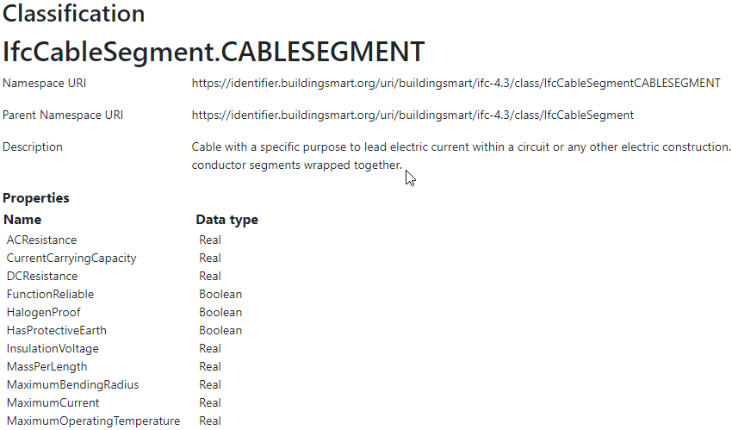
Uniform Identification
IfcCableSegment has also URI assigned by a data provider:
https://identifier.buildingsmart.org/uri/buildingsmart/ifc-4.3/class/IfcCableSegmentCABLESEGMENT
CableSegment entity as displayed at the bSDD web site
11th Linked Data in Architecture and Construction Workshop, 15-16 June 2023, Matera, Italy"

Slide 19
Uniform Identification
Non-unique identification violates FAIR Findability principle
F1: (Meta)data are assigned a globally unique and persistent identifier
11th Linked Data in Architecture and Construction Workshop, 15-16 June 2023, Matera, Italy"

Slide 20
Equal Data Retrieved from Different API
We have compared three representations returned by the bSDD server:
JSON from the GraphQL API
https://test.bsdd.buildingsmart.org/graphiql/
JSON from the REST (entity) API
curl https://identifier.buildingsmart.org/uri/buildingsmart/ <domain>/class|prop/<name> and
RDF from the REST (entity) API
curl -Haccept:text/turtle \ https://identifier.buildingsmart.org/uri/buildingsmart/ <domain>/class|prop/<name>
11th Linked Data in Architecture and Construction Workshop, 15-16 June 2023, Matera, Italy"

Slide 21
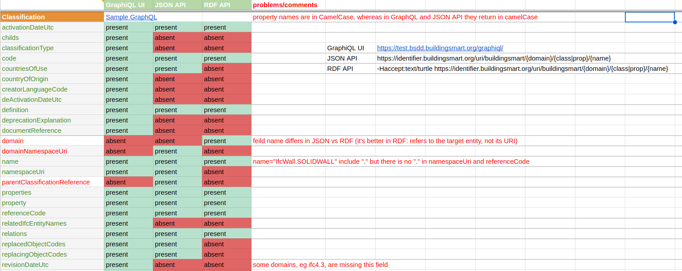
Equal Data Retrieved from Different API
We selected entities of each class that have the maximum number of filled fields, and compared the results returned by each API.
11th Linked Data in Architecture and Construction Workshop, 15-16 June 2023, Matera, Italy"

Slide 22
Improve URL Structure and Consistency
Almost all bSDD domain URLs now have the same structure: https://identifier.buildingsmart.org/uri/<org>/<domain>-<version>
URIs can be more “hackable”, allowing users to navigate the hierarchy by pruning the URI: https://identifier.buildingsmart.org/uri/<org>/<domain>/<version>
In some cases, the <org> is repeated in the <domain> part
D. Garijo and M. Poveda-Villalón, ``Best practices for implementing FAIR vocabularies and ontologies on the web,’’, 2020
L. Dodds and I. Davis, ``Linked data patterns: A pattern catalogue for modelling, publishing, and consuming linked data. Linked data patterns,’’ Sep. 06, 2022.
11th Linked Data in Architecture and Construction Workshop, 15-16 June 2023, Matera, Italy"

Slide 23
Improve URL Structure and Consistency
In some cases, the <org> name doesn’t quite mesh with the domain name, perhaps due to the way bSDD allocates <org> identifiers to bSDD contributors
bim-de/DINSPEC91400: the publisher of this spec is DIN (the German standards organization), not the bim-de initiative
digibase/volkerwesselsbv: bimregister.nl news from 2018 suggest that digibase is a new company/initaitive within Volker Wessel
digibase/nen2699: the publisher of this spec is NEN (the Netherlands standards organization), not the digibase company/initiative
digibase/digibasebouwlagen: perhaps the org name digibase should not be repeated as the prefix of the domain bouwlagen (building layers)
11th Linked Data in Architecture and Construction Workshop, 15-16 June 2023, Matera, Italy"

Slide 24
Explicate domain versions
https://identifier.buildingsmart.org/uri/acca/ACCAtest-0.1
can become
https://identifier.buildingsmart.org/uri/acca/ACCAtest/0.1
A new entity DomainVersion can provide linking all versions of a domain to its master Domain entity.
11th Linked Data in Architecture and Construction Workshop, 15-16 June 2023, Matera, Italy"

Slide 25
Improve URL Structure and Consistency
Declare URLs to be ID and use a mandatory field id
Most GraphQL implementations call this field simply id, whereas bSDD uses namespaceUri
Many nodes do not have their own namespaceUri field, or it is not fully populated
11th Linked Data in Architecture and Construction Workshop, 15-16 June 2023, Matera, Italy"

Slide 26
Entity Classes vs classificationTypes
The key field classificationType specifies the kind of classification.
E.g., there is the classification with name décret 2011-321 (23/03/2011) from ATALANE/REX-OBJ-1.0 domain and
with classificationType=“REFERENCE_DOCUMENT”, that it is not in the list of ReferenceDocuments.
Why is it not a ReferenceDocument entity?
c | classificationType | overlaps with entity
29 | “DOMAIN” | Domain
18 | “REFERENCE_DOCUMENT” | ReferenceDocument
11th Linked Data in Architecture and Construction Workshop, 15-16 June 2023, Matera, Italy"

Slide 27
All entities should have URL
All significant classes should have ID, which in the case of RDF data is the node URL.
However, many bSDD classes don’t have such a field:
Domain, Property, Classification do have namespaceUri
Country, Language, Unit don’t have an ID but have a field (code, isocode) that can be used to make an ID, when prepended with an appropriate prefix.
11th Linked Data in Architecture and Construction Workshop, 15-16 June 2023, Matera, Italy"

Slide 28
URL for ClassificationProperty
Property and ClassificationProperty are two different classes, but the latter does not have a distinct URL(*) in GraphQL and JSON.
The same URL is overloaded to identify entities of both classes.
ClassificationProperty are not returned separately by the JSON or RDF entity API, but only as part of the respective Classification
E.g., IfcCableSegment.CABLESEGMENT classification has ACResistance as a ClassificationProperty, but
curl https://identifier.buildingsmart.org/uri/buildingsmart/ifc-4.3/class/IfcCableSegmentCABLESEGMENT/ACResistance
returns
{"":["Classification with namespace URI 'https://identifier.buildingsmart.org/uri/buildingsmart/ifc-4.3/class/IfcCableSegmentCABLESEGMENT/ACResistance' not found"]}
(*) Artur Tomczak, 19 May 2023: “We’re adding identifiers to the resources lacking it, like the ClassificationProperty”
11th Linked Data in Architecture and Construction Workshop, 15-16 June 2023, Matera, Italy"

Slide 29
MODELLING ISSUES
11th Linked Data in Architecture and Construction Workshop, 15-16 June 2023, Matera, Italy"

Slide 30
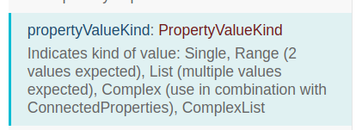
Unify Solutions to Model Complex Properties
The key attribute propertyValueKind has values COMPLEX and COMPLEX_LIST used in combination with connectedProperties. These key values are defined for Property and ClassificationProperty
However, connectedPropertyCodes is defined only for Property
More importantly, these key values are never used
connectedProperty is used only on 7 Properties (and not ClassificationProperties)
Instead of using connectedPropertyCodes to describe complex properties, some providers have used classifications with the type COMPOSED_PROPERTY.
11th Linked Data in Architecture and Construction Workshop, 15-16 June 2023, Matera, Italy"

Slide 31
Improve Modelling of Dynamic Properties
12385 Properties are declared with isDynamic=true
135250 are not.
However, the field dynamicParameterPropertyCode (used to compute the dynamic property) is always empty, so how can one know which “sub-properties” to use?
Additionally, dynamicParameterPropertyCodes is String, but should be [Property], i.e. an array of Properties.
11th Linked Data in Architecture and Construction Workshop, 15-16 June 2023, Matera, Italy"

Slide 32
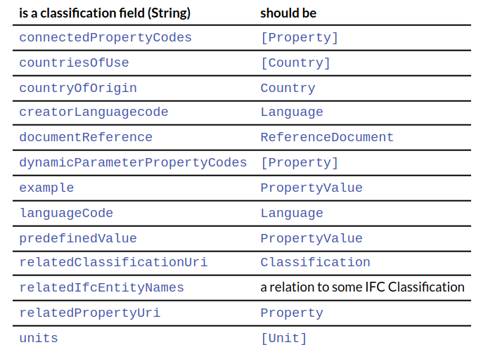
Improve Relations Between Entities
11th Linked Data in Architecture and Construction Workshop, 15-16 June 2023, Matera, Italy"

Slide 33
Add More Entities
bSDD includes numerous string attributes (codes or URLs) that should be converted to relations (object fields) to improve the connectedness of the bSDD GraphQL graph
is a classification field (String) | should be
physicalQuantity | (New) PhysicalQuantity
propertySet | (New) PropertySet
subdivisionsOfUse | (New) CountrySubdivision
version | (New) DomainVersion
replaced/(-ing)ObjectCodes | some kind of objects. Currently they are empty
11th Linked Data in Architecture and Construction Workshop, 15-16 June 2023, Matera, Italy"

Slide 34
Use Class Inheritance
Property and ClassificationProperty: have 46 fields in common, differ in only 5 fields:
belongs uniquely to Property | belongs uniquely to ClassificationProperty
connectedPropertyCodes (String) | isRequired (Boolean)
relations (PropertyRelation) | isWritable (Boolean)
 | predefinedValue (String)
 | propertySet (String)
 | symbol (String)
Since there are no rules on which fields of Property to reuse in ClassificationProperty, the latter type copies most of the fields from the former
11th Linked Data in Architecture and Construction Workshop, 15-16 June 2023, Matera, Italy"

Slide 35
Improve PropertyValues
PropertyValue and ClassificationPropertyValue are structured values with rich fields:
code, value, namespaceUri, description, sortNumber
However, most structured values we’ve seen have only
code, value
This has multiple problems:
Individual values have no description (description is not filled out)
Some values are described in the property definition, intermingling multiple descriptions together
The “standard” values NOTKNOWN, OTHER, UNSET are not described at all.
Values have no namespaceUri, precluding unique identification.
11th Linked Data in Architecture and Construction Workshop, 15-16 June 2023, Matera, Italy"

Slide 36
Improve predefinedValue
allowedValues store structured values (ClassificationPropertyValue)
However, their “sibling” property predefinedValue holds just a String, which means that even in the future, predefinedValue cannot be an enumeration value identified globally with a URL
11th Linked Data in Architecture and Construction Workshop, 15-16 June 2023, Matera, Italy"

Slide 37
Improve Multilingual Support
bSDD is advertised as a multilingual dictionary
In the GraphQL API, one can specify a desired language(*) when fetching classifications and properties
However, currently most domains are present in one language only (unilingual).
(*) Artur Tomczak, 26 April 2023 Proper way to access translations of IFC entities: language header is working
11th Linked Data in Architecture and Construction Workshop, 15-16 June 2023, Matera, Italy"

Slide 38
DATA QUALITY
11th Linked Data in Architecture and Construction Workshop, 15-16 June 2023, Matera, Italy"

Slide 39
Data Quality Issues
Leading, trailing, consecutive whitespace
Improve physical quantities and units
No rules on missing data
Unicode problems
Unresolved HTML entities
Bad classification relations (broken links)
11th Linked Data in Architecture and Construction Workshop, 15-16 June 2023, Matera, Italy"

Slide 40
Implementing Improvements
We implemented a lot (but not all) of the improvements suggested above by using the following process:
Fetch bSDD data as JSON
Draft SOML schema
Convert it to RDF using SPARQL Anything
Load it to GraphDB
Refactor the RDF using SPARQL Update
The results are available at the SPARQL endpoint and in GraphQL
11th Linked Data in Architecture and Construction Workshop, 15-16 June 2023, Matera, Italy"

Slide 41
Conclusions and Future Work
Here are further ideas for improvement:
improve bSDD ontology
implement more radical data model refactoring to convert “strings” (countries, reference documents, etc.) into “things”
link bSDD units of measure to QUDT ontology
perform deeper data quality analysis using SHACL shapes generation and validation provided by Ontotext Platform Semantic Objects
address and resolve more data quality issues, including
seek correlation between dimension vectors, units of measure and physical quantity,
parse out enumeration values from Property/ClassificationProperty descriptions and create corresponding PropertyValue lists
make more graph visualizations
obtain more interesting statistics using SPARQL
11th Linked Data in Architecture and Construction Workshop, 15-16 June 2023, Matera, Italy"

Slide 42




Acknowledgements
Funding: ACCORD project, Horizon Europe, grant #101056973
Data: buildingSMART Data Dictionary (Leon van Berlo, Artur Tomczak, Erik Baars)
Powered by:
Ontotext GraphDB
Ontotext Platform Semantic Objects
11th Linked Data in Architecture and Construction Workshop, 15-16 June 2023, Matera, Italy"

