Slide 1
Project Report Checkpoint 2
Data Query
Spatial Gene Expression from Histology
Mobai (James) Jiang, Junewoo (June) Koo, Bobby Wang, Jiayin (Moria) Li
GitHub: https://github.com/Accord985/Hist2ST

Slide 2
Our project in one sentence
Can what tissue looks like under a microscope predict which genes are active at each spot?
Input: a small H&E image patch at one spot
Output: how much each gene is expressed at that spot

Slide 3
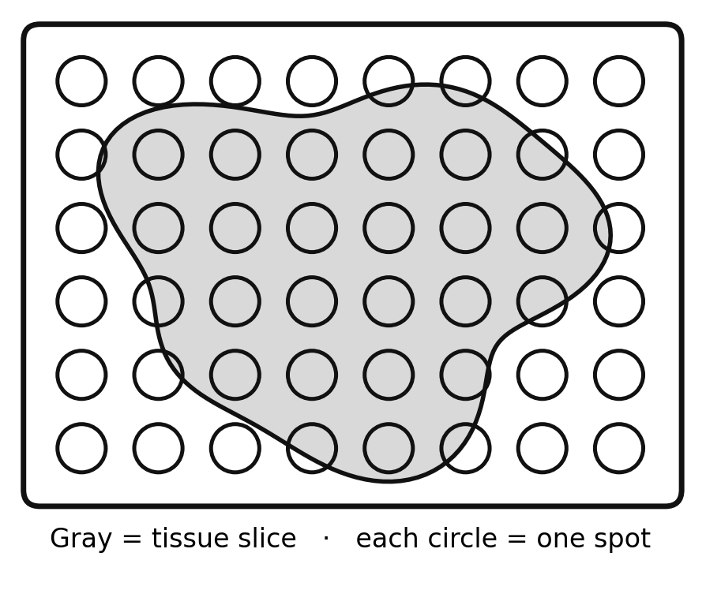
What is a spot?
Spatial transcriptomics (10x Visium)
  A thin slice of tissue is placed on a special glass slide
  The slide has a grid of thousands of tiny spots (~55 µm, about 1–10 cells)
  Each spot catches the RNA from the cells right above it and tags it with the spot's barcode
  The same slice is stained with H&E and photographed

Slide 4
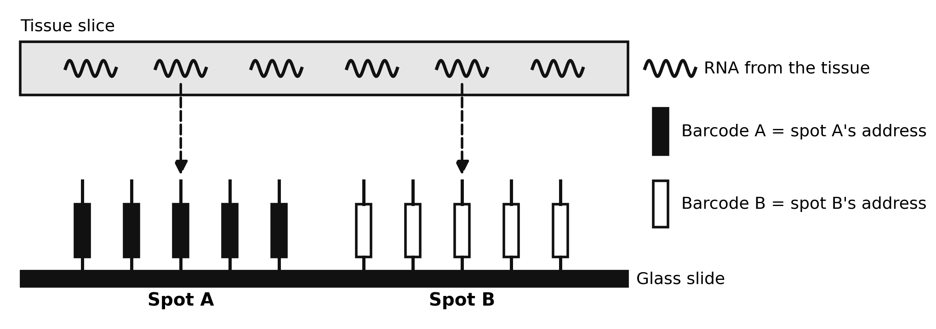
Barcode = the spot's address
Made by the lab, not the cell: DNA “catchers” are pre-printed on the slide
All catchers in one spot share one barcode (~16 letters of A, T, G, C)
RNA falls onto a catcher → its DNA copy carries that barcode
After sequencing, the barcode tells us which spot the RNA came from

Slide 5
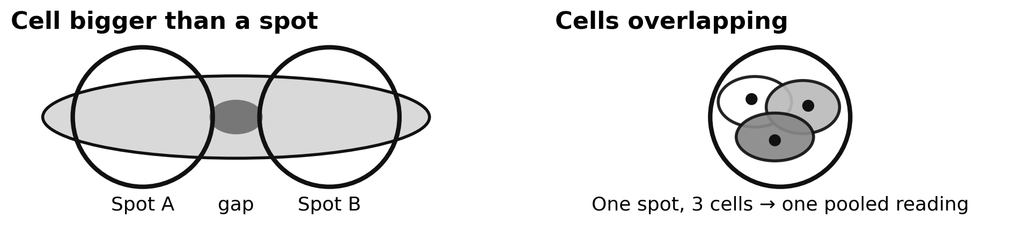
One spot = a mix of cells
The “true answer” we predict is a blurry average of several cells, not one clean cell

Slide 6
Every spot gives us two things
A picture: the H&E patch around that spot (224 × 224 pixels)
A list of numbers: how much of each gene’s RNA was caught there
Like a satellite photo of a block + the weather station on that block
  Can we guess the station’s reading from the photo alone?

Slide 7
Our data: HEST
Made by the Mahmood Lab (Harvard Medical School / Mass General Brigham)
HEST-1k (dataset): 1,276 samples of paired H&E images and spot-level gene expression, in one standard format
HEST-Benchmark (test): which pretrained model gives the best embeddings?
  Embedding → PCA → ridge regression
  Scores (Pearson r): about 0.2–0.67 by cancer type, ~0.42 on average

Slide 8
Getting the data
Hosted on Hugging Face: huggingface.co/datasets/MahmoodLab/hest (free, but gated)
  1. Request access: log in and accept the dataset’s terms
  2. Make a read-only token and log in with it
  3. Download only one sample’s small files, not the multi-GB whole-slide images
Full notebook: github.com/Accord985/Hist2ST
snapshot_download(repo_id="MahmoodLab/hest", repo_type="dataset",
allow_patterns=["patches/*TENX95*", "st/*TENX95*", ...])

Slide 9
What’s in the download
Folder / file | What’s inside | Used for
wsis/ | Full whole-slide H&E image (multi-GB) | Rarely needed
patches/ (.h5) | 224×224 patch for each spot + its barcode and position | Model input
st/ (.h5ad) | Gene table: spots × genes, with each spot’s barcode | Target (true answer)
thumbnails/, spatial_plots/ | Small preview pictures | Just for looking
HEST_v1_1_0.csv | One row per sample: organ, species, technology, cancer type | Choosing samples
The barcode links them: same spot ID in patches/ and st/ → picture matched to its gene values

Slide 10
One sample: TENX95
Human breast tissue, measured with Xenium
1 tissue slide → 11,845 spots (one patch each) → 541 gene values per spot
Xenium measures single RNA molecules, so HEST draws imaginary Visium-sized pseudo-spots
  Every sample then has the same format: one patch + one row of gene values per spot

Slide 11
What the gene data looks like
Barcode (spot ID) | Gene 1 | Gene 2 | Gene 3 | … Gene 541
spot_00001 | 12 | 0 | 3 | …
spot_00002 | 8 | 1 | 0 | …
… | … | … | … | …
spot_11845 | 15 | 0 | 5 | …
Example values for illustration
One row = one spot · one column = one gene
The barcode links each row to its image patch
We predict a smaller chosen set (e.g. 50 of the 541 genes)

Slide 12
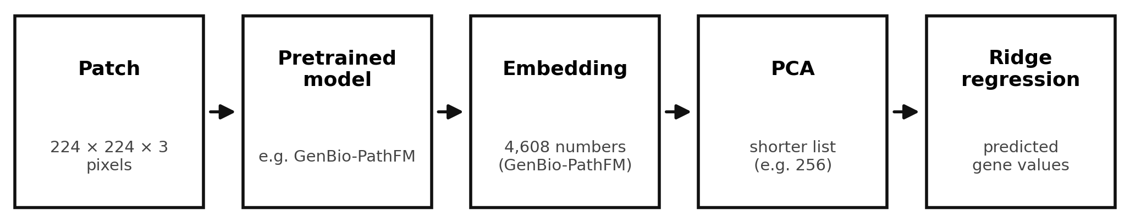
From pixels to gene values
Training input: the embedding of each patch (after PCA), a list of numbers that summarizes only the image
Training target: the real measured gene values at that spot

Slide 13
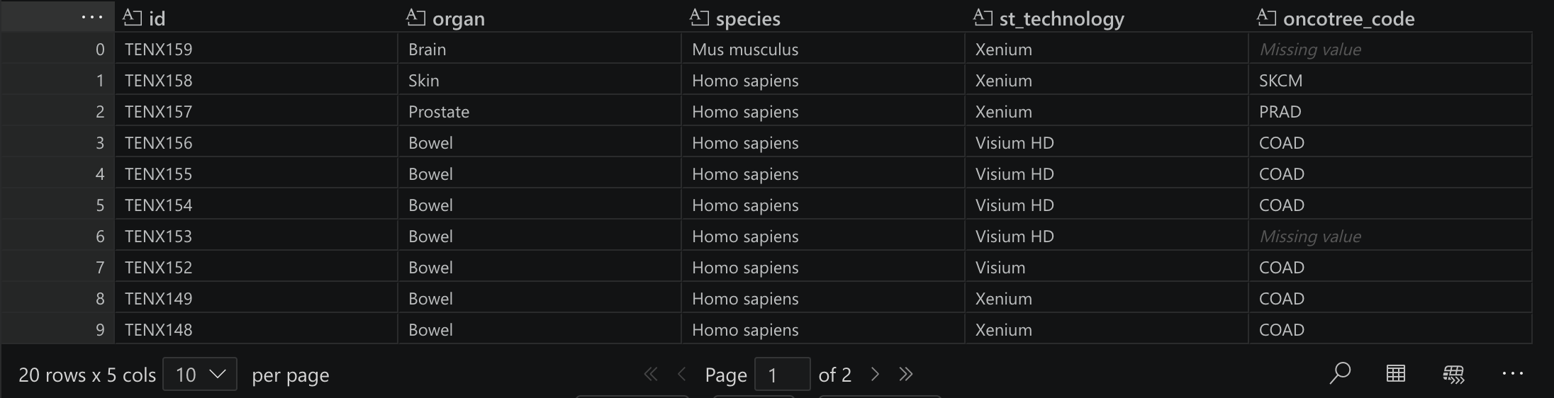
Sample catalog (HEST_v1_1_0.csv)
One row = one tissue slide (1,276 in total)
Columns: sample id, organ, species, technology, cancer type (oncotree code)
Used to choose which samples to download

Slide 14
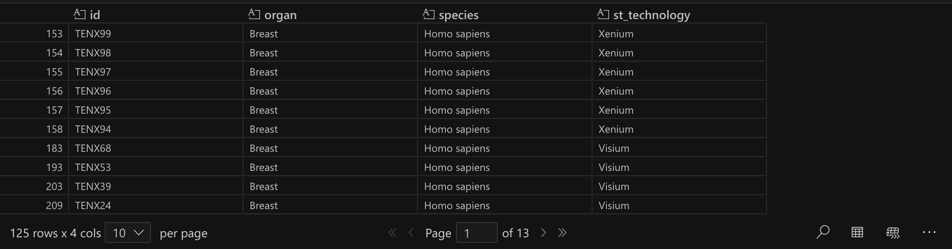
Breast samples only
125 breast samples, TENX95 among them
Mixed technologies (Xenium, Visium, …) → mix them or pick one?

Slide 15
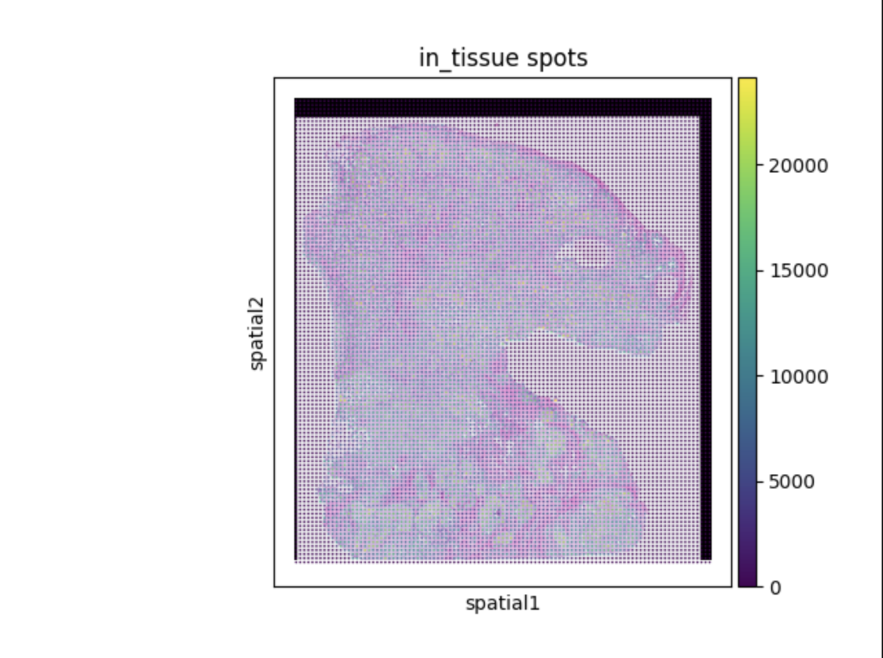
TENX95: the whole slide
Background: the H&E image
Dots: ~11,845 pseudo-spots
spatial1 / spatial2: x and y position
Color bar: total RNA counts per spot (0 to ~24,000)
Black strip: spots with no tissue (~0 counts)

Slide 16
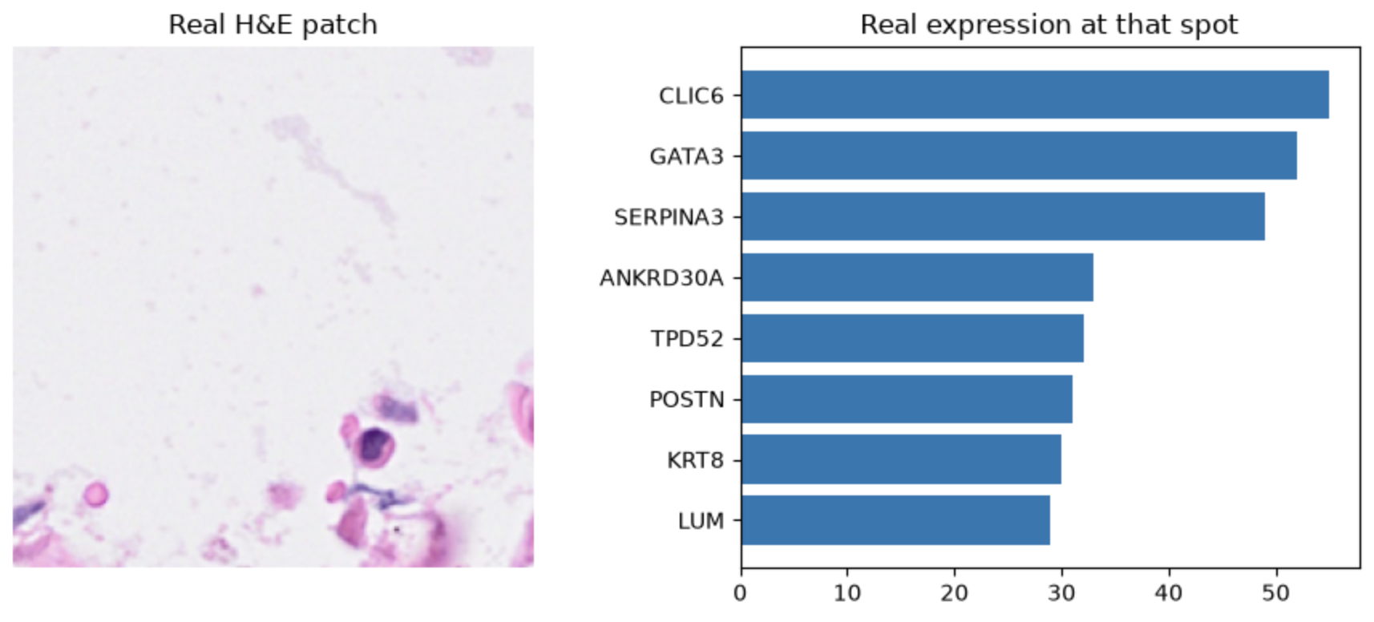
One spot up close
Left: the image patch (model input) · Right: its top 8 genes (the answer to predict)

Slide 17
Slide pre-processing
We are able to implement GenBio – PathFM
The result is 1 a by 4608 list
Next step is a pipeline that mass produce embeddings
Notes:
GenBio-PathFM is a 1.1-billion-parameter vision foundation model specifically trained for histopathology. GenBio AI reports that it performs strongly on benchmarks including HEST, THUNDER, and PathoROB, while being trained entirely on public data.

Slide 18
