Slide 2
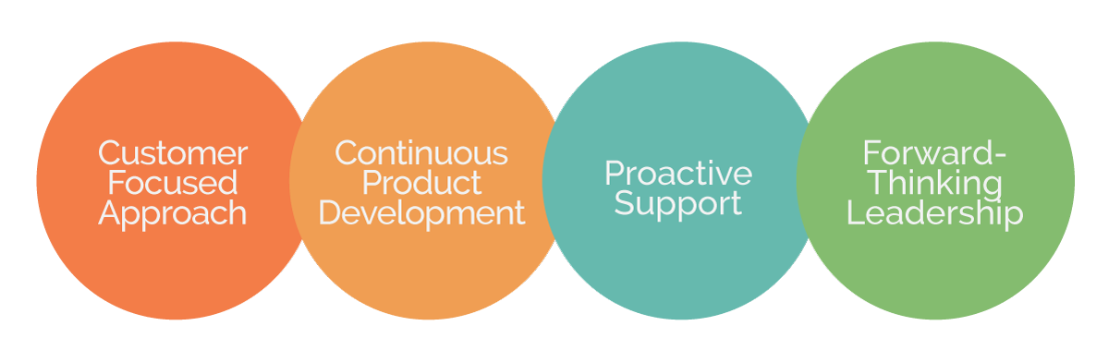
The Accusoft Difference
A leader in content and imaging solutions focused on solving document lifecycle complexities through:

Slide 3

25 Years and Growing
Founded in 1991, Accusoft has grown through persistent product innovation and strategic mergers and acquisitions into the best-in-class solutions provider it is today. The company has been awarded 30 patents and is recognized as a thought leader in the industry.

Slide 4
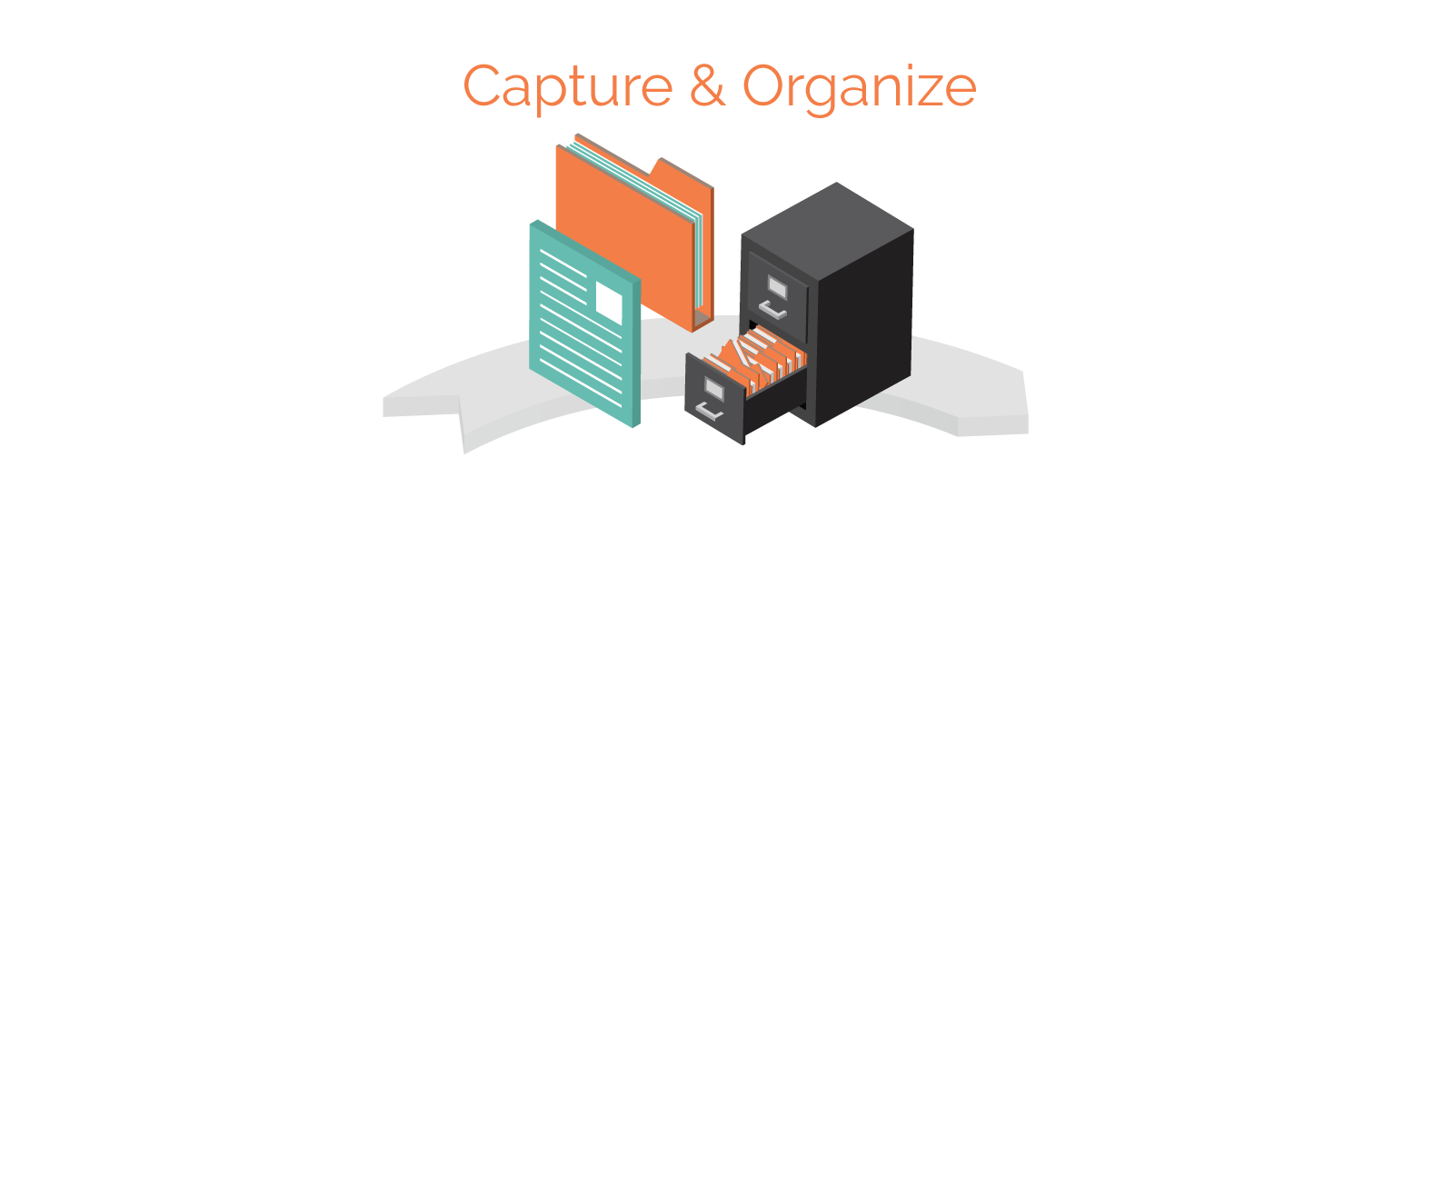



Overview of the
Document Lifecycle

