Slide 1
MIXELLE
Pixel Game

Slide 2
Git Hub
https://github.com/Ace-03/CS225_Project_Repo?search=1

Slide 3
Game Overview
Based on the game Little Alchemy
Click to drag elements on top of each other to combine and create new elements
These systems were also used to create a pachinko machine

Slide 4
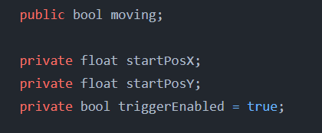

Naming Style
Short descriptive names
Variables Camel Case
Functions/Classes Pacal Case
Describes variable's purpose

Slide 5
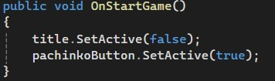
Functions
Multiple functions were used and called while playing the game
Example the OnStartGame() function shown above
Called when Start Button is pressed
Sets Start Button and Title to false

Slide 6

Class Definitions
These keep are scripts organized
Unity creates them by default
MonoBehavour is the base class that Unity pulls from

Slide 7
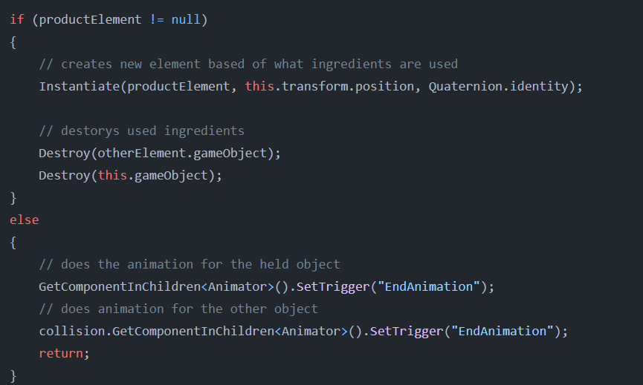
If Statements
This statement checks if you can make a new element
Then creates that element and destroys used elements
Or plays error animation

Slide 8
Inheritance
Every class in our Unity project inherits from MonoBehaviour with the exception of PachinkoMarbleBehavior which Inherits from ElementBehaviour

Slide 9
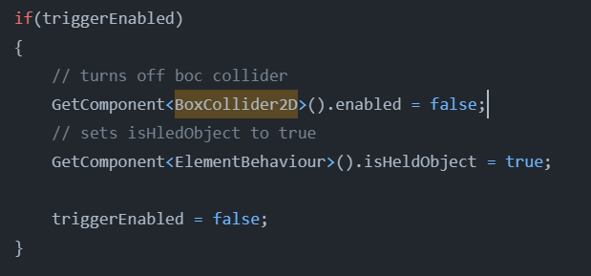
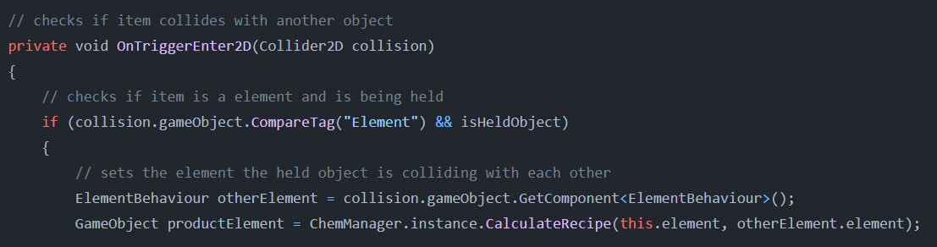
BoxCollider OnTriggerEnter
BoxCollider2D is a component in Unity
It allows for object collision

Slide 10
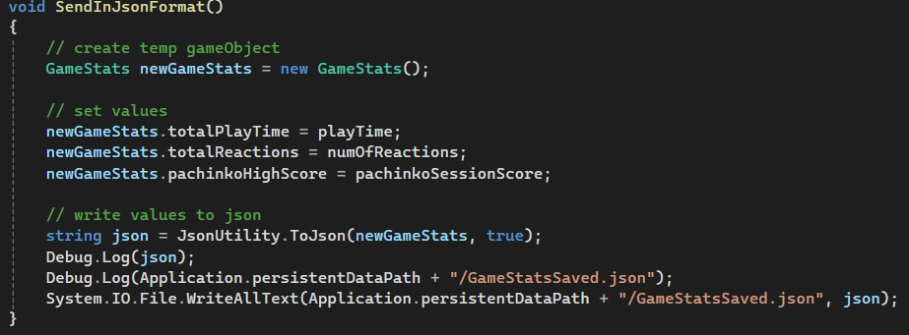
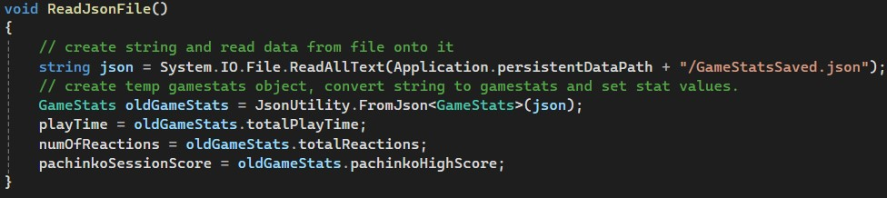
File I/O

Slide 11
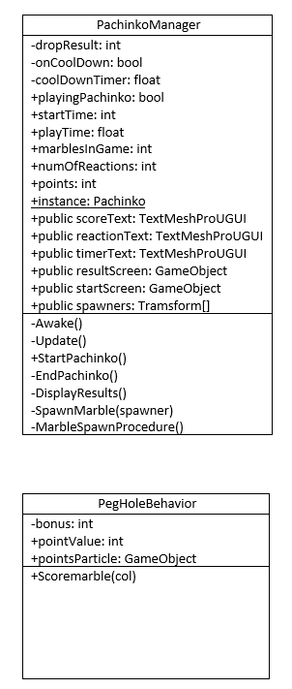
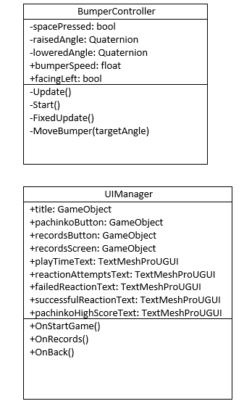
UML Diagram

Slide 12
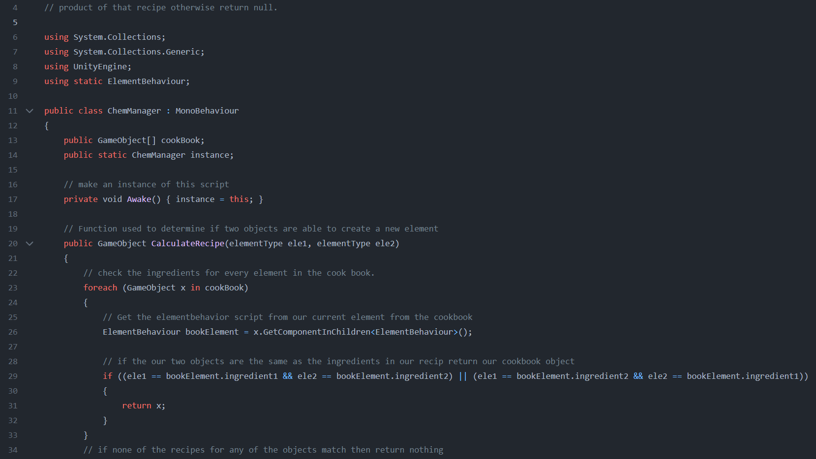
Good Programing Practices

Slide 13
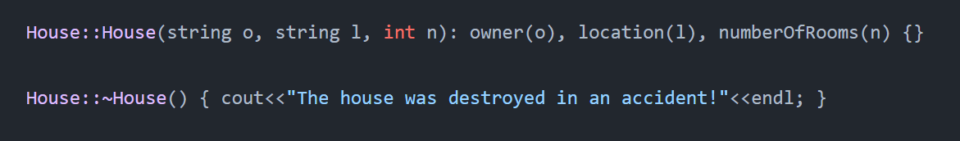
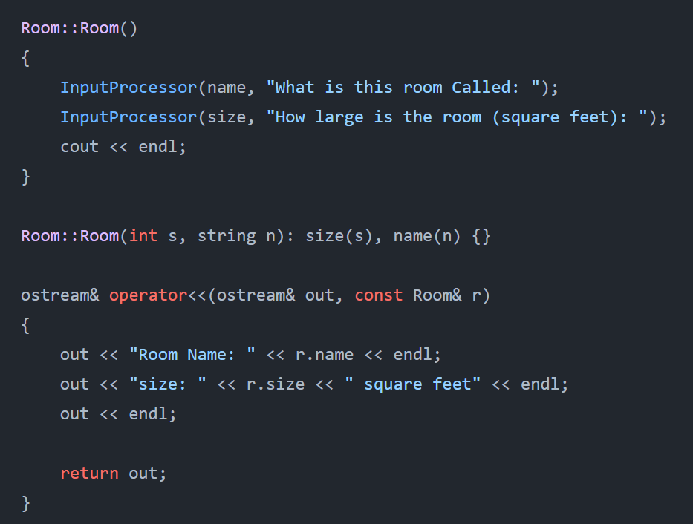
Constructors Destructors

Slide 14
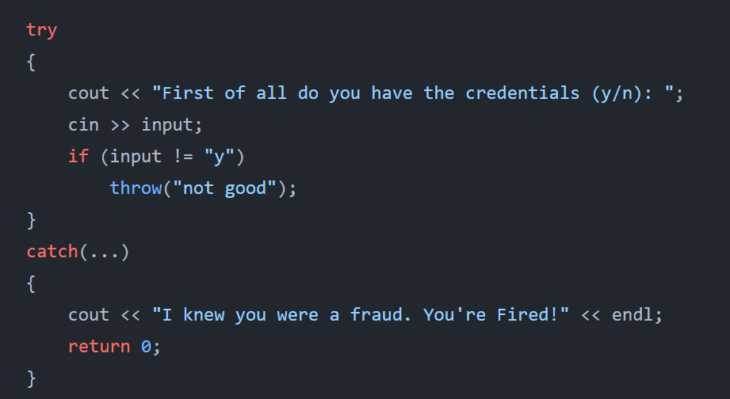
Exceptions

Slide 15
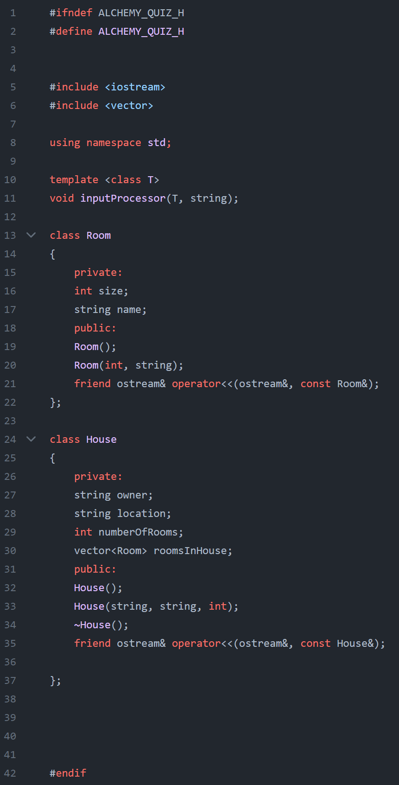
Header Files

Slide 16
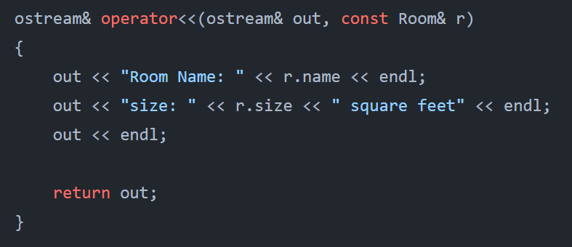
Operator Overloading

Slide 17
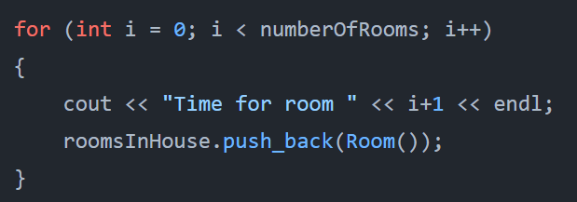
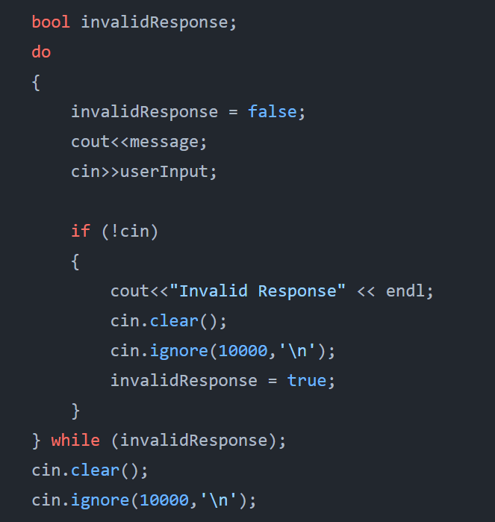
Loops

Slide 18
Demonstration
https://github.com/Ace-03/CS225_Project_Repo?search=1

