Slide 1
Fraud Detection on Credit Card Transactions Using Machine Learning Models.
Final Submission for Data Science Course
September 2022
presented by
Abhinand J S,
Abhiram N
&
Aman Nehra

Slide 2
Agenda
Understanding the Credit Card domain and developing the model to identifying the fraudulent transactions to minimise the loss to the Banks and card holders. !!

Slide 3
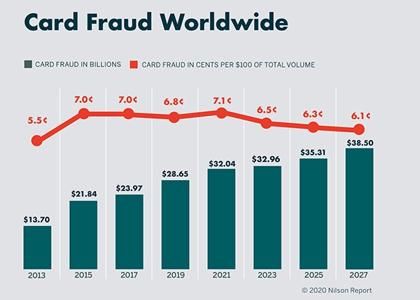
Credit Card Fraud Definition
Credit card frauds are committed in the following ways:
An act of criminal deception (mislead with intent) by use of unauthorized account and/or personal information
Illegal or unauthorized use of account for personal gain
Misrepresentation of account information to obtain goods and/or services.

Slide 4
Credit Card Fraud Detection Scheme
The basic idea in the process is that before the transaction is authorised by the bank there should be a check which can verify that the transaction is genuine or fraudulent. If it is suspected to be fraudulent we can call the customer to verify the authenticity of the transaction.

Slide 5
Protection Mechanisms for Credit Card Fraud
Protection Mechanisms
Prevention
Firewall
Encryption/
Decryption
Detection
Anomaly Detection
Supervised
Unsupervised
Semi-supervised

Slide 6
Traditional Machine Learning Methods
Random Forest Classifier
K-nearest Neighbor Classifier
Gradient Boosting Classifier
LGBM Classifier

Slide 7
Evaluation Criteria for Credit Card Fraud Detection
Measure | Description | Formula
Accuracy | The percentage of correctly predicated transactions | TN+TP/TP+TN+FP+FN
Detection Rate (Precision) | The number of classified fraud transactions that actually are fraud transactions, and gives the accuracy of the fraud transaction | TP/TP+FP
False Alarm Rate | The ratio of credit card fraud detected incorrectly | FP/FP+TN
True Positive Rate (Sensitivity or Recall) | The number of correctly classified fraud transaction and gives the accuracy of the fraud transaction. | TP/TP+FN
True Negative Rate (Specificity) | The amount of correctly classified non-fraud and gives the accuracy of the non-fraud transaction. | TN/TN+FP
P = Positive N = Negative
FP = False Positive FN = False Negative
TP = True Positive TN = True Negative

Slide 8
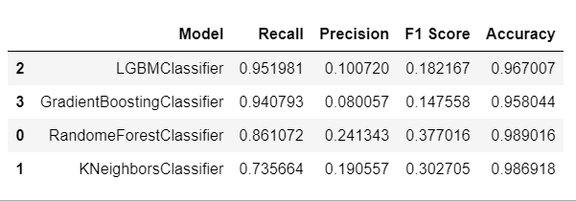
Comparing the performance of different Models.

Slide 9
Results of Testing ML Fraud Detection Techniques

Slide 10
Challenges and Future Works

Slide 11
Challenges in Credit Card Fraud Detection
Data Deficiency
Highly Imbalanced Data
Behavior Variations
Cost-sensitive Problem

Slide 12
Current Solutions of The Problems
Data Deficiency
Creation of Synthetic Data
Imbalanced Data
Oversampling and Under sampling methods
SMOTE, etc
Behavior
Adaptive base learners and ensembles
Cost-sensitiveness
Implementing several algorithms and methods
Feature engineering

Slide 13
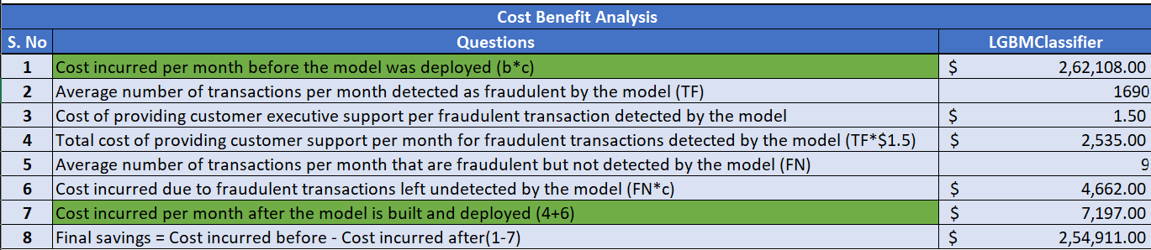
Evaluating Cost and Benefit Analysis.

Slide 14
Any Questions?

Slide 15

Thank You
For
Attention

