Slide 1
Expense Tracker
A Web-Based Manual Expense Tracker
Presenters:
Pranavi Uprety
Anuska Khatri
Niharika Rajbhandari
Under Supervision of
Sanju Shrestha

Slide 2
Outline
Title
Introduction
Motivation
Problem Statement
Literature Review
Objectives
Key Features
Methodology
Tech Stack
Feasibility
Conclusion

Slide 3
Introduction
Web-based expense tracking application
Fully manual entry
Designed for students and employees
Supports personal and shared expenses
Focus on simplicity and privacy

Slide 4
Motivation
Students face difficulty tracking daily expenses
Shared expenses with friends often create confusion
Most apps are complex or paid
Limited reliable solutions in Nepal
Need for simple, free, and local-friendly tool
Promotes better financial habits

Slide 5
Problem Statement
Manual tracking in Excel is time-consuming
Difficulty in settling group expenses
No proper budgeting visualization
Privacy concerns with auto-sync apps
Existing free tools have heavy limitations
Lack of multi-currency and local payment support

Slide 6
Literature Review
Splitwise: Strong in group splitting, weak budgeting
Goodbudget: Excellent envelopes, limited free version
Spendee: Good visuals, restricted free tier
Gap: Balanced manual tool with group features Opportunity for simple & effective solution

Slide 7
Objectives
Develop a responsive web expense tracker
Enable manual income and expense tracking
Implement budget setting and alerts
Provide group expense splitting feature
Deliver clear reports and visualizations
Ensure data privacy and user-friendliness

Slide 8
Key Features
User registration and login
Multiple wallets and categories
Add income & expense transactions
Budgets with progress tracking
Group expense splitting & settlement
Dashboard, reports, and charts
Savings goals and bill reminders

Slide 9
Methodology
Followed Agile development approach
Phases: Planning → Design → Implementation → Testing
User-centered design process
Iterative development and testing
Focus on clean code and documentation

Slide 10
Tech Stack
HTML – structure
CSS – design
JavaScript – functionality
Backend – Node.js / PHP
Database – MySQL / MongoDB

Slide 11
Feasibility
1. Technical Feasibility
Built using standard web technologies (HTML, CSS, JavaScript, PHP/Node.js)
Easy to develop, deploy, and maintain
Compatible with most devices and browsers
2. Operational Feasibility
Simple and user-friendly interface
Requires minimal training for users
Suitable for students and working individuals
3. Economic Feasibility
Low development cost using open-source tools
No need for expensive infrastructure
Affordable and accessible solution

Slide 12
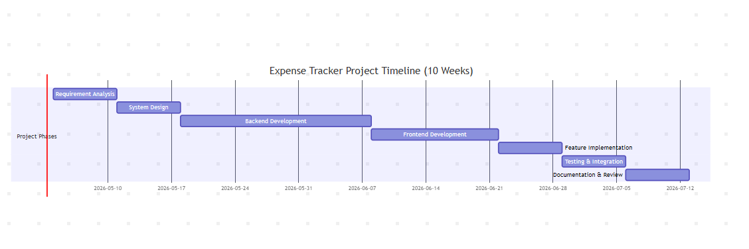
Gantt Chart

Slide 13
Any questions?

Slide 14
Thank you

