Slide 1

ACE INSTITUTE OF MANAEGMENT
StockSmart: Inventory Management System
Diya Manandhar, Shreyas Regmi, Avash Shrestha, Krishala Pokhrel
Under Supervision of Mr. Sanju Shrestha

Slide 2

Table of Contents
Project Overview
Commitments from Proposal Defense
Feedback Received During Proposal Defense
Overall Progress Summary
Tools and Technologies Used
Gantt Chart
Current Achievements
Live Demo
Future Work Before End-Term Defense
Conclusion
1
1

Slide 3
Project Overview (Precap)
What StockSmart Is:
A centralized, web-based inventory and point-of-sale (POS) management system for SMEs
Problem Being Solved:
Manual stock tracking causes stock-outs, overstocking, expired goods, and revenue loss
Target Users:
Small shops, supermarkets, warehouses, and wholesalers with limited IT staff
Main Objectives:
Centralized real-time tracking, automated low-stock/expiry alerts, simple and affordable for SMEs
‹#›
2

Slide 4
Commitments from Proposal Defense
Commitment Made | Current Status | Evidence of Completion
Complete database design | Designed | Schema designed in stocksmart.sql and in active use by backend APIs
Develop inventory management module | Done | inventory.html — live stock, locations, reorder alerts
Create dashboard with analytics | Done | dashboard.html — stats, charts, activity feed
Build POS / checkout module | Done | checkout.php + cart.php — session cart
Testing & deployment | In Progress | Unit testing ongoing
‹#›
3

Slide 5
Feedback Received During Proposal Defense
Feedback / Suggestion | Action Taken | Current Result
Re-prepare the Gantt chart | Prepared a revised project timeline showing remaining tasks and durations | Updated Gantt chart added to this presentation
Add a homepage | Built index.html as a static landing page introducing StockSmart | Homepage completed and linked into site navigation
‹#›
4

Slide 6
Overall Progress Summary
Estimated Completion: ~60%
Major Milestones Achieved:
Database schema designed
Homepage, Products, Inventory, Dashboard, and POS Checkout modules built
Consistent UI applied across all pages
Current Status:
Core inventory-to-checkout flow works end-to-end; testing and deployment still in progress
‹#›
5

Slide 7
Tools and Technologies Used
Technology | Purpose | Current Usage
PHP 8 (native, PDO) | Backend framework & business logic | Powers checkout, cart, and JSON API endpoints
MySQL | Relational database | Stores products, inventory, orders, users
HTML / CSS / JS/ Figma | Frontend structure & interactivity | All pages: dashboard, inventory, products, POS
XAMPP | Local Apache + MySQL server | Local development environment
phpMyAdmin | Database administration | Schema management & query testing
GitHub | Version control & collaboration | Source code hosting and team collaboration
MySQL Server | Production database server | Using both through Xampp and In VPS
Apache Web Server | Serves PHP pages and APIs | Used locally via XAMPP and in VPS
Ubuntu VPS | Deployment target server | currently hosted at stocksmart.live domain
‹#›
6

Slide 8
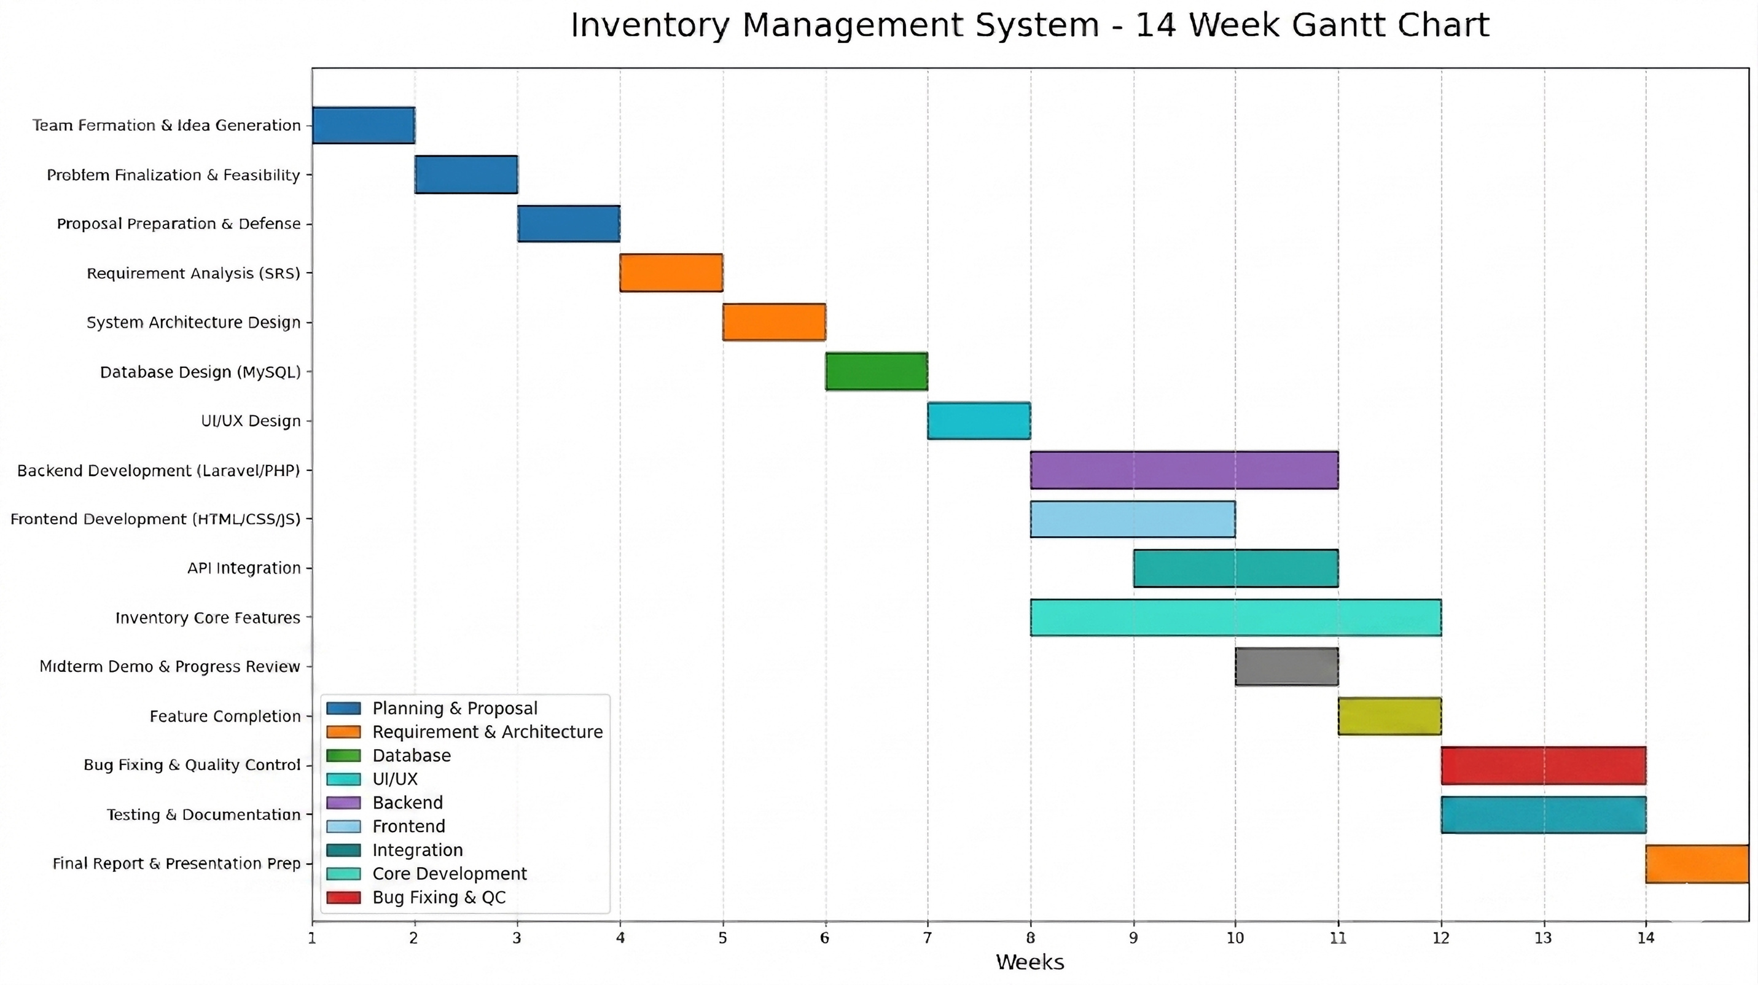

Gantt Chart
‹#›
7

Slide 9
Current Achievements
Homepage — Done
homepage.html: static landing page introducing StockSmart to visitors
Products Module — Done
products.php: CRUD JSON API over products + inventory; products.html performs add/edit/delete via fetch()
Inventory Module — Done
inventory.php: per-warehouse stock, reserved/available quantities, stock-status counts, and activity feed
Dashboard Module — Done
dashboard.php: weekly sales, low-stock/expiry alerts
POS / Checkout Module — Done
checkout.php: session cart, discounts, order saved to orders/order_items
‹#›
8

Slide 10
Live Demo
‹#›
9

Slide 11
Future Work Before End-Term Defense
Remaining Tasks:
Implement login & role-based access control; complete unit & integration testing; fix identified bugs
Testing Plan:
Functional testing of all modules + user acceptance testing with sample SME data
Documentation Plan:
Finalize SRS, ER diagrams, user manual, and final report
Timeline: 2 weeks testing, 1 week deployment, 1 week documentation before End-Term Defense
‹#›
10

Slide 12
Conclusion
Current Progress:
~60% complete; Homepage, Products, Inventory, Dashboard, and POS Checkout modules functional
Objectives Achieved:
Centralized inventory tracking, low-stock alerts, and a simple affordable design — core objectives largely met
Readiness for End-Term Defense:
Core inventory/POS flow is demo-ready; authentication integration, testing, and deployment remain before final defense
‹#›
11

Slide 13
Thank You!
‹#›
12

