Slide 1

ACE INSTITUTE OF MANAGEMENT
Micro Task Planner
A Productivity Tool for Breaking Big Tasks into Manageable Steps
Presenters:
Sanjit Yadav • Ashwin Lamichane • Kailash Devkota • Dipu Yadav
Semester 4 Project Presentation
Under Supervision of: [Supervisor Name]

Slide 2











ACE INSTITUTE OF MANAGEMENT
Presentation Outline
Introduction & Motivation
Feasibility Analysis
Problem Statement
Gantt Chart & Timeline
Literature Review
Tech Stack
Project Objectives
Comparative Analysis
Methodology
Conclusion
2

Slide 3






ACE INSTITUTE OF MANAGEMENT
Introduction & Motivation
The Productivity Gap
Overwhelm caused by large, complex projects
leads to procrastination and decreased output.
The Solution
Micro Task Planner enforces a "micro-step"
DAUNTING GOAL
philosophy to simplify complex workflows.
Core Value
Reducing cognitive load by transforming
daunting goals into achievable, low-friction
MICRO STEPS
actions.
3

Slide 4




ACE INSTITUTE OF MANAGEMENT
Problem Statement
Task Paralysis
Lack of Granularity
Users feel overwhelmed by large tasks, leading to indecision and significant delays in starting.
Existing tools focus on high-level deadlines rather than the small, actionable steps required.
Estimation Errors
Mental Fatigue
Poor time estimation for large projects results in missed deadlines and inefficient scheduling.
Managing unstructured "to-do" lists increases cognitive load, stress, and decreases overall focus.
4

Slide 5




ACE INSTITUTE OF MANAGEMENT
Literature Review
GTD Methodology
Zeigarnik Effect
David Allen's "Getting Things Done" emphasizes capturing and breaking down projects into "next actions" to clear mental space.
Psychological tension from unfinished tasks is relieved by micro-tasks, which provide frequent points of cognitive closure.
Atomic Habits
Existing Tools
James Clear's framework highlights how small, incremental changes and low-friction tasks lead to significant long-term results.
Analysis of Trello and Todoist reveals a gap in automated "breakdown" assistance for complex, multi-stage projects.
5

Slide 6




ACE INSTITUTE OF MANAGEMENT
Project Objectives
Automated Decomposition
Progress Visualization
Develop an interface that encourages users to split complex tasks until they reach a "micro" level.
Create intuitive dashboards to visualize completion percentages and dependencies of sub-tasks.
Time Estimation
User Engagement
Implement a system to track and predict time requirements for granular steps to improve accuracy.
Design a low-friction UI/UX to ensure the tool is easier to use than the manual task management process.
6

Slide 7



ACE INSTITUTE OF MANAGEMENT
Methodology
Agile Process
User-Centric Design
System Architecture
•
Iterative development cycles (Sprints)
•
Requirement gathering via student surveys
•
Modular frontend component structure
•
Continuous feedback and refinement
•
RESTful API for backend communication
•
UI/UX wireframing and prototyping
•
Rapid prototyping of core features
•
Usability testing with target audience
•
Relational database for task hierarchy
•
Regular team stand-ups for coordination
•
Focus on low-friction interaction
•
Cloud-based deployment strategy
7

Slide 8







ACE INSTITUTE OF MANAGEMENT
Feasibility Analysis
Technical Feasibility
Operational Feasibility
Proven stack: React, Node.js, PostgreSQL
Addresses common student productivity issues
Scalable architecture for task hierarchies
Low learning curve for target users
Availability of extensive documentation
High potential for adoption in academic settings
Economic Feasibility
Schedule Feasibility
Minimal costs using open-source tools
4-month timeline aligns with semester
Free-tier cloud hosting (Vercel, Render)
Agile sprints allow for MVP delivery
No specialized hardware requirements
Buffers included for testing and documentation
8

Slide 9
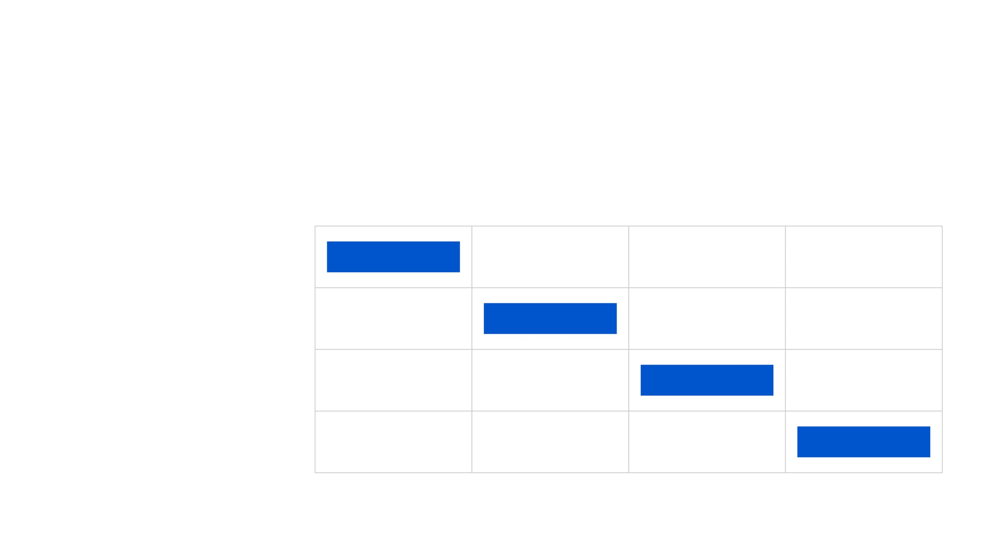
ACE INSTITUTE OF MANAGEMENT
Gantt Chart & Timeline
Project Phase
Month 1
Month 2
Month 3
Month 4
Requirement Analysis & UI/UX
Backend & Database Design
Frontend & Core Integration
Testing & Documentation
9

Slide 10




ACE INSTITUTE OF MANAGEMENT
Tech Stack
Frontend
Backend
Database
Deployment
React.js
Node.js
PostgreSQL
Vercel
Tailwind CSS
Express.js
Prisma ORM
Render
Lucide Icons
REST API
Supabase
GitHub Actions
10

Slide 11







ACE INSTITUTE OF MANAGEMENT
Comparative Analysis
Feature
Traditional Apps
Complex Tools
Micro Task Planner
Task Decomposition
Manual
Manual
Guided/Enforced
Learning Curve
Low
High
Low
Focus Mode
Basic
Advanced
Purpose-Built
Cognitive Load
High
Moderate
Minimal
Student Optimized
No
No
Yes
11

Slide 12









ACE INSTITUTE OF MANAGEMENT
Conclusion & Future Work
Summary
Future Work
Addresses the root cause of procrastination: task complexity.
AI-driven automated task decomposition.
Integration with Google Calendar and Outlook.
Improves student productivity and mental well-being.
Mobile application for on-the-go productivity.
Provides a scalable framework for granular task management.
"Big things are often just a collection of small things done well."
12

