Slide 1

Web Development
Alexis Plantin
alexis.plantin@gmail.com

Slide 2
Introduction
The goal is to implement a StackOverflow-like
Basically, it’s a Q&A application
A gamification is in place to reward users’ actions/invests

Slide 3
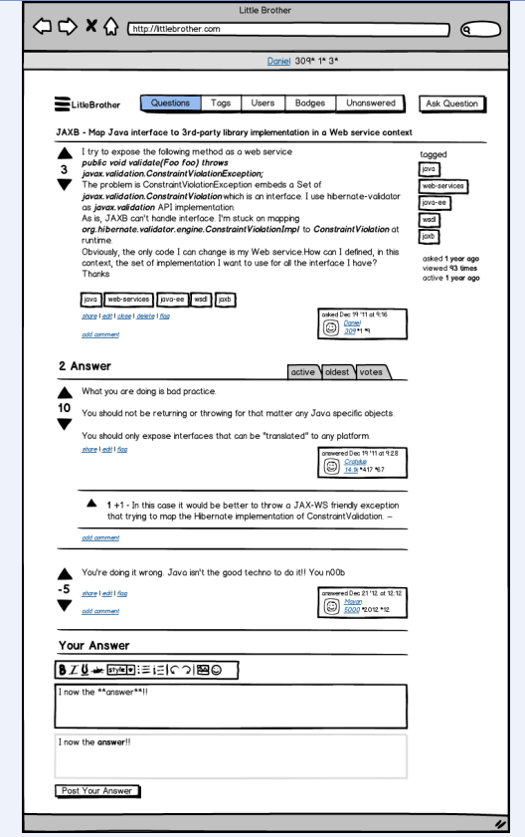
The big picture

Slide 4
Architecture (1/2)
A Grails based application.
A RDBMS will store the application's data

Slide 5
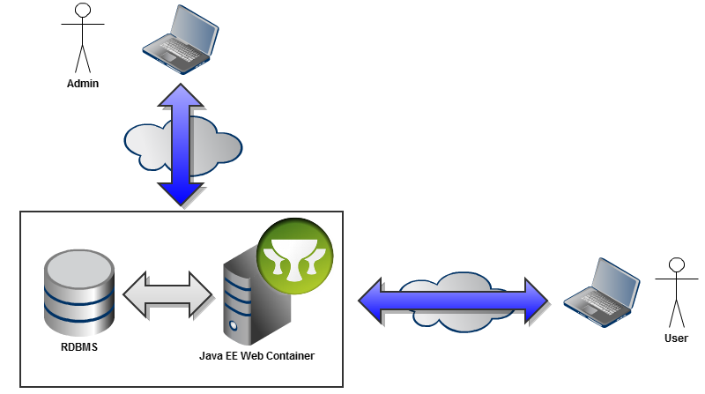
Architecture (2/2)

Slide 6
Expected features
The project will offer a system to ask and answer questions.
An answer can be upvoted. It means it's the more accurate answer for the question. Of course, they can also be downvoted.
The answers will be ordered by number of votes, this feature should be a matter of presentation.
Questions can also be voted to reflect their interests in the community.
A question can be tagged to appear in categories.
A question or an answer can be edited to add some additional information or to fix a typo.
A reputation mechanism brings a gamification to the application (The rules have to be defined).
Some actions (to be defined) will allow the user to gain some badges (part of the gamification).
Users can fill a profile.
The profile will sum up all the user's actions (questions asked, answers given, edits, ...) and the earned reputation.
The profile will compute the grand total of the user's reputation.
Admins should act as moderators.

Slide 7
Misc (1/2)
The application MUST:
Have a specification document
A UML analysis is mandatory
Functional/technical specifications
UI Mockups (Have a look at Balsamiq or Moqups)
Whatever documentation you want

Slide 8
Misc (2/2)
The application MUST:
Be internationalized (French & English)
Developed in English (code + comments)
Be tested (unit tests, acceptance tests, etc.)
Follow coding standards
Have meaningful Logs
Be versioned (use whatever VCS you want: SVN, Git, hg, etc.)
The final version of your application will be tagged and the url will be sent by mail

Slide 9


