Slide 1
SPAM DATASET
PROJECT – PYTHON FOR DATA ANALYSIS
YVANN VINCENT ANTOINE SERAFINI

Slide 2
Data analysis

Slide 3
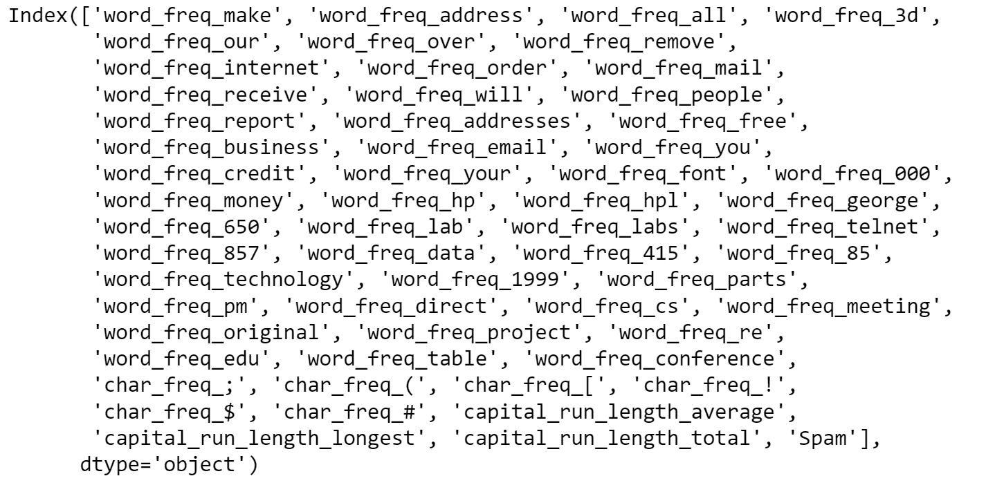

The Spam Dataset is a set of features Extracted from emails that hints whether the email is a Spam or not
It is composed of 58 features (the last one determines if it is a spam), and of 4061 entries, each representing an email.
48 FEATURES indicate specific word frequencies in the email. 6 features do the same for character frequencies (like ‘!’ or ‘;‘ ) and the last 3 indicate capital letterS run length.

Slide 4
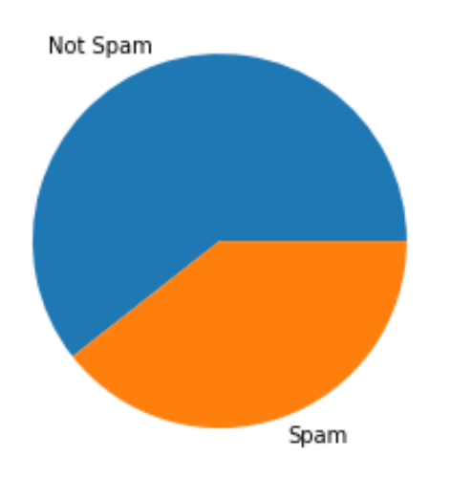
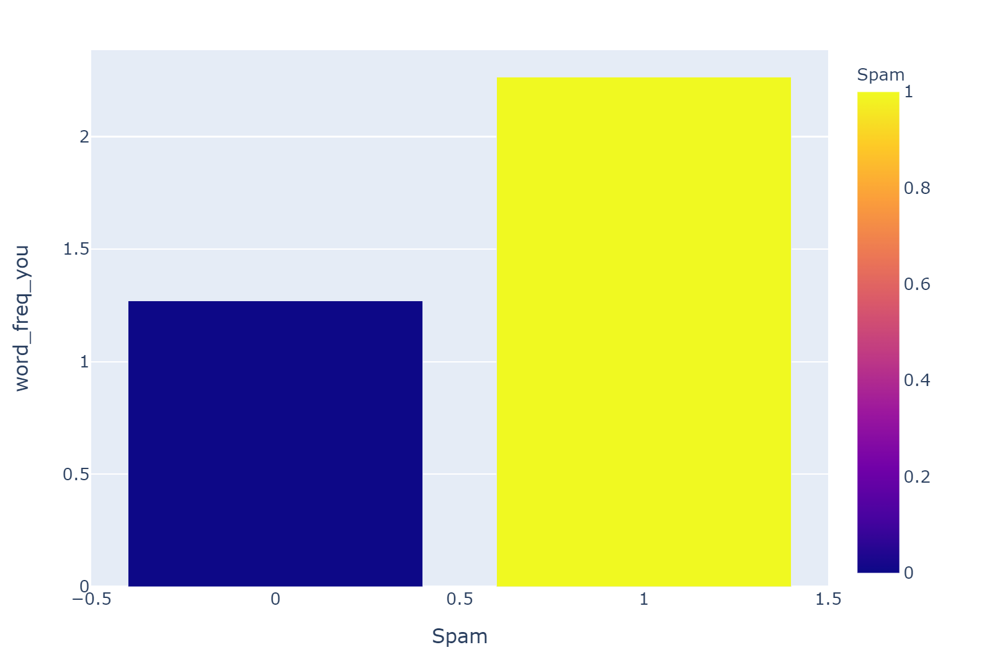
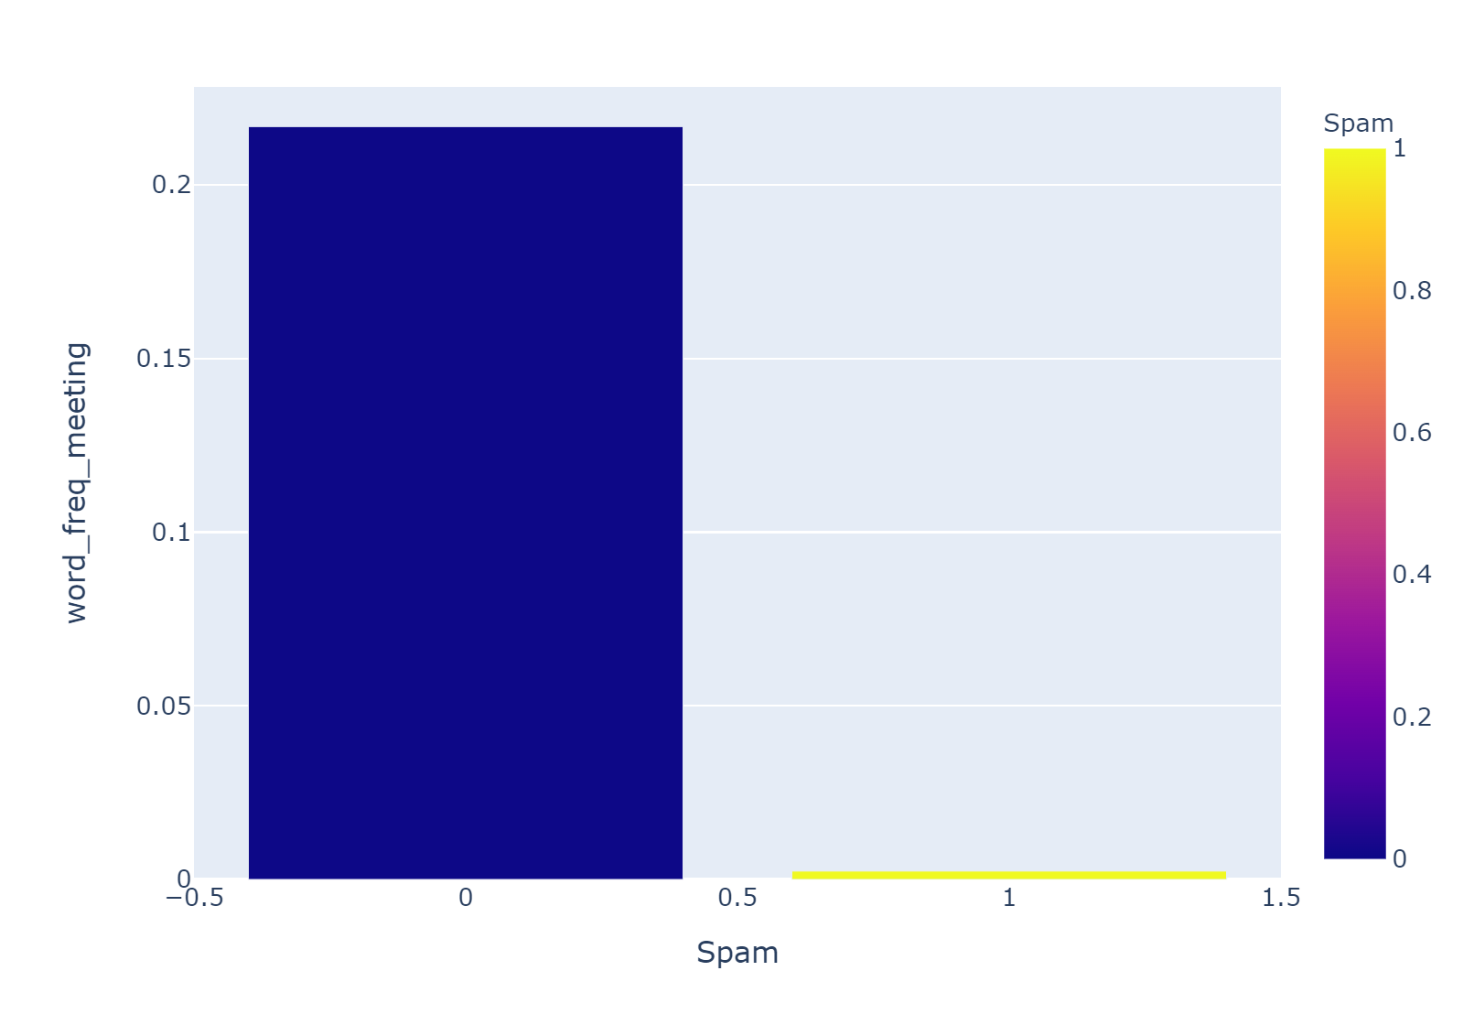
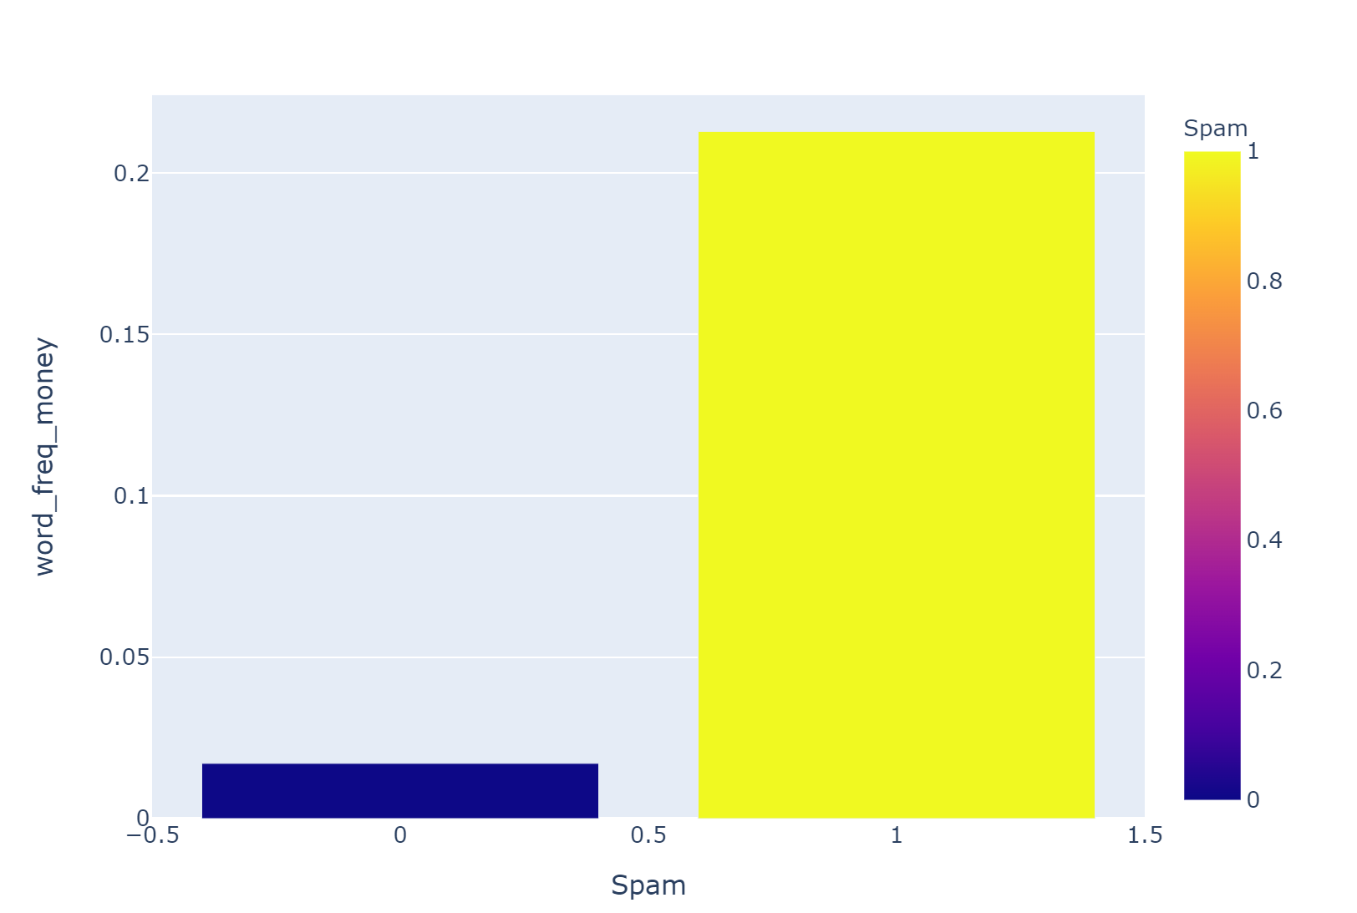
First, we decided to explore the dataset with some simple plots to get a better understanding of the features and their correlation with the Spam variable.
Here, the proportion of Spam emails in the dataset
Here we see that the features (here word_freq_you, word_freq_meeting and word_freq_money) are differently correlated to the Spam variable.

Slide 5
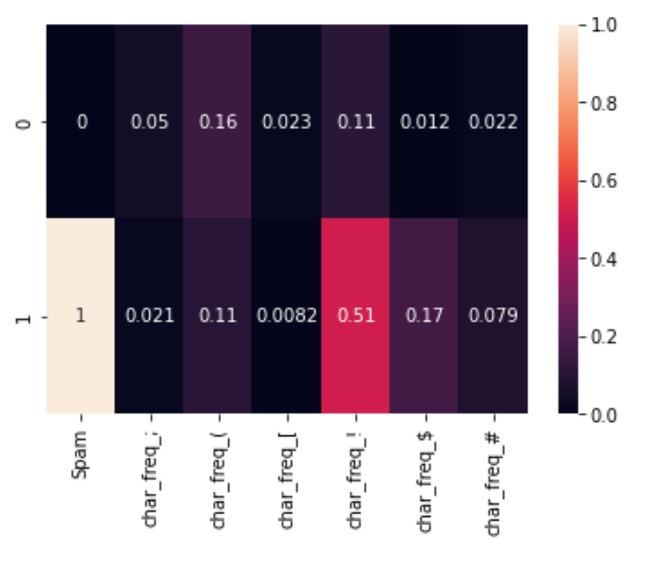
This heatmap, with character frequency features only, shows that spam and non spam emails have sensibly different character distributions. ‘!’ seems to be a good indicator for Spam, ‘[‘ for Non-Spam, and ‘#’ looks irrelevant.
After visualizing correlations, we ranked the variables to determine which ones are the most interesting to predict spams.

Slide 6
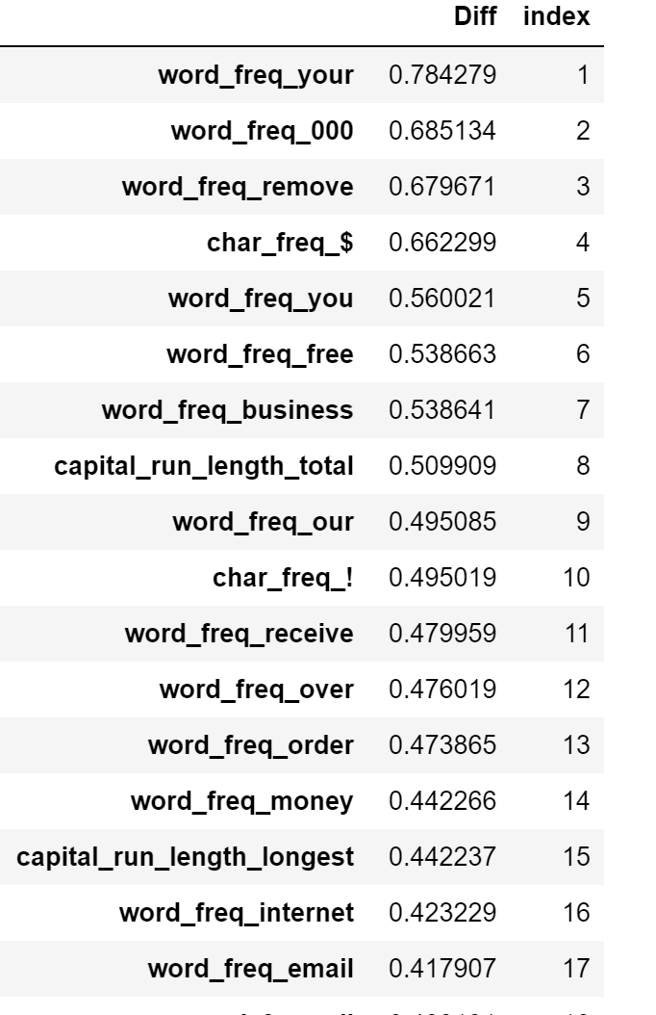
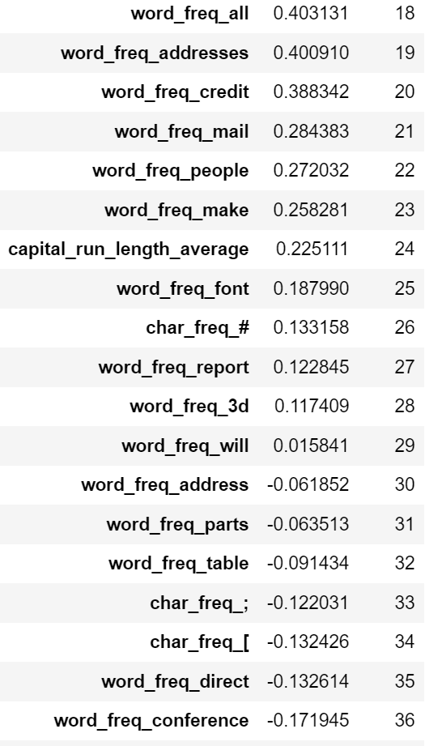
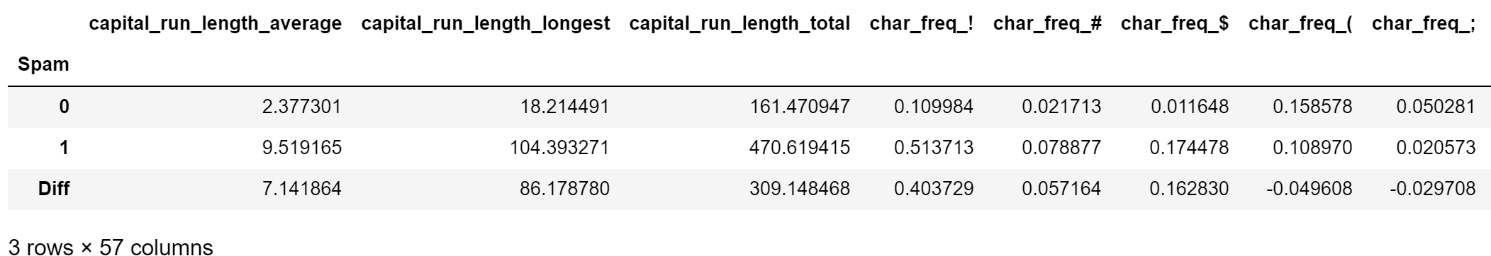
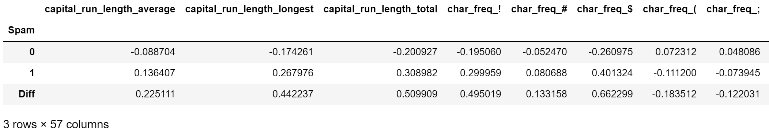
To get the first ranking we constructed a pivot table to calculate the mean of each feature, grouped by Spam. We then computed the difference between Spam and Non-Spam entries.
The we scaled the data to set a reliable comparison standard.
Finally, we ranked features based on the gap between Spam and Non-Spam entries. We called it the ‘index’ rank.

Slide 7
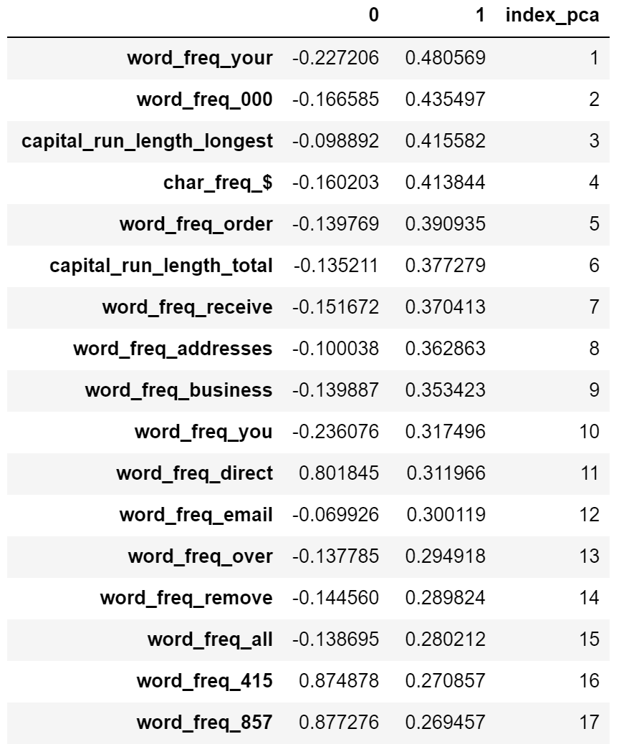
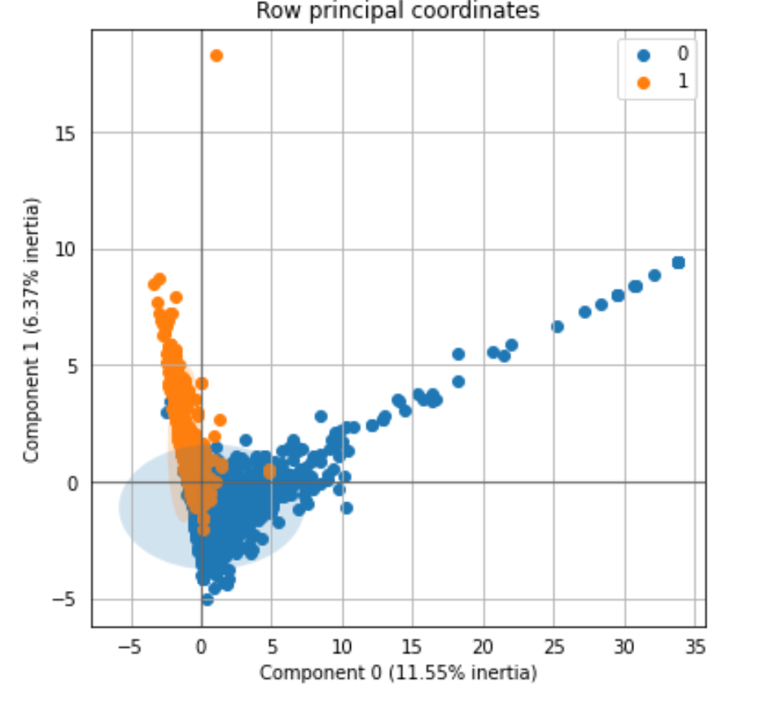
For the second ranking we decided to check correlations through dimensionality reduction
This PCA allowed us to visualize Spam and Non-Spam distribution by projecting the dataset on an optimal 2-dim plane
PCA showed that Spam emails are strongly correlated to component 1, so we ranked all the variables by their correlation to component 1 and made it a new dataframe

Slide 8
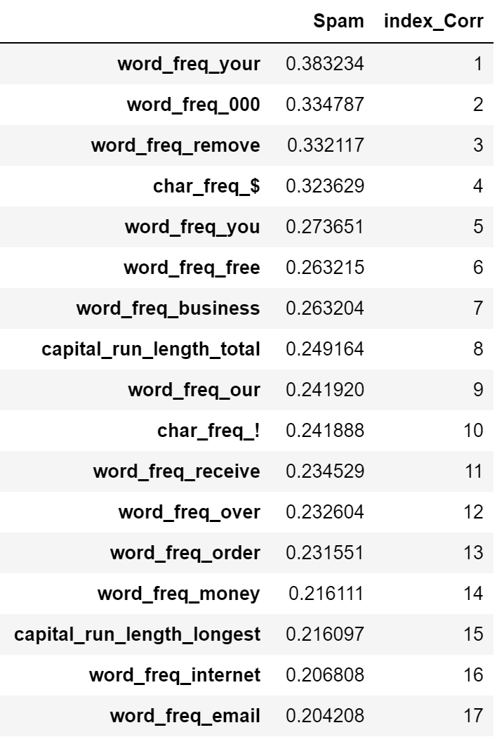
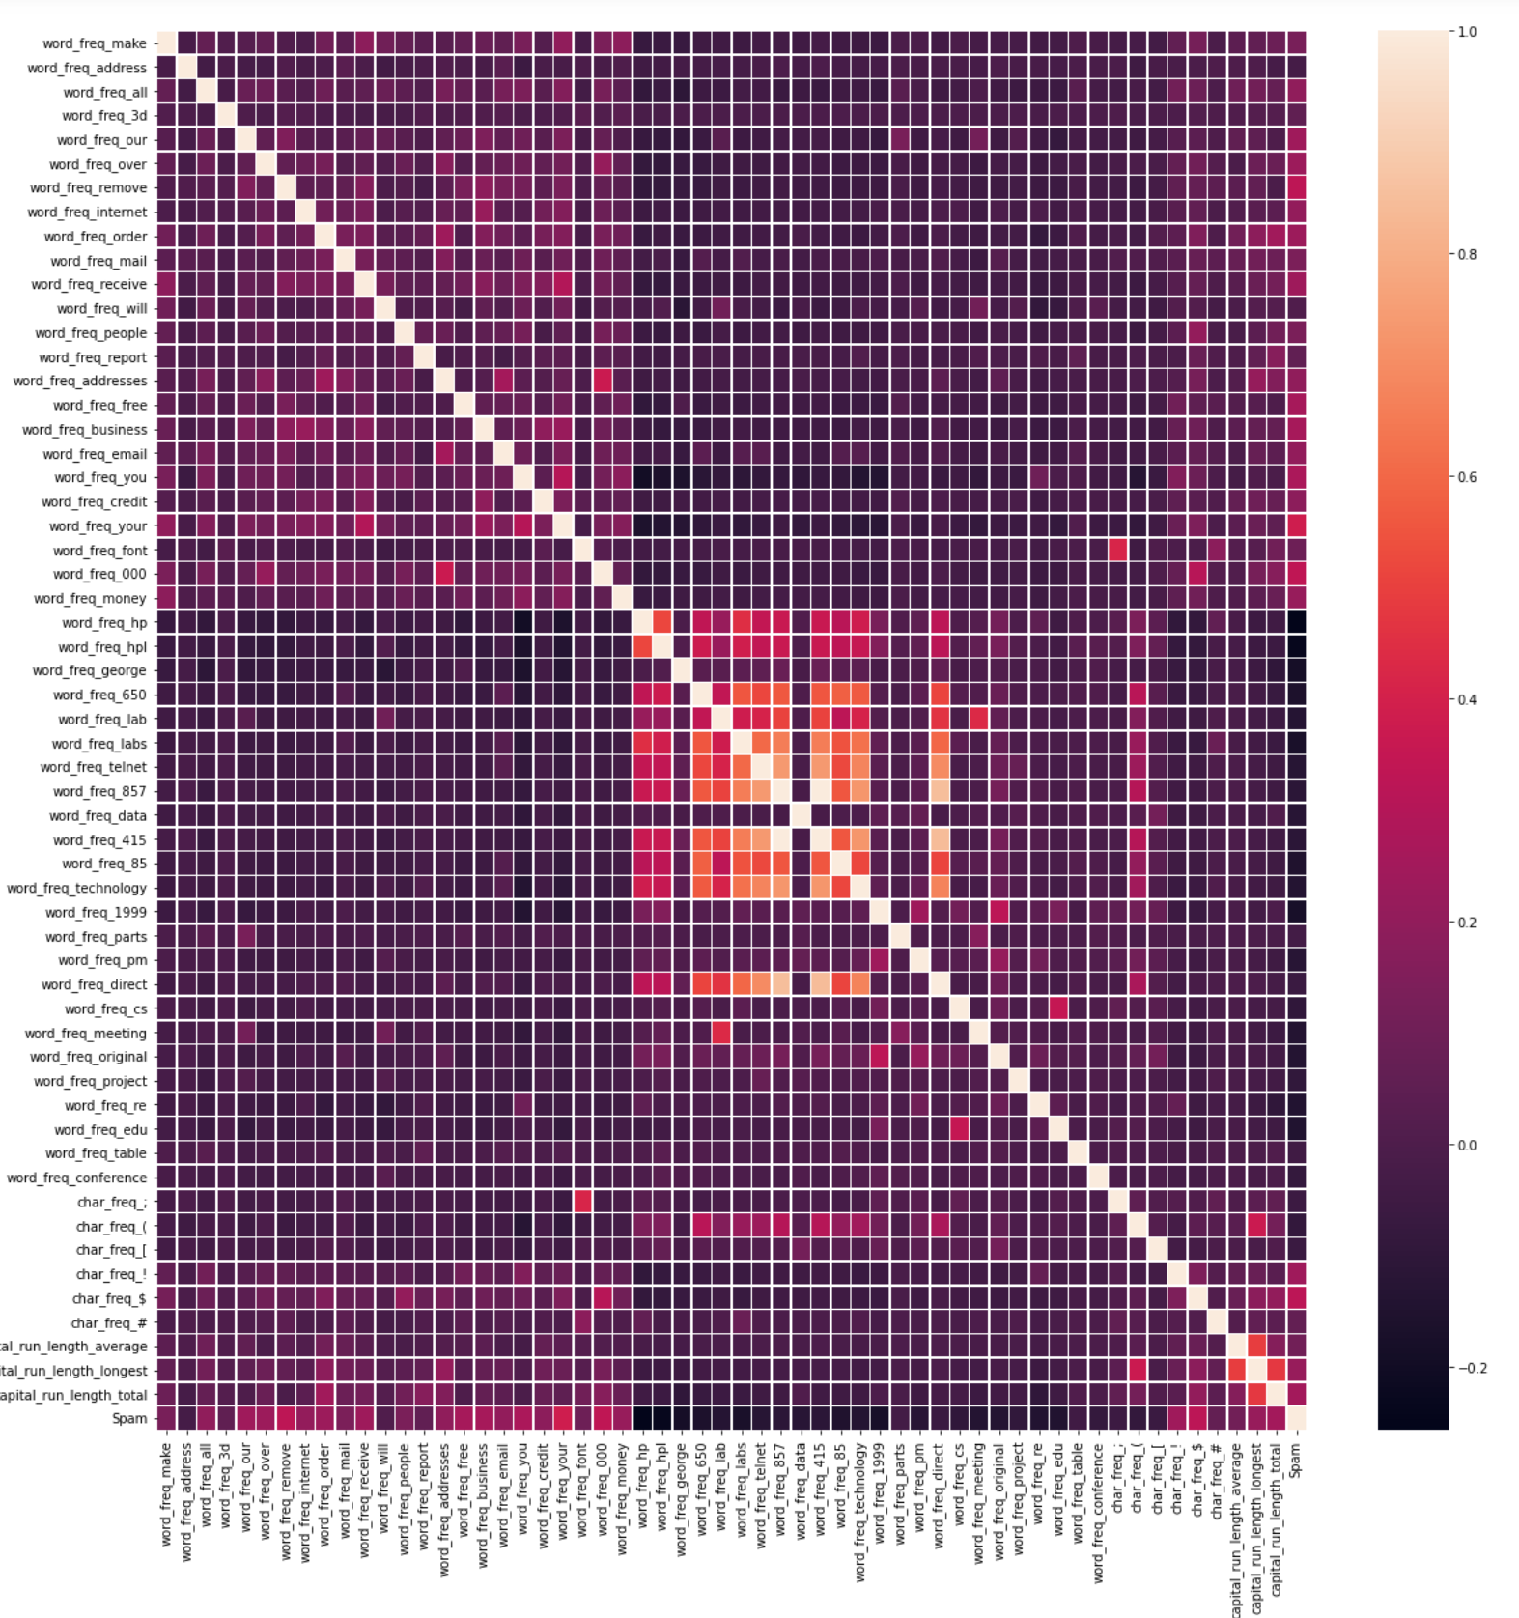
We decided to base the last ranking on pure correlations in the dataset
We first plotted all the features’ correlations with a Seaborn heatmap
This plot was too dense to be usable, so we sorted the output by correlation with the Spam variable, and once again made it a new dataframe

Slide 9
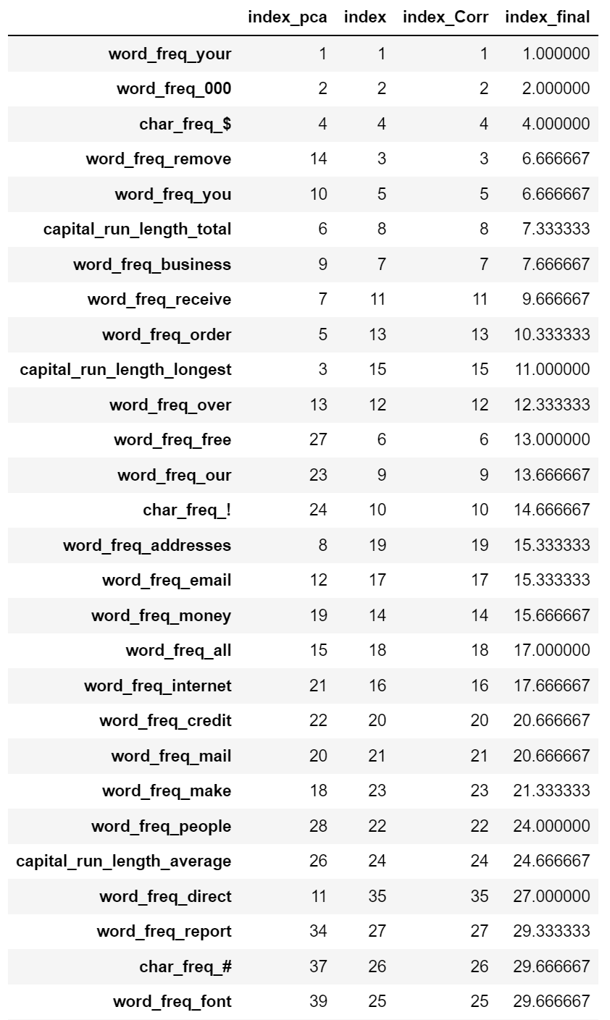
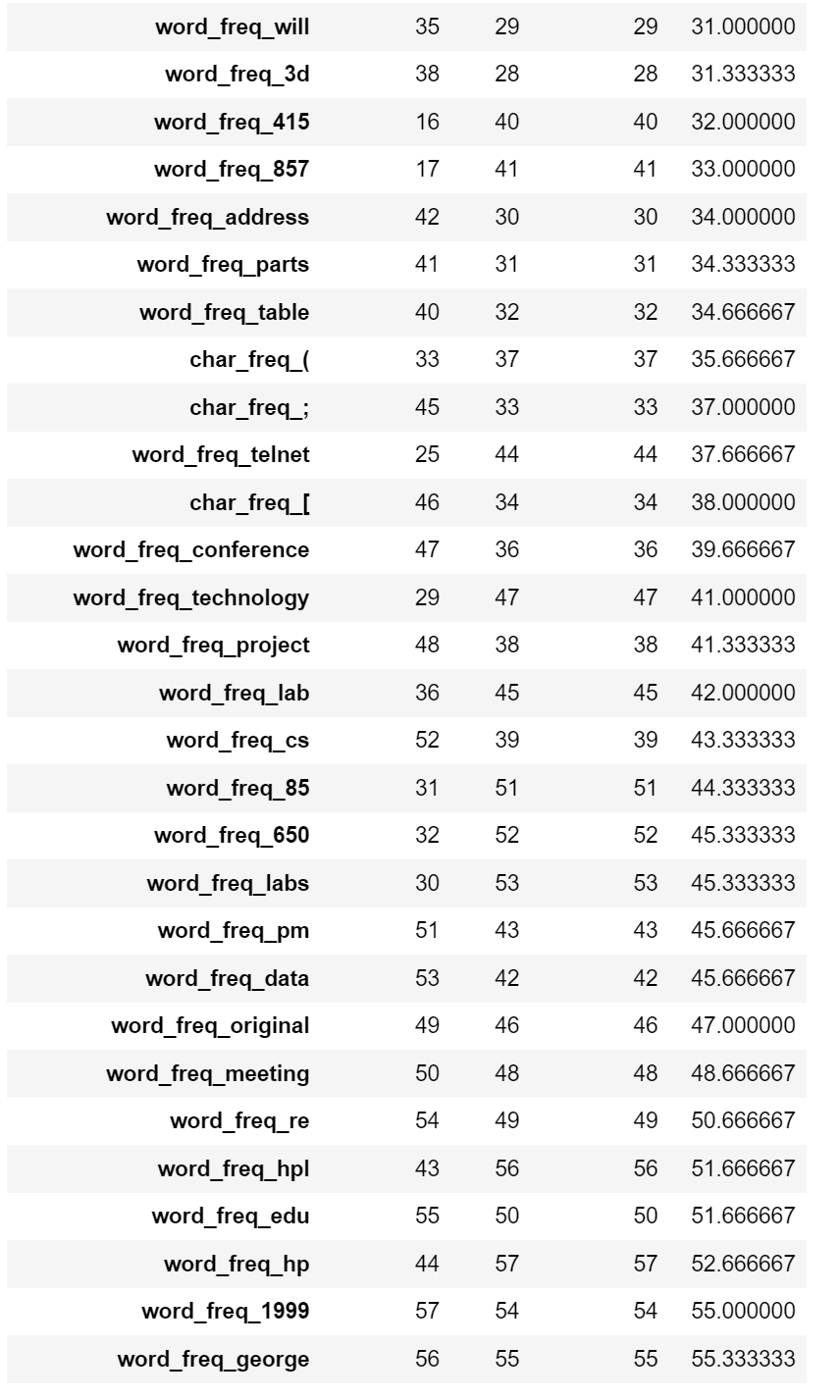
In the end, we merged the 3 rankings and computed a final index as the mean of the 3. This index was used as a final reference for feature priority in training a prediction algorithm.

Slide 10
Supervised learning

Slide 11
In this part, our goal was to determine if an email was a Spam or not with the best possible accuracy.
To maximize accuracy, we have to determine :
- What features to use
- What model to use
- How to tune its parameters to fit the dataset

Slide 12
To optimize feature choice for training, we compared results on 4 subsets :
- the entire dataset
- a subset with the 17th best ranked features
- a subset with the 22nd best ranked variables
- a subset with the best 10 and worst 10 ranked variables
After training models on the 4 sets, training on the full dataset proved to yield better results on testing sets (with scores 2 points better on average).
We chose ranks 10, 17 and 22 because they represent important correlation gaps in the ranking
So, we decided to train our prediction model on the full dataset.

Slide 13
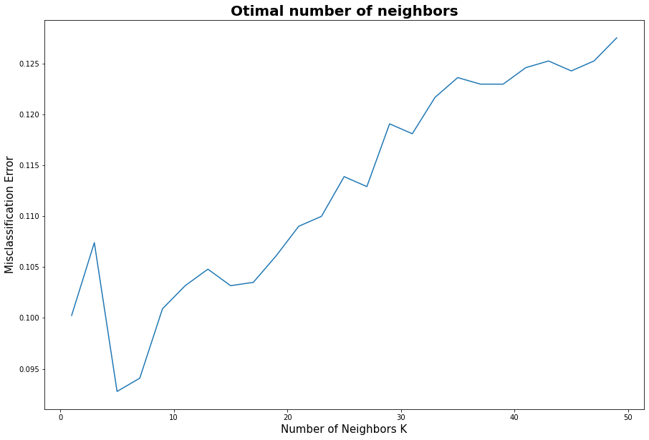
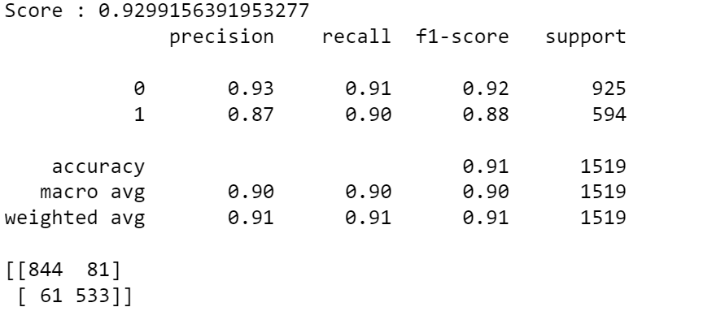
To find the best model with the best parameters, we proceeded by trial and error. We tested differents model from the sklearn library(like SVC, Logisitic Regression or KNN) and also from TensorFlow to try Deep Learning.
Deep Learning provided disappointing results for great effort, so we shifted our focus on more standard protocols.
The best results were obtained using the K-Nearest-Neighbors (KNN) algorithm, which scored an impressive 93% prediction accuracy.
To tune the algorithm, we used both a loop testing all the parameters to find the best accuracy and a grid search. For the number of neighbors, we plotted the accuracy to determine if we weren’t overfitting to the dataset.

Slide 14
API & WEBSITE

Slide 15
The last step to completion was to develop an API to make our prediction model accessible to everyone.
We have made it into a website called SPAMAILS.
You can check it out here :
https://spamails.herokuapp.com/

Slide 16
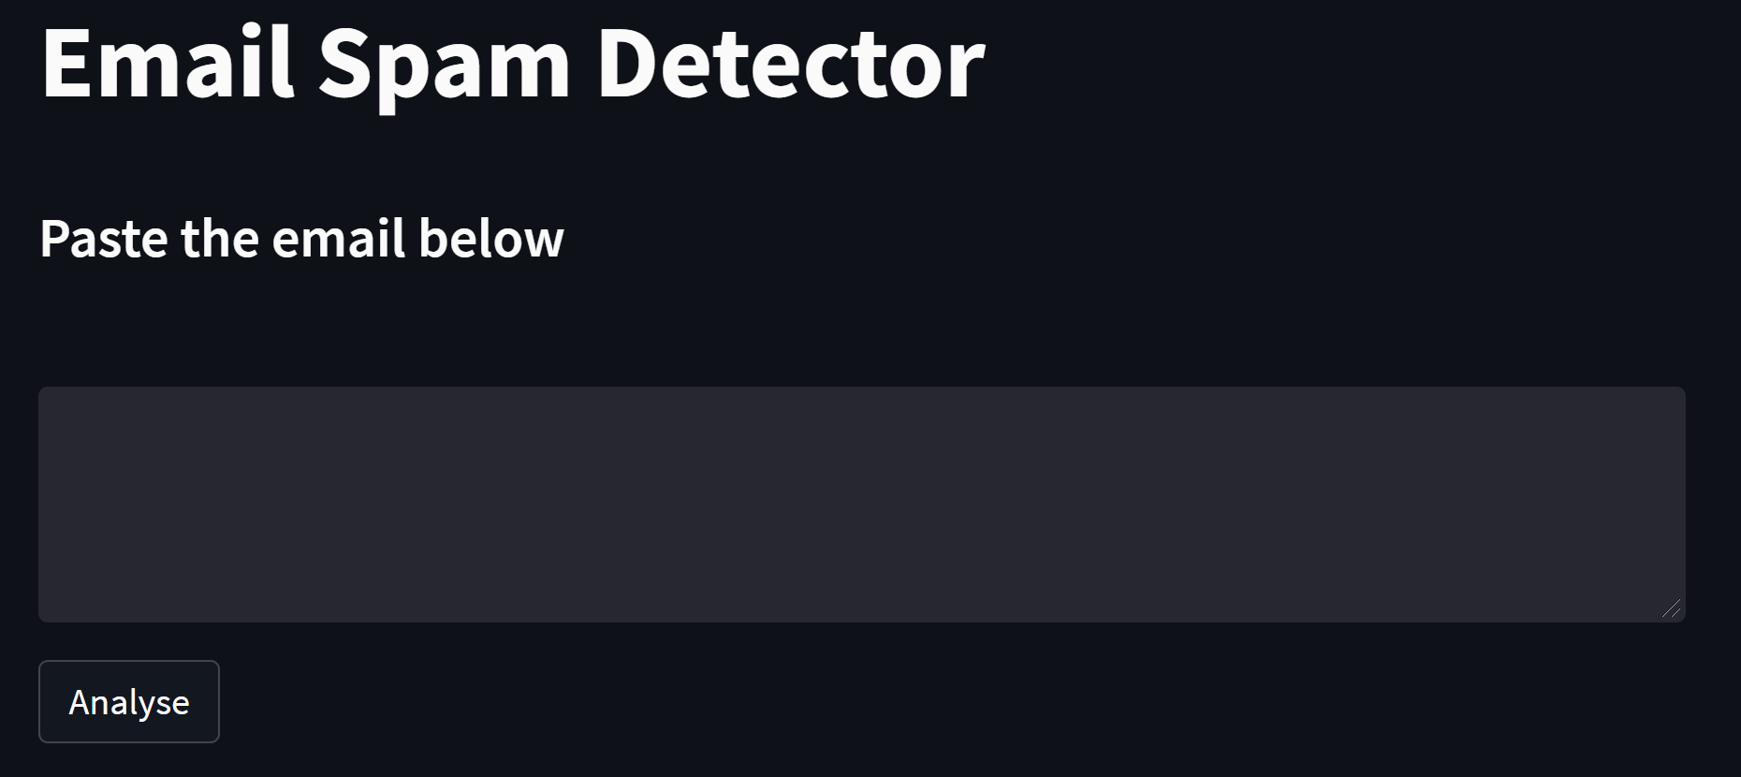
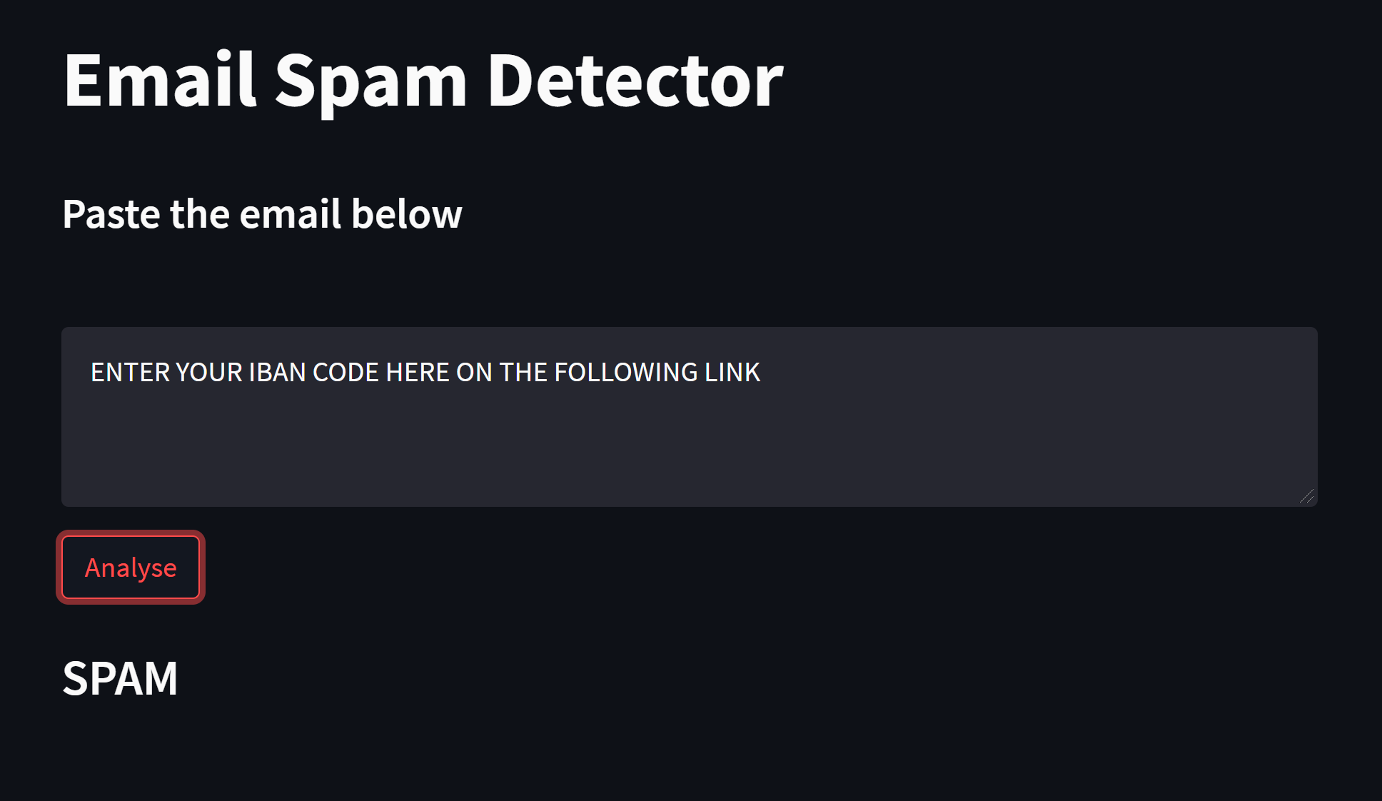
Once we were done training models, we focused on creating an API that can parse data from a real text and turn it into the required parameters for our model.
The point of this experiment was also to test our model’s real-world efficiency, where parsed data can significantly differ from what’s in the training dataset.
First, we had to implement function to compute word/character frequencies and run lengths from a string input
We then feed the data to the model to get a prediction.

Slide 17
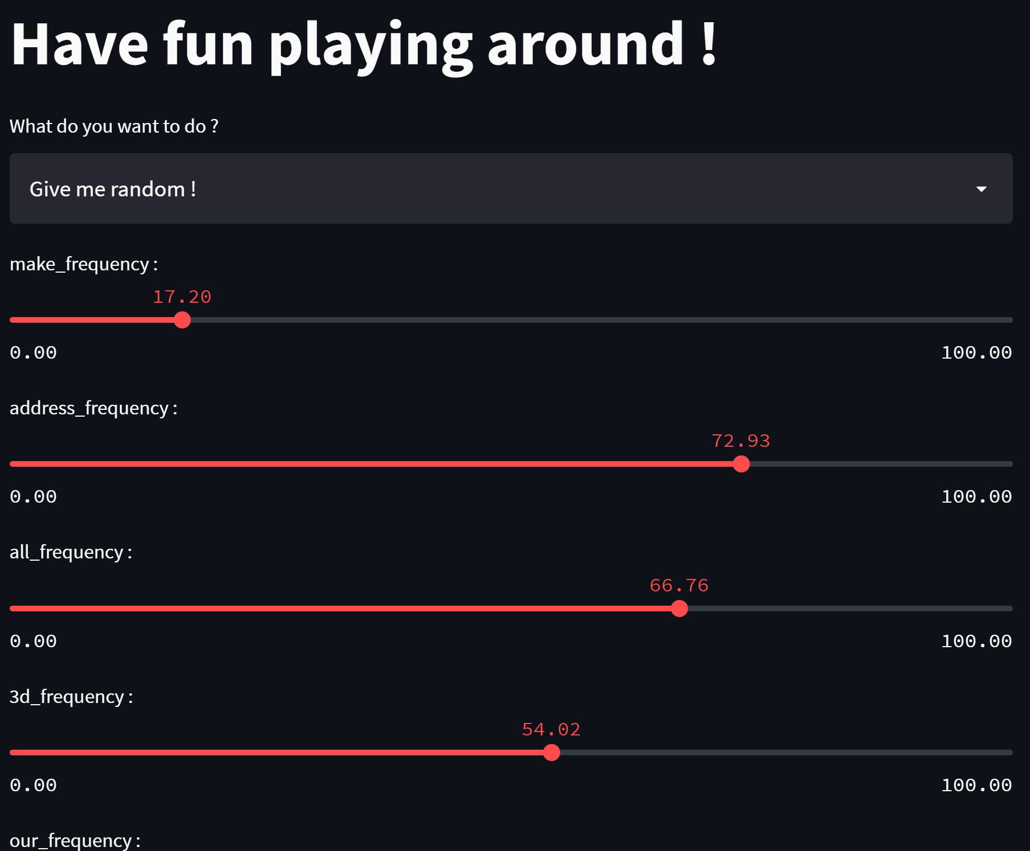
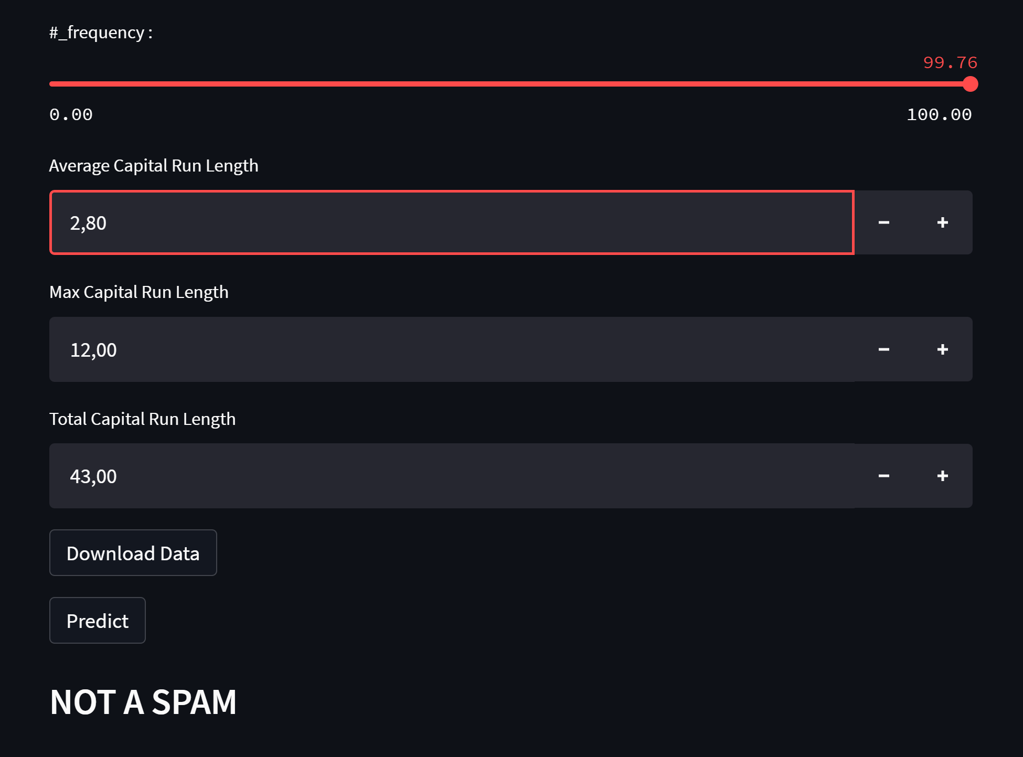
In order to better explore the database and this AI’s behavior, we have implemented a Sandbox mode on the website to let users experiment with features values, either at random or chosen. This allows better understanding of the characteristics of spam emails.

Slide 18
CONCLUSION

Slide 19
After having done Data Analysis and Supervised Learning on the Spam dataset, we really enjoyed working on a database relevant to everyday life.
By working on this project, we attained a better understanding of spam structures. It served as a great example of how to use AI knowledge for practical applications.

Slide 20
However, our IA can fail, especially since the training dataset is from 1998. Emails (and messages overall) from today are different from 1998’s standard, which can lead to flawed predictions
Notably, emails and messages today are shorter due to more spontaneous communication. It makes a frequency-based approach highly unstable on modern messages
Frequency based approach creates a strong bias for high ranked features like word “you” or “your” in Spam prediction. Seeing only one in a short text is enough to trick the AI into thinking it’s spam
We recommend an approach based on both frequency and count to compensate for skyrocketing frequency values on short texts, that are closer to today’s standard but not represented in the dataset

