Slide 1
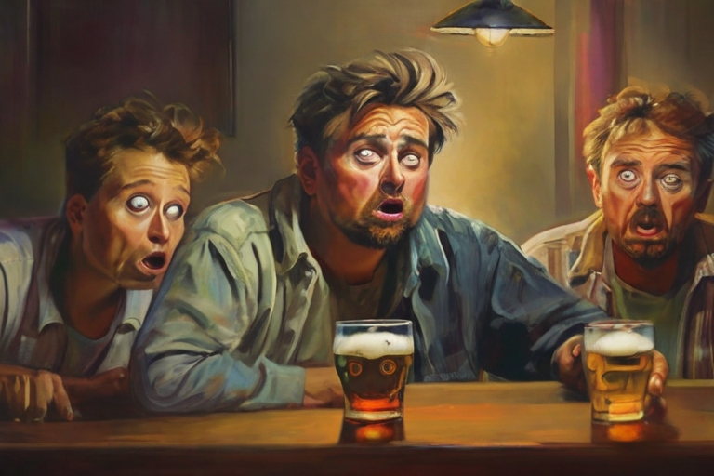

Slide 2
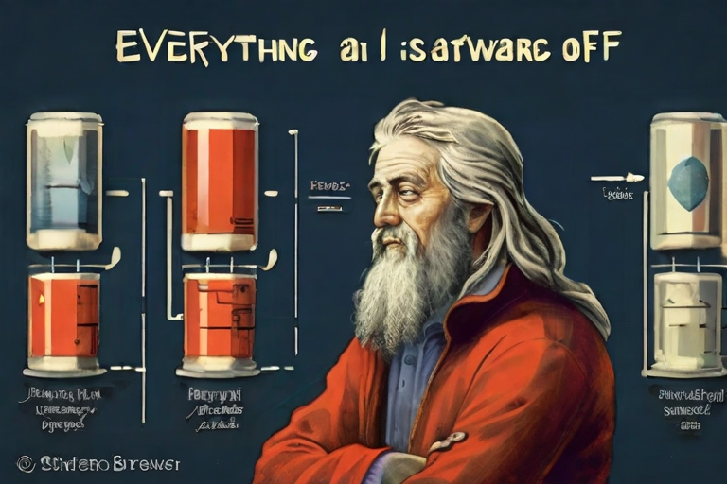
Everything in
Beer Production
Software Architecture
is a Trade-Off

