Slide 1
XmasDev 2023
Saga: a long story of heroic achievement.

Slide 2

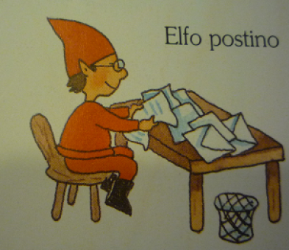


Slide 3
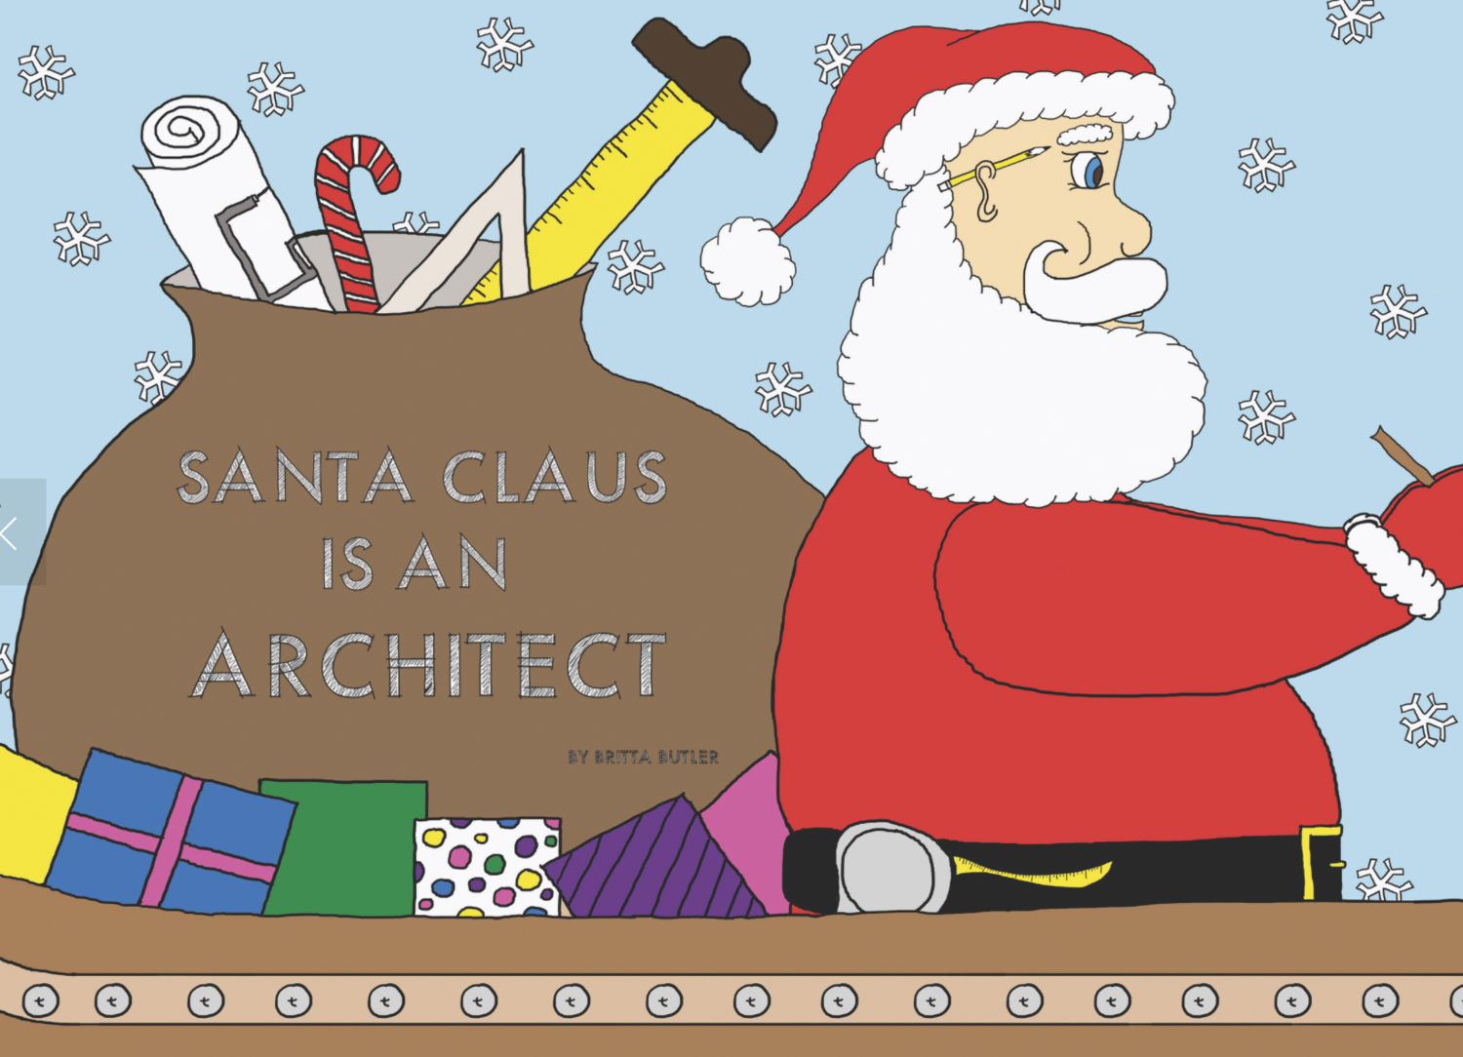
First Law
Second Law
Everything in software architecture is a trade off
Why is more important then how

Slide 4
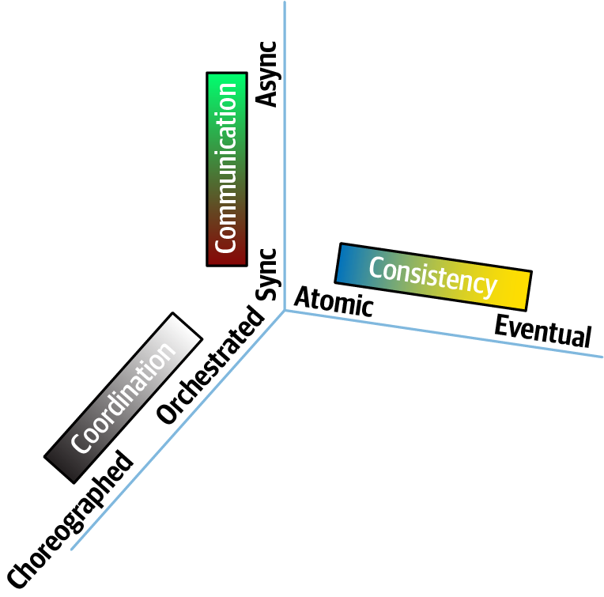

Slide 5


Slide 6
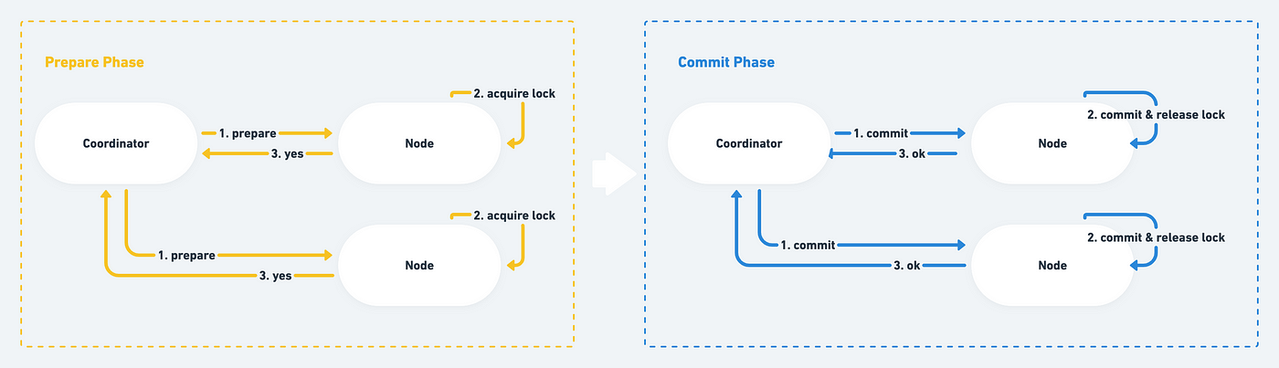
2PC aka Two-Phase Commit Protocol

Slide 7
In a message-based system, we might feel a lack of control, especially when in need of compensating changes spread across the system. Fear not! Real life deals with compensation every day! And it's better than rolling back a transaction or deleting some data in the database. Compensation is all around us.

Slide 8
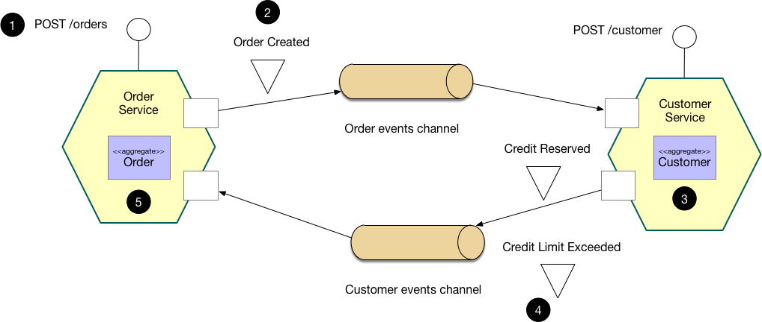
Choreography-based Saga
Microservices.io

Slide 9
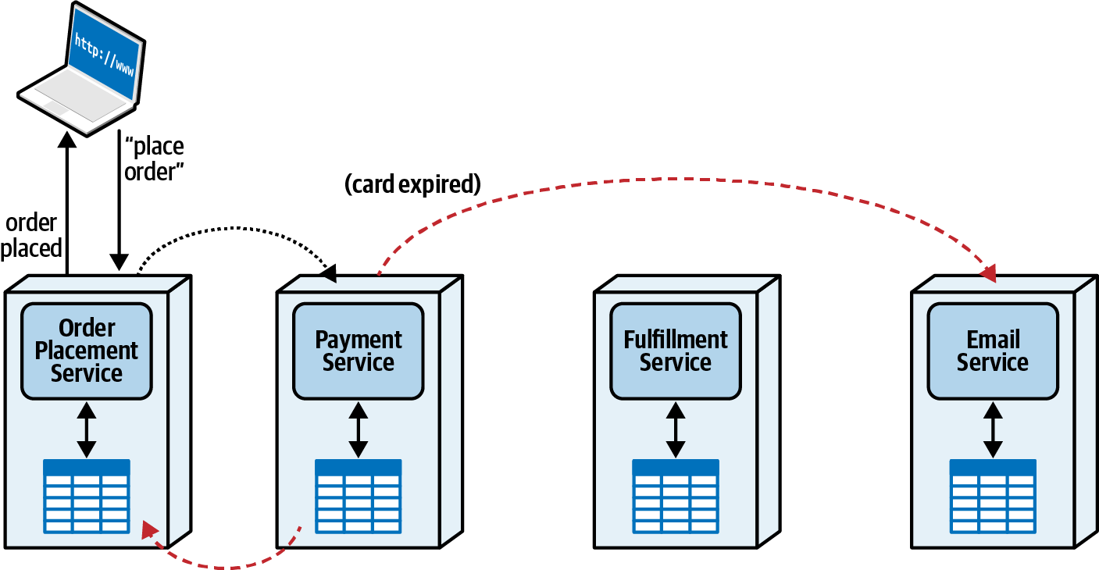

Slide 10
Responsiveness
Distributed Workflow
Scalability
State Management
Fault Tolerance
Error Handling
Service Decoupling
Recoverability

Slide 11
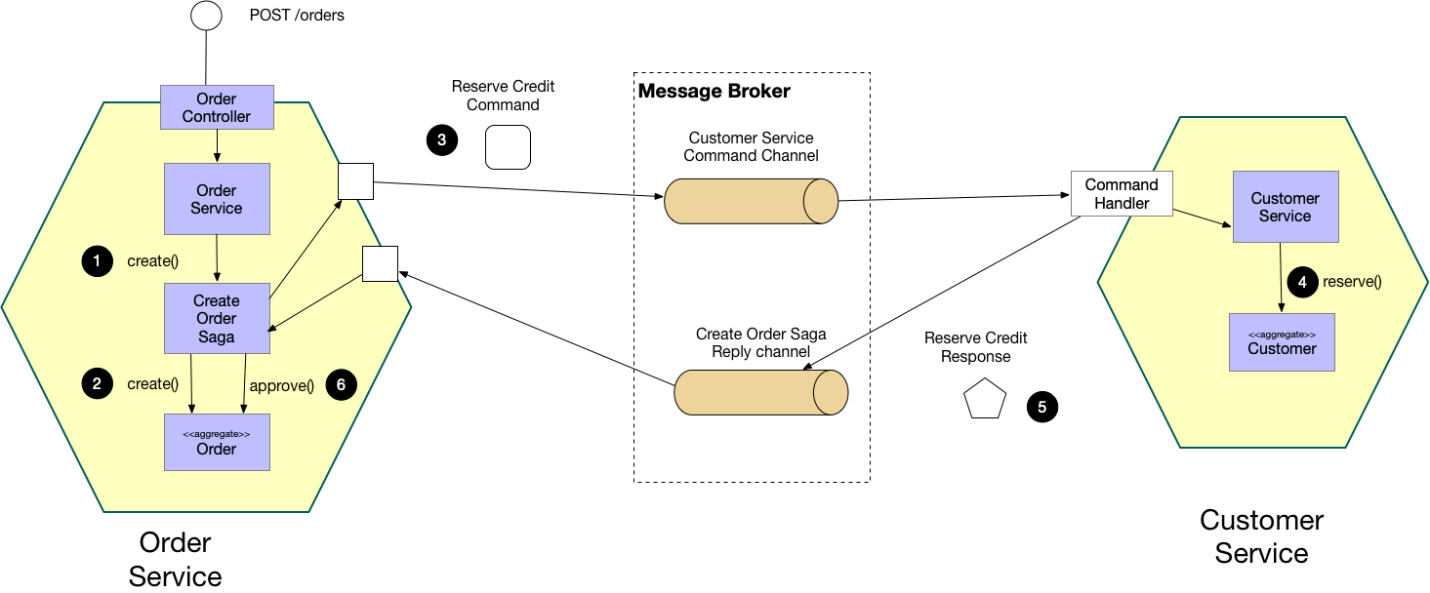
Orchestration-based Saga
Microservices.io

Slide 12
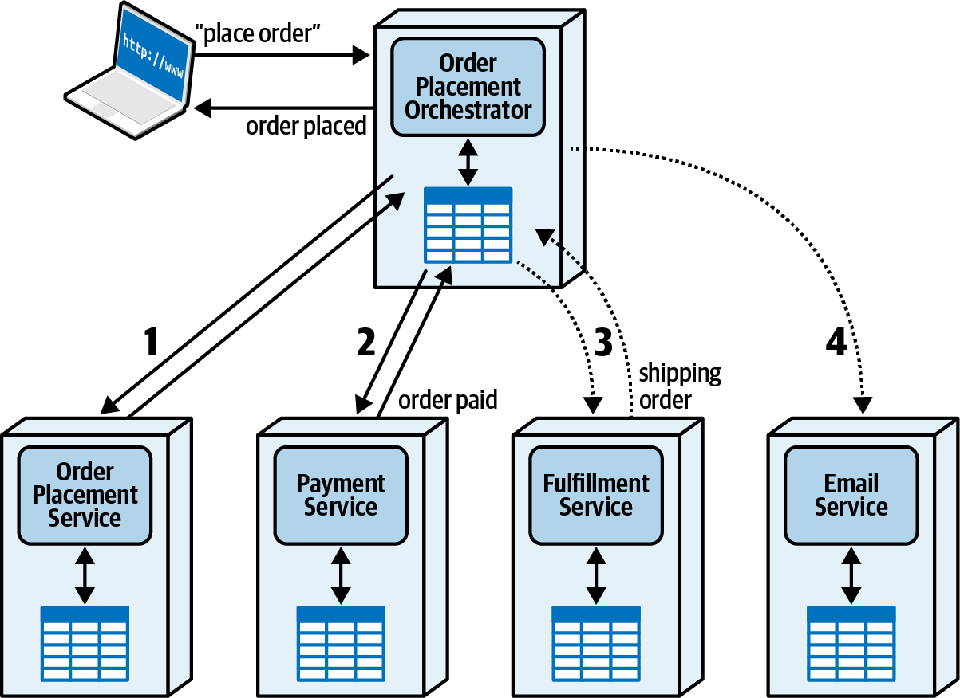

Slide 13
Centralized Workflow
Responsiveness
Error Handling
Fault Tolerance
Recoverability
Scalability
State Management
Service Coupling

Slide 14
