Slide 1
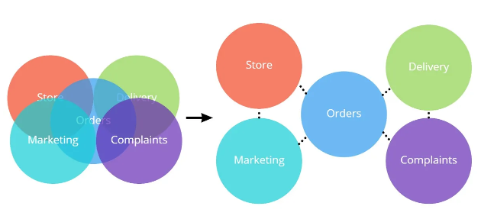

Slide 2


Slide 3
In 2009 Netflix faced growing pains. Its infrastructure couldn’t keep up with the demand for its rapidly growing video streaming services. The company decided to migrate its IT infrastructure from its private data centers to a public cloud and replace its monolithic architecture with a microservices architecture. The only problem was, the term “microservices” didn’t exist and the structure wasn’t well-known

Slide 4
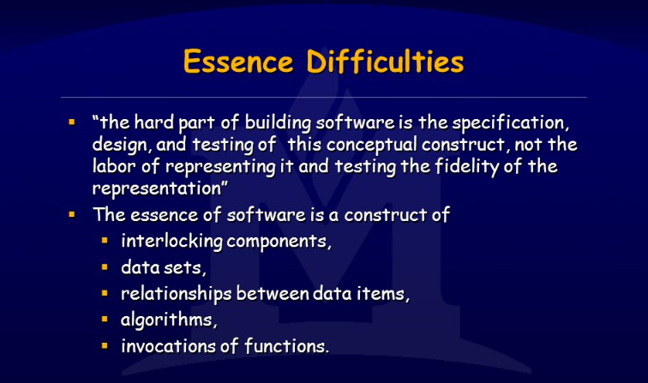
No Silver Bullet
(Fred Brooks – 1986)

Slide 5
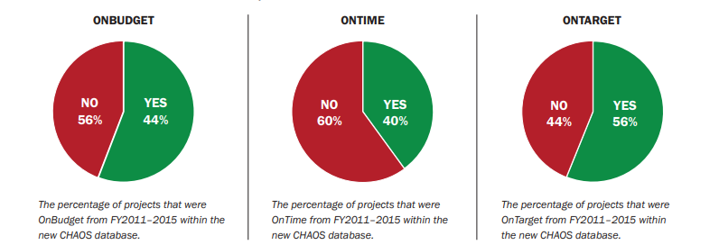
2015 Standish Group - CHAOS Report

Slide 6
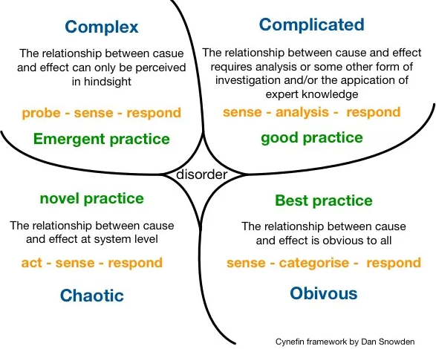
Dan Snowden Cynefin - 2007

Slide 7
Warehouse
Proxy
Sales
Sales
Warehouse

Slide 8
Risk comes from not knowing what you are doing.
(Warren Buffet)

Slide 9
The only way to decrease ignorance is to increase understanding

Slide 10
A system is never the sum of its parts. It is the product of the interactions of its parts.
Dr. Russel Ackoff

Slide 11
Bit rot (the silent killer): is either a slow deterioration of software quality over time or its diminishing responsiveness that will eventually lead to software becoming faulty

Slide 12
Architectural Fitness function is any mechanism that provides an objective integrity assessment of some architectural characteristics
Architectural Fitness function forms the primary mechanisms for implementing evolutionary architecture

Slide 14
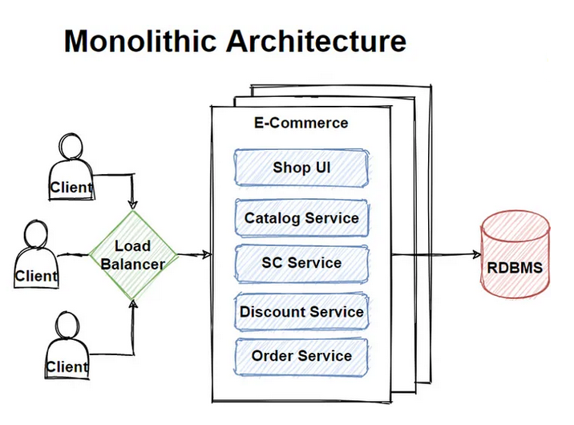
https://www.atlassian.com/microservices/microservices-architecture/microservices-vs-monolith

Slide 15
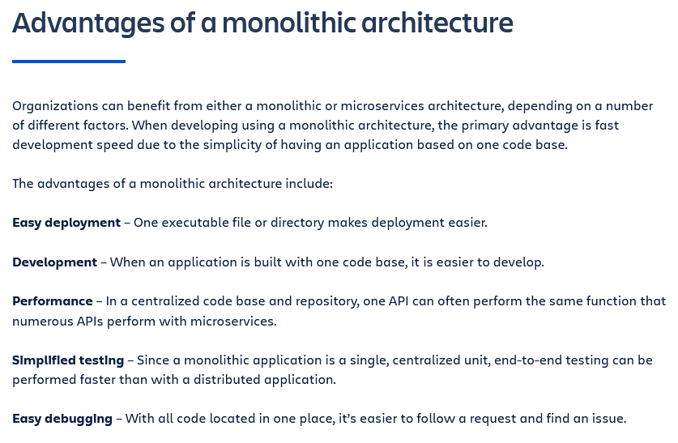

Slide 16
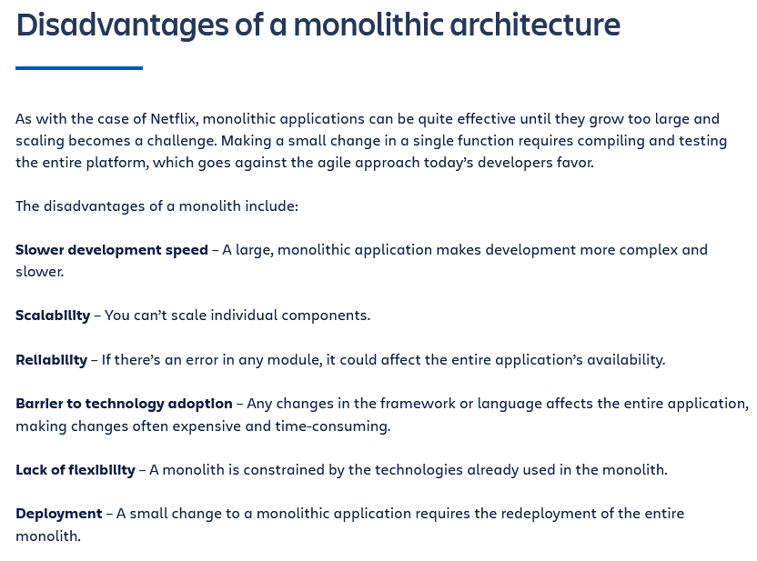

Slide 17
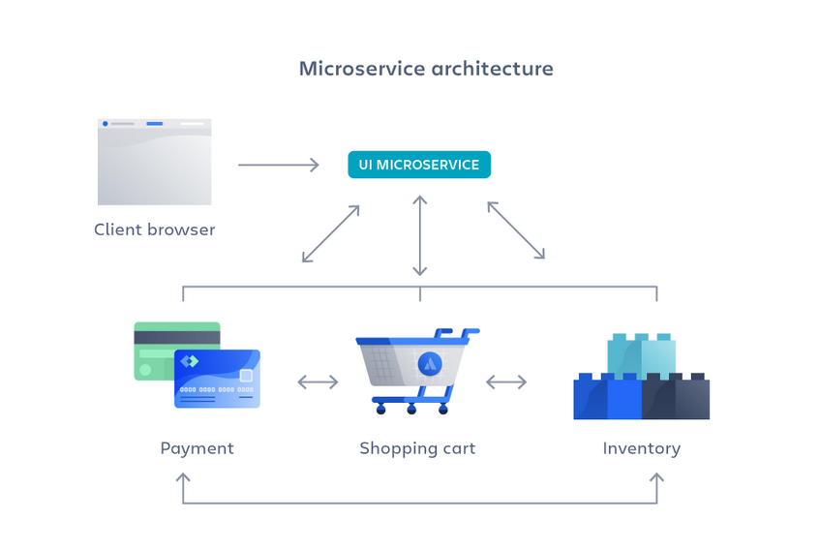

Slide 18
Cos’è un Microservizio?
Componentization via Services
Organized around Capabilities
Products not Projects
Smart endpoint and dumb pipes
Decentralized Governance
Decentralized Data Management
Infrastructure Automation
Design for Failure
Evolutionary Design
Martin Fowler

Slide 19
When you do a migration,
it’s not just a technical migration,
but a people and organizational change

Slide 20
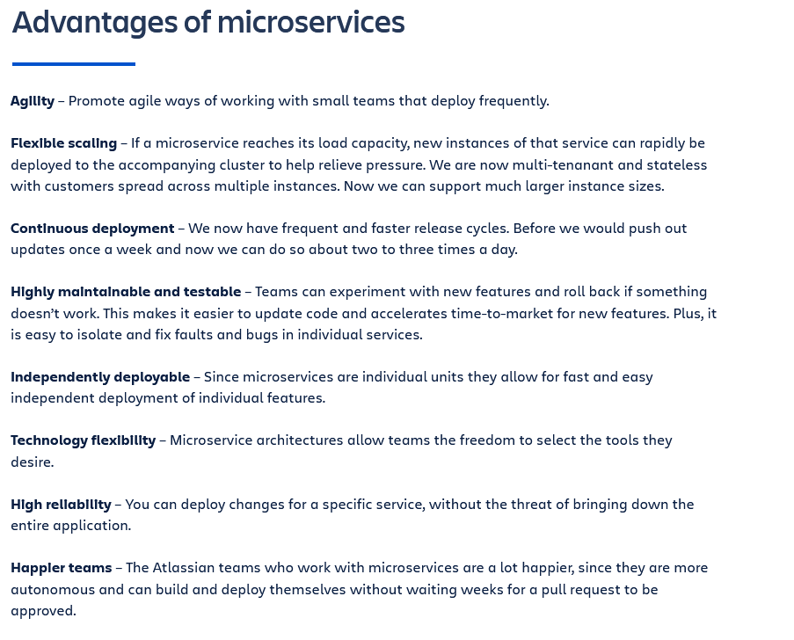

Slide 21
