Slide 1

A supplier all to myself

Slide 2
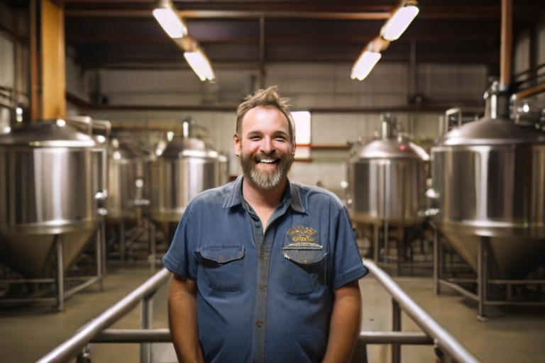
An happy supplier

Slide 3
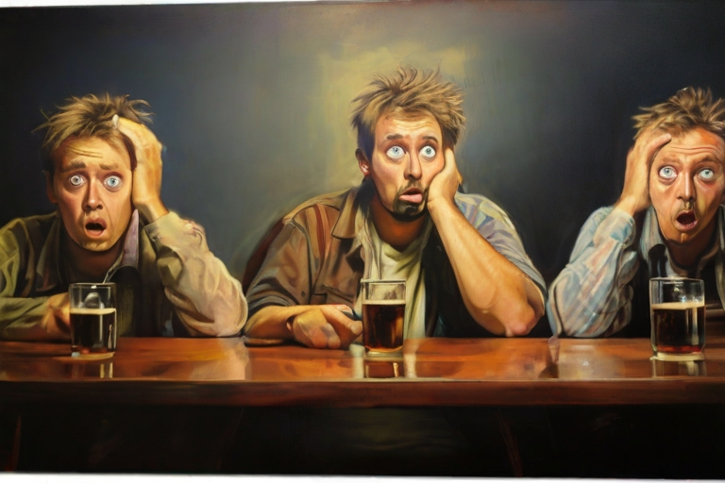
Requests for beer increase

Slide 4
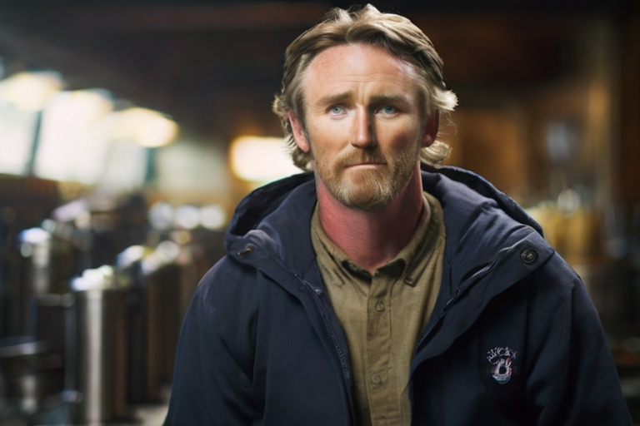
Too much orders

Slide 5
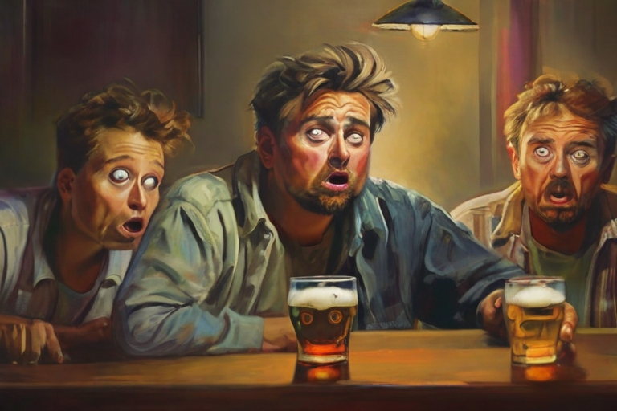
Distributed Systems

Slide 6
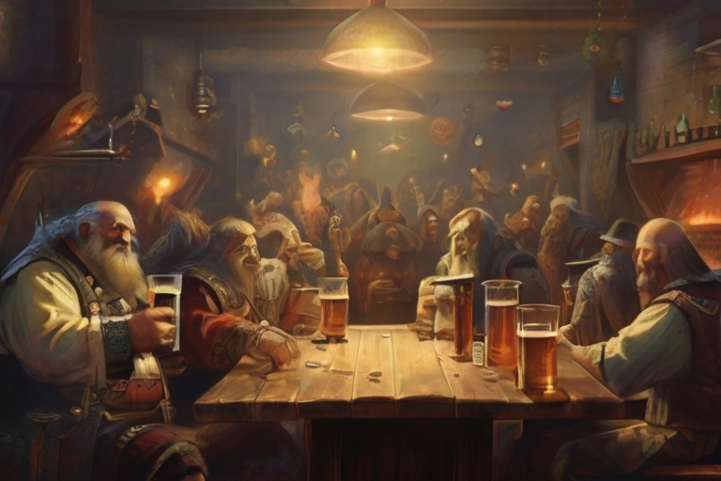
Saga: a long story of heroic achievement

Slide 7
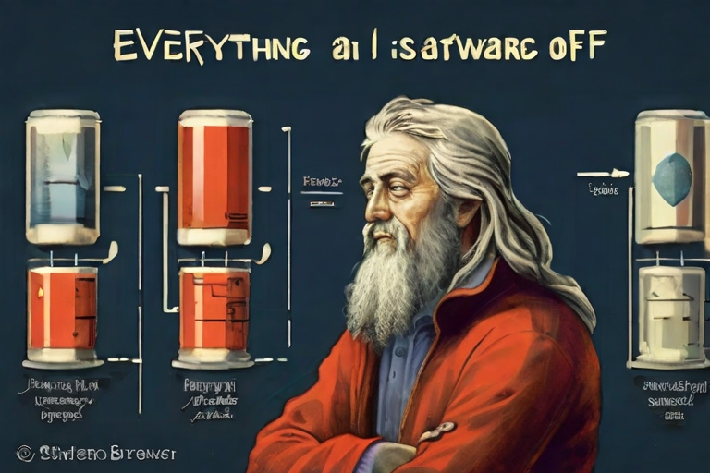
Everything in
Beer Production
Software Architecture
is a Trade-Off

