Slide 2

«Failures are given, and everything will eventually fail over time» (Werner Vogels – CTO Amazon)

Slide 3
Eight Fallacies of Distributed Computing
The network is reliable
Latency is zero
Bandwith is infinite
The network is secure
Topology doesn’t exist
There is one administrator
Transport cost is zero
The network is homogeneous

Slide 4
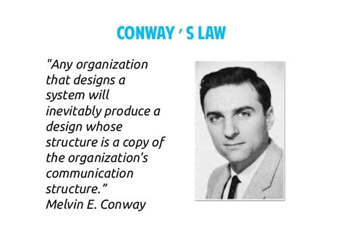
Conway's law

Slide 5
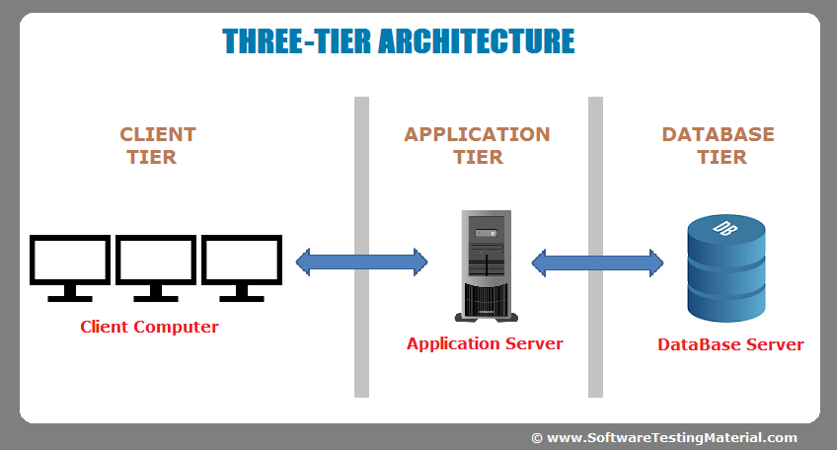
On-Premises Application
Before the Cloud, users were connected to our application through the Company’s local network
A server’s downtime was planned and involved stopping production

Slide 6
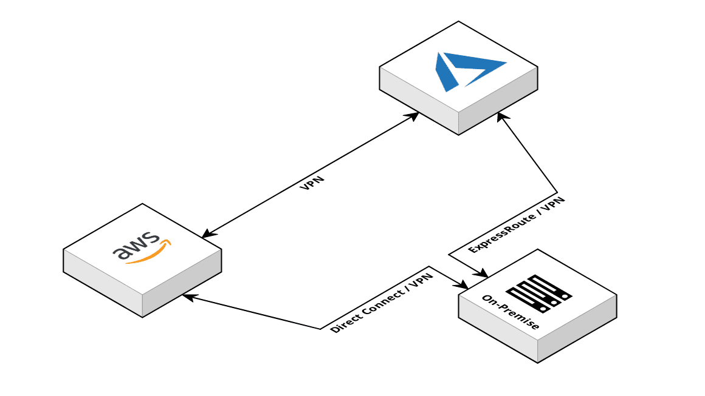

Modern Application
Now our users are connected through the Internet
The workload to which our services are subjected will increase significantly, thanks to the greater spread of the application themselves.
Many MicroServices replace one Monolithic

Slide 7
Microservices: is it really a matter of sizes?
Common Characteristics
Componentisation via services
Organised around business capabilities
Decentralised data management
Products not projects
Decentralised governance
Smart endpoints and dumb pipes
Evolutionary design
Infrastructure automation
We cannot say there is a formal definition of the microservices architectural style, but we can attempt to describe what we see as common characteristics for architectures that fit the label.
(Martin Fowler, James Lewis)

