Slide 1


Python vs .NET
Very popular in ML
Small core language engine with a large standard library
Needs to be translated into C++ when performance really matters
ASP.NET Core services and apps are multithreaded applications
Can serve many HTTP requests at the same time
.NET Core provides a managed thread pool that is managed by the system

Slide 2

What is ML.NET
Machine Learning framework free, open source and cross platform
Enable use of C# and F# to build custom Machine Learning model
Include automated ML (AutoML), Model Builder, ML.NET CLI
Make easy integrating ML in our application

Slide 3
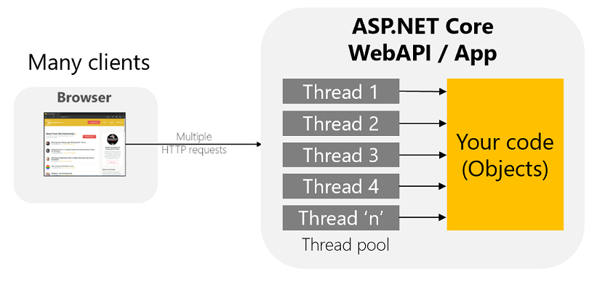
Make ML Scalable

Slide 4
Demo
Demo Time

