Slide 1
Model Selection
Choose and evaluate your model
Marco Acerbis
ML & AI Developer

Slide 3
What is Model Selection?
The Model Selection is a key step in choosing which (statistical) model to adopt in order to solve a precise problem. Infact, almost always we can find different implementations for a solution, so which one should we develop into our final algorithm?

Slide 4
What we need
A collection of models: nowdays there are many SoTA models available for different applications.
A metric to evalute our models
With also some data (tricky part: the amount and quality of data influence our analysis)

Slide 5
Walkthrough Example
To better present the Model Selection process, I’ll use a Deep Learning project that I developed with Nicolaas Ruberg during the MSc in AI at the University of Bologna. You can find the code at: https://github.com/Ace95/DeepLearning_Project

Slide 6
We needed to develop a CV application able to classify different images. But there exist many and different SoTA or custom models that can fullfit our request.
First decision: the type of NN -> Covolutional Neural Networks
Second decision: a pre-trained model + transfer learning? O ar custom from-the-scratch model?
We decided to try and test 3 different approaches:
- Mobilenet
- VGG19
- From-the-scratch model

Slide 8

Covolutional Neural Networks
Convolutional neural networks are a class of neural networks where the hidden layers consist in a series of convolutional layers, that work as filters and usually use a ReLU activation function, and pooling layers, that summarize the presence of features.

Slide 9
Model Evaluation
Model Evaluation is an extimation of the generalization error, so how «accurate» is our model in making prediction on new unseen data.
Why we need to evaluate our model?
Because overfitting exist!

Slide 10
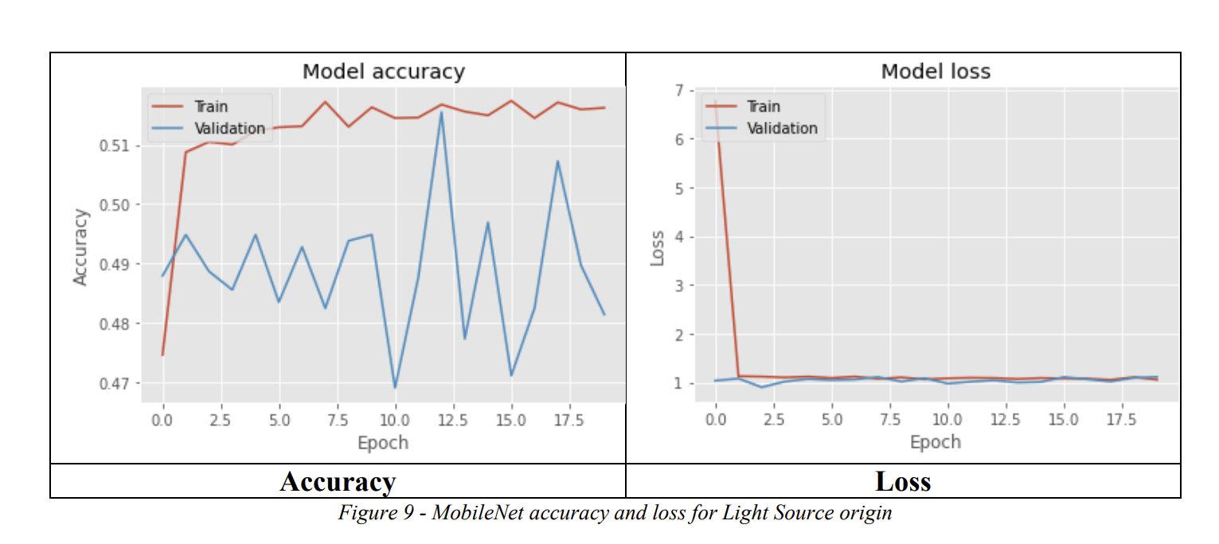
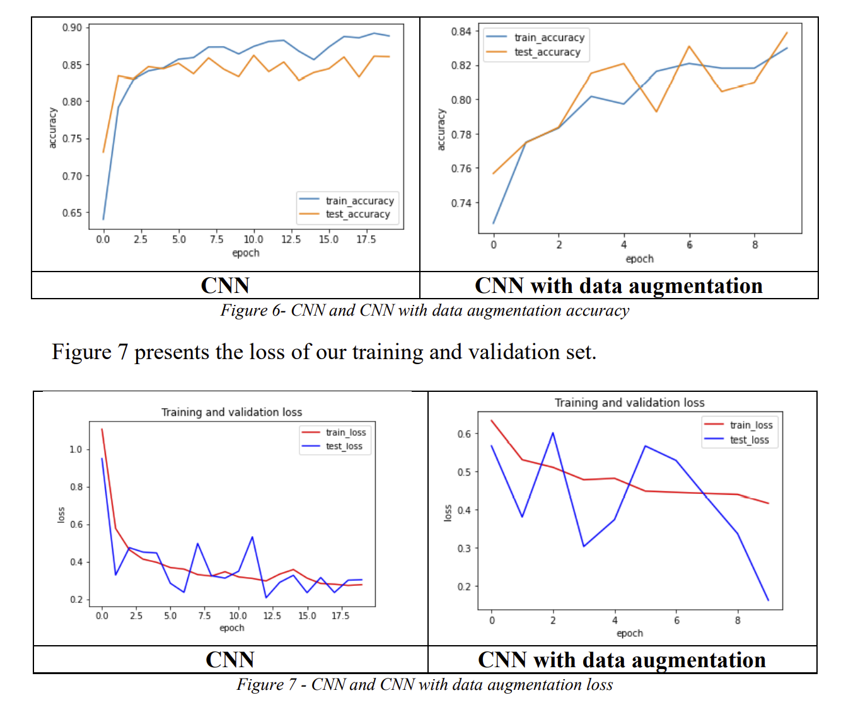
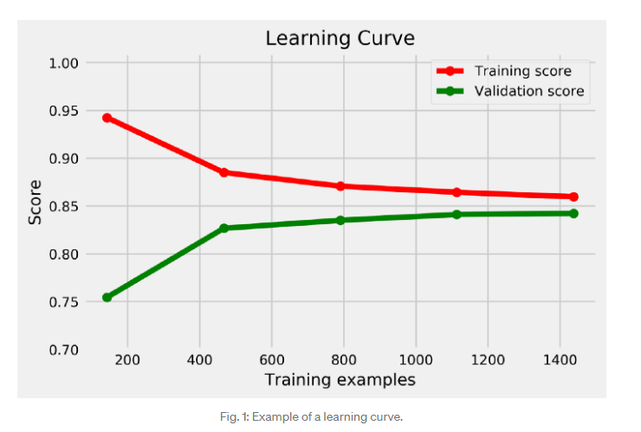
Now we are ready to begin our selection process:
First, we split the data into 3 categories: train / validation / test Also, what to do with scares data?
We need to plot the history for “Accuracy” and “Loss” or the Learning Curve
This approach allows to account for bias and variance.

Slide 11
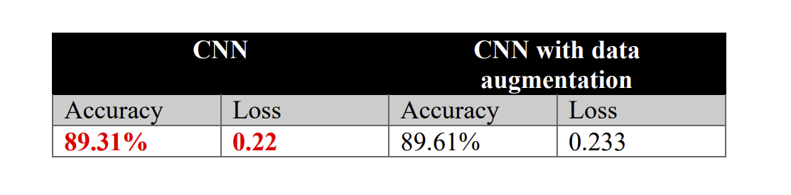
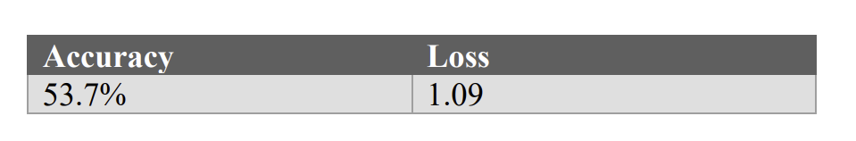
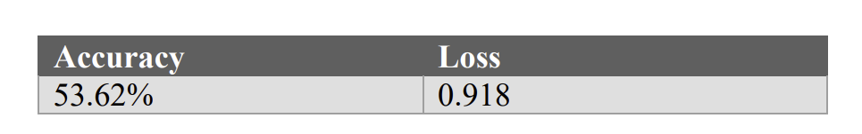
Looking at our example, we can compare the different final scores of our models:
Custom CNN
VGG19
MobileNet

Slide 12


At this point we may encounter two different scenarios:
Simple model: High Bias, Low Variance
Complex model: Low Bias, High Variance
We need to find a good trade-off between goodness of fit and model simplicity. There are many and different criteria that can be used to find the optimal model, here two example:
Akaike information criterion (AIC)
Bayesian information criterion (BIC)
Both penalize the number of model parameters but reward goodness of fit on the training set, hence the best model is the one with lowest AIC/BIC

Slide 14
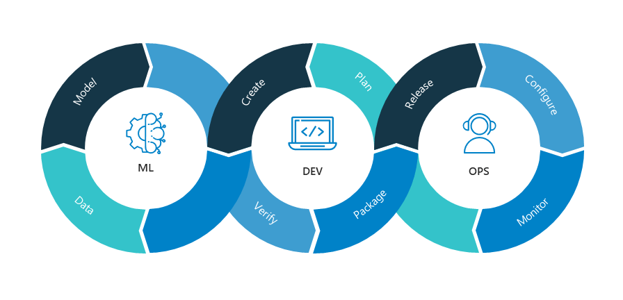
Dev vs Data Scientist

Slide 15


Python vs .NET
Very popular in ML
Small core language engine with a large standard library
Needs to be translated into C++ when performance really matters
ASP.NET Core services and apps are multithreaded applications
Can serve many HTTP requests at the same time
.NET Core provides a managed thread pool that is managed by the system

Slide 16

ML.NET
ML framework free, open source and cross platform
Enable use of C# and F# to build custom ML moldel
Include automated ML (AutoML) Model Builder and ML.NET CLI
Make easy integrating ML in our applications

Slide 17
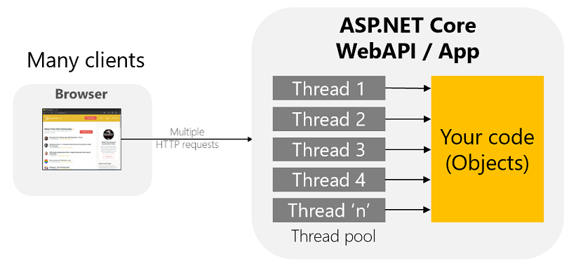
Make ML Scalable

Slide 18
Sharing ML model
Sharing the ML model (ITransformer) across HTTP requests in ASP.NET Core
Sharing PredictionEngine objects (Object Pooling based) across HTTP requests in ASP.NET Core
How to optimize and run ML.NET models on scalable ASP.NET Core WebAPIs or web apps

Slide 19
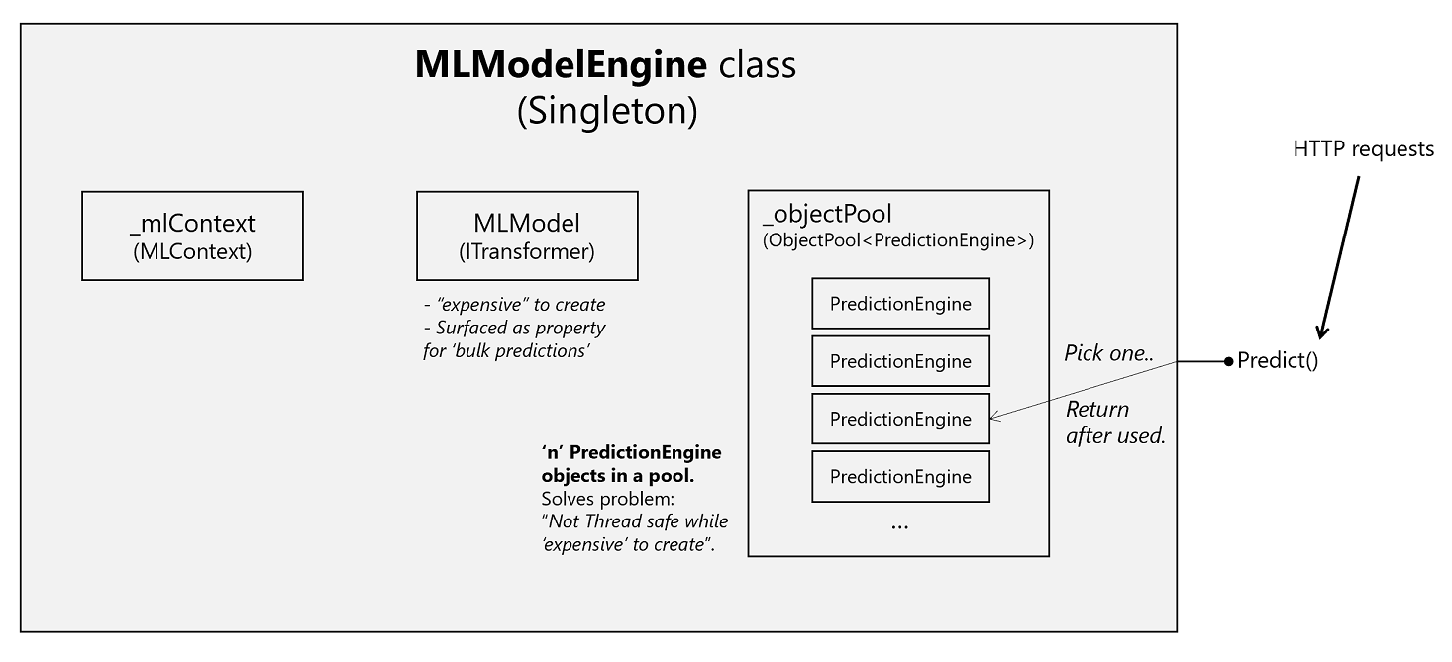
Sharing ML model
SamplePrediction prediction = _modelEngine.Predict(sampleData);
How to optimize and run ML.NET models on scalable ASP.NET Core WebAPIs or web apps

Slide 20
Demo Time

Slide 21




Marco Acerbis
ML & AI Developer
ML & AI Developer
Alberto Acerbis
Software Architect @4Solid
Alberto Acerbis | LinkedIn
@aacerbis

