Slide 1

Navigare in un fiume di Dati senza annegare
Come sopravvive un Dev in un mondo sempre connesso?

Slide 2




Thanks for collaboration

Slide 3




Who I am
@aacerbis
https://github.com/Ace68
Alberto @4Solid
Alberto Acerbis | LinkedIn

Slide 4
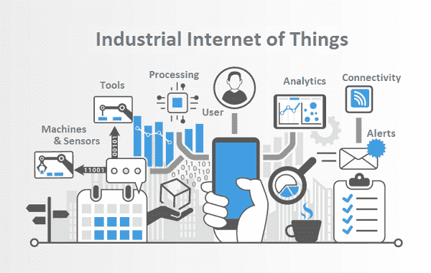
IoT for Industry?
Tecnologie IoT applicate all’ambiente industriale
Integrazione sensori intelligenti su macchinari produttivi
Miglioramento efficienza, produttività, sicurezza

Slide 5

Perchè?
Without data you’re just another person with an opinion.
(W. Edwards Deming – Data Scientist)

Slide 6

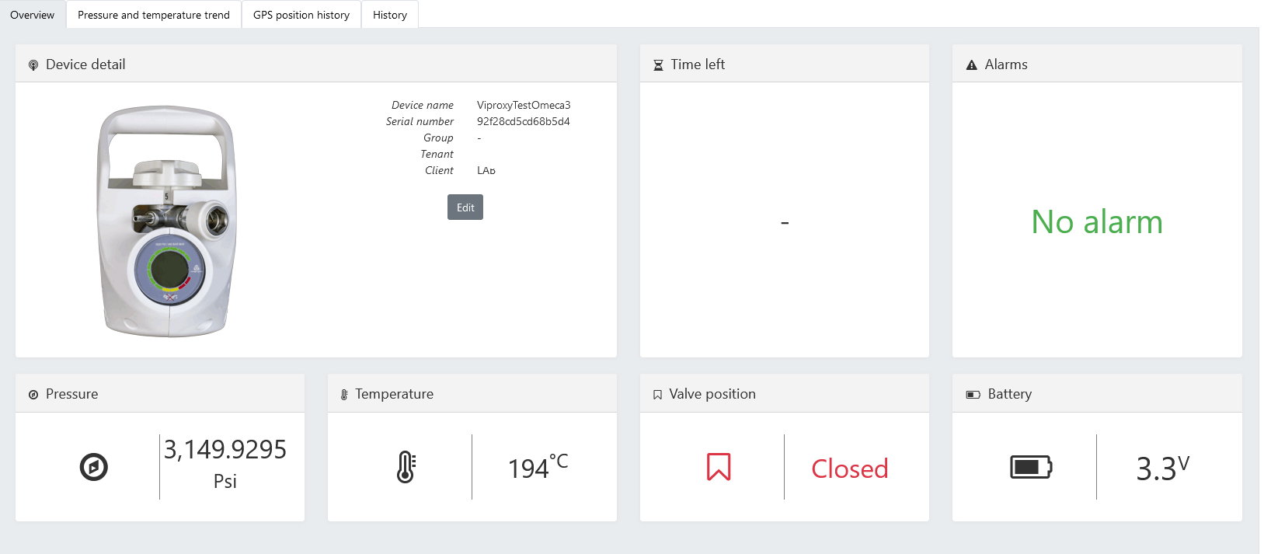
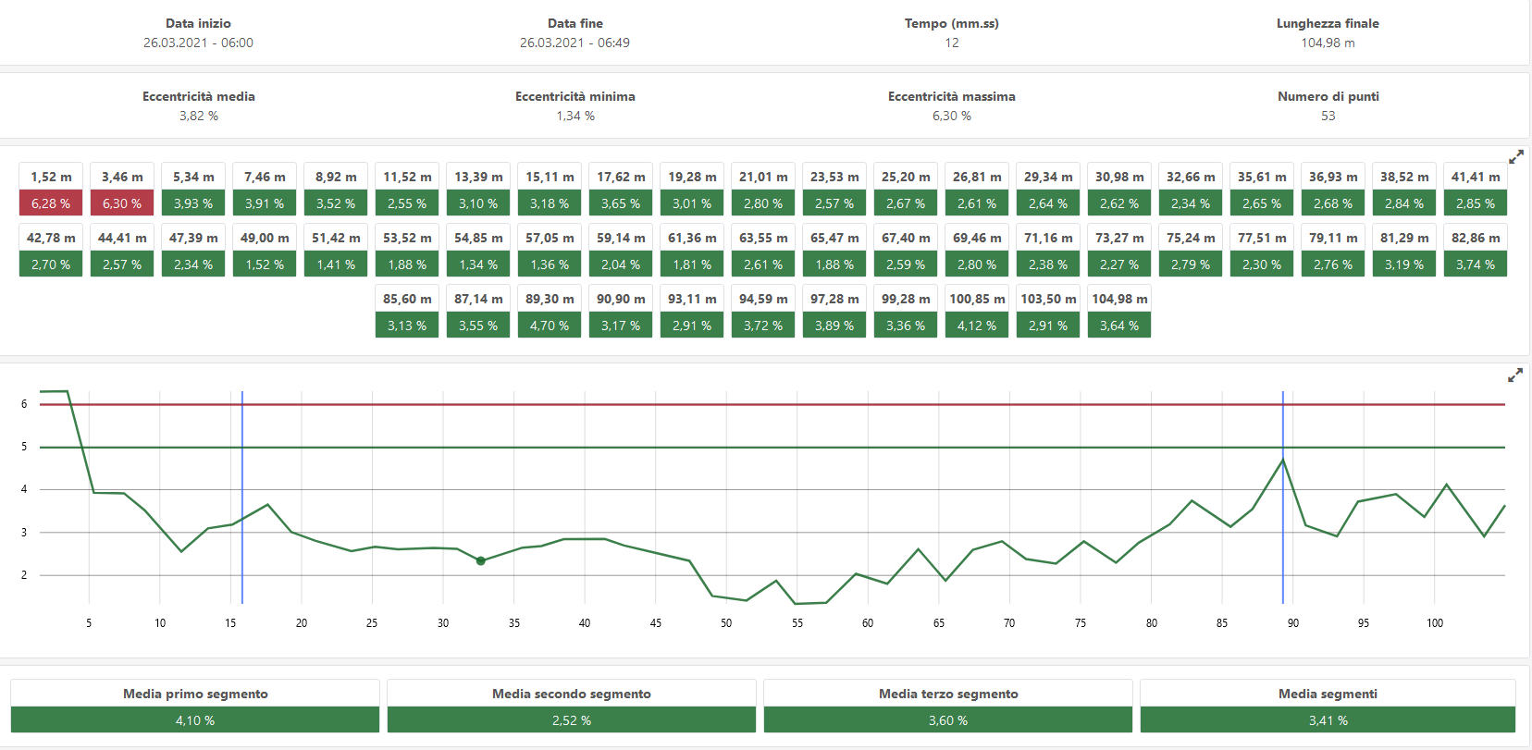
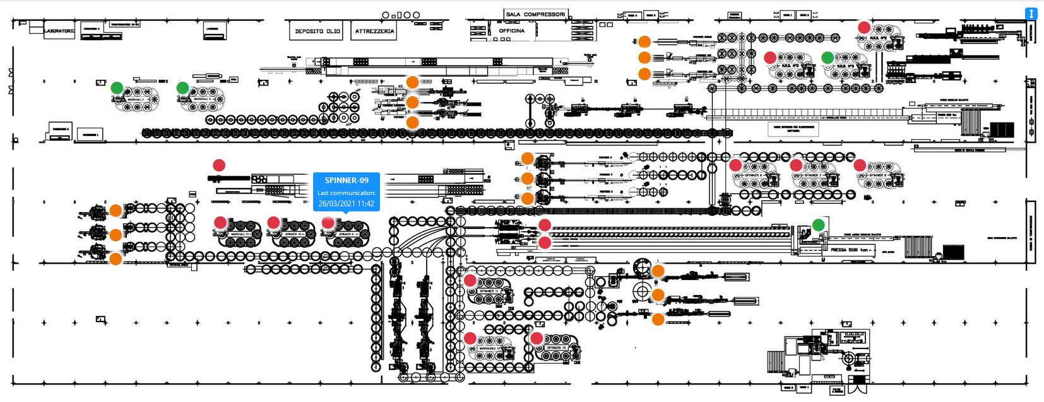
Monitorare i Processi Produttivi

Slide 7
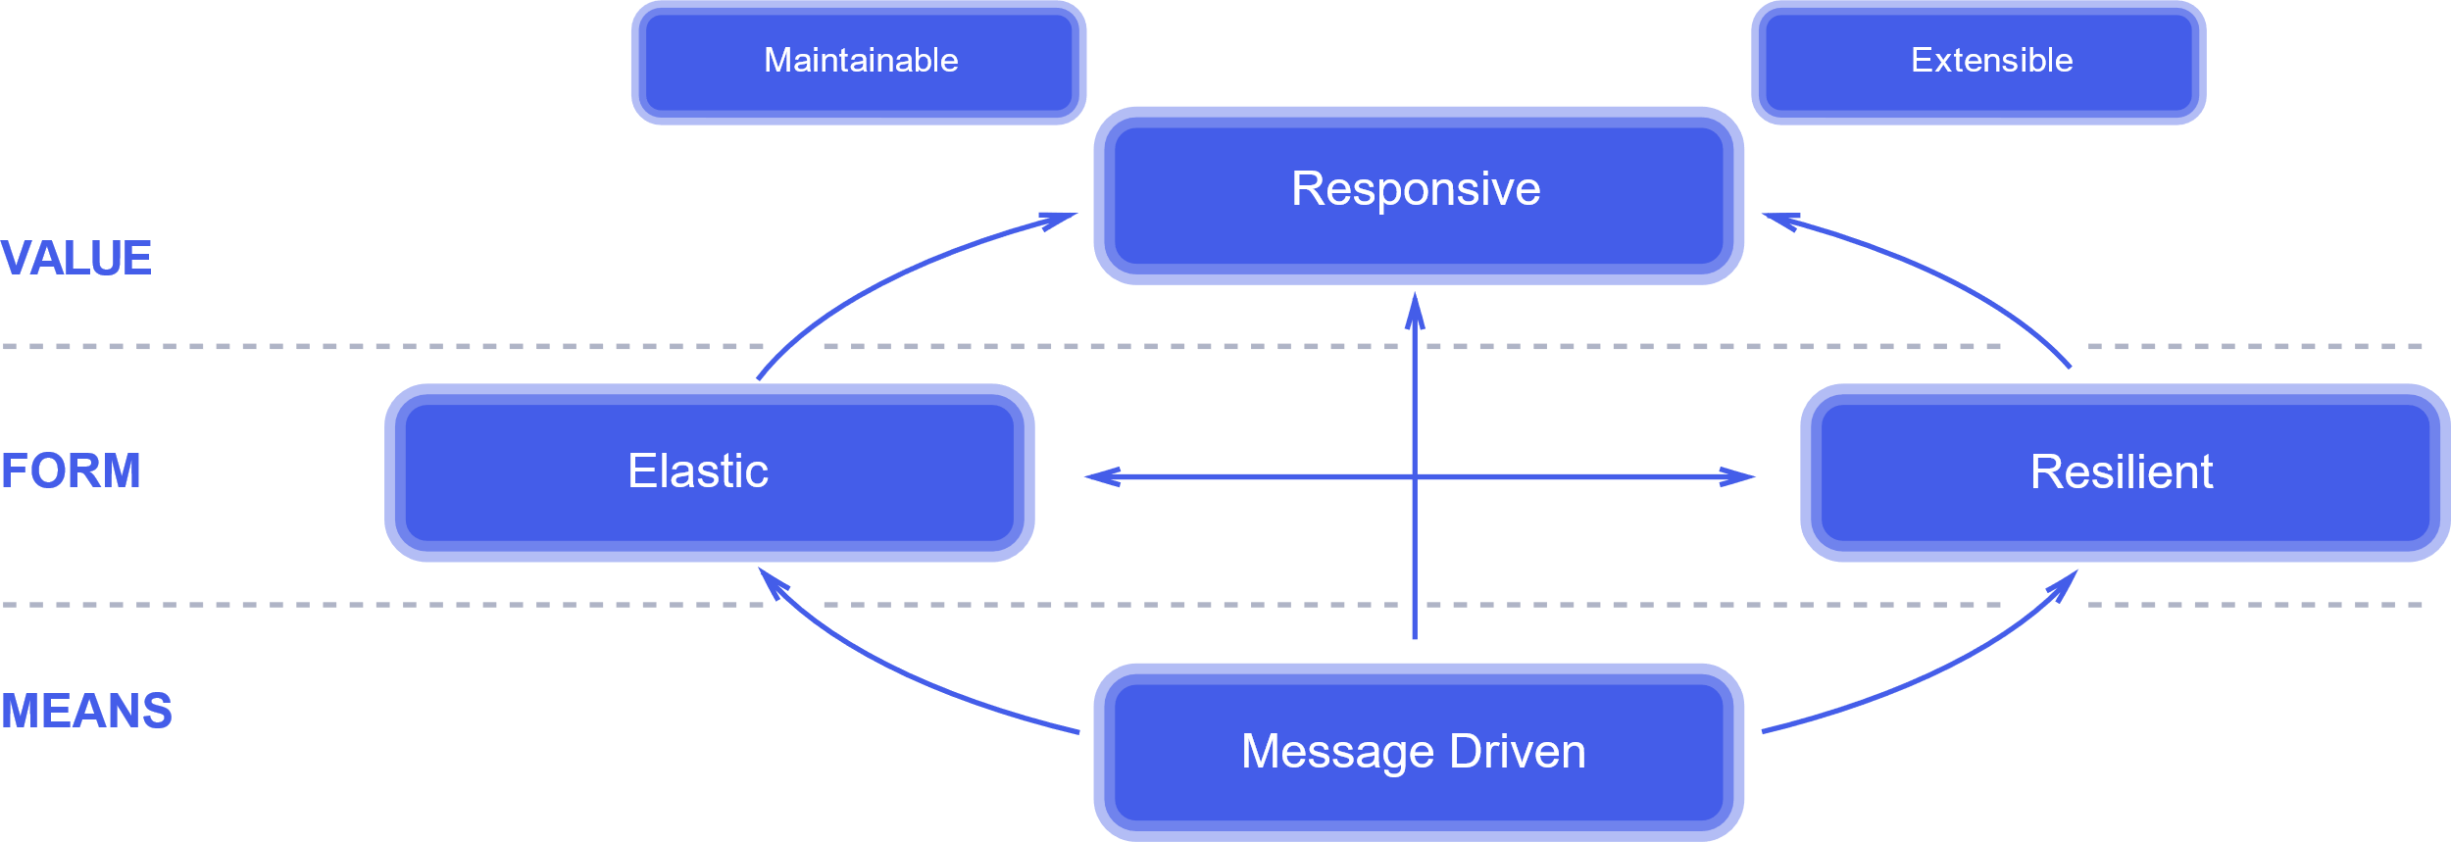
Reactive Is
Reactive Manifest
- September 16 2014

Slide 8
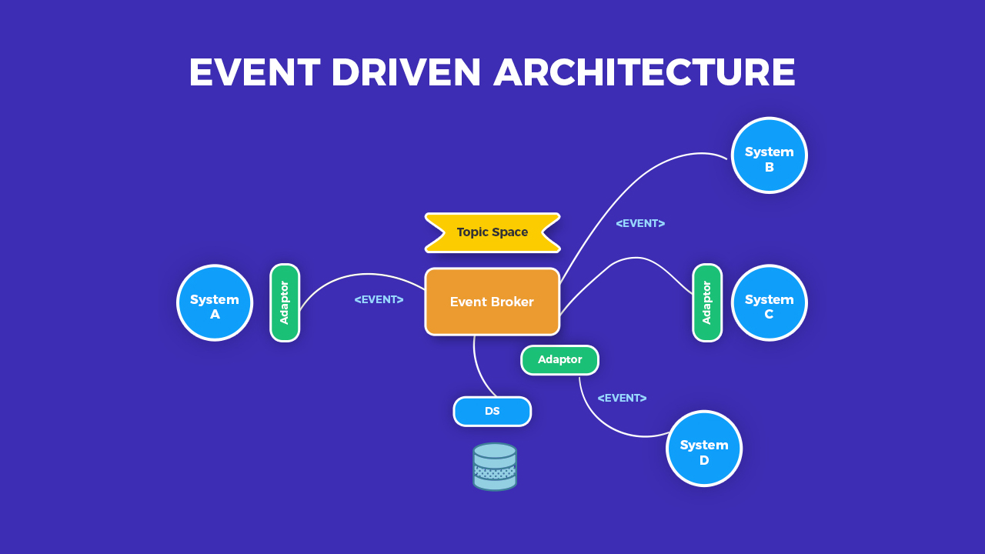
Event Driven Architecture (EDA)
EDA Components
Producer
Routers
Consumer

Slide 9
Microservices: is it really a matter of sizes?
Common Characteristics
Componentisation via services
Organised around business capabilities
Decentralised data management
Products not projects
Decentralised governance
Smart endpoints and dumb pipes
Evolutionary design
Infrastructure automation
Designed for failure
We cannot say there is a formal definition of the microservices architectural style, but we can attempt to describe what we see as common characteristics for architectures that fit the label.
(Martin Fowler, James Lewis)

Slide 10
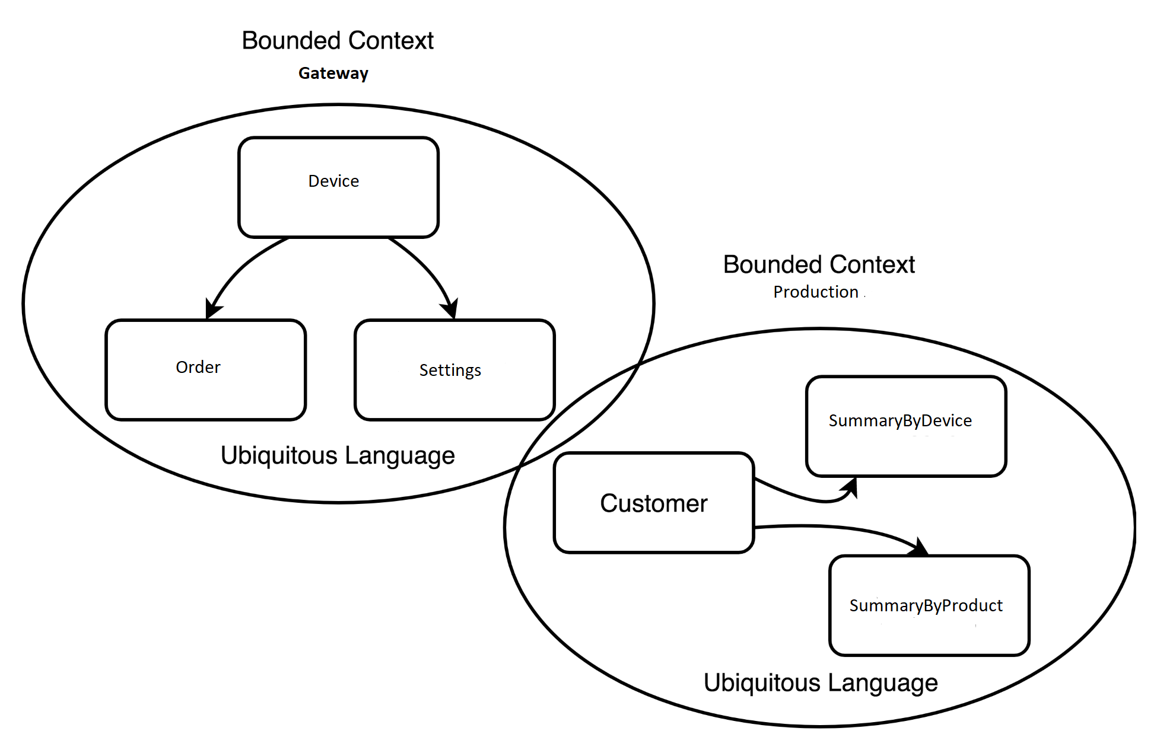
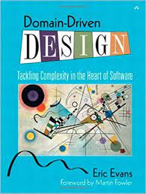
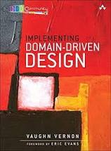
Bounded Context
A Bounded Context is not arbitrary in size
A Bounded Context is the size of its Ubiquitous Language codifled in a domain model, and with supporting components for UI and/or REST endpoints, database access, and possibly a messaging mechanism.
(Vaughn Vernon)

Slide 11
Context Map
Device Gateway
API / Custom
Variables Converter
API / Core

Slide 12


Question Time

Slide 13
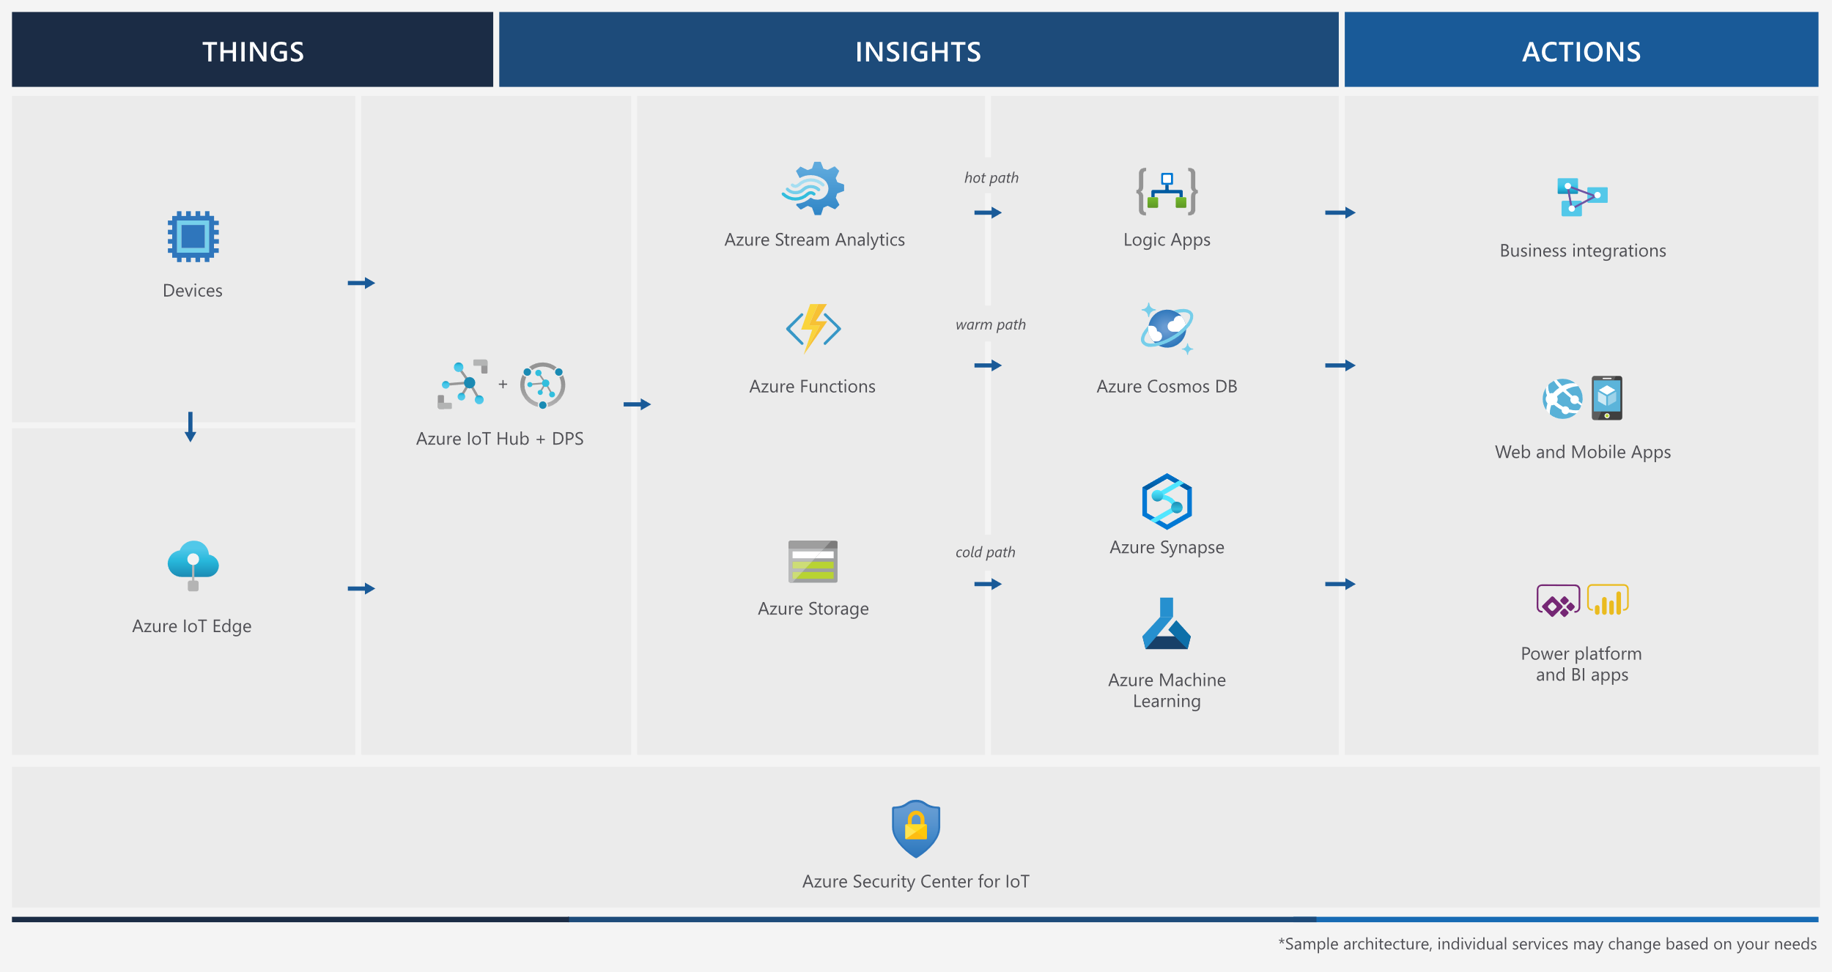
Azure IoT reference architecture

Slide 14
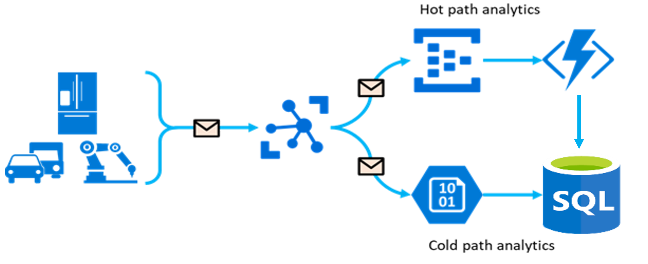
IoT Hub
Cloud Service fully managed
OTA Over-the-Air updates
Full integration with Azure Event Grid
Bidirectional Communication with bilions of IoT devices

Slide 15
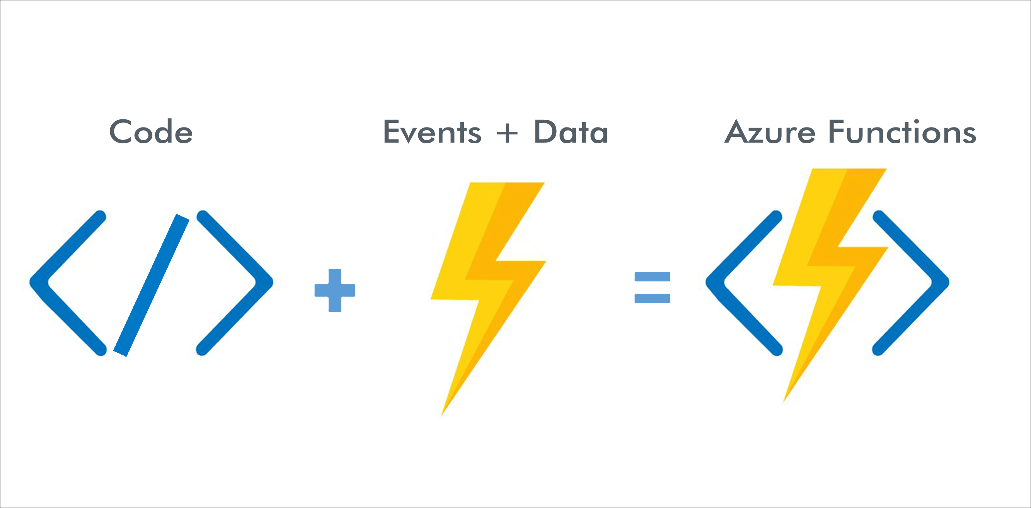
Azure Function
Event-driven serverless compute platform
Scalable
Orchestration

Slide 16
DEMO

Slide 17
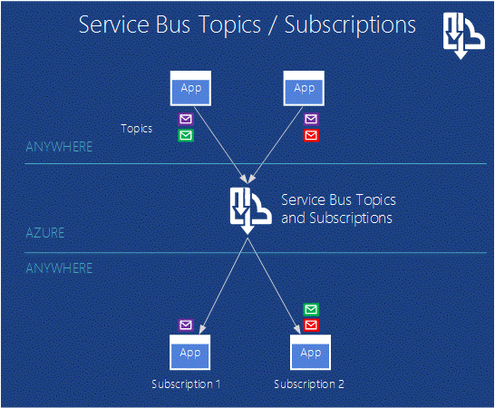
Service Bus
Enterprise Cloud Messaging Service
Like a physical postal service
JSON, XML, Text

Slide 18
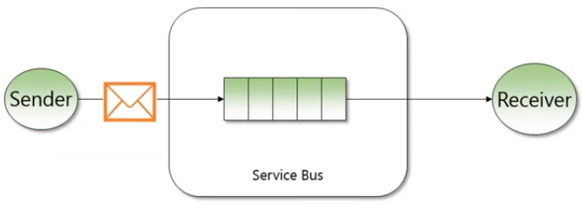
Service Bus - Queues
Queue => Sender / Receiver
FIFO (First-In-First-Out) (Enable Sessions)
Persistence
Commands

Slide 19
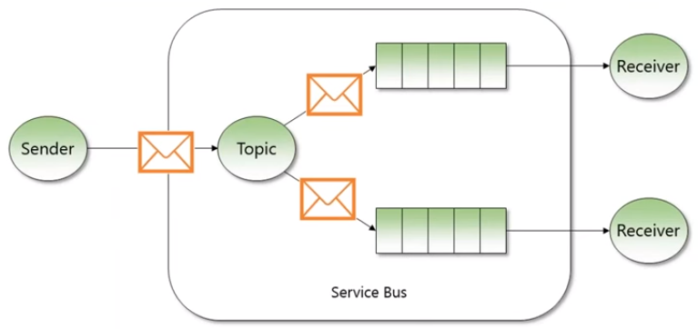
Service Bus - Topics
Topic => Pub / Sub
Events

Slide 20
DEMO

Slide 21
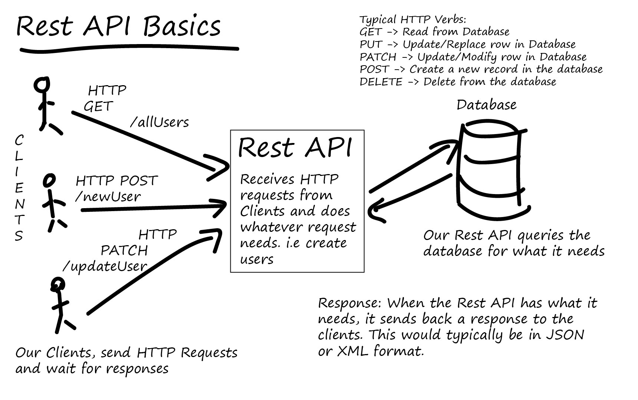
API REST
REST: a set of architectural principles
Is not a protocol or a standard

Slide 22
DEMO

Slide 23
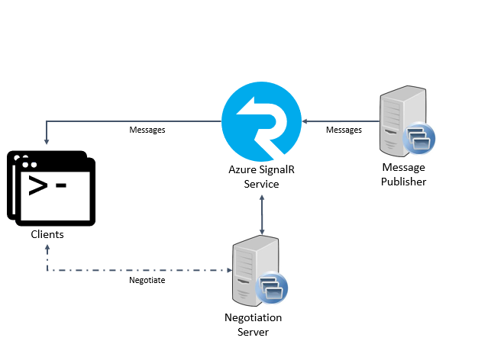
SignalR
Simplify one-to-many real-time communication
Is not a protocol ora a standard
It’s stateless

Slide 24
DEMO

Slide 25
Question Time

Slide 26
Device Simulator
Azure Function (Events-Consumer)
API

Slide 27
Who I am
@aacerbis
https://github.com/Ace68
Alberto @4Solid
Alberto Acerbis | LinkedIn

Slide 28
Thanks for collaboration

Slide 29
Ace
@aacerbis
Alberto Acerbis

