Slide 1
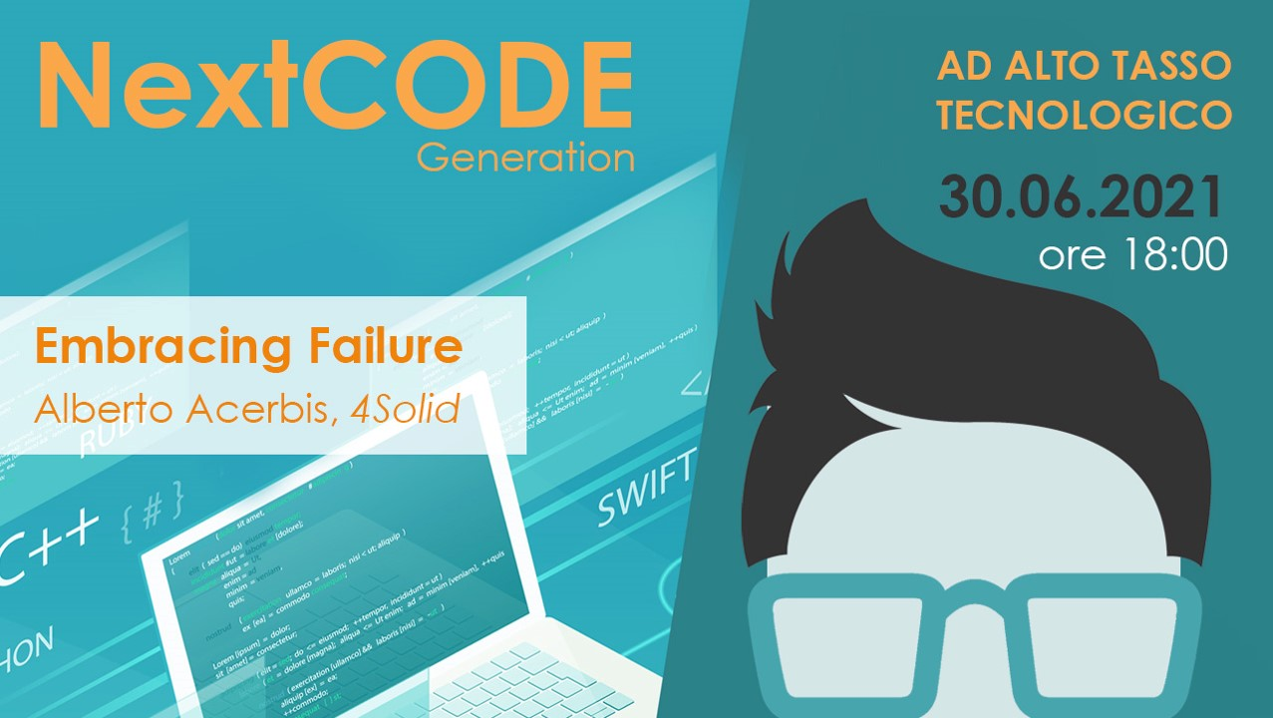

Slide 2

Chaos Engineering
Organizations that are ignoring Chaos Engineering are leaving money on the table.

Slide 3
«Failures are given, and everything will eventually fail over time» (Werner Vogels – CTO Amazon)

Slide 4
Eight Fallacies of Distributed Computing
The network is reliable
Latency is zero
Bandwith is infinite
The network is secure
Topology doesn’t exist
There is one administrator
Transport cost is zero
The network is homogeneous

Slide 5
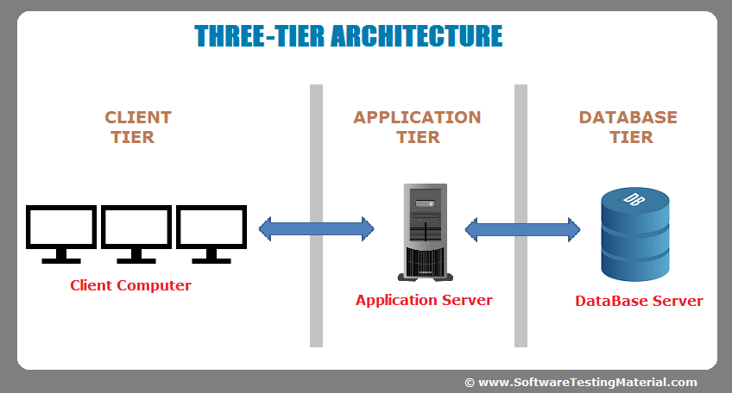
From On-Premises …
Before the Cloud, users were connected to our application through the Company’s local network
A server’s downtime was planned and involved stopping production
Monolithic

Slide 6

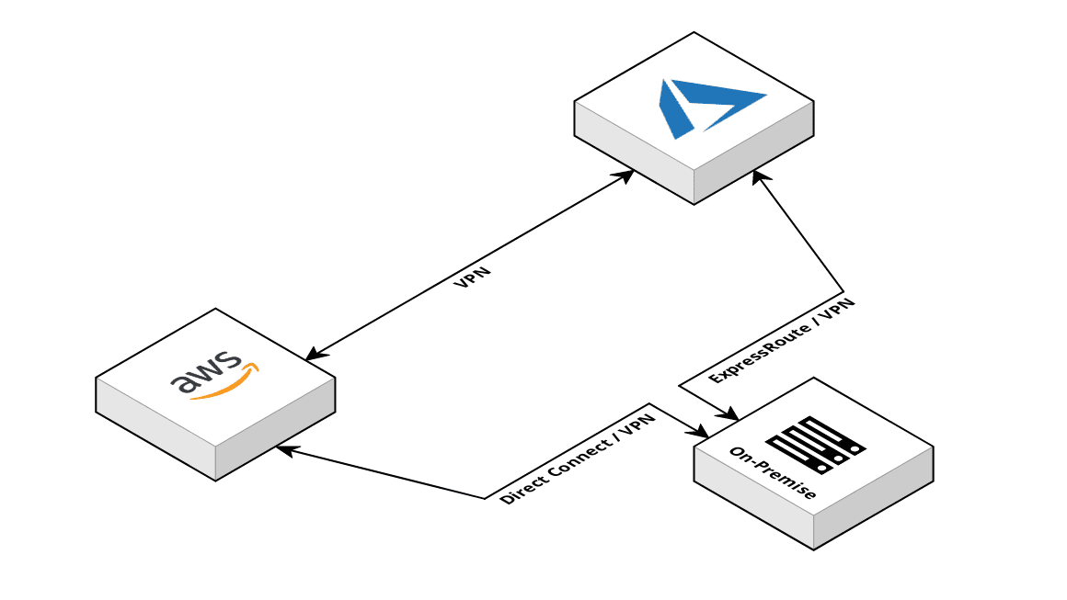
… To Cloud
Now our users are connected through the Internet
The workload to which our services are subjected will increase significantly, thanks to the greater spread of the applications themselves
Many Microservices replace one Monolithic

Slide 7
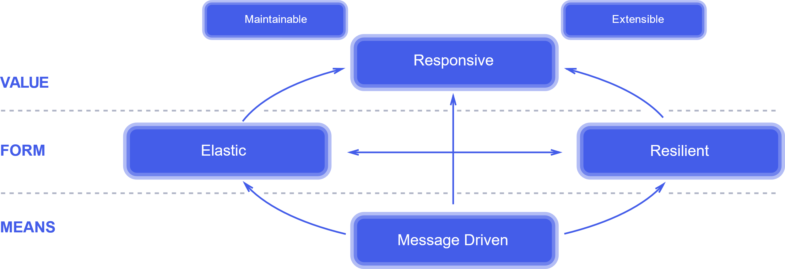
Reactive Manifesto
Jones Boner, Dave Farley, Roland Kuhn, Martin Thompson – 16.01.2014
The absolute, most important thing is it to be responsive. This means that a reactive system needs to remain responsive event when a failure occurs.

Slide 8
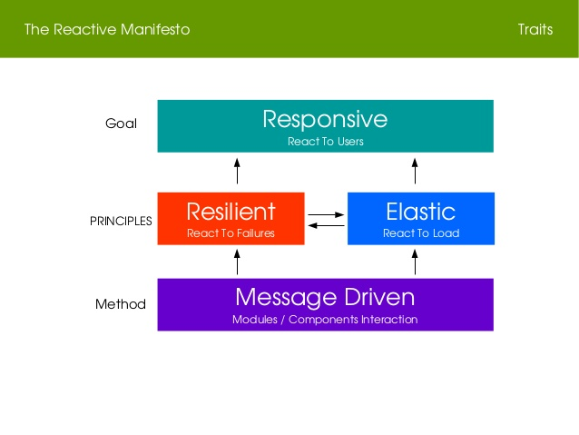
Responsive
The system responds in a timely manner if at all possibile. Responsiveness is the cornerstone of usability and utility, but more than that, responsiveness means that problems may be detected quickly and dealt with effectively.
https://www.reactivemanifesto.org/it

Slide 9
Microservices … What?
Common Characteristics
Componentisation via services
Organised around business capabilities
Decentralised data management
Products not projects
Decentralised governance
Smart endpoints and dumb pipes
Evolutionary design
Infrastructure automation
Designed for failure
We cannot say there is a formal definition of the microservices architectural style, but we can attempt to describe what we see as common characteristics for architectures that fit the label.
(Martin Fowler, James Lewis)

Slide 10

Chaos Engineering
Chaos Engineering is the discipline of experimenting on a system in order to build confidence in the system’s capability to whitstand turbolent conditions in production
https://principlesofchaos.org
Instead of trying to avoid failure, chaos engineering embraces it
Provide evidence of system weaknesses through scientific chaos engineering experiments
Which kind of weaknesses? Dark Debt

Slide 11
History time
1564-1642 | Galileo Galilei – Il metodo scientifico
2000 | Jesse Robbins – Master of Disaster
2010 | Netflix - Chaos Monkey
2011 | Simian Army
2012 | Netflix – Chaos Monky open source
2014 | Netflix – Chaos Engineer

Slide 12
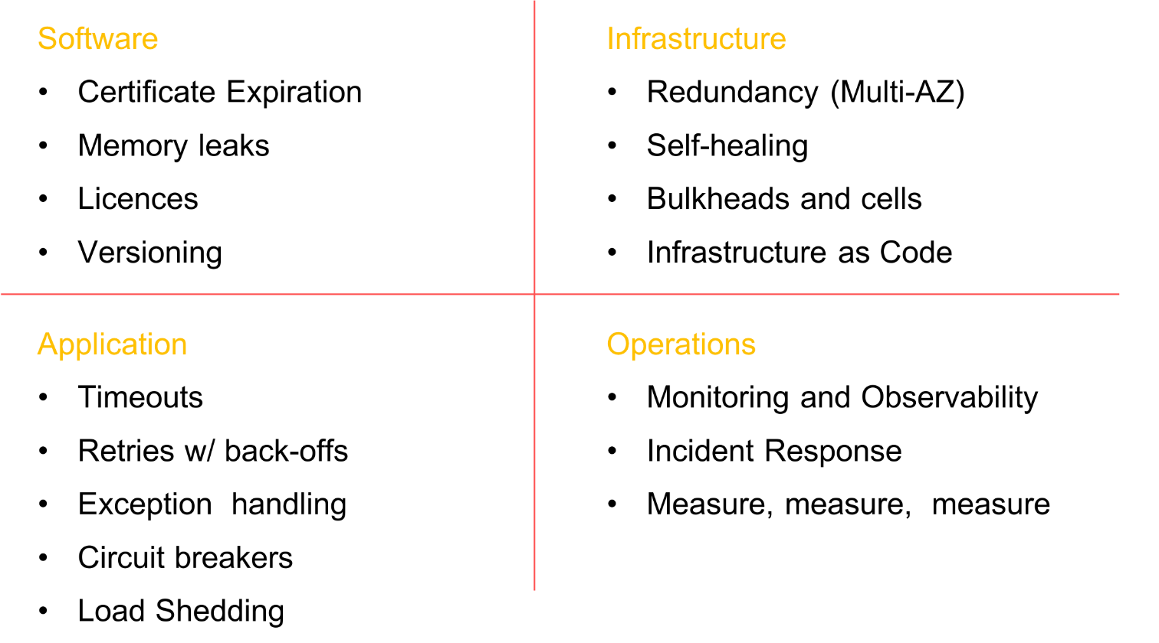
Sociotechnical System
Before starting your journey into chaos engineering, make sure you’ve done your homework and have built resiliency into every level of your organization. Building relient systems isn’t all about software. It starts at the infrastructure layer, progress to the network and data, influences application design and extends to people and culture.
Adrian Hornsby

Slide 13

Dark Debt
Dark Debt is not recognizable at the time of creation.
Dark Debt arises from the unforeseen interactions of hardware or software with other parts of the framework.
Dark Debt is invisible until an anomaly reveals its presence.
Platform
Applications
People, practices, and processes

Slide 14
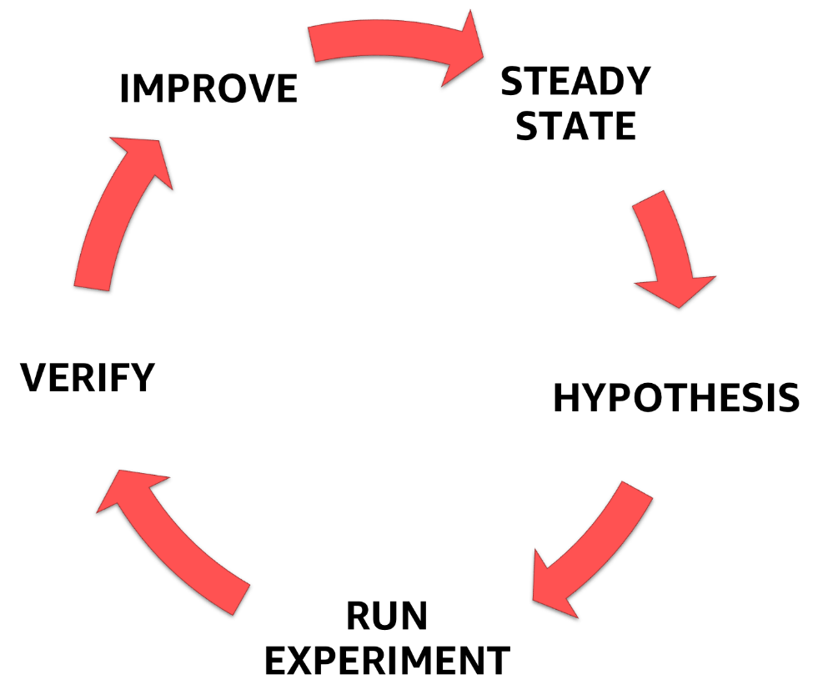
The Phases of Chaos Engineering
It’s important to understand that cahos engineering is NOT about letting monkeys loose or allowing them to break things randomly without a purpose. Chaos engineering is about breaking things in a controlled environment, through well-planned experiments in order to build confidence in your application to withstand turbulent conditions.

Slide 15
Start with Experiments
Get your team together and come up with a picture of your system (including people, practices, processes)
Make the right questions:
Where would it be most valuable to create an experiment that helps us build trust and confidence in our system under turbolent conditions?
What could possibly go wrong?
Chaos Engineering doesn’t guarantee you have the perfect system
Chaos Engineering never ends
Likelihood and Impact

Slide 16
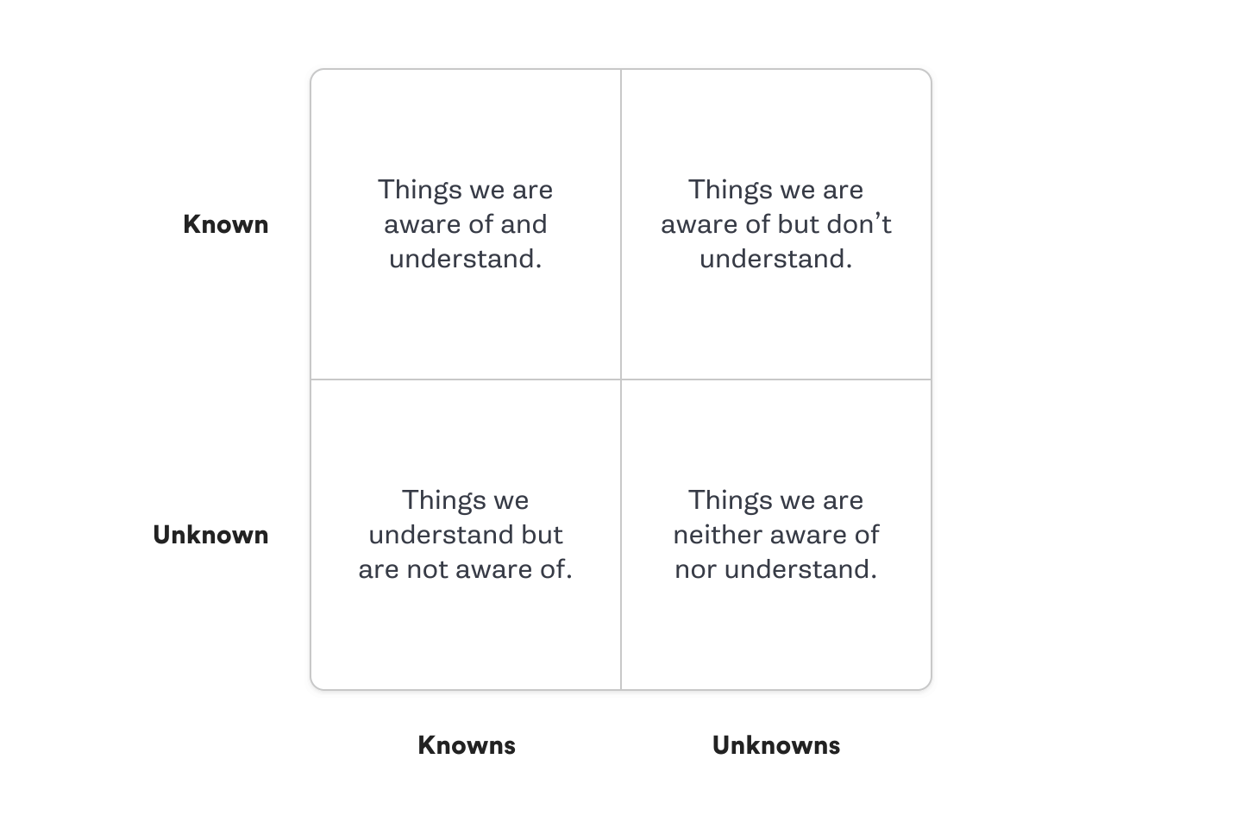
Which First?

Slide 17
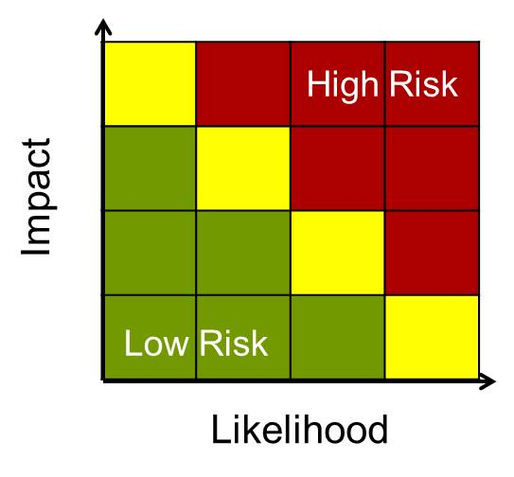
Likelihood-Impact Map
The likelihood that a failure may occur
The potential impact your system will experience if it does
API becomes unavailable
Contribution
Availability

Slide 18

Game Day
The goal of a Game Day is to practice how you, your team, and your supporting system deal with real-world turbolent conditions.
How well your alerting systems perform
How your team members react to an incident
Whether you have any indication that your system is healthy or not
How your technical system responds to the turbolent conditions
Pick a hypothesis to explore
Pick a style
Decide who partecipates in your Game Day and who observes
Decide where your Game Day is going to happen
Decide when your Game Day is going to start, and how long it will last
Decide your Game Day experiment
Get approval!

Slide 19
Experiment.json
{
"title": "What are you looking for?",
"description": "How works our system, and what could be a weakness of his?",
"tags": [
"tutorial",
"filesystem"
],
"steady-state-hypothesis": {
"title": "The exchange file must exist",
"probes": [
{
"type": "probe",
"name": "service-is-unavailable",
"tolerance": [200, 503],
"provider": {
"type": "http",
"url": "http://localhost:8080/"
}
}
]
},
"method": [
{
"name": "move-exchange-file",
"type": "action",
"provider": {
"type": "python",
"module": "os",
"func": "rename",
"arguments": {
"src": "./exchange.dat",
"dst": "./exchange.dat.old"
}
}
}
]
}

Slide 20
Steady-state-hyphothesis
"steady-state-hypothesis": {
"title": "The exchange file must exist",
"probes": [
{
"type": "probe",
"name": "service-is-unavailable",
"tolerance": [200, 503],
"provider": {
"type": "http",
"url": "http://localhost:8080/"
}
}
]
},

Slide 21
Method
"method": [
{
"name": "move-exchange-file",
"type": "action",
"provider": {
"type": "python",
"module": "os",
"func": "rename",
"arguments": {
"src": "./exchange.dat",
"dst": "./exchange.dat.old"
}
}
}
]

Slide 22
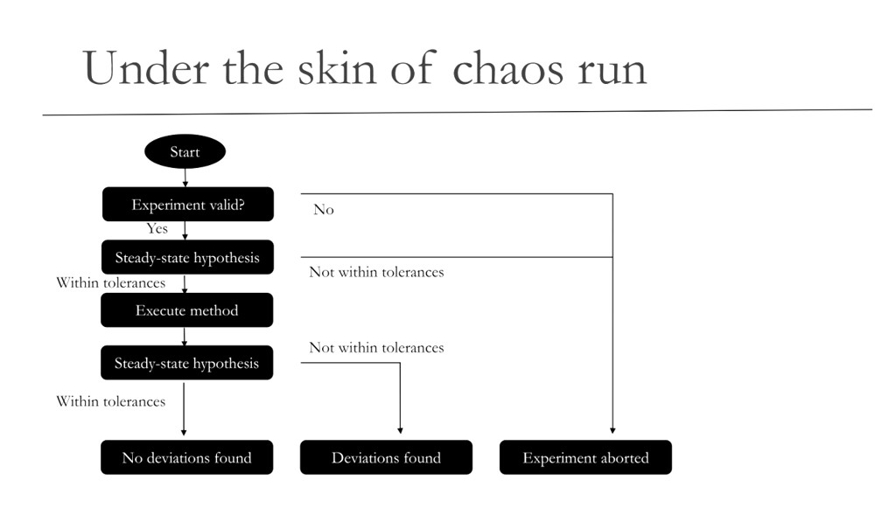

Slide 23
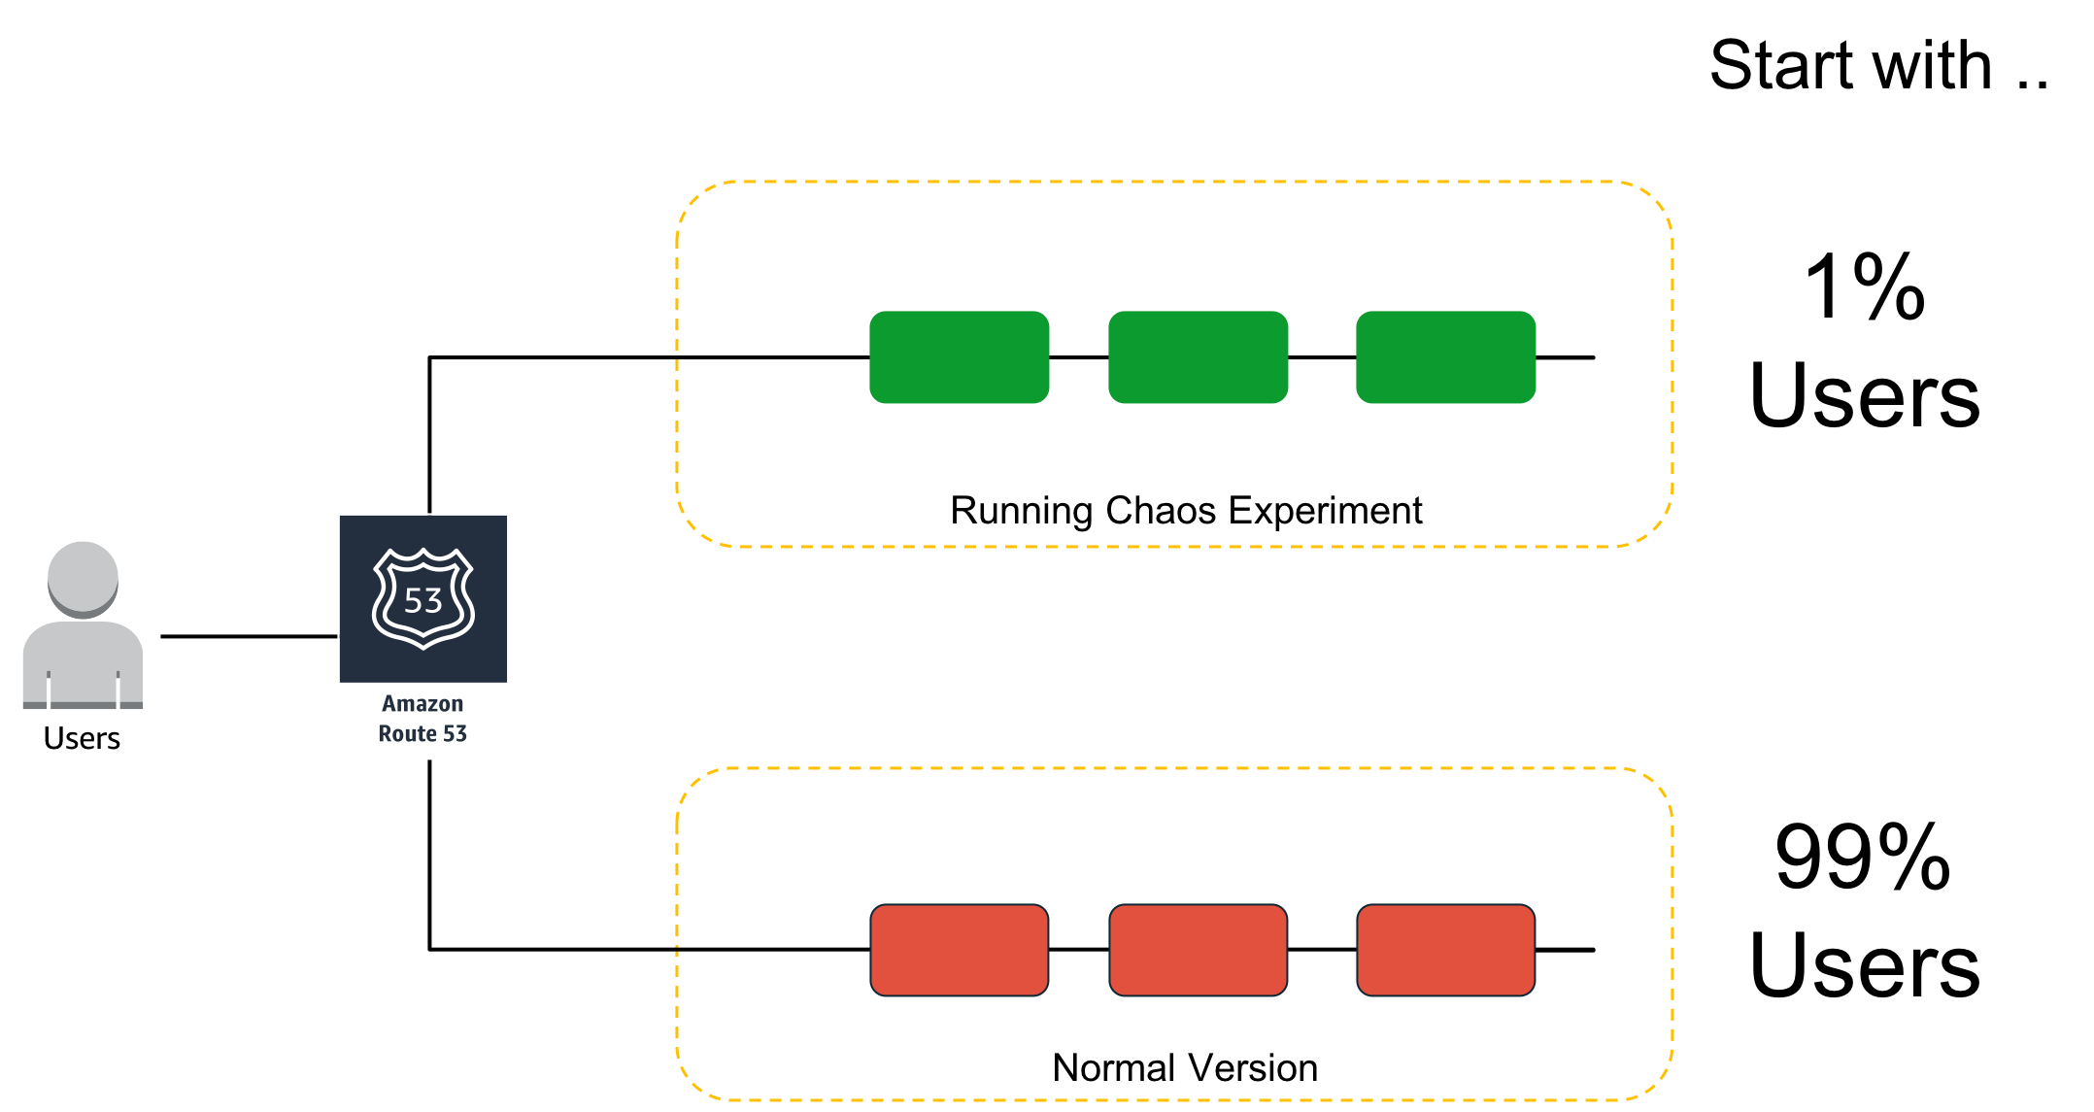
Canary Deployment
Start small and slowly build confidence within your team and your organization.
How many customers are affected?
What functionality is impaired?
Which locations are imapcted?

Slide 24

Benefits of Chaos Engineering
Customer: the increased availability and durability of service means no outages disrupt their day-to-day lives.
Business: Chaos Engineering can help prevent extremely large losses in revenue and maintenance costs, create happier and more engaged engineers, improve in on-call training for engineering teams
Technical: the insights from chaos experiments can mean a reduction in incidents, reduction in on-call burden, increased understanding of system failure modes, improved system design

Slide 25
Link Utili
How much does 1 hour of downtime cost the average business?
Principles of Chaos Engineering
Chaos Monkey source code
ChaosToolkit
Mokabyte

Slide 26
But behind all the beauty lies madness and chaos
Tanner Walling

Slide 27







Thank you
@aacerbis
https://github.com/Ace68
Alberto Acerbis | LinkedIn
Alberto @4Solid

