Slide 1

DDD in salsa Cloud
Minimal API & Blazor mixed by Azure ServiceBus
Sabato 24 settembre 2022
Alberto Acerbis

Slide 2



Grazie ai nostri sponsor

Slide 3
Perchè DDD?
La tecnologia è destinata a diventare, inevitabilmente, obsoleta!
La comprensione del Dominio diventa il punto centrale nello sviluppo software
I Domain Expert sono la nostra risorsa principale
Non parlano il nostro linguaggio
Ci serve un Linguaggio Comune
NON si parte dal database!

Slide 4
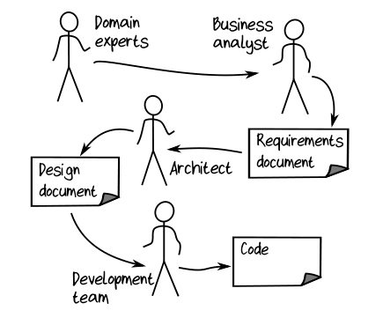
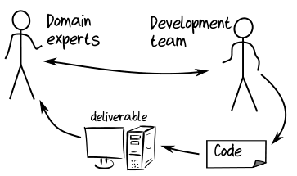
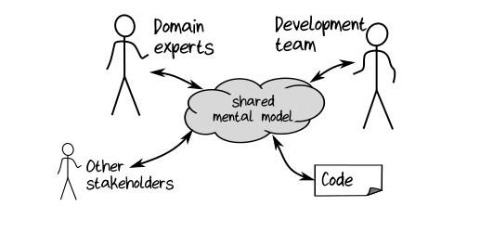
Shared Model
Scott Wlaschin: Domain Modelling made Functional

Slide 5
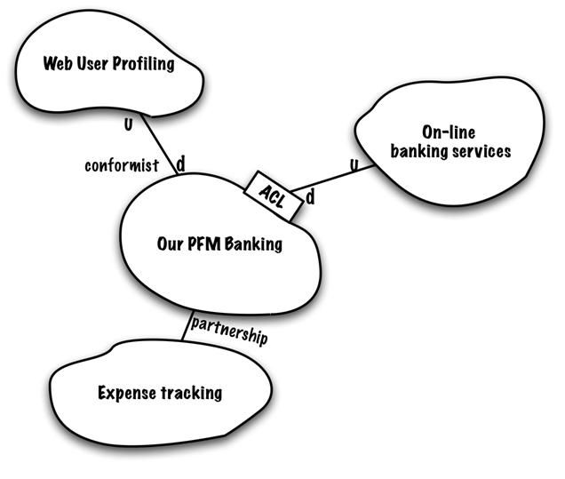
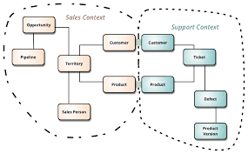
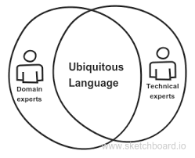
Cosa Propone DDD?
Context Mapping
Bounded Context
Ubiquitous Language
https://www.infoq.com/articles/ddd-contextmapping/
https://martinfowler.com/bliki/BoundedContext.html
https://blog.carbonfive.com/ubiquitous-language-the-joy-of-naming/

Slide 6
Come Risolve il Problema DDD?
Feature | Bounded Context | Microservices | Microfrontends
Organized around Business Capabilities | It is implicitly understood in the very concept of Ubiquitous Language, which is the main pattern for identifying a Bounded Context | Cross-Functional Teams specific to a business functionality | Each SCS is owned by One Team
Decentralized Governance | A shared model for each purpose | Local choices, which must be independent, are favored/encouraged. | Autonomous WebApp
Decentralized Data Management | Private persistence is critical for language consistency, but especially necessary for the safe and independent evolution of the model | Each microservice must persist its data in a private database! Otherwise, it will be unable to evolve independently from others | Each SCS has its own API Include Data and Logic
Evolutionary Design | Each model can, and must, evolve independent of the others | Key feature | No Shared UI No Shared Business Code Shared infrastructure can be minimized
Smart endpoints and dumb pipes | Recommended as a strategic model | Key feature. SOA docet! | Asynchronous Communication
Language Consistency | Ubiquitous Language | Key feature | Private Logica and Data

Slide 7
Minimal API & Microservices
No supporto nativo per content negotiation. Solo JSON
No supporto nativo per il versioning
No supporto nativo per la validazione
Ma noi abbiamo FluentValidation
No forzature sulla struttura del progetto
E questo ci piace molto!

Slide 8


Talk is Cheap … Show me the code

Slide 9
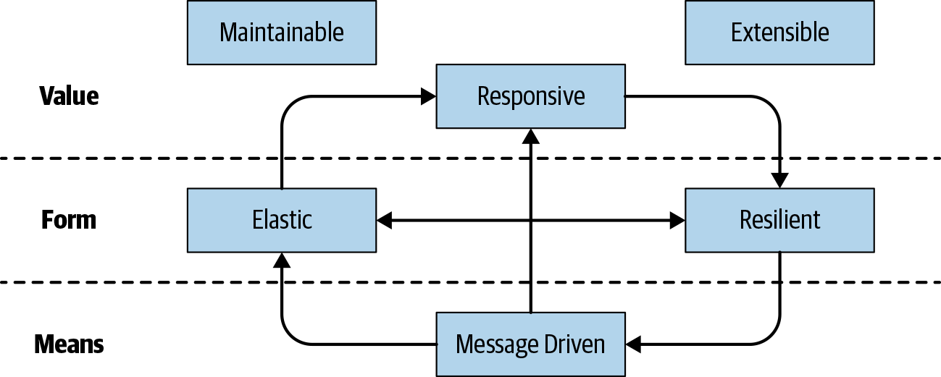
Reactive Manifesto
Jones Boner, Dave Farley, Roland Kuhn, Martin Thompson – 16.01.2014
The absolute, most important thing is it to be responsive. This means that a reactive system needs to remain responsive event when a failure occurs.

Slide 10
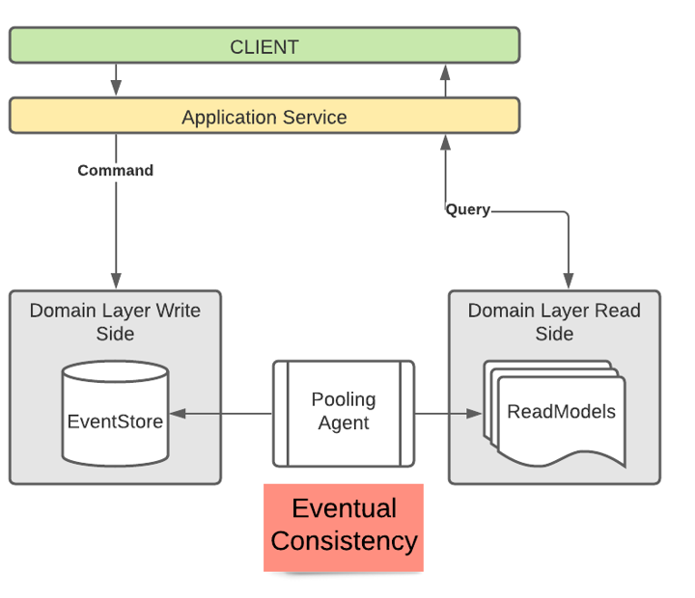
Eventual Consistency

Slide 11
Talk is Cheap … Show me the code

Slide 12

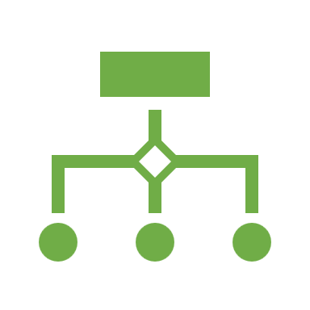
Microfrontend
ThoughtWorks Technology Radar 2016
Self-Contained Systems
- Autonomous Web Application
- Each SCS is owned by One Team
- Asynchronous Communication
- Each SCS has its own API
- Each SCS include Data and Logic
- No Shared UI
- No Shared Business Code
- Shared Infrastructure can be minimized

Slide 13
Cosa sono i Microfrontend?
Microfrontends are the technical representation of a business subdomain, they allow independent implementations with the same, or different, technology choices.
Finally they should avoid sharing logic with other subdomains and they are own by a sigle team.

Slide 14
Microfrontend in Pratica
Micro-apps with a shared session and parameters
Routing
Blazor as a component in an existing project
Shared components or a Razor class library

Slide 15
Talk is Cheap … Show me the code

Slide 16
Grazie ai nostri sponsor

Slide 17

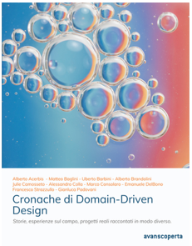





Thanks!
alberto.acerbis@intre.it
https://github.com/brewup
https://github.com/cqrs-muflone

