Slide 1
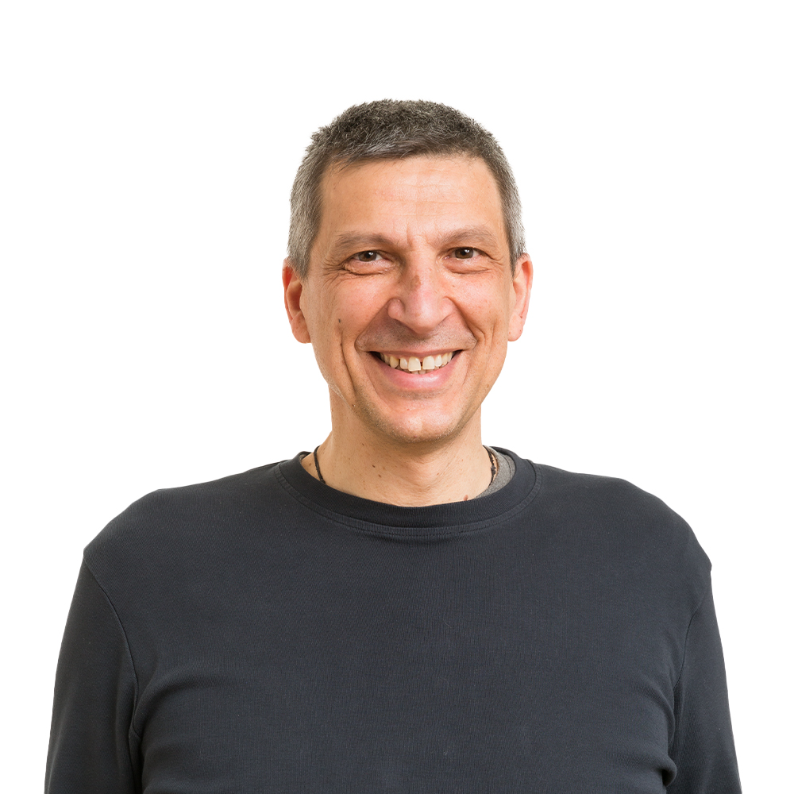




Alberto Acerbis
alberto.acerbis@intre.it
@aacerbis
LinkedIn
https://github.com/ace68
https://github.com/brewup
https://github.com/cqrs-muflone

