Slide 1
Gilda i3D
Let’s Learn Domain-Driven Design

Slide 2
The Holy Books

Slide 3
Why DDD
Technology is bound to become inevitably obsolete!
Understanding the Domain becomes the central point in software development
The Domain Experts are our primary resource
They don’t speak our language
We need an Ubiquitous Language

Slide 4
Understanding well to implement better
Domain Understanding
Ubiquitous Language
Bounded Context
Strategy
Context Mapping
Tactics
Entity
Value Object
Aggregate

Slide 5
Definitions
Domain
Represents the sphere of knowledge retaled to the area for which we are developing the application.
There are more domains in an application
Model
An abstraction describing selected aspects of a Domain, which is used to solve problems related to that Domain.

Slide 6
Definitions
Ubiquitous Language
A language structured around the domain model and used by all Team member to prepare documentation, write code, request information in the corridors. If this language changes, the whole chain must update itself.
Context
The context in which a word, or statment, appears determines its meaning. These kinds of statments make sense only in that particular context.

Slide 7
Definitions
Bounded Context
The description of a boundary (typically a system part managed by a Team) within an Ubiquitous Language is in force and is defined by a precise dedicated Model.
Context Mapping
The way each individual Bounded Context relates to the others. There are different patterns of relationship, to the applied as needed. The pattern of communication defined between two Bounded Context may change over time.

Slide 8
Strategic Distillation
It is essential to categorize portions of our domain based on their relevance to business.
DDD defines three main categories of domain, precisely based on their relevance to business.

Slide 9
Strategic Distillation
Generic Subdomain
This portion of the domain is not specific to our business, altough it is necessary. We can think of sotware for billing, or for general reporting. Often we do not write such code

Slide 10
Strategic Distillation
Supporting Subdomain
While not the focus of our business, this portion of the domain is specific enough to merit ad hoc development. It will not be what sets us apart in the marketplace, so it will be critical to keep development costs under control.

Slide 11
Strategic Distillation
Core Subdomain
It is the portion of the domain that allows us to have a competitive advantage over the competition. The one that allows us to do what others, the competition, is not doing.If we are clear what the differentiating factor is for the domain we are addressing, this is the point, in our software, where we invest time and resources because they will have a positive impact on the business.

Slide 12
Strategic Distillation
What is not
The strategic component of software components is something that is not immutable, but changes over time. What is strategic today, for the market we are working on, could become the practice in a few years, forcing us to change strategy.The difference between a core component and a support component, is that the first one must not break down, or stop, if we want to be competitive. The second, is yes important, but if it fails, or stops, we just need to fix it. It is critical, but not fundamentalTranslated with www.DeepL.com/Translator (free version)

Slide 13
Developmental Classification
We have to classify the parts of our domain clearly because developing software in the core domain is a totally different job than developing in the supporting area.
In the Core Domain we think in experiments, we accept the possibility of rewriting the solution several times, of following a trajectory that is not exactly clear, because that is the right strategy to follow, not because we want to be cool!
This is why it is important to adopt agile methodologies that allow us to change course in peace. (Testing, SOLID principles, etc.)

Slide 14
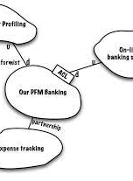
Context Mapping
It is the tool that allows us to govern complexity by visualizing the presence and ways of collaboration between different models within the domain.
It is a combination of graphical language to draw maps and some typical principles of inquiry to ask the right questions

Slide 15
Context Mapping: Brownfield
It is a map of the "as is" scenario. A brownfield model doesn't have to be perfect, but honest enough to let us know as soon as possible what doesn't add up. We can follow some simple guidelines to get it
Are the boundaries accurate? Then they are Bounded Contexts; otherwise Big Balls of Mud
We highlight the relationships between the models
Which model is upstream (dominant) and which is downstream
What patterns do we use to describe relationships?
We highlight risk conditions on the map

Slide 16
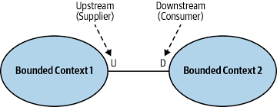
Upstream e Downstream
Upstream and Downstream allow us to visualize on the map the power relations between contexts.
They make the politics within project artifacts visible. It is not a technical issue between who is Client and who is Server, but rather key information about who is in charge and who is suffering!

Slide 17
Context Mapping: Pattern
Partnership. Two Bounded Contexts Evolving in Harmony. It occurs mainly in the early stages of development
Customer-Supplier. The asymmetrical relationship of collaboration is more pronounced, more time for sharing and planning is needed
Conformist. We adapt to an existing model for our purpose. We are strongly downstream
Shared Kernel. It is a small shared model. The risk here is in changing this model, because it will affect the whole system. Let us not exaggerate with the size of the Shared Kernel

Slide 18
Context Mapping: Pattern
Open Host. As a team, we have to make our model accessible via APIs, or similar mechanisms. We are upstream, but we must devote time and resources to documentation and backward compatibility
Published Language. Whenever two models interact, they need a common model, that of communication. We can adopt an existing one, or make our own public
Anti-Corruption Layer. In the case where we are downstream, but we want to protect our model from being modified
Separate Ways. In the case where we are downstream, but we want to protect our model from being modified

Slide 19
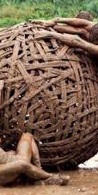
Big Ball of Mud
If we do not protect the boundary of our model, if we do not ensure conceptual integrity, if we have to cross our fingers every time we release a change, if we have accidental complexity that forces us to invest months in onboarding ... then, without a shadow of a doubt, we are in a Big Ball of Mud.
No one deliberately draws a Big Ball of Mud, but if we do not exploit Context Mapping patterns to strictly categorise each contest as it is, it is very likely that sooner or later we will find ourselves in this situation.

Slide 20
Context Mapping: Goal
Context Mapping forces us to define the relationships between Teams, to govern the relationships that are there, or that are to come. It is not uncommon to be told 'we did not deliver on time because we lacked the other team's API' (Read Team Topologies on this).
The added value of Context Mapping is not the bubbles that define contexts, but the lines we draw to define relationships.
Ultimately Context Mapping allows us to bridge the gap between architecture and corporate policies

Slide 21
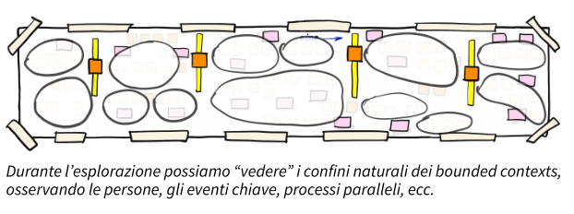
Context Mapping: Greenfield
When we have the privilege of starting from scratch, we can use Context Mapping to draw the natural boundaries of our domain
In this context, people, the analysis of the progress stages of a process that crosses several departments, are the indicators that most show us the map of the system
Big Picture EventStorming is a very effective tool for this type of investigation

Slide 22
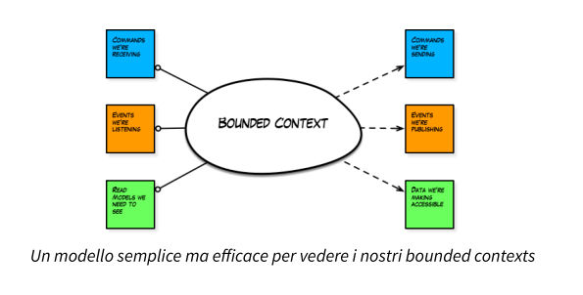
Bounded Context Canvas
When our Bounded Contexts are ready to be implemented in code then they can be seen as components that exchange information with the outside world, which semantically speaking, are Commands, Events, Queries.
At this stage it is very useful to rely on the Bounded Context Canvas (Nick Tune)
Other very interesting insights into Bounded Context vs. Team relations is the book Team Topologies di Matthew Skelton e Manuel Pais

Slide 23
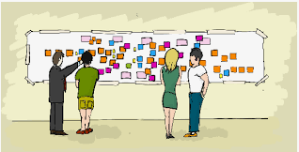
EventStorming
It is a family of workshops with a single purpose "to represent the complexity of key flows in organisations using Events as a tool for exploration".
Events are represented by orange post-it notes, and since they represent something that has already happened, they are written in the past tense.
It is essential to involve all stakeholders in the project, business experts, users, developers.

Slide 24
EventStorming
There are three EventStorming formats
Big Picture. Discovery of complex domains, and possible inconsistencies in the understanding of the problem, or solution
Process Modelling. It allows processes and their dynamics to be modelled in detail by representing the actors, steps and interests involved
Software Design. It is the format oriented towards the design of software to support key processes. With this format, we deepen the exploration begun with Process Modeling by identifying the boundaries between the various contexts, responsibilities and information exchange, always with an eye on the business.

Slide 25
Architetture DDD
Those who delude themselves that they can write code only once, immediately finding the high road, have probably either never developed in complex contexts, or have created large Big Ball of Mud.
The need to rewrite code frequently stems mainly from
Domains too complex to be implemented correctly the first time round (in my case financial and IoT applications)
The Domain is not an immutable element, it is constantly evolving, and the code must adapt to this change
We want to be able to add or remove functionality without fear. Any architecture that allows us to do so is welcome

Slide 26
Architetture: Blue Book
Vaughn Vernon has repeatedly made the point that the first book that speaks openly about DDD architectures is his Implementing Domain-Driven Design (aka Red Book).
In fact, simply for historical reasons, the Blue Book proposes an architectural solution that is, to say the least, obsolete, but the only one truly possible in 2004!
The layer architecture proposed by Eric Evans was absolutely in line with the way of developing software from the database, absolutely relational.
Event-Driven was still to be defined.

Slide 27
Tactical Patterns
This is a collection of patterns suggested by Eric Evans, within the Blue Book, with the aim of helping us in the robust implementation of our domain model.
It should be pointed out that the Blue Book does not mention Domain Events, because the concept had not yet arrived in 2004, just as the whole event-based architectural part is missing, precisely because it was not yet present.

Slide 28
Aggregate
It is a collection of objects whose behaviour is consistent as a whole. The aggregate relies on a group of classes designed to work together, some of which have a well-defined architectural role (EntityRoot, or AggregateRoot) In this context, the patterns of OOP (see Martin Fowler's Refactoring) take on particular significance, where the role of coordinating and guarding invariants (conditions that must always be true) is left to the root, while the data are implemented via Value Objects.

Slide 29
Aggregate Root
If we are to guarantee the consistent state of the aggregate, it is a good idea to grant mutating privileges to a single party. All methods that trigger a transformation of the aggregate - mutators - are managed by the Root
The Root is the union representative of the aggregate. No one has direct access to the internals of the aggregate, and the same goes for the internals, they cannot speak directly with the internals of other aggregates, but must go through the Root
Within the aggregate, responsibilities, in full accordance with OOP, are distributed among the various entities.

Slide 30
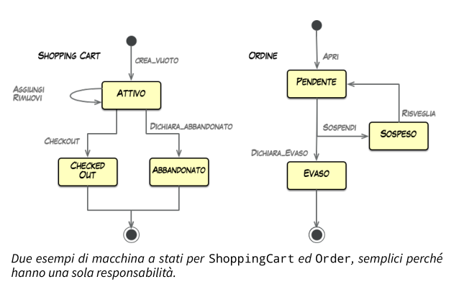
Entity
It is an object with an identity that allows us to trace its evolution. It represents the heart of an aggregate.It is essential that the Entity is well defined, unambiguous, and its behaviour well governed by a state machine
Theory says that an aggregate may contain several entities, one of which is the root. Practice suggests having only one entity per aggregate (i.e. having small, limited-liability aggregates)

Slide 31
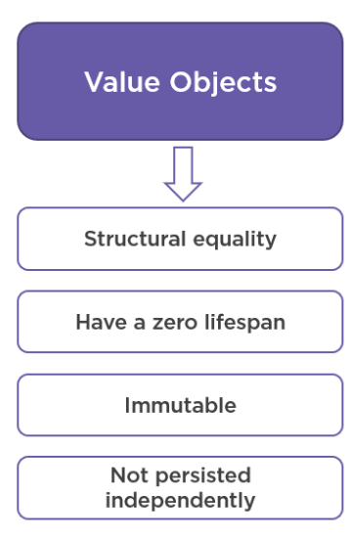
Value Object
It is an object defined by its value. Unlike the entity it does not have an identity, because we do not need to monitor the change of state, as a Value Object is immutable.
Making types explicit through the use of Value Objects ensures clarity in the code, avoids ambiguities and, consequently, the emergence of semantic errors. Reducing the complexity of the codebase from below
Closure of Operations. If the domain is complex, but in general as good development practice, it is our responsibility to identify the abstraction and language that make it robust.

Slide 32
Factory
This is not really a pattern, but rather a responsibility. Since we must guarantee the consistent state of the aggregate at all times, we must start off on the right foot, guaranteeing it from the beginning
The Factory is responsible for the first step of our state machine (from nothing to a consistent object), while the Root is responsible for the subsequent steps (from a consistent object, to a consistent object)
The Factory guarantees that there are no alternative ways of having an instance of our aggregate, only the one proposed by us that guarantees its integrity from the outset

Slide 33
Repository
It aims to build an abstraction layer on top of the persistence infrastructure (I don't want to bind myself to the database technology you decide to use)
Allow me to use the language of my domain when I have to persist the data, or rehydrate it from the database
Abstracting persistence issues allows us to implement domain-specific tests, without worrying about how the data is persisted between transactions

Slide 34
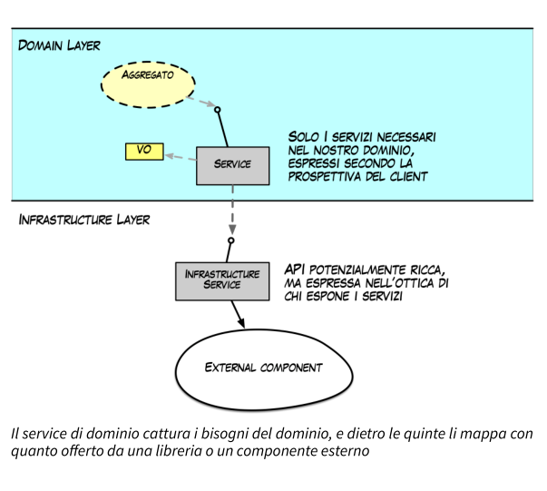
Services
There are key functionalities within the Domain that transcend the boundary of the single aggregate. The calculation of the litres required to create a pack of beer bottles given the capacity of the bottle itself, for example. In this case, since this is 'general' behaviour within the Domain, we can implement it via a service and make it available to multiple aggregates.

Slide 35
Bounded Context: Implementazione
In order to guarantee the assumption that we have maximum freedom of action within a Bounded Context, being optimised for a single purpose, a number of main requirements must be met
Each Bounded Context is free to adopt its own architecture, and of course, its own language
Persistence must be private. Any form of sharing is delegated to the frontier of our Bounded Context
Encouraging communication between different Bounded Contexts through the use of events
Hexagonal architecture (Alistair Cockburn), then proposed under various other acronyms, allows the decoupling of domain logic from infrastructure implementation

Slide 36
Bounded Context & Microservizi
Common Characteristics
Componentisation via services
Organised around business capabilities
Decentralised data management
Products not projects
Decentralised governance
Smart endpoints and dumb pipes
Evolutionary design
Infrastructure automation
Designed for failure
We cannot say there is a formal definition of the microservices architectural style, but we can attempt to describe what we see as common characteristics for architectures that fit the label.
(Martin Fowler, James Lewis)

Slide 37
Bounded Context & Microservizi
Feature | Bouded Context | Microservice | Compatibility
Organized around Business Capabilities | È implicitamente inteso nel concetto stesso di Ubiquitous Language, che è il pattern principale per identificare un Bounded Context | Teams Cross-Funzionali specifici per una funzionalità di business | Perfetta!
Decentralized Governance | Un modello condiviso per ogni scopo | Vengono favorite/incentivate le scelte locali, che devono essere indipendenti. | Perfetta!
Decentralized Data Management | La persistenza privata è fondamentale per la consistenza del linguaggio, ma soprattutto necessaria per l’evoluzione sicura e indipendente del modello | Ogni microservizio deve persistere i propri dati in un database privato! Pena l’impossibilità di evolvere autonomamente dagli altri | Perfetta!
Evolutionary Design | Ogni modello può, e deve, evolvere indipendente dagli altri | E’ una key feature | Perfetta!
Smart endpoints and dumb pipes | Raccomandato come modello strategico | Key feature. SOA docet! | Fattibile
Language Consistency | Ubiquitous Language! Obbligatorio! | Implicito e raccomandato | Nessun problema
Componentization via Services | Context Map | Key feature | Nessun problema
Products not Projects | Raccomandato per la conoscenza approfondita del modello | Key feature | Nessun problema
Design for Failure | DDD incentiva l’evoluzione continua | Key feature | Nessun problema

Slide 38
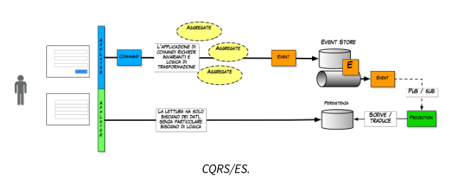
CQRS
Command-Query Responsibility Segregation is a pattern that has become cool thanks to Greg Young and Udi Dahan.
Born from the ashes of Bertrand Meyer's CQS, it emphasises the clear separation between the model used to write information, and thus make changes to the aggregate, and the one used to read it.
Unlike CQS, in CQRS there are precisely two distinct database models, each optimised for its own purpose

Slide 39
CQRS
The strong segregation promoted by this pattern entails a radical overhaul in the way applications are developed.
The write model is an append-only event store.
The read model is the projection of the Domain, and as such 'suffers' its choices
When it comes to CQRS, Domain Events are the obvious choice in terms of information propagation.

Slide 40
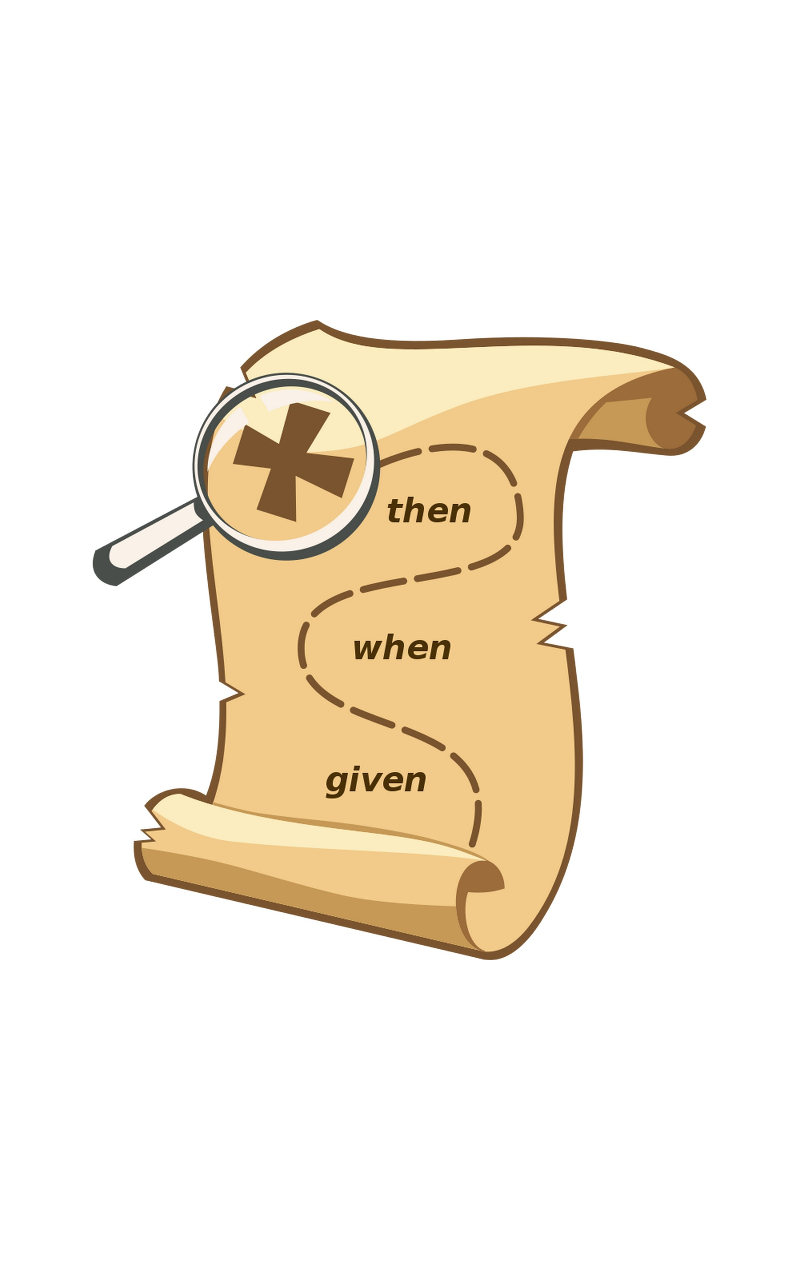
Testing
Given that commands and events are immutable objects, and that the Domain is a box to which we send commands and expect events, how do we test our software?
Tests should be able to simply represent any complex behaviour
They must be understandable by all
They represent the thinking behind the design of the aggregate
“Given, When, Then” with events, commands and Command Handlers

Slide 41
Testing
The essential idea is to split a scenario into three sections :
Given: describes the state of the aggregate before sending the command. A kind of test prerequisite
When: rrepresents the command to be sent to the aggregate
Then/Expect: describes the state changes expected as a result of the command

Slide 42
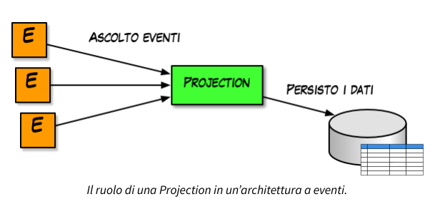
Projections
Projections are the tools that allow us to transform events into consumable data by our applications
The rather simple task of a projection is to aggregate the information arriving from events into data structures that are easily, and above all quickly, consumable. This is why document databases find ample space in ReadModel

Slide 43
Event Sourcing
It is now customary, when using the CQRS pattern, to save the events generated by the Domain. EventSourcing is an architectural pattern that allows the reconstruction of the state of an application from the events saved. From an architectural point of view, it is one of the highest expressions of application of a functional pattern, in fact, we can express the state of an aggregate as a function of its event history
State = f(events)
Going from a CRUD model to an event model is a bit like going from photographing an object at a precise moment, to the whole film telling its entire story.
The classic example is the bank statement, obtained by reading all the movements on our current account.

Slide 44
Event-Driven Architecture
This type of architecture exploits precisely the propagation of events as an asynchronous communication mechanism allowing, in effect, a total decoupling between the parties involved.
In order for propagated events to carry as much information as possible, there is a clear distinction between events that are typically Dominion, and tied to a specific Bounded Context, and events that are used to propagate information to the rest of the world
Domain Event. Events local to a specific Bounded Context
Integration Event. Public events, shared with the rest of the system, in a language more agnostic than the Ubiquitous Language of the Bounded Context

Slide 45
The Reactive Manifesto
The system, if it is generally possible to give an answer to clients, gives it in a timely manner. Responsiveness is the cornerstone of system usability and usefulness; it presupposes that problems are identified quickly and handled effectively. Responsive systems are focused on minimising response time by identifying a predetermined upper limit for it in order to guarantee a consistent quality of service over time. The resulting behaviour is therefore predictable, which simplifies the management of error situations, generates confidence in end users and predisposes them to further interaction with the system.

Slide 46
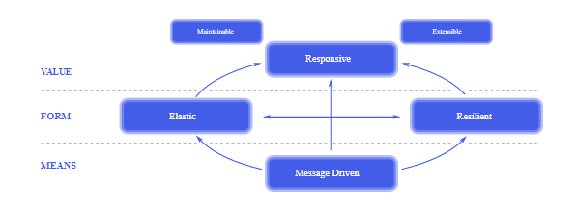
The Reactive Manifesto
Resilient. The system remains responsive even in the event of faults
Elastic. The system remains responsive under time-varying workloads
Message Driven. The system is based on asynchronous message exchange to ensure low coupling between components.

Slide 47
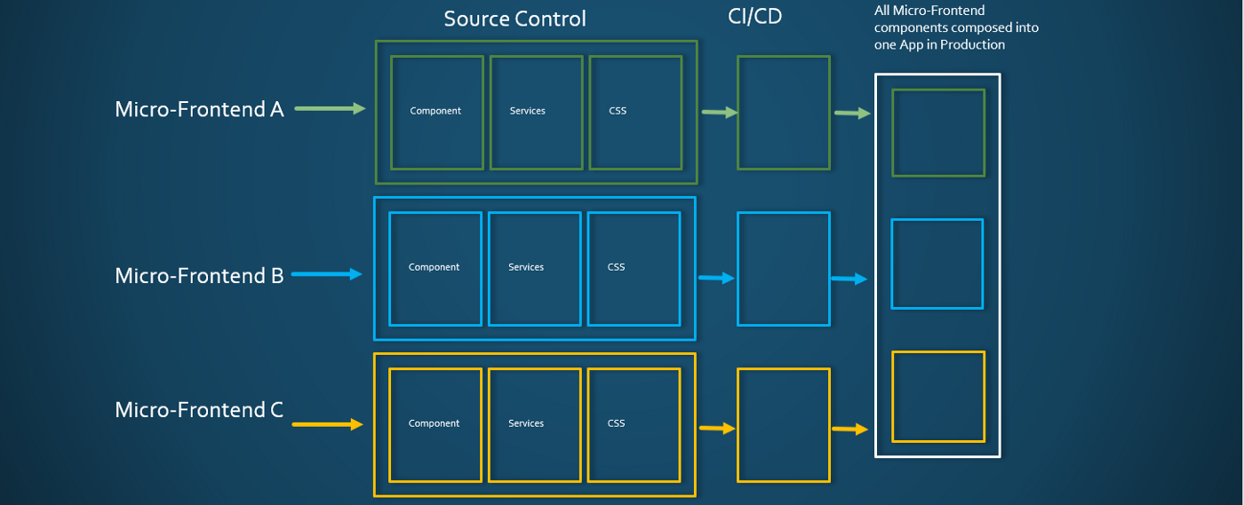
DDD nel Frontend
After splitting the Big Ball of Mud on the backend side why not do the same thing on the frontend side?
The same patterns applied to the backend can also be applied to the frontend?

Slide 48

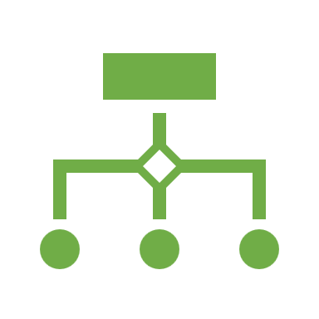
An Old History – Self-Contained System
ThoughtWorks Technology Radar 2016
- Autonomous Web Application
- Each SCS is owned by One Team
- Asynchronous Communication
- Each SCS has its own API
- Each SCS include Data and Logic
- No Shared UI
- No Shared Business Code
- Shared Infrastructure can be minimized

Slide 49
Decision Framework
Before starting with the breakdown of the frontend, a few points must be clarified
Defining what a microfrontend is in our architecture
Composition of microfrontends
Routing
Communication between microfrontend

Slide 50
Microfrontend Ways
We can implement a microfrontend solution in four different ways
Shared Session and parameters
Routing
Components
Shared Components / Class Library

