Slide 1


Eventual Consistency
Eventualmente oppure Prima o Poi?
Alberto Acerbis

Slide 2









Thanks to our partners

Slide 3
Dealing with Eventual Consistency
Eventual Consistency is the idea that, in a distributed system,
all the different parts of the system will eventually return all the same values.
It is a form of weak consistency.
Beginner's Guide to Event Sourcing | Event Store

Slide 4
Dealing with Eventual Consistency
Eventual Consistency is the idea that, in a distributed system,
all the different parts of the system will eventually return all the same values.
It is a form of weak consistency.
Beginner's Guide to Event Sourcing | Event Store

Slide 5
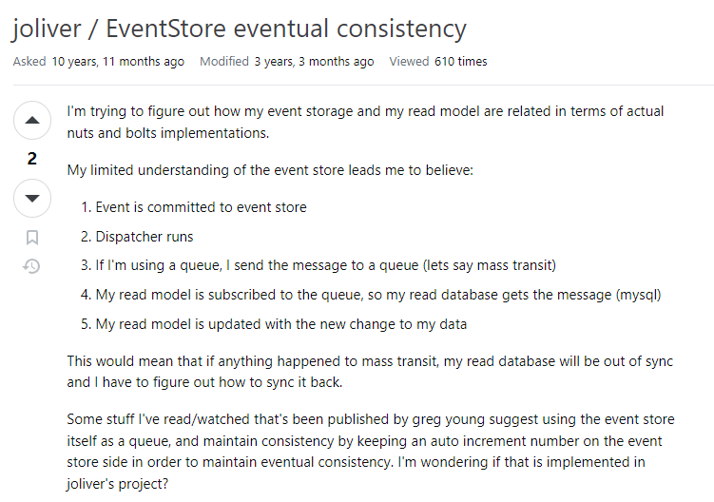

Dealing with Eventual Consistency

Slide 6
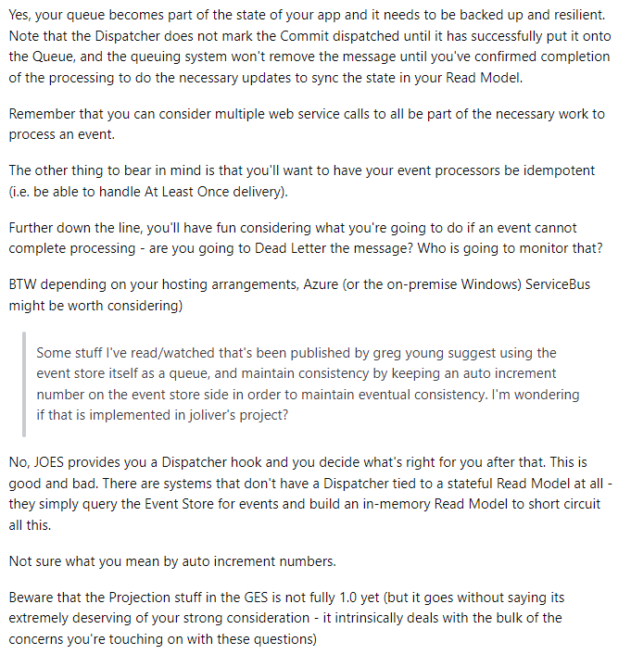
Dealing with Eventual Consistency

Slide 7
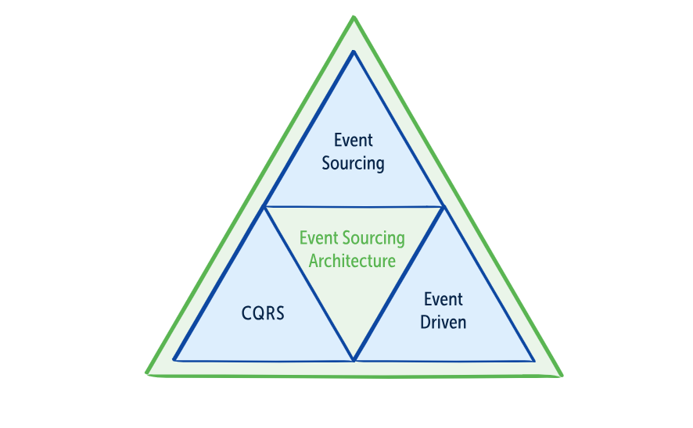
You don’t need to use an event database inside a distributed system with event-driven architecture
A Beginner's Guide to Event-Driven Architecture (eventstore.com)

Slide 8
Dealing with Distributed Systems
Persistence
- Atomic
- Eventually
Communication
- Sync
- Async
Coordination
- Orchestrator
- Choreoghraphy

Slide 9

What is Event Sourcing?
Event Sourcing is an alternative way to persist data … Event Sourcing stores each state mutations as a separate record called an event
https://www.eventstore.com/blog/what-is-event-sourcing
Model information about activity in the domain as a series of discrete events.
Represent each event as domain object.
Eric Evans, Domain-Driven Design Reference

Slide 10
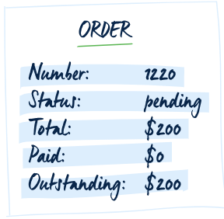
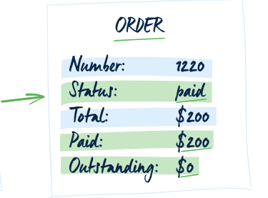
State-Oriented Persistence
Change history of entities can allow access to previous states, but ignore the
meaning of those changes, so that any manipulation of the information is
procedural, and often pushed out of the domain layer
Eric Evans, Domain-Driven Design Reference

Slide 11
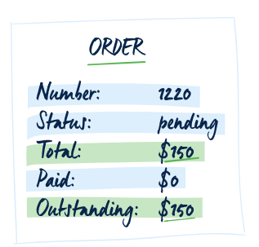
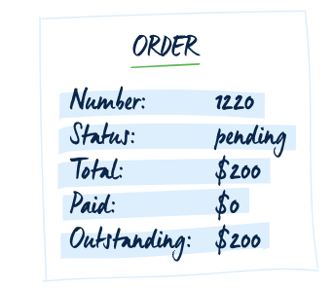
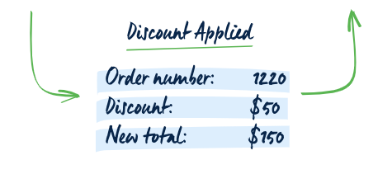
Event-Oriented Persistence

Slide 12
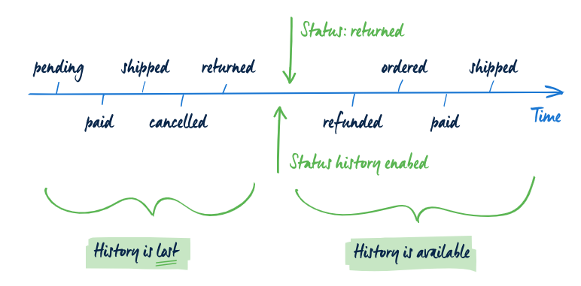
From picture to movie

Slide 13
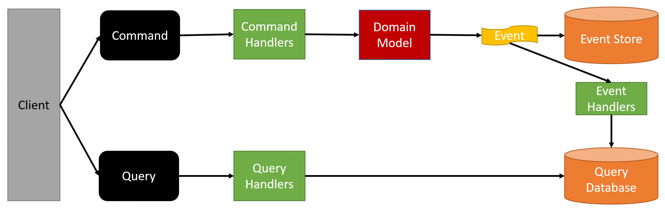
Command Query Responsibility Segregation (CQRS)

Slide 14
Write Model
The write model is responsible for handling the business logic!
Stream
Order
Placed
Order
Approved
Order
Shipped
The Write Model is Strong Consistency!!!

Slide 15
Read Model
A read model contains specific information. It is specialized for queries
Stream
Order
Placed
Order
Approved
Order
Shipped
Read Model(s)
Orders
Payments

Slide 16
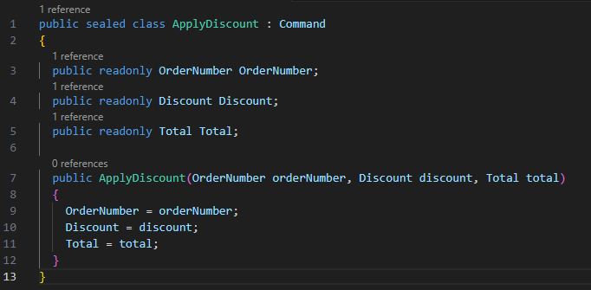
Command
A command is a simple object with a name of an operation and the data required
to perform that operation (DTO).

Slide 17
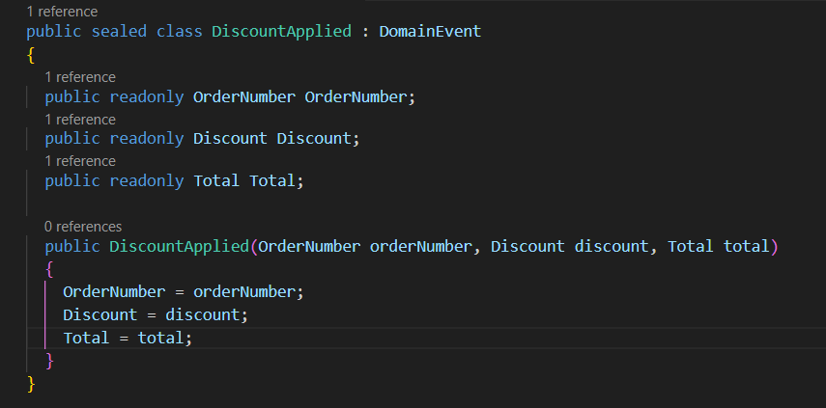
Domain Event
A domain event is a fully-fledged part of the domain model, a representation of
something that happened in the domain
Eric Evans, Domain-Driven Design Reference

Slide 18
Show me the Code!

Slide 19

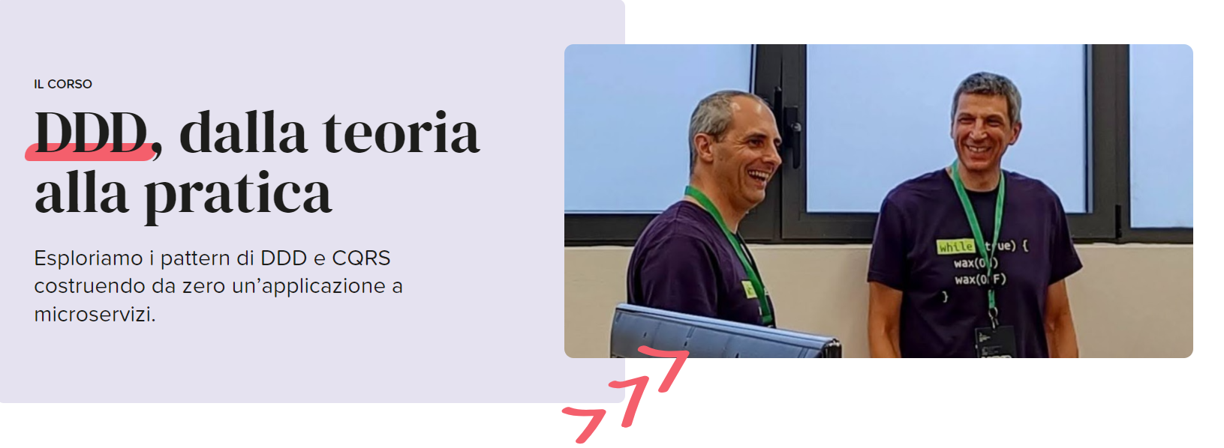

Alberto Acerbis
Ace68
@aacerbis
Alberto Acerbis
alberto.acerbis@intre.it

Slide 20
#CodeGen2024

