Slide 1






XMASDev - WebAssembly
alberto.acerbis@intre.it
stefano.maffeis@intre.it

Slide 2

WebAssembly
WebAssembly (abbreviated Wasm) is a binary instruction format for a stack-based virtual machine. Wasm is designed as a portable compilation target for programming languages, enabling deployment on the web for client and server applications.

Slide 3
A bit of history …
HTML: 1989 (Sir Tim Berners Lee)
JavaScript: 1995.
NaCl / PaNaCl 2014.
asm.js 2014
WebAssembly (2015): Brendan Eich

Slide 4


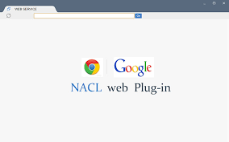


A bit of history …

Slide 5
What we need?
JavaScript is not enough!
Portability of high-level languages (C/C++/Rust … all)
We need something to provide software that is
Safe
Fast
Portable
Compact
We need portability at both the code and application levels
WebAssembly is a target platform with a series of instructions that are vaguely assemblyesque

Slide 6


Interpreted vs Compiled

Slide 7
WebAssembly Text Format
A text format that describes the behavior of a module that is easier for humans to read (.wat)
(module
(func $how_old (param $year_now(i32) (param $year_born i32) (result i32)
get_local $year_now
get_local $year_born
i32.sub)
(export "how_old" (func $how_old)
)
)

Slide 8


Slide 9
WebAssembly Structure
Id | Name | Description
0 | Custom | Debugging or metadata information for third-party uses
1 | Type | Type definitions used in the modules
2 | Import | Imported elements used by a module
3 | Function | Type signatures associated with the functions in a module
4 | Table | Tables that define indirect, immutable reference used by a module
5 | Memory | Linear memory structures used by a module
6 | Global | Global variables
7 | Export | Exported elements provided by a module
8 | Start | An optional start function to initiate a module
9 | Element | Elements defined by a module
10 | Code | The body of the functions defined by a module
11 | Data | The data elements defined by a module
12 | Data Count | The number of data elements defined by a module

Slide 10
WASI (WebAssembly System Interface)
Cross platform applications and games
Code re-use between platforms and use cases
Video-editing, ML, Virtual Reality, Games
Running applications written in any Wasm/Wasi compilable language on a single runtime
Containerizing applications and their dependencies
This would not be a replacement for containerization, but could be a better option for applications

Slide 11
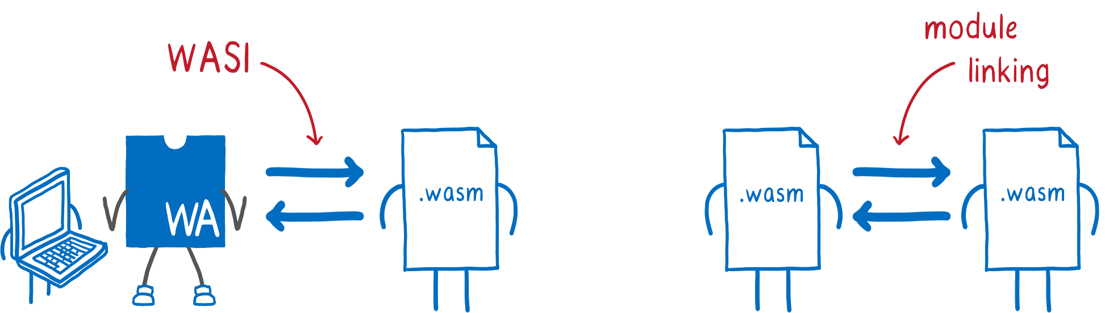
WASI Goals

Slide 12
WAGI
WebAssembly Gateway Interface
(WAGI)

Slide 13
WebAssembly and .NET
WebAssembly is a binary exectable format
C# compiles one binary exceutable formatm .NET bytecode
Changing it to target another is trickly
C# is deeply entwined with .NET standard library
C# gets a lot less interesting without NuGet packages
.NET has taken a different approach to Wasm
The strategy is to compile the .NET runtime to Wasm bytecode
Just as Python …
SteveSandersonMS/dotnet-wasi-sdk:

Slide 14
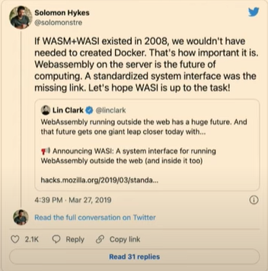
WebAssembly will replace Docker?
Wasm is like a container, but with abstraction at a higher level
Wasm is platform agnostic
Wasm runs in an isolated sandbox
It will be possible to build Wasm-based components
We can create containers for Windows or for Linux, but not 'universal' containers

Slide 15
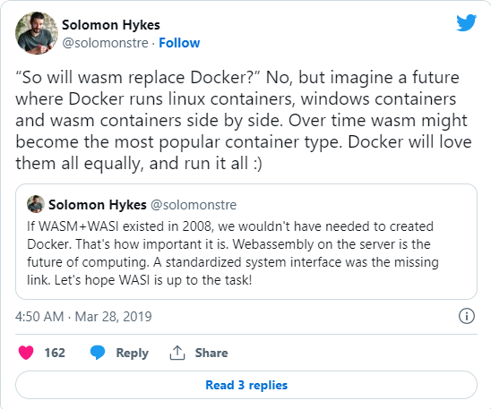
Docker love WebAssembly
Containers and WebAssembly are fast friends, not mortal enemies
Docker and WebAssembly work well together

Slide 16

Thanks
alberto.acerbis@intre.it
stefano.maffeis@intre.it
https://webassembly-studio.kamenokosoft.com/?f=5z61oxzmbch

