Slide 1

Modular Architecture con .NET
<Alberto Acerbis>

Slide 3
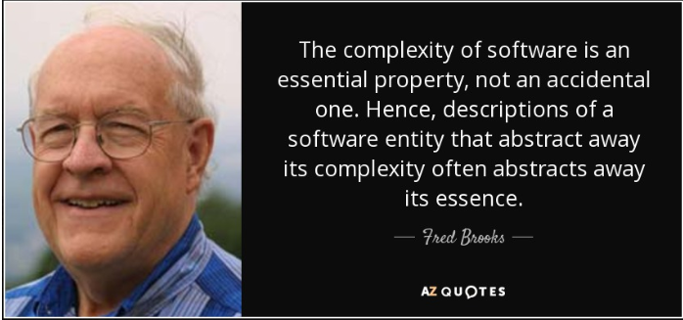
No Silver Bullets

Slide 4
Monolithics
A monolithic architecture is a traditional model of a software program, which is built as a unfied unit that is self-contained and independent from other applications.

Slide 5
Microservices
Microservices are self-contained small services that handle specific budiness functions within clearly defined boundaries known as Bounded Context.

Slide 6
No Best Practice
Why have architects struggled with decisions in distributed architectures?
Why has the complexity ramped up so much with microservices?

Slide 7
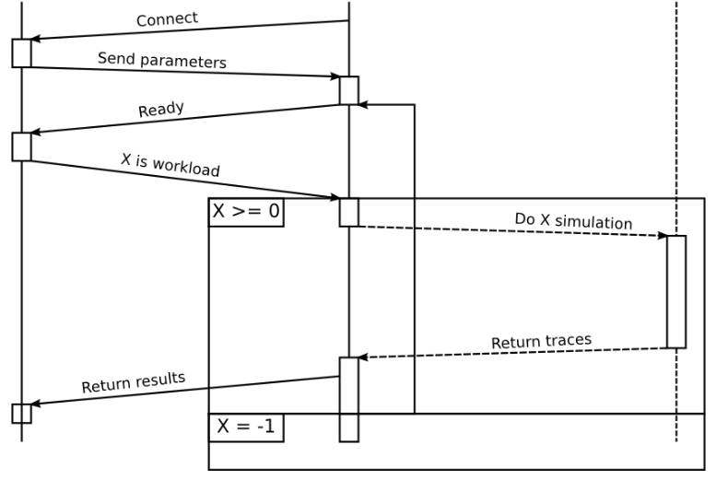
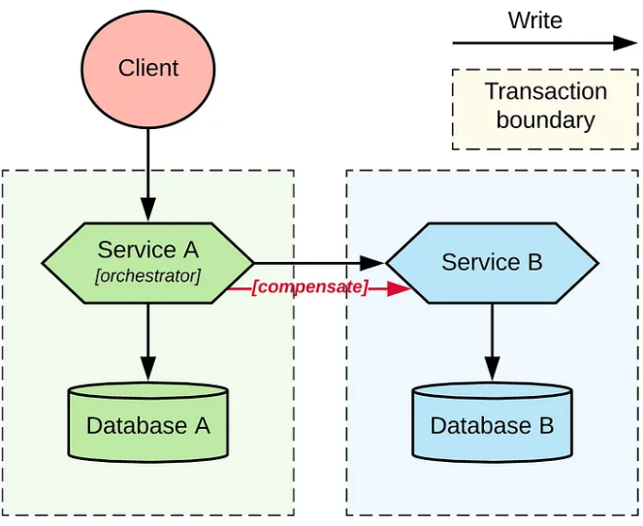
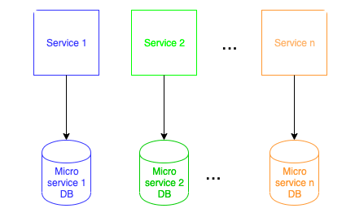
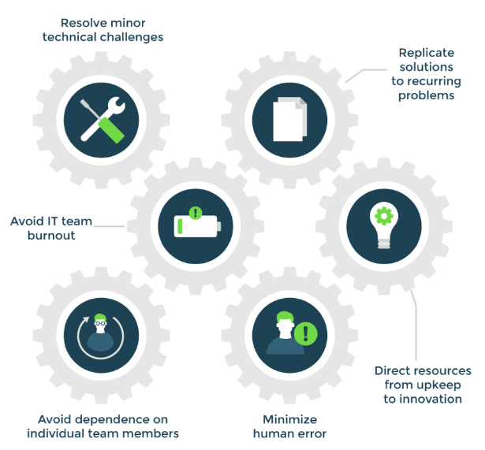
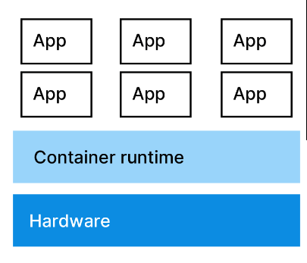
Microservices Traps
Data Decomposition
Distributed Workflow
Distributed Transaction
Operational automation
Containerization

Slide 8

A Matter of Dimensions?
Modularity
Granularity
Granularity
Disintegrators
Granularity
Integrators

Slide 9
Granularity Disintegrators
Service Scope and function
Code Volatility
Scalability and throughput
Fault Tolerance
Security
Extensibility

Slide 10
Granularity Integrators
Database Transactions
Workflow and Choreography
Shared Code
Database Relationships

Slide 11
Software Architecture
Software Architecture is the stuff you can’t Google Bing answers for.

Slide 12
Hamletic doubt
What is Essential?
What is Accidental?

Slide 13
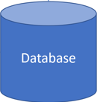
Quantum Architecture
Frontend
Frontend
Microservice
Microservice
Service Bus

Slide 14
Laws of Software Architecture
First Law
Second Law
Everything in software architecture is a trade-off
Why is more important than how
Corollary 1
If an architect thinks they have discovered something that isn’t a trade-off, more likely they just haven’t yet identified the
trade-off

Slide 15

Where do I start from?
Risk comes from not knowing what you are doing
(Warren Buffet)
If you think good architecture is expensive,
try bad architecture

Slide 16
Modular Architecture
Accounts
Payments
Admin
Sales
Warehouses
Purchases
In-Memory Event Bus
Kamil Grzybek

Slide 17

What is a Module?
Low Coupling
Each module should be independent of other modules in the system
High Cohesion
Components of the module are all related thus making it easier to understand what module does as a self-contained subsystem
Attempting to divide a cohesive module would only result in increased coupling and decreased readability

Slide 18


Slide 19
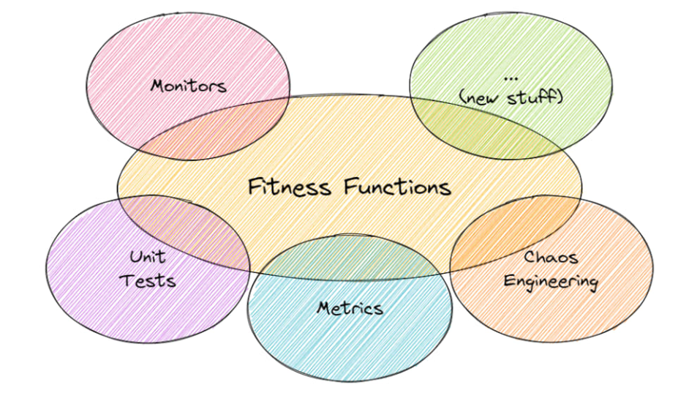
Fitness Functions
An architectural fitness function provides an objective integrity assessment of some architectural characteristic(s).

Slide 21



Books

Slide 22







Thanks!
alberto.acerbis@intre.it
https://github.com/brewup
https://github.com/cqrs-muflone
https://github.com/ace68
Alberto Acerbis

