Slide 1
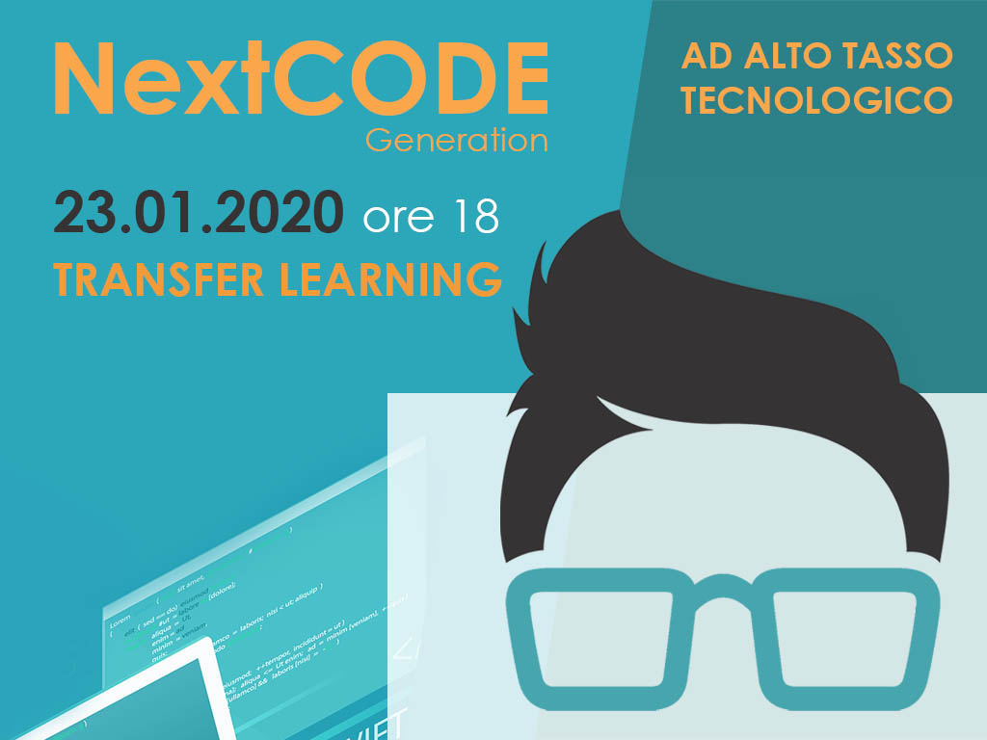

Slide 2
Transfer Learning Adapting Models for Custom Applications
Marco Acerbis – MSc Student in AI @UNIBO

Slide 3
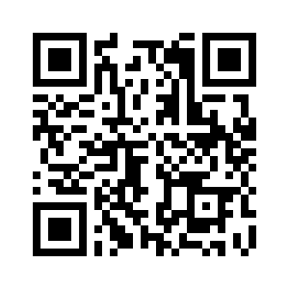
Transfer Learning
In this session the following arguments will be covered:
What Transfer Learning is
How and when you should use Transfer Learning
Transfer Learning & Deep Learning: Re-train your own CNN
Real case application: Mobilenet & MaixPy Bit AI Board
Example: Transfer Learning with ML.NET
In order to help everyone to follow the session I have set up a GitHub repo with useful papers, links and all the scripts used in the real case application.
https://github.com/Ace95/transferlearning_AIDay

Slide 4
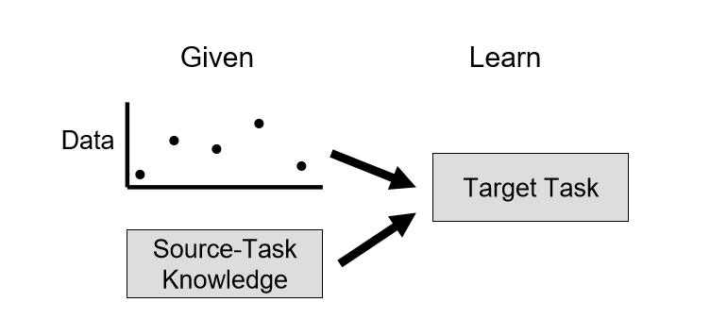
What is Transfer Learning?
Transfer learning is a machine learning technique where a model already trained on one task is re-purposed on a second related task in order to improve the performance.
Common ML algorithms traditionally address isolated tasks, while transfer learning attempts to change this: developing methods that allow to transfer knowledge learned in one or more source tasks and use it to improve the training in a related target task.

Slide 5
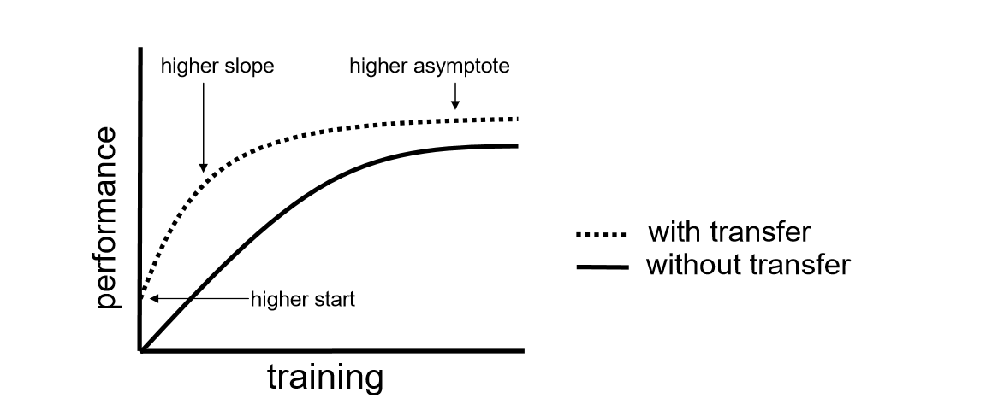
Usually to measure the improvement introduced with Transfer Learning, three different measures are used:
Performance achievable using only the transferred knowledge vs performance of an agent trained from scratch
The amount of time taken to fully learn the target task using only the given transferred knowledge vs the amount of time to learn it from scratch
The final performance level achievable in the target task vs the finals performance level achievable without transfer
Our method must avoid negative transfer : the loss of performance when applying Transfer Learning.

Slide 6
Inductive Transfer
In particolar, different ML applications require different approaches in transfer the knowledge from one task to another. For this reason, during this session, we are going to put the focus on inductive trasfer as it is used in the deep learning applications like image recognition with CNNs, an area in which Transfer Learning has become popular due to the enormous resources required to train this kind of models.
In Inductive Learning the aim is to obtain a model starting from a training set of example. To complete this task the algorithms needs an inductive bias, a set of assumptions about the true distribution of the training data. This bias is usually based on the informations about the hypoteses space.
In inductive transfer, the bias is chosen based on the source-task knowledge. Some transfer methods narrow the hypothesis space, limiting the possible models, or remove search steps from consideration. Other methods broaden the space, allowing the search to discover more complex models, or add new search steps.

Slide 7
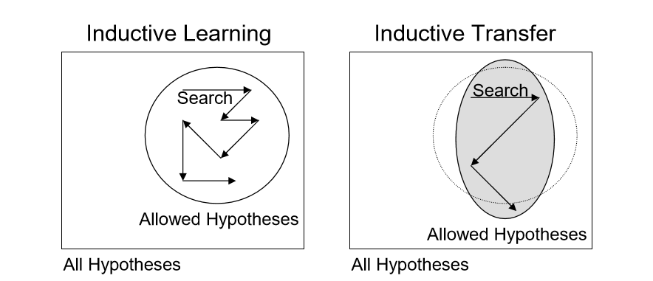

Slide 8
Applying Transfer Learning
There are two common ways to apply Transfer Learning:
Develop Model Approach
1) Define a source task – You must select a related predictive modeling problem withan abundance of data where there is some relationship.
2) Develop source model – You must develop a model on the first task.
3) Reuse model – The source model can be used as starting point for a model on the second task of interest.
4) Tune model – Eventually fix your model on the input-output pair data available for the task of interest.

Slide 9
Pre-trained Model Approach
1) Select Pre-trained model – Choose a pre-trained model among available ones.
2) Reuse model - The source model can be used as starting point for a model on the second task of interest.
3) Tune model - Eventually fix your model on the input-output pair data available for the task of interest.
NOTE This approach is usually the one considered in deep learning applications.

Slide 10

CNNs & MobileNet
Convolutional neural networks are a class of neural networks where the hidden layers consist in a series of convolutional layers, that work as filters and usually use a ReLU activation function, and pooling layers, that summarize the presence of features.

Slide 11
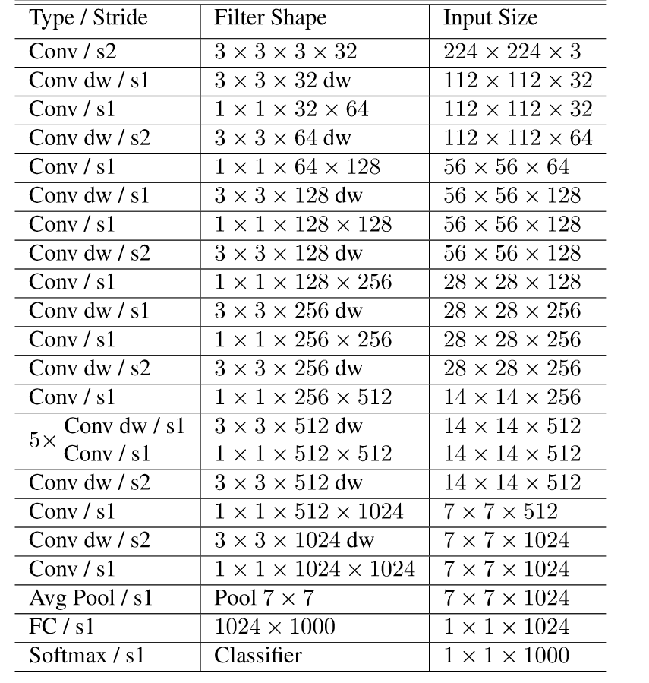
CNNs & MobileNet
MobileNet
Body Architecture
CNN optimized for mobile applications
Pre-trained models available through Keras
Good performance on the ImageNet dataset
Free to use
Official paper available in the session repo

Slide 12
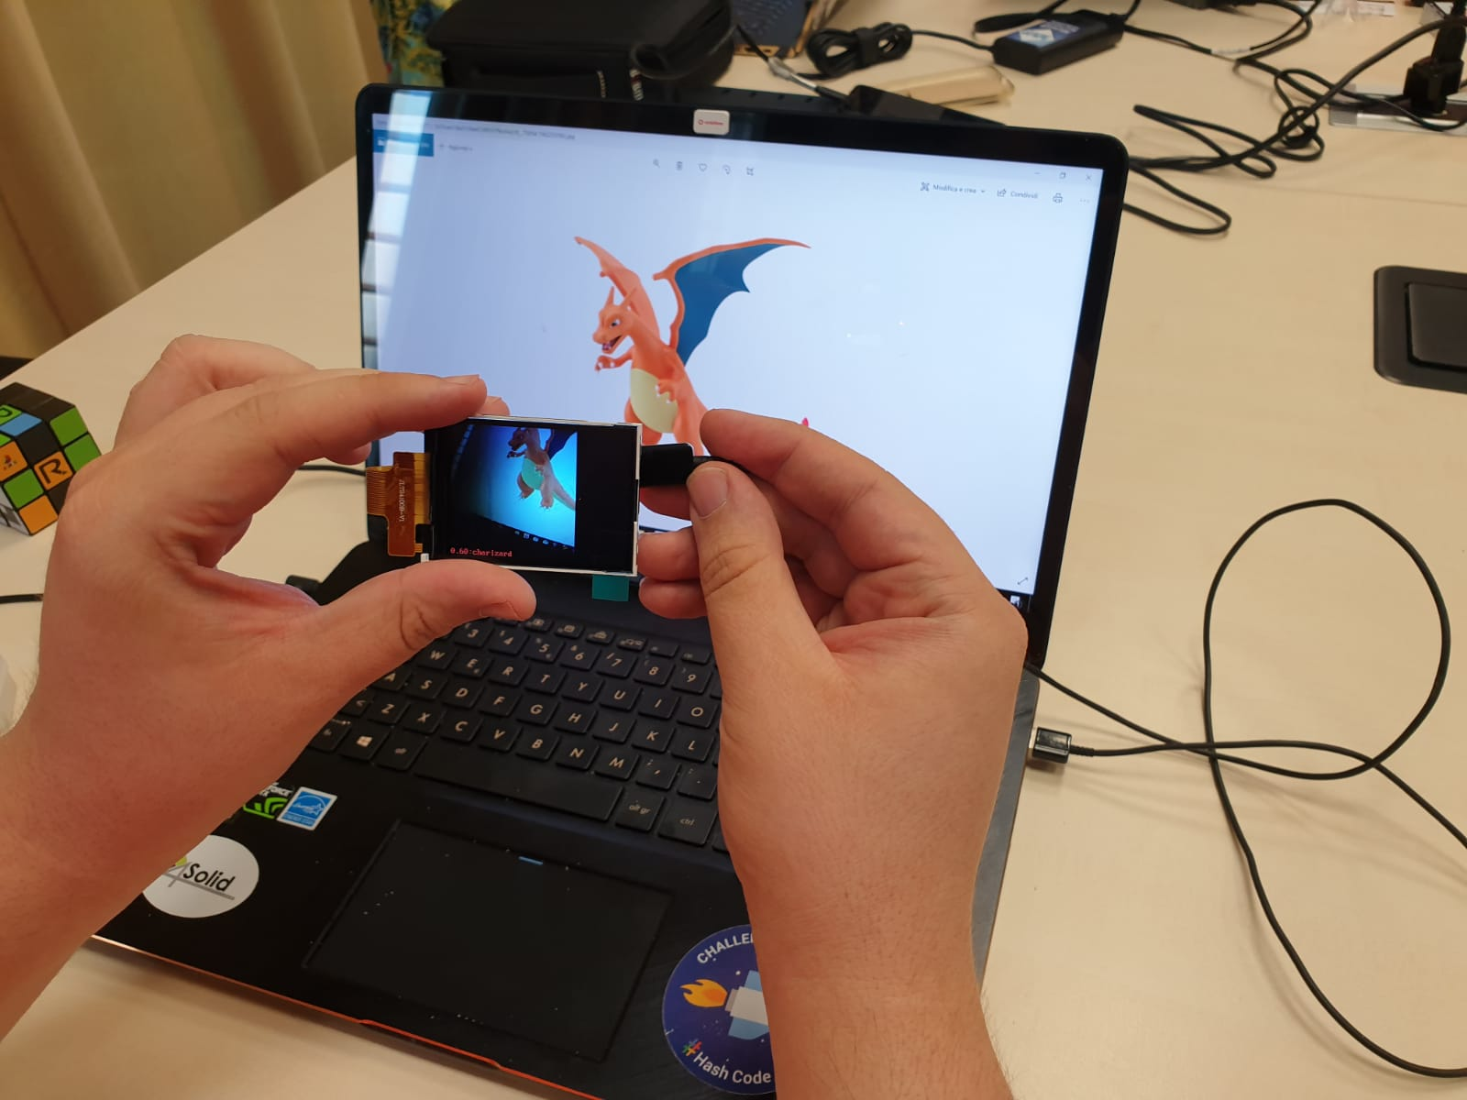

Slide 13
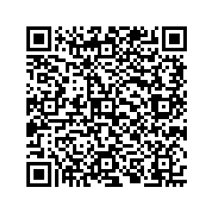
Example: Transfer Learning with ML.NET
Image Classification: for these cases, you can either use pre-trained models or train your own model to classify images specific to your custom domain.
pre-trained Inception-5h TensorFlow model
C# and ML.NET ( you need Visual Studio)
You can re-train your custom model in Python and then import the .h5 model in the C# application.

Slide 14

Any Questions?

