Slide 1







Technology Trends of Data Professionals
Adedeji Adegbile
23rd May, 2024.

Slide 2



OUTLINE
Executive Summary
Introduction
Methodology
Results
Visualization – Charts
Dashboard
Discussion
Findings & Implications
Conclusion
Appendix

Slide 3

EXECUTIVE SUMMARY
With the increase in development of Technology and Science, data professionals are required to gain more knowledge of two or more types of Technologies that improve their ability in Data Analysis.
Types of Technologies
Programming Languages
Databases
Platforms
Web Frames
Objective:
Find and analyze the Technology Trends of Data Professionals

Slide 4

INTRODUCTION
This report aims to explore and analyze technology usage trends among data professionals, covering both current usage patterns and projected future trends.
This report is intended for individuals looking to enter the field of Data Analytics.
This presentation enables target consumers to quickly grasp the trends in technology usage among data professionals and identify additional skills they should learn to enhance their job prospects in this field.

Slide 5

METHODOLOGY
The data was collected through survey, API and Web Scraping.
Survey:
Currently used technology
Technology desired in the future
Demographics
API: Job posting data
Web Scraping: Popular Language and Salary list
Source of Data:
https://stackoverflow.blog/2019/04/09/the-2019-stack-overflow-developer-survey-results-are-in/

Slide 6
RESULTS

Slide 7
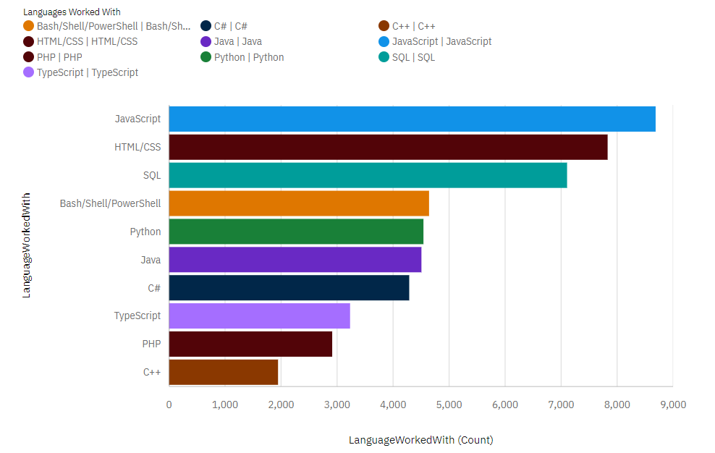
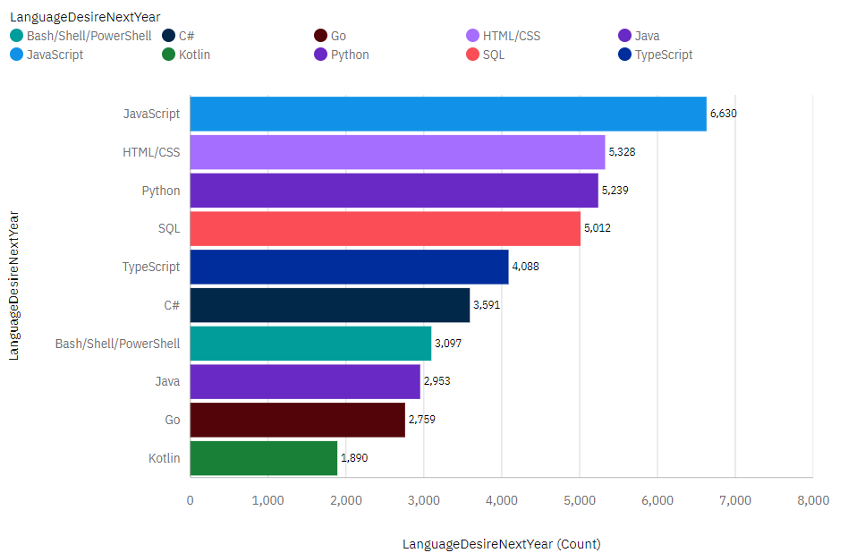
PROGRAMMING LANGUAGE TRENDS
Top 10 Programming Languages worked with this Year
Top 10 Programming Languages worked with Next year
<Bar chart of top 10 programming languages for the current year goes here.>

Slide 8
PROGRAMMING LANGUAGE TRENDS - FINDINGS & IMPLICATIONS
Findings
JavaScript is the most popular programming language for current and future usage.
HTML/CSS is the second most popular programming language.
Python is getting more and more popular in the future trend.
Implications
Frontend development is crucial in the field of data professionals. To enter this field, one should be proficient in at least one frontend programming language, such as JavaScript, HTML, or CSS.
Mastering Python will enhance one's competitiveness in the future data professional market.

Slide 9
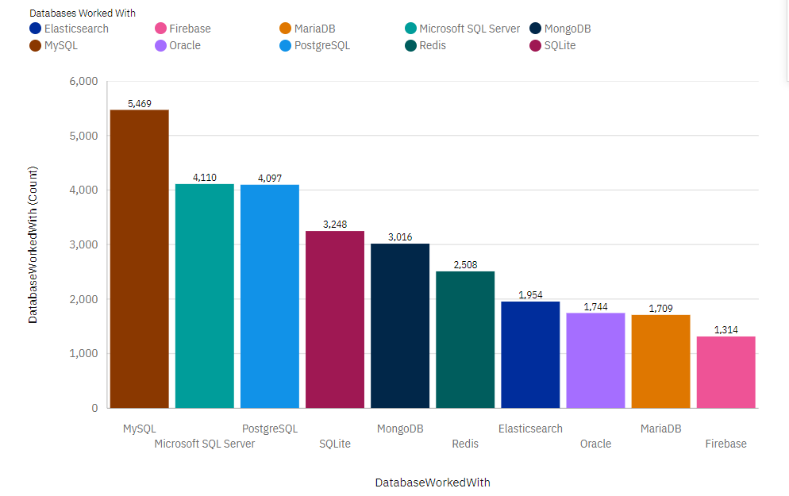
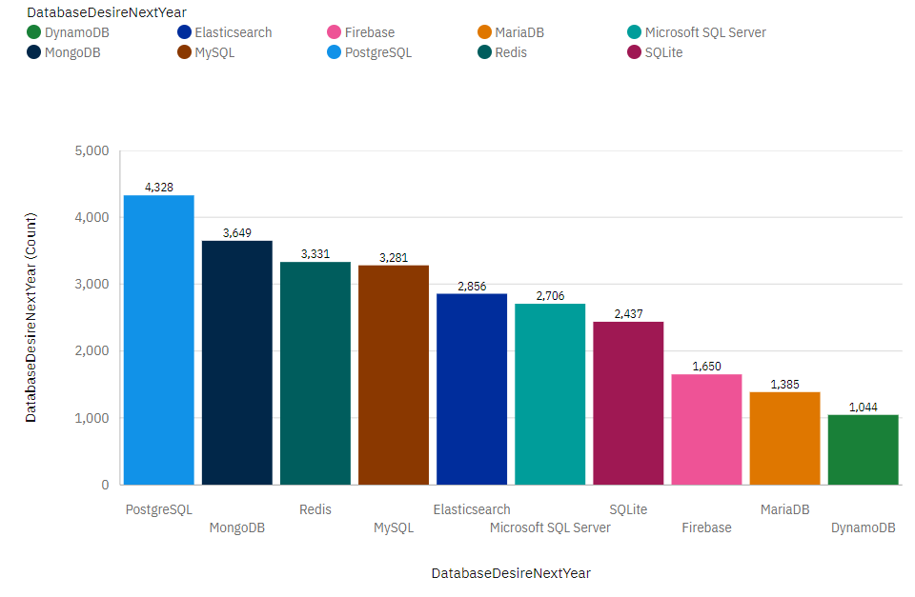
DATABASE TRENDS
Current Year
Next Year

Slide 10
DATABASE TRENDS - FINDINGS & IMPLICATIONS
Findings
MySQL is an important database that data professionals currently use the most.
PostgreSQL and MongoDB are popular databases in current usage and getting more popular in the future trend.
Redis and Elasticsearch are not as popular as other databases mentioned above but are also getting more popular
Implications
MySQL is highly recommended to learn before going into data analytics because is it the basis.
Learning at least one or both PostgreSQL or MongoDB could be important as they are likely to be more frequently used in the future.
Learning to use these two databases could help increase one's competitiveness in the job market.

Slide 11

DASHBOARD
https://github.com/AceAdedeji10/CapstoneProject/blob/main/_%20Final%20Project%20dashboard%20Copy.pdf

Slide 12
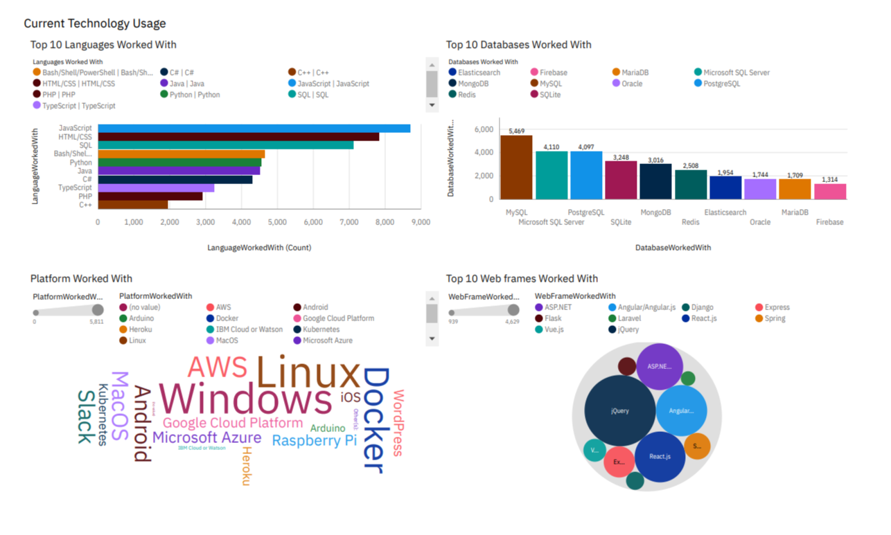
DASHBOARD TAB 1

Slide 13
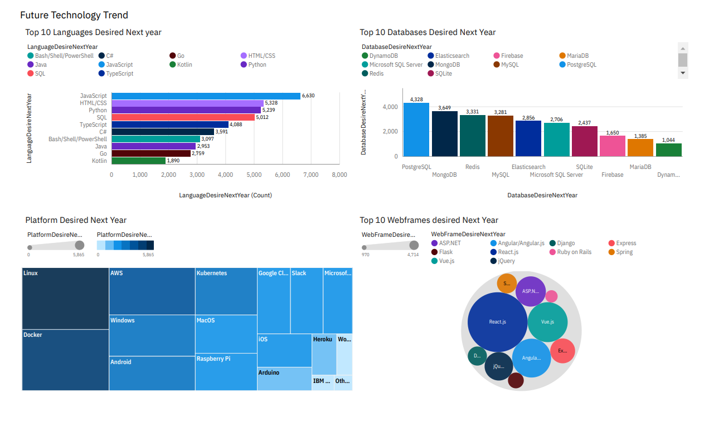
DASHBOARD TAB 2

Slide 14
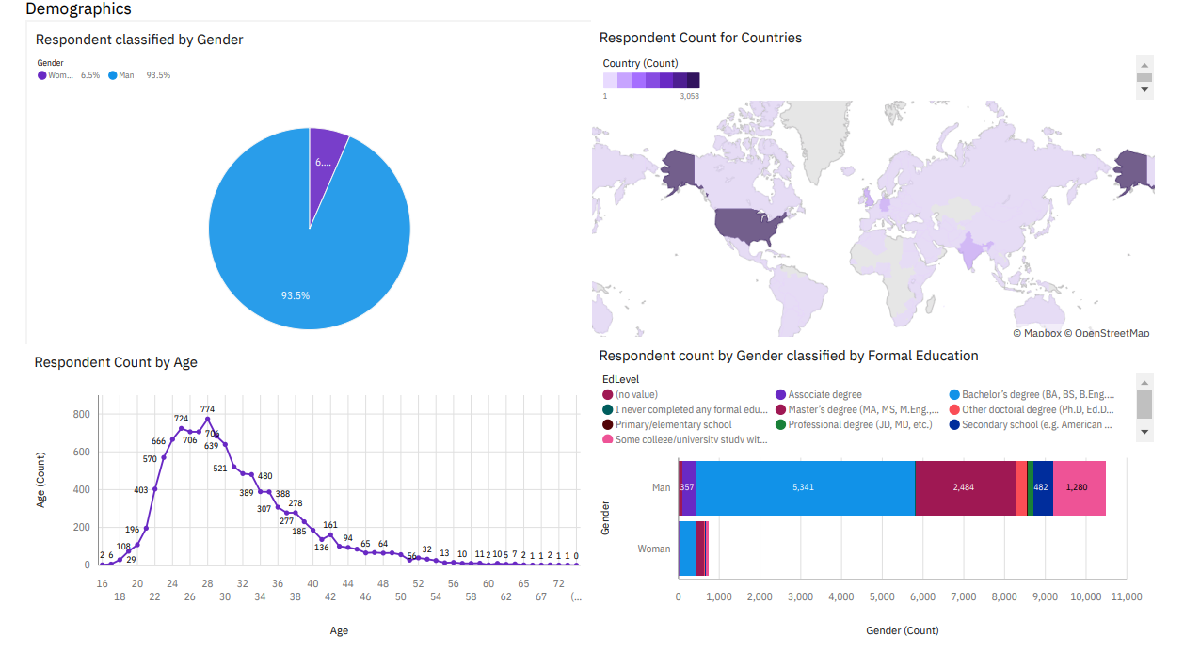
DASHBOARD TAB 3

Slide 15
DISCUSSION
Technology trends now and in the future.
Training and Upskilling data professionals.
Participation of females in the Technology field.
The division of technology gaps in developing countries.
The role of the age factor in the technology field.

Slide 16
OVERALL FINDINGS & IMPLICATIONS
Findings
JavaScript, HTML/CSS and Python are popular programming languages in current and future trend.
MySQL, PostgreSQL and MongoDB are popular databases in current usage and future trend
Implications
Recommend to learn, to increase employability.
Recommend to learn, to increase employability.

Slide 17

CONCLUSION
In order to become a data professional, it is recommended to manage software skills including programming languages and databases.
Data analytics is becoming more popular as analysis is highly needed in many fields to make the best decisions.
Recommendation:
Programming languages: JavaScript, HTML/CSS, Python.
Databases: MySQL, PostgreSQL, MongoDB.

Slide 18
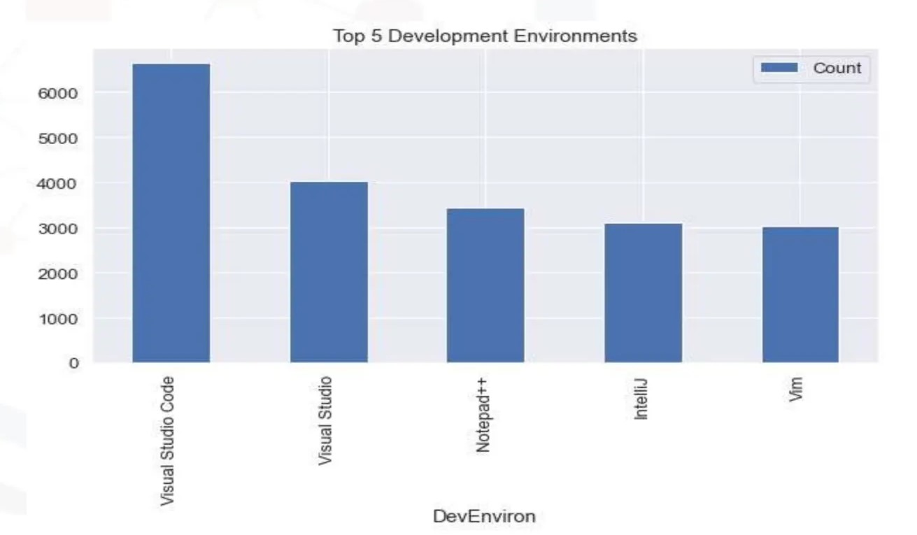

APPENDIX

Slide 19
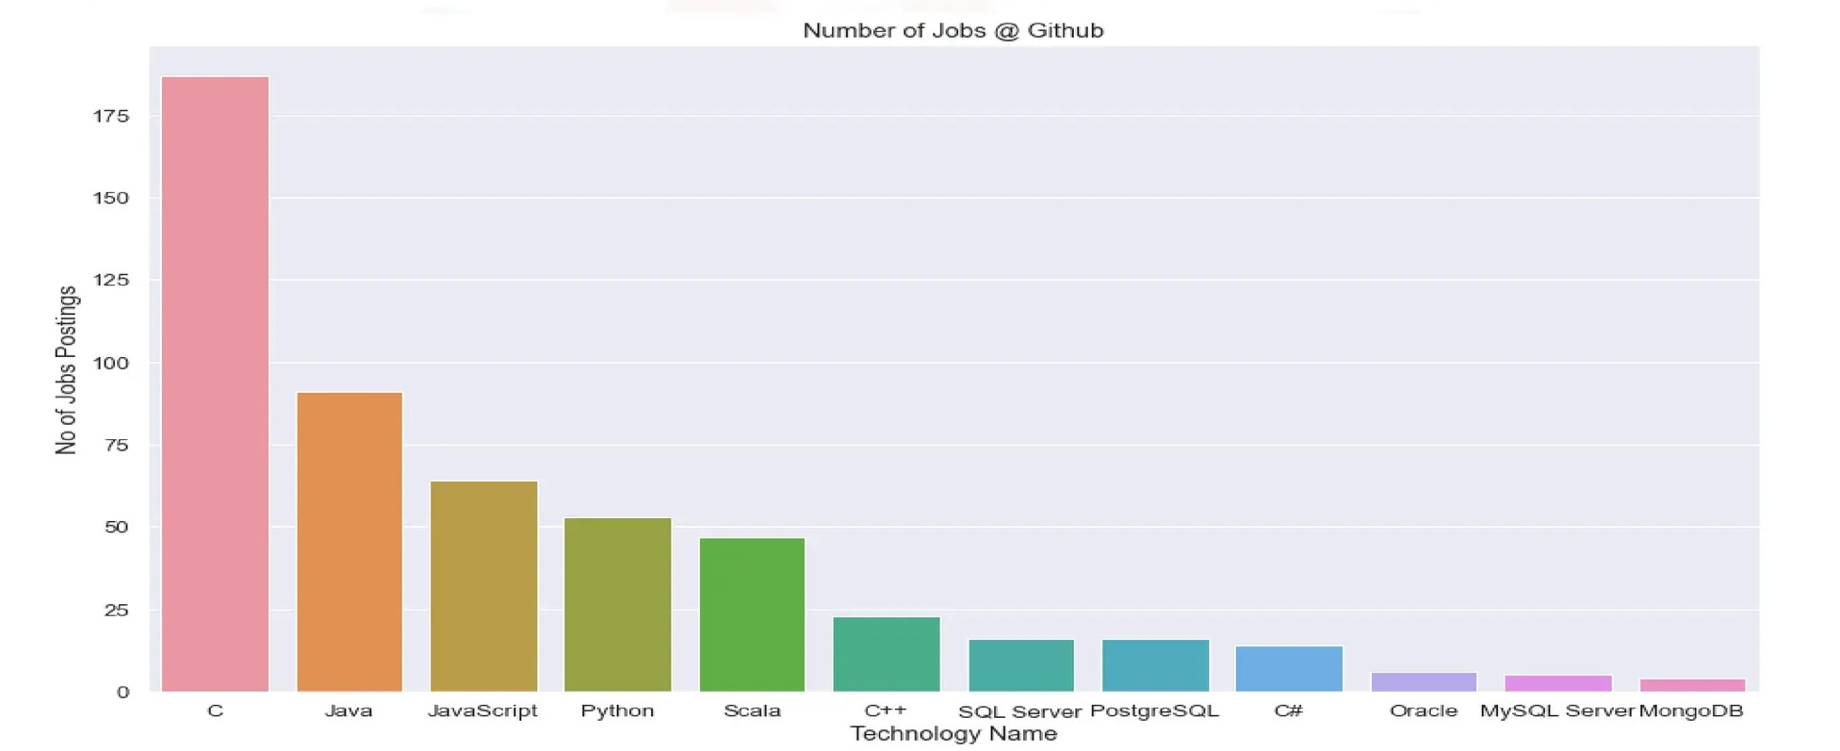
JOB POSTINGS

Slide 20
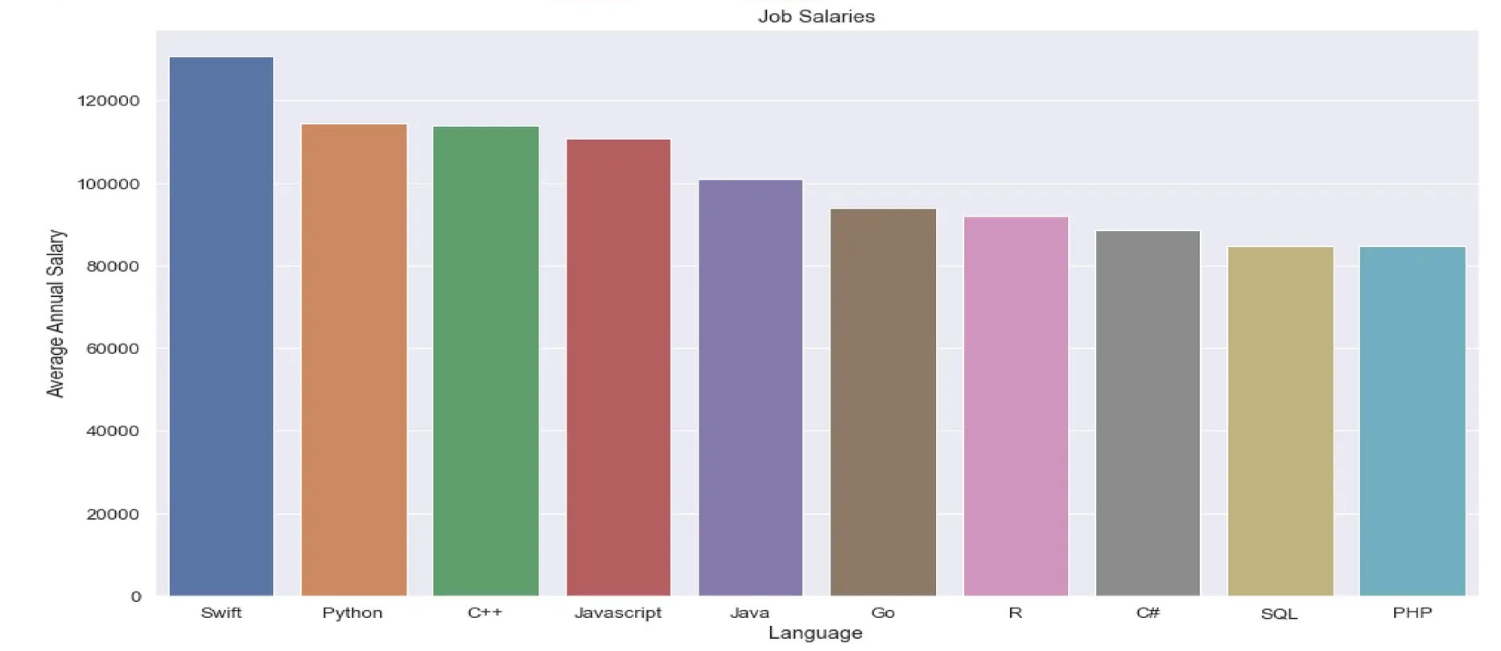
POPULAR LANGUAGES BY SALARY

