Slide 1
Anthony Moncion Product design
Selected independent work
September 2026
Notes:
Selected independent portfolio work by Anthony C. Moncion. Public portfolio: https://ruca-mobile-presentation-hub.vercel.app/portfolio/. Uses the retained Simple Dark Mode template.

Slide 2
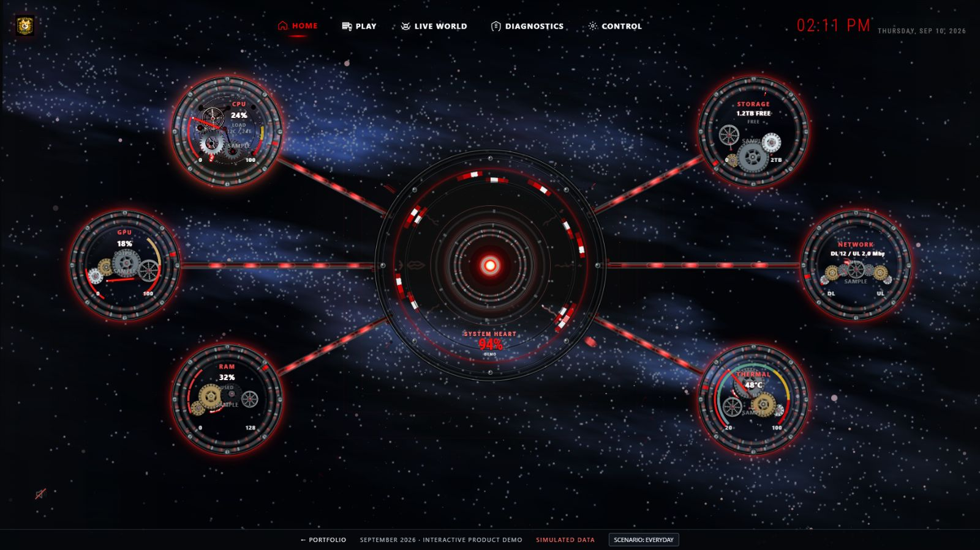
RUCA OS
Desktop product system
One shell brings readiness, commands, media, live context, diagnostics, and controls together. The current direction uses the System Heart, mechanical gauges, and a galaxy field.
My work: product direction, information architecture, interaction requirements, visual direction, and implementation review.
Public demo: an interactive simulation with demonstration states.
Notes:
Source: current public RUCA OS demonstration, captured at 1600 by 900 on September 10, 2026. Front-end derived from the verified live-served September 9 source, based on 3ce2807 with current refinements. https://ruca-mobile-presentation-hub.vercel.app/demo/. Visible footer and System Heart identify simulated demonstration data. Private workstation telemetry and commands remain separate.

Slide 3
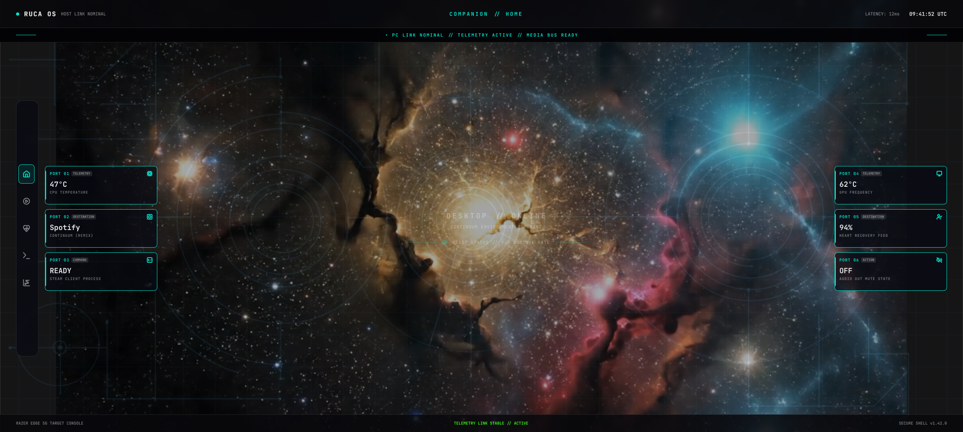
RUCA OS Mobile Companion
Current V1 design
A touch interface with six configurable HOME ports and five destinations: HOME, MEDIA, SYSTEM HEART, COMMAND DECK, and DIAGNOSTICS.
Connection feedback and consistent command meaning keep the companion aligned with the desktop product.
Current Figma frame exported September 10, 2026.
Notes:
Source: Figma file vo2DuY25t0yN7O9VxjcWjc, node 53:8, exported September 10, 2026. https://ruca-mobile-presentation-hub.vercel.app/mobile-showcase/. This is the current V1 design, not an installed-device screenshot.

Slide 4
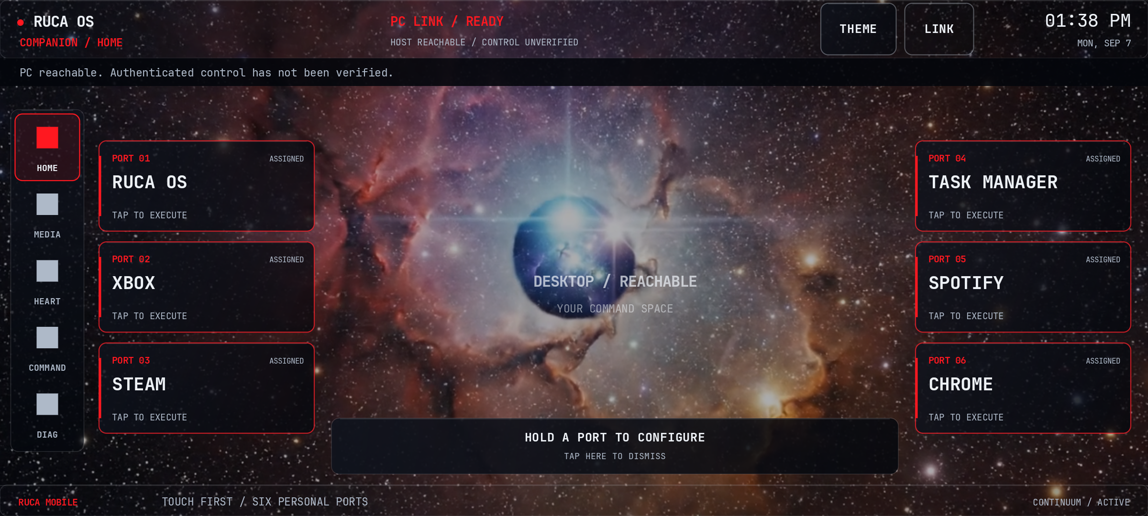
The native Android foundation
Device validation evidence
The existing Android implementation provides a working companion foundation. This screenshot records the native HOME surface during device validation on September 7, 2026.
The current V1 design and the installed build represent different stages of the product. The portfolio labels each source and date.
Capture precedes later repairs on the same day.
Notes:
Source: native Android validation capture dated September 7, 2026 at 13:38. The screenshot precedes later repairs that day. The captured state is not a claim about final repair validation.

Slide 5
Workflow and service design
La Cosa Nostra Design Studio
An independent local prototype for AI-assisted work. Missions carry project context, assigned responsibility, progress, and review evidence. Human approval remains explicit before consequential actions.
My work: workflow architecture, mission lifecycle, state language, and product direction.
Summer Grocery Delivery in the Catskills
A service design proposal for seasonal fulfillment. Delivery zones, order stages, staging, dispatch, and exception paths connect physical work with visible information.
My work: territory structure, order lifecycle, physical flow, and exception handling. Implementation and operating outcomes remain unvalidated.
Notes:
Source: https://ruca-mobile-presentation-hub.vercel.app/portfolio/la-cosa-nostra/ and https://ruca-mobile-presentation-hub.vercel.app/portfolio/catskills-grocery/. Both are independent projects. La Cosa Nostra is a local prototype. Summer Grocery Delivery in the Catskills is a design proposal with no implemented operation or client outcome claimed.

Slide 6
From operations to product design
Experience that shapes the work
Postal operations and hospitality inform how I design handoffs, state, recovery, and the information people need to act.
Operational responsibility
USPS work supported approximately 75 employees and 49 city and rural routes.
Interaction design
Figma, information architecture, product requirements, and working prototypes.
Google UX Design
Professional Certificate completed July 10, 2026.
Google Advanced Data Analytics
Professional Certificate completed July 31, 2026.
Notes:
Sources: existing public resume and certificate PDFs. UX verification: https://coursera.org/verify/professional-cert/9HA7GIF9HSYN. Advanced Data Analytics verification: https://coursera.org/verify/professional-cert/8EW8G2NR5GMU.

Slide 7
Explore the work
Contact
Open portfolio and demos
Read the resume
Contact Anthony
Notes:
Portfolio: https://ruca-mobile-presentation-hub.vercel.app/portfolio/
Resume: https://ruca-mobile-presentation-hub.vercel.app/resume/Anthony_Moncion_Interaction_Designer_Public_Resume.pdf
Contact: mailto:hello@rucasrapidpcrepairlab.com

