Slide 1
Frontend development Angular framework (Part1)

Slide 2

Angular Fundamental
Typescript Programming Language
Angular Environment Setup
Angular Concepts
Angular Pipe
Angular Directive
Angular Forms
Angular Service
Dependency Injection(DI)
Angular Routing & Navigation
Angular Modules - Feature Module
Angular Httpclient - Getting Data From Server
Angular Material Design Components To Enhance UI/UX
BCI - Web Core

Slide 3
Typescript programming language
Angular Fundamental
TypeScript – Variable
let
var
const
Example:
console.log(x);
let x=5;
console.log(x);
TypeScript - lambda function
(param1, param2, ..., paramN) => expression
Example:
let sum = (x: number, y: number): number => {
return x + y;
}
TypeScript – Primary Type
Number
Boolean
String
Example:
let a: number = 10;
const b: string = ‘Hello’;
var c: Boolean = true;
TypeScript –User Defined Type
class
enum
interface
https://www.typescriptlang.org/docs/handbook/2/basic-types.html

Slide 4
Exercise
Angular Fundamental
Given a string, write a function to get the maximum count of repeated letters in a string
For example: "fdsfjngjkdsfhhhhhhhhhhhfsdfsd". Output should be 11
const a = "fdsfjngjkdsfhhhhhhhhhhhfsdfsd";
const findMaximumRepeating = str => {
let max = 0;
for (let start = 0, end = 1; end < str.length;) {
if (str[end] === str[start]) {
if (max < end - start + 1) {
max = end - start + 1;
};
end++;
} else {
start = end;
};
};
return max;
}

Slide 5
Environment Setup
Angular Fundamental
Install Node.js
Set npm proxy
Install Angular CLI
npm install -g @angular/cli
Generate new project
ng new <project name>
? Would you like to add Angular routing? No
? Which stylesheet format would you like to use? SCSS
cd <project name>
ng serve

Slide 6
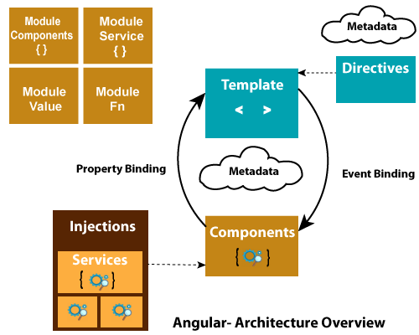
Angular Concepts - Architecture
Angular Fundamental

Slide 7
Angular Concepts - Module
Angular Fundamental
import { NgModule } from '@angular/core';
import { BrowserModule } from '@angular/platform-browser';
@NgModule({
imports: [ BrowserModule ],
providers: [ Logger ],
declarations: [ AppComponent ],
exports: [ AppComponent ],
bootstrap: [ AppComponent ]
})
export class AppModule { }

Slide 8
Angular Concepts - Component
Angular Fundamental
export class HeroListComponent implements OnInit {
heroes: Hero[];
selectedHero: Hero;
constructor(private service: HeroService) { }
ngOnInit() {
this.heroes = this.service.getHeroes();
}
selectHero(hero: Hero) { this.selectedHero = hero; }
}

Slide 9
Angular Concepts - Component metadata
Angular Fundamental
@Component({
selector: 'app-hero-list',
templateUrl: './hero-list.component.html',
providers: [ HeroService ]
})
export class HeroListComponent implements OnInit {
/* . . . */
}

Slide 10
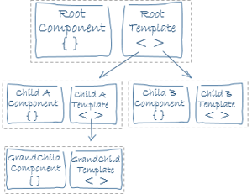
Angular Concepts - Templates & Views
Angular Fundamental
A template is a form of HTML that tells Angular how to render the component.
Views are typically arranged hierarchically, allowing you to modify or show and hide entire UI sections or pages as a unit. The template immediately associated with a component defines that component's host view.

Slide 11
Angular Concepts - Templates syntax
Angular Fundamental
<h2>Hero List</h2>
<p><i>Pick a hero from the list</i></p>
<ul>
<li *ngFor="let hero of heroes" (click)="selectHero(hero)">
{{hero.name}}
</li>
</ul>
<app-hero-detail *ngIf="selectedHero" [hero]="selectedHero"></app-hero-detail>
{{hero.name}} interpolation , [hero] property binding, (click) event binding

Slide 12
Angular Concepts - Template syntax
Angular Fundamental
Interpolation {{...}} e.g {{title}}
Template expressions {{ 1 + 1}}
*ngFor, *ngIf
<ul>
<li *ngFor="let customer of customers">{{customer.name}}
<div *ngIf=”customer.name”><div>
</li>
</ul>
Template reference variable
<label>Type something:
<input #customerInput>{{customerInput.value}}
</label>

Slide 13
Exercise
Angular Fundamental
Writing Our First App
https://codecraft.tv/courses/angular/quickstart/first-app/

Slide 14
Angular Concepts - Component Interaction - Passing data
Angular Fundamental
import { Component, Input } from '@angular/core';
import { Hero } from './hero';
@Component({
selector: 'app-hero-child',
template: `
<h3>{{hero.name}} says:</h3>
<p>I, {{hero.name}}, am at your service, {{masterName}}.</p>
`
})
export class HeroChildComponent {
@Input() hero: Hero;
@Input('master') masterName: string;
}

Slide 15
Angular Concepts - Component interaction - Data Binding
Angular Fundamental
import { Component } from '@angular/core';
import { HEROES } from './hero';
@Component({
selector: 'app-hero-parent',
template: `
<h2>{{master}} controls {{heroes.length}} heroes</h2>
<app-hero-child *ngFor="let hero of heroes"
[hero]="hero"
[master]="master">
</app-hero-child>
`
})
export class HeroParentComponent {
heroes = HEROES;
master = 'Master';
}

Slide 16
Angular Concepts - Component interaction- Event
Angular Fundamental
import { Component, EventEmitter, Input, Output } from '@angular/core';
@Component({
selector: 'app-voter',
template: `
<h4>{{name}}</h4>
<button (click)="vote(true)" [disabled]="didVote">Agree</button>
<button (click)="vote(false)" [disabled]="didVote">Disagree</button>
`
})
export class VoterComponent {
@Input() name: string;
@Output() voted = new EventEmitter<boolean>();
didVote = false;
vote(agreed: boolean) {
this.voted.emit(agreed);
this.didVote = true;
}
}

Slide 17
Angular Concepts - Component interaction - @ViewChild
Angular Fundamental
import { AfterViewInit, ViewChild } from '@angular/core';
import { Component } from '@angular/core';
import { CountdownTimerComponent } from './countdown-timer.component';
@Component({
selector: 'app-countdown-parent-vc',
template: `
<h3>Countdown to Liftoff (via ViewChild)</h3>
<button (click)="start()">Start</button>
<button (click)="stop()">Stop</button>
<div class="seconds">{{ seconds() }}</div>
<app-countdown-timer></app-countdown-timer>
`,
styleUrls: ['../assets/demo.css']
})
export class CountdownViewChildParentComponent implements AfterViewInit {
@ViewChild(CountdownTimerComponent)
private timerComponent: CountdownTimerComponent;
}

Slide 18
Angular Concepts - Angluar Lifecycle
Angular Fundamental
ngOnChanges()
ngOnInit()
ngDoCheck()
ngAfterContentInit()
ngAfterContentChecked()
ngAfterViewInit()
ngAfterViewChecked()
ngOnDestroy()

Slide 19
Angular Concepts - View encapsulation
Angular Fundamental
ShadowDom : uses the browser's native shadow DOM implementation to attach a shadow DOM to the component's host element, and then puts the component view inside that shadow DOM.
Emulated: emulates the behavior of shadow DOM by preprocessing (and renaming) the CSS code to effectively scope the CSS to the component's view.
None: no view encapsulation.
@Component({
selector: 'customers',
templateUrl: './customers.component.html',
styleUrls: ['./customers.component.scss'],
changeDetection: ChangeDetectionStrategy.OnPush,
encapsulation: ViewEncapsulation.None
})
<hero-details _nghost-pmm-5>
<h2 _ngcontent-pmm-5>Mister Fantastic</h2>
<hero-team _ngcontent-pmm-5 _nghost-pmm-6>
<h3 _ngcontent-pmm-6>Team</h3>
</hero-team>
</hero-detail>
[_nghost-pmm-5] {
display: block;
border: 1px solid black;
}
h3[_ngcontent-pmm-6] {
background-color: white;
border: 1px solid #777;
}

Slide 20
Angular directive - Built-in Directives
Angular Fundamental
NgFor
<ul>
<li *ngFor="let person of people"> (1)
{{ person.name }}
</li>
</ul>
NgIf
<ul *ngFor="let person of people">
<li *ngIf="person.age < 30">
{{ person.name }} ({{ person.age }})
</li>
</ul>
NgSwitch
<ul *ngFor="let person of people"
[ngSwitch]="person.country">
<li *ngSwitchCase="'UK'"
class="text-success">{{ person.name }} ({{ person.country }})
</li>
<li *ngSwitchCase="'USA'"
class="text-primary">{{ person.name }} ({{ person.country }})
</li>
</ul>
NgStyle
<div [ngStyle]="{'background-color':'green'}"></<div>
NgClass
<div [ngClass]="{'text-success':person.country === 'UK'}“</div>

Slide 21
Angular directive – custom directive
Angular Fundamental
ng generate directive highlight
import { Directive, ElementRef } from '@angular/core';
@Directive({
selector: '[appHighlight]'
})
export class HighlightDirective {
constructor(el: ElementRef) {
el.nativeElement.style.backgroundColor = 'yellow';
}
@Input() highlightColor: string;
}
Apply the attribute directive
<p [appHighlight]="color">Highlight me!</p>

Slide 22
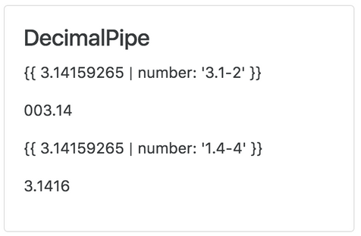
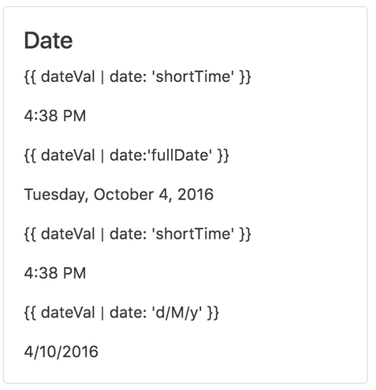
Angular Pipe - Built-In Pipes
Angular Fundamental
<!-- Default format: output 'Jun 15, 2015'-->
<p>Today is {{today | date}}</p>
<!-- fullDate format: output 'Monday, June 15, 2015'-->
<p>The date is {{today | date:'fullDate'}}</p>
<!-- shortTime format: output '9:43 AM'-->
<p>The time is {{today | date:'shortTime'}}</p>
<!-- CA$1,234.56 -->
{{ 1234.56 | currency:'CAD' }}
<!-- $1,234.56 -->
{{ 1234.56 | currency:"CAD":"symbol-narrow" }}
{{ 3.14159265 | number: '3.1-2' }} // 003.14
{{ 3.14159265 | number: '1.4-4' }} // 3.1416

Slide 23
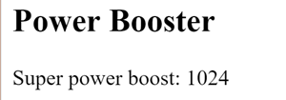
Angular Pipe - Custom pipe
Angular Fundamental
import { Pipe, PipeTransform } from '@angular/core';
/*
* Raise the value exponentially
* Takes an exponent argument that defaults to 1.
* Usage:
* value | exponentialStrength:exponent
* Example:
* {{ 2 | exponentialStrength:10 }}
* formats to: 1024
*/
@Pipe({name: 'exponentialStrength'})
export class ExponentialStrengthPipe implements PipeTransform {
transform(value: number, exponent?: number): number {
return Math.pow(value, isNaN(exponent) ? 1 : exponent);
}
}

Slide 24
Exercise
Angular Fundamental
Write a custom pipe which rounds a float number with given format
For example: float number : 10.28002 . Output of the pipe should be: 10.28

Slide 25
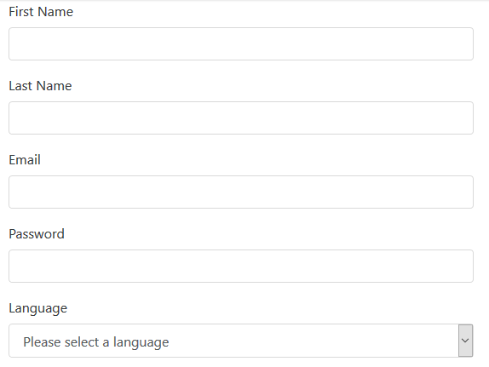
Angular Form
Angular Fundamental
Reactive forms vs Template-driven forms https://angular.io/guide/forms
Creating a FormGroup instance
class ModelFormComponent implements OnInit {
myform: FormGroup;
ngOnInit() {
myform = new FormGroup({
name: new FormGroup({
firstName: new FormControl(),
lastName: new FormControl(),
}),
email: new FormControl(),
password: new FormControl(),
language: new FormControl()
});
}
}

Slide 26
Angular Form - Form Group
Angular Fundamental
Associating the FormGroup model and view
class ModelFormComponent implements OnInit {
myform: FormGroup;
ngOnInit() {
this.myform = new FormGroup({
name: new FormGroup({
firstName: new FormControl(),
lastName: new FormControl(),
}),
email: new FormControl(),
password: new FormControl(),
language: new FormControl()
});
}
}
<form [formGroup]="myform">
<div formGroupName=“name"
<div class="form-group">
<label>First Name</label>
<input type="text" formControlName="firstName">
</div>
</div>
<div class="form-group">
<label>Last Name</label>
<input type="text" formControlName="lastName">
</div>
</div>
<div class="form-group">
<label>Email</label>
<input type="email" formControlName="email">
</div>
<div class="form-group">
<label>Password</label>
<input type="password" formControlName="password">
</div>
</form>

Slide 27
Angular Form - Validation
Angular Fundamental
Reactive forms vs Template-driven forms https://angular.io/guide/forms
Creating a FormGroup instance
class ModelFormComponent implements OnInit {
myform: FormGroup;
ngOnInit() {
myform = new FormGroup({
name: new FormGroup({
firstName: new FormControl('', Validators.required),
lastName: new FormControl('', Validators.required),
}),
email: new FormControl('', [
Validators.required,
Validators.pattern("[^ @]*@[^ @]*")
]),
password: new FormControl('', [
Validators.minLength(8),
Validators.required
]),
language: new FormControl()
});
}
}

Slide 28
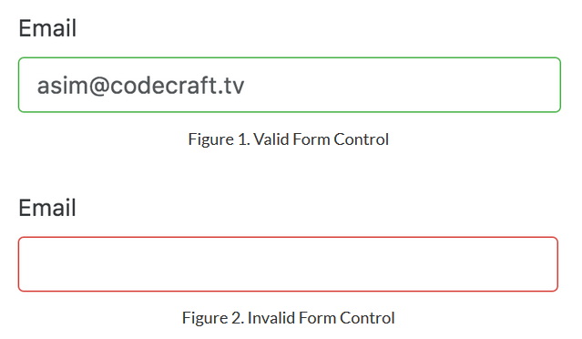
Angular Form - Validation
Angular Fundamental
<div class="form-group">
<label>Email</label>
<input type="email" formControlName="email" required>
<div *ngIf="email.errors && (email.dirty || email.touched)">
<p *ngIf="email.errors.required">Email is required</p>
<p *ngIf="password.errors.pattern">The email address must contain at least the @ character</p>
</div>
</div>

Slide 29
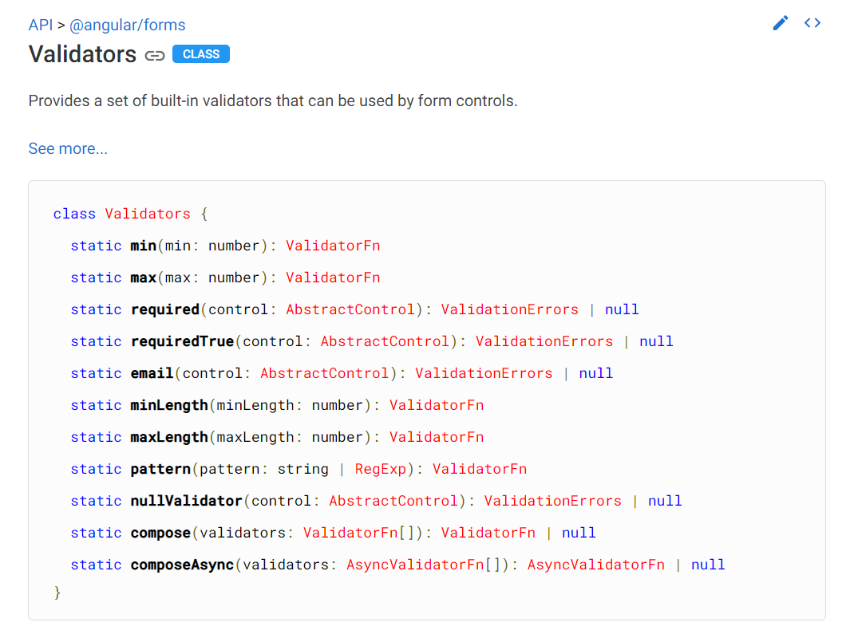
Angular Form - Validation
Angular Fundamental
https://angular.io/api/forms/Validators

Slide 30


Angular Form – Custom validation
Angular Fundamental
class ModelFormComponent implements OnInit {
myform: FormGroup;
ngOnInit() {
this.myform = new FormGroup({
………
language: new FormControl(),
phone: new FormControl('', [
Validators.pattern(“^[0-9]*$"),
this.validatePhoneLength
])
});
}
validatePhoneLength(control: AbstractControl): ValidationErrors | null {
if (control.value && control.value.length != 10) {
return { 'phoneLength': true };
}
return null;
}
}
<ng-template #defaultTemplate let-item>
<span>{{ item.name }}</span>
<p>{{ item.phone }}</p>
</ng-template>
<div class="form-group">
<label>Phone</label>
<input type="text" class="form-control“
formControlName="phone">
<div *ngIf="phone.errors">
<p *ngIf="phone.errors.pattern">
Phone pattern is invalid!</p>
<p *ngIf="phone.errors.phoneLength">
Phone length is invalid!</p>
</div>
</div>

Slide 31
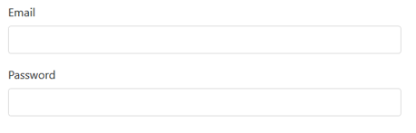

Angular Form – Custom validation – Cross field validation
Angular Fundamental
class ModelFormComponent implements OnInit {
myform: FormGroup;
ngOnInit() {
this.myform = new FormGroup({
………
language: new FormControl(),
phone: new FormControl('', [
Validators.pattern(“^[0-9]*$"),
this.validatePhoneLength
])
}, [this.validatePassword]);
}
validatePassword(control: AbstractControl): ValidationErrors | null {
const password = control.get('password');
const email = control.get('email');
return password.value && email.value && password.value == email.value ?
{ passwordInsecure: true } : null;
}
}
<div class="form-group">
<label>Password</label>
<input type="password" class="form-control“
formControlName="password">
<p *ngIf="myform.errors?.passwordInsecure">
Password insecure!</p>
</div>

Slide 32
Angular Form – Saving&Reseting Form Data
Angular Fundamental
Component
onSubmit() {
console.log(this.myForm.value);
}
onReset() {
if (this.myForm.valid) {
console.log("Form Submitted!");
this.myForm.reset();
}
}

Slide 33
Angular Service
Angular Fundamental
export class HeroService {
private heroes: Hero[] = [];
constructor(
private backend: BackendService,
private logger: Logger) { }
getHeroes() {
this.backend.getAll(Hero).then( (heroes: Hero[]) => {
this.logger.log(`Fetched ${heroes.length} heroes.`);
this.heroes.push(...heroes); // fill cache
});
return this.heroes;
}
}

Slide 34

Dependency Injection(DI)
Angular Fundamental
src/app/hero-list.component.ts (constructor)
constructor(private service: HeroService) { }

Slide 35
Providing services
Angular Fundamental
Declare Service
@Injectable({
providedIn: 'root',
})
Register
@NgModule({
providers: [
BackendService,
Logger
],
...
})

Slide 36
Angular Routing & Navigation
Angular Fundamental
<base href>
Most routing applications should add a <base> element to the index.html as the first child in the <head> tag to tell the router how to compose navigation URLs.
src/index.html (base-href)
<base href="/">
Router imports
src/app/app.module.ts (import)
import { RouterModule, Routes } from '@angular/router';

Slide 37
Angular Routing & Navigation - Config
Angular Fundamental
const appRoutes: Routes = [
{ path: 'hero/:id', component: HeroDetailComponent },
{
path: 'heroes', component: HeroListComponent
},
{ path: '',
redirectTo: '/heroes',
pathMatch: 'full'
},
{ path: '**', component: PageNotFoundComponent }
];
@NgModule({
imports: [
RouterModule.forRoot(
appRoutes,
{ enableTracing: true } // <-- debugging purposes only
)
],
})
export class AppModule { }

Slide 38
Providing service
Angular Fundamental
Register service at component level
@Component({
selector: 'app-hero-list',
templateUrl: './hero-list.component.html',
providers: [ HeroService ]
})

Slide 39
Angular Modules - Feature Module
Angular Fundamental
A feature module is an organizational best practice, as opposed to a concept of the core Angular API.
A feature module collaborates with the root module and with other modules through the services it provides and the components, directives, and pipes that it shares.
ng generate module CustomerDashboard
import { NgModule } from '@angular/core';
import { CommonModule } from '@angular/common';
@NgModule({
imports: [ CommonModule ], declarations: [] })
export class CustomerDashboardModule { }
<h1>
{{title}}
</h1>
<app-customer-dashboard></app-customer-dashboard>

Slide 40
Angular Httpclient
Angular Fundamental
get()
delete()
post()
put()
patch()
@Injectable({ providedIn: 'root' })
export class DefaultDataService {
private readonly url = `${environment.baseUrl}`;
constructor(private readonly http: HttpClient) {}
getData(id: number,param2?: string): Observable<Members[]> {
let url = `${environment.baseUrl}/projects/${id}/subProjects?param2=${param2}`; return this.http.get<Members[]>(url).pipe( map(json => json.map(data => { return Members.deserialize(data); })), );
}
}

Slide 41
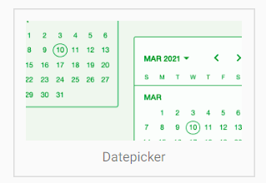
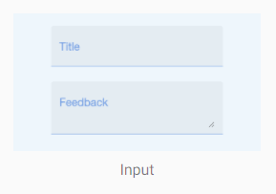
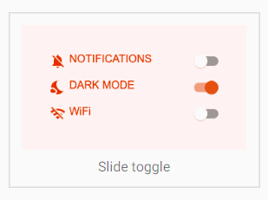
Angular Material Design Components To Enhance UI/UX
Angular Fundamental
https://material.angular.io/

Slide 42
Reference
Angular Fundamental
TypeScript Tutorial
https://www.tutorialspoint.com/typescript/index.htm
TypeScript excersise
https://typescript-exercises.github.io/
TypeScript playground
https://www.typescriptlang.org/play/
https://www.javatpoint.com/angular-7-tutorial
Angular Tutorial: Learn Angular from scratch step by step
https://angular-templates.io/tutorials/about/learn-angular-from-scratch-step-by-step

