Slide 1

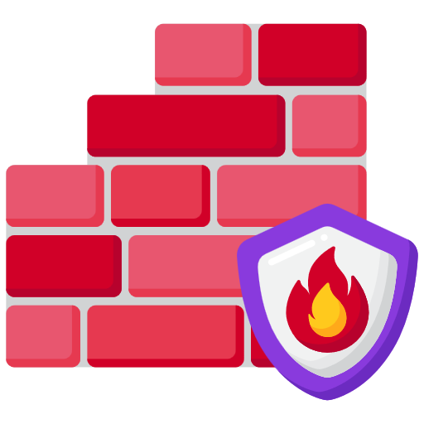

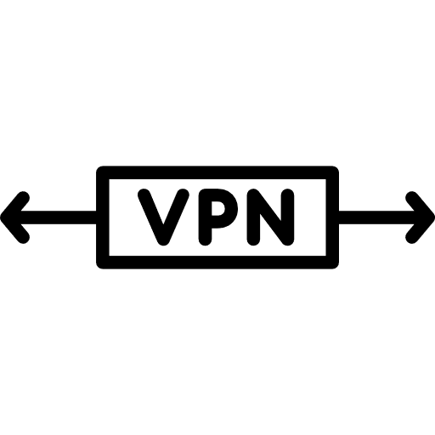
Network @ Home
Network @ Ski Cabin
HTTPS tunnel
Other traffic
Network
MQTT over SSL
Network
MQTT over SSL
MQTT over SSL
Matter Zigbee
Zigbee

