Slide 1



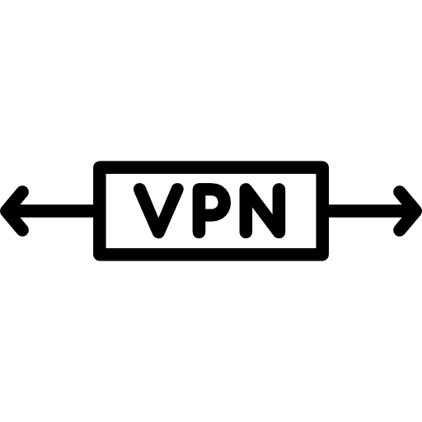
Network @ Home
Network @ Ski Cabin
HTTPS tunnel
Other network traffic
LAN
MQTT over TLS
LAN
MQTT over TLS
MQTT over TLS
Matter Zigbee
Zigbee

