Slide 1
Double/Debiased/Neyman Machine Learning
of Treatment Effects
Victor Chernozhukov, Denis Chetverikov, Mert Demirer,
Esther Duflo, Christian Hansen, and Whitney Newey
American Economic Review: Papers & Proceedings · 2017
Aaron Chotzen-Jenner
Notes:
Introduce yourself and the paper. Keep this slide simple: title, authors, journal/year, and your name. Mention that your presentation focuses on the applied 401(k) replication rather than the full theoretical DML paper.

Slide 2
What makes this paper different?
A short applied DML example, not the full theoretical framework.
KEY DISTINCTION
This paper
(my replication)
Shows DML in a concrete empirical application: 401(k) eligibility and household assets.
MAIN CAUSAL QUESTION
Does 401(k) eligibility increase net financial assets?
Notes:
Differentiate your paper from the next presentation. Then state the causal question: does 401(k) eligibility increase net financial assets? The issue is confounding because eligibility is observational rather than randomized.

Slide 3
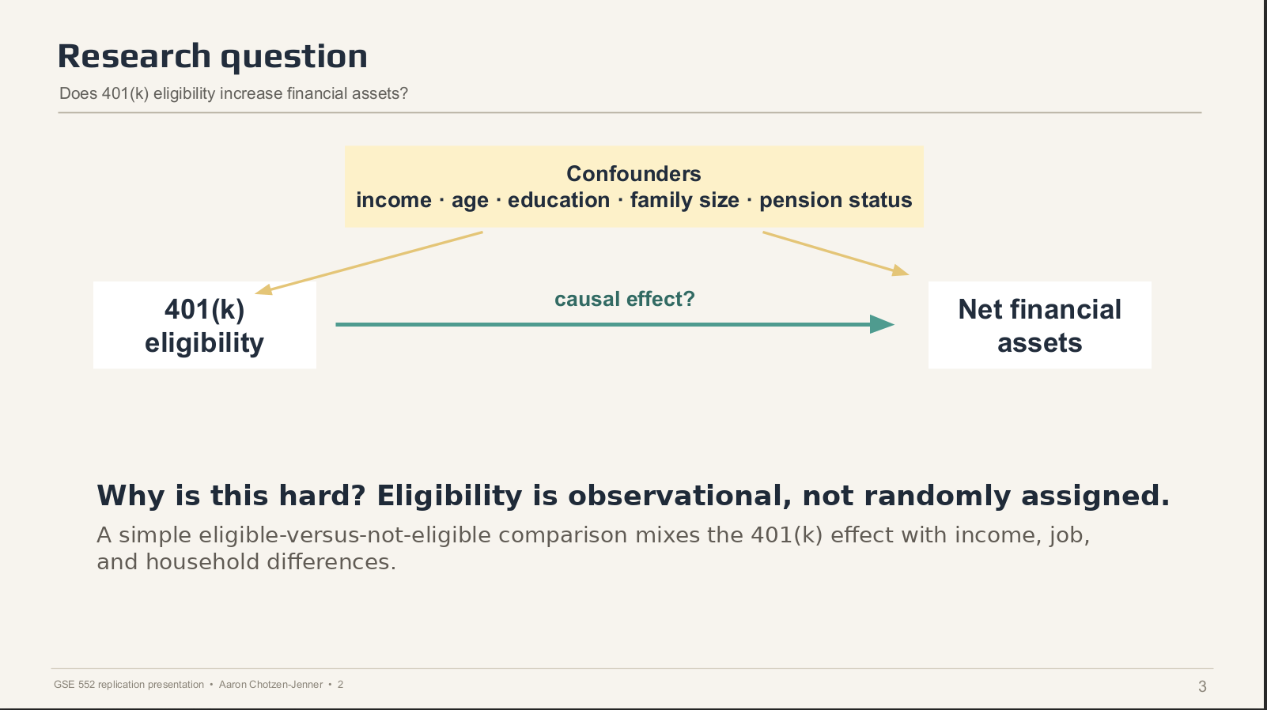

Slide 4
Data and empirical setting
The paper uses observational data where flexible controls matter.
DATASET
WHY THIS METHOD IS NEEDED HERE
Item
Description
Dataset
1991 SIPP
Machine learning can model complicated confounding relationships, but DML is needed so prediction errors do not drive the final causal estimate.
Sample
9,915 observations
Outcome
Net total financial assets
Treatment
401(k) eligibility
Controls
Age, income, education, family size, marital status, pension/IRA/home ownership
Simplified:
DML tries to compare people who differ in 401(k) eligibility after removing the parts of wealth and eligibility explained by observed characteristics.
Notes:
Describe the data: SIPP 1991, 9,915 observations, outcome net financial assets, treatment 401(k) eligibility, controls. Then explain why DML is needed in this empirical setting: eligible and non-eligible workers are not randomly assigned.

Slide 5
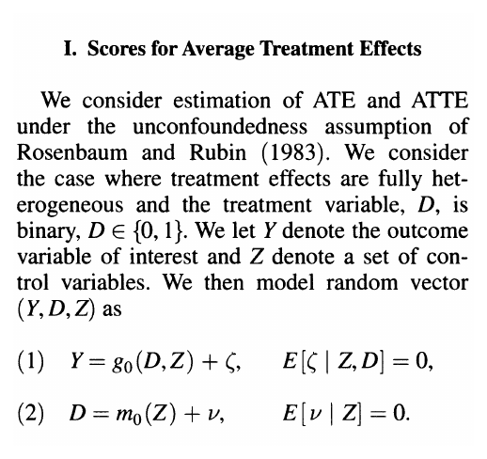
Model used in the paper
The equation frames the treatment-effect problem.
FROM CHERNOZHUKOV ET AL. (2017)
HOW TO READ IT
Y = outcome: net financial assets
D = treatment: 401(k) eligibility
Z = controls: income, age, education, etc.
The paper models both:
• how controls affect assets
• how controls affect eligibility
DML uses these two predictions to isolate the treatment effect.
Takeaway: DML lets the authors use flexible ML controls while still estimating a causal treatment effect.
Notes:
Use the screenshot directly from the paper. Do not read the equations line by line. Explain what Y, D, and Z are, and say that DML uses machine learning to estimate the relationships involving controls before estimating the effect of eligibility.

Slide 6
What I replicated: the Ensemble estimate
Table 1, Panel B · Partially Linear Model · 2-fold cross-fitting
REPLICATION TARGET
Mean ATE of 401(k) eligibility on net financial assets
Original paper target: $9,043 in the Ensemble column
WHAT IS THE ENSEMBLE?
A weighted combination of several ML methods. More weight goes to methods that predict best out of sample.
METHODS INSIDE THE ENSEMBLE
RLasso
Boosting
Random Forest
Neural Net
penalized linear model
sequential tree model
many trees averaged
flexible nonlinear predictor
GSE 552 replication presentation • Aaron Chotzen-Jenner
5
Notes:
State exactly what you replicated: Table 1, Panel B, ATE 2-fold, Ensemble column. Explain Ensemble in simple terms: it combines RLasso, Boosting, Random Forest, and Neural Net, with weights based on out-of-sample prediction performance.

Slide 7
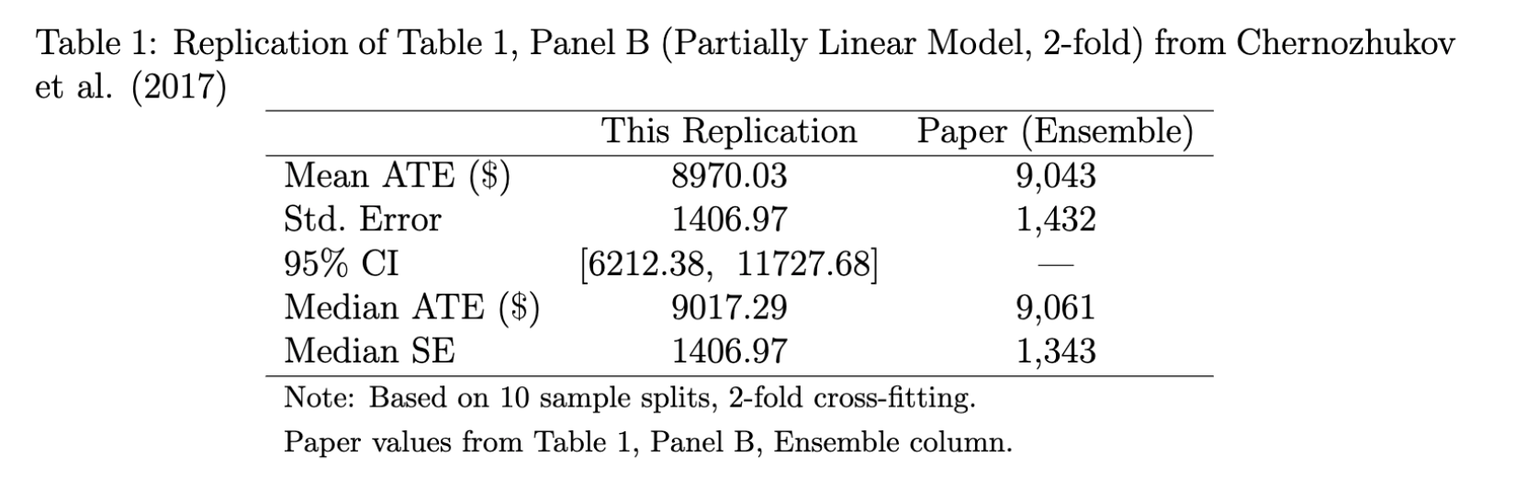
Replication results
The headline estimate closely matches the original paper.
MAIN COMPARISON
$9,043
paper estimate
$8,970
replication estimate
$73
difference
INTERPRETATION
WHY SMALL DIFFERENCES ARE EXPECTED
After flexibly controlling for confounders, 401(k) eligibility is estimated to increase net financial assets by about $9,000.
The paper averages over 100 random sample splits. I used 10 splits to keep computation time manageable, so small split-to-split differences are expected.
Notes:
Show your actual result screenshot. Say: my estimate is 8,970 versus 9,043 in the paper, a difference of 73 dollars, less than one percent. Interpret in plain English: 401(k) eligibility increases net financial assets by about 9,000 dollars after flexible controls. Explain the small difference: 10 splits vs. 100 splits.

