Slide 1
READING A SCIENTIFIC ARTICLE
Kira Mills
UTD Neuroscience Student Association
March 3, 2020

Slide 2
HELLO!
I am Kira Mills
I am a Ph.D. student in the Department of Chemistry & Biochemistry here at UTD
Read also: I read A LOT of journal articles

Slide 3

MY GOAL TODAY IS TO ANSWER:
What is a scientific article?
What is a scientific article?
How do you pick an article?
How do you pick an article?
What is the best way to read the article?
What is the best way to read the article?
How should you analyze and digest the information?
How should you analyze and digest the information?

Slide 4
What is a scientific article?
And why are you reading one?

Slide 5
THERE ARE SEVERAL TYPES OF ARTICLES
And most people only read a few
Primary Literature | Secondary Literature
Original research articles | Narrative reviews
Surveys | Systematic reviews
Case reports/case series | Meta-analysis
Conference proceedings and abstracts | Book reviews
Editorial | Guidelines
Correspondence/letters to the editor | Commentary
Primary Literature | Secondary Literature
Original research articles | Narrative reviews
Surveys | Systematic reviews
Case reports/case series | Meta-analysis
Conference proceedings and abstracts | Book reviews
Editorial | Guidelines
Correspondence/letters to the editor | Commentary

Slide 6
THE MAIN TYPES OF ARTICLES
Original Research
Written to present findings on new scientific discoveries
Follows IMRAD structure
Narrative Review
A broad overview of a topic without any specific question
Essentially an update or qualitative summary
Systematic Review
Addresses a specific question and evaluates papers
Ex: a meta-analysis, reviewing numeric results of several studies

Slide 7
What Are You Looking For?
Idea for Research (or for class/club)
Diagnosis/Therapy/ Prognosis
Topic Overview/ Updates
Original Research Articles
Randomized Control Trials
Controlled Clinical Trials
Experimental Studies
Cohort studies
Case-control studies
Reviews
Proceedings
Textbooks
Case series
Case reports
Narrative Reviews
Systematic Reviews
Meta-analysis
Adapted from: Subramanyam R. Art of reading a journal article: Methodically and effectively. J Oral Maxillofac Pathol. 2013;17(1):65–70. doi:10.4103/0973-029X.110733

Slide 8
While every field, journal, and article is unique, there is still a general flow and purpose of every article that we can follow

Slide 9
ORIGINAL RESEARCH IS USUALLY ORGANIZED THIS WAY:
What did we study and why?
How did we study it?
What did we learn about it?
Introduction
Background & Significance
Materials & Methods
Part of Results
Results
Discussion & Conclusions

Slide 10
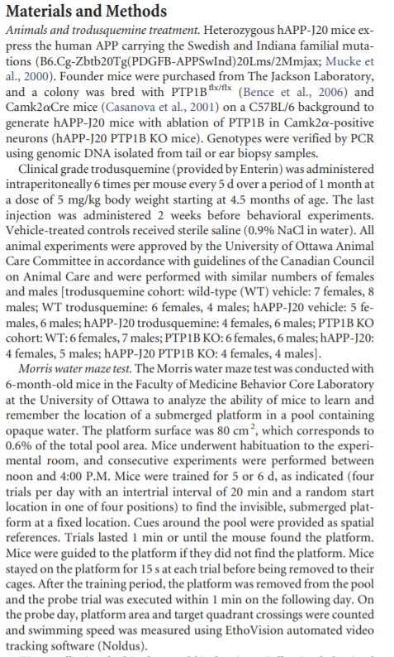

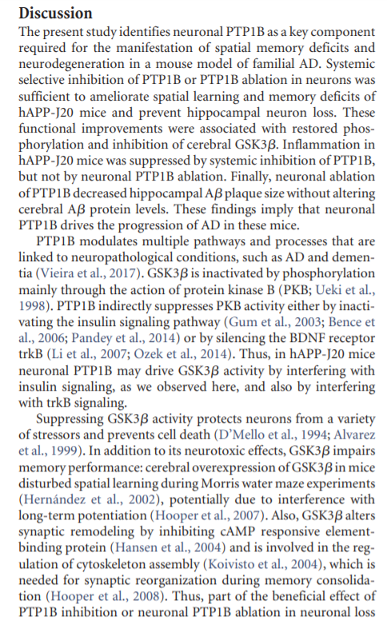
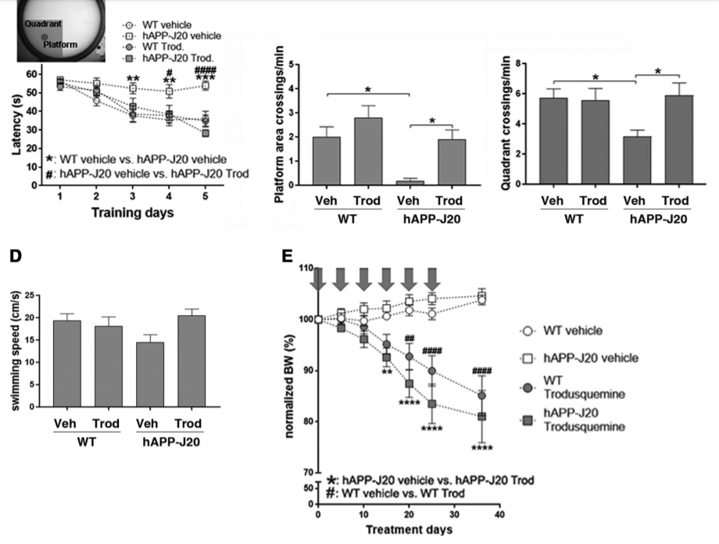

SECTIONS OF A RESEARCH ARTICLE
ABSTRACT: Brief overview of the article
INTRODUCTION: Background information and statement of research hypothesis
METHODS: Details of how the study was conducted, procedures followed, instruments used, and variables measured
RESULTS: All the data of the study along with figures, tables and/or graphs
DISCUSSION: The interpretation of the results and implications of the study
ABSTRACT: Brief overview of the article
INTRODUCTION: Background information and statement of research hypothesis
METHODS: Details of how the study was conducted, procedures followed, instruments used, and variables measured
RESULTS: All the data of the study along with figures, tables and/or graphs
DISCUSSION: The interpretation of the results and implications of the study

Slide 11
How do you pick one?
Where do you even find it?

Slide 12
WHERE TO LOOK FOR ARTICLES
The library’s website
A different database (SCOPUS, ScienceDirect, PubMed)
Can be found through the library
A journal’s website
The Journal of Neuroscience
Nature Neuroscience
The reference list of a different article

Slide 13
SHOULD YOU READ AN ARTICLE?
Is the Title related to the topic that I am looking for? Does it have the Keywords I have in mind?
NO
YES
Skip the article and go to the next
Read the Abstract / Summary / Conclusion
Clear-cut Aims and Objectives?
Well-defined Research Hypothesis?
Are the Conclusions precise?
NO
Is the above useful or relevant to what I’m looking for?
YES
Read the entire article
Adapted from: Subramanyam R. Art of reading a journal article: Methodically and effectively. J Oral Maxillofac Pathol. 2013;17(1):65–70. doi:10.4103/0973-029X.110733

Slide 14
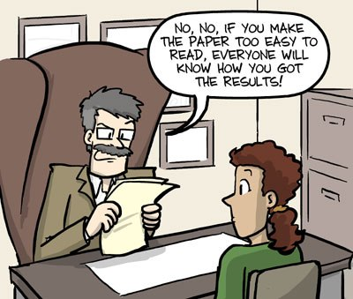
IT’S OKAY TO NOT KNOW
You don’t need to understand every part of a paper, you just need to be able to follow along with the story they’re telling.
Everything else you can learn later.

Slide 15
So how do you read it?
Hint: You’re not reading a book - don’t just go beginning to end

Slide 16
THE 10 STAGES OF READING A SCIENTIFIC ARTICLE
As given by Adam Ruben, Ph.D
1.
Optimism
2.
Fear
3. Regret
4.
Corner-cutting
5.
Bafflement
10.
Genuine contemplation of a career change
9.
Rage
8.
Determination
7.
Realization that 15 minutes have gone by and you haven’t progressed to the next sentence
6.
Distraction
Adam Ruben. (2016) How to read a scientific article. Science Careers.
doi:10.1126/science.caredit.a1600012
Notes:
1. Optimism. “This can’t be too difficult,” you tell yourself with a smile—in the same way you tell yourself, “It’s not damaging to drink eight cups of coffee a day” or “There are plenty of tenure-track jobs.” After all, you’ve been reading words for decades. And that’s all a scientific paper is, right? Words?
2. Fear. This is the stage when you realize, “Uh … I don’t think all of these are words.” So you slow down a little. Sound out the syllables, parse the jargon, look up the acronyms, and review your work several times. Congratulations: You have now read the title.
3. Regret. You begin to realize that you should have budgeted much more time for this whole undertaking. Why, oh why, did you think you could read the article in a single bus ride? If only you had more time. If only you had one of those buzzer buttons from workplaces in the 1960s, and you could just press it and say, “Phoebe, cancel my January.” If only there was a compact version of the same article, something on the order of 250 or fewer words, printed in bold at the beginning of the paper…
4. Corner-cutting. Why, what’s this? An abstract, all for me? Blessed be the editors of scientific journals who knew that no article is comprehensible, so they asked their writers to provide, à la Spaceballs, “the short, short version.” Okay. Let’s do this.
5. Bafflement. What the hell? Was that abstract supposed to explain something? Why was the average sentence 40 words long? Why were there so many acronyms? Why did the authors use the word “characterize” five times?
6. Distraction. What if there was, like, a smartphone for ducks? How would that work? What would they use it for? And what was that Paul Simon lyric, the one from “You Can Call Me Al,” that’s been in your head all day? How would your life change if you owned a bread maker? You’d have to buy yeast. Is yeast expensive? You could make your own bread every few days, but then it might go stale. It’s not the same as store-bought bread; it’s just not. Oh, right! “Don’t want to end up a cartoon in a cartoon graveyard.” Is Paul Simon still alive? You should check Wikipedia. Sometimes you confuse him with Paul McCartney or Paul Shaffer. Shame about David Bowie. Can you put coffee in a humidifier?
7. Realization that 15 minutes have gone by and you haven’t progressed to the next sentence.
8. Determination. All righty. Really gonna read this time. Really gonna do it. Yup, yuppers, yup-a-roo, readin’ words is what you do. Let’s just point those pupils at the dried ink on the page, and …
9. Rage. HOW COULD ANY HUMAN BRAIN PRODUCE SUCH SENTENCES?
10. Genuine contemplation of a career in the humanities. Academic papers written on nonscientific subjects are easy to understand, right? Right?

Slide 17
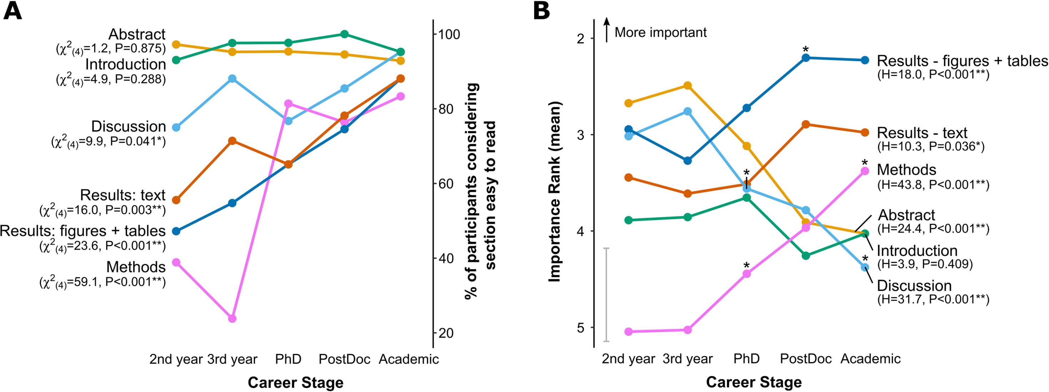
Survey results showing what students and PIs think is the most important section of an article and how easy each is to read
Hubbard, K. E., & Dunbar, S. D. (2017). Perceptions of scientific research literature and strategies for reading papers depend on academic career stage. PloS one, 12(12), e0189753

Slide 18
WHERE TO ACTUALLY BEGIN
During these stages, underline or highlight the text and take notes in the margins as you go
Read the title and abstract
What are the main goals of the paper?
What were the high-level results?
Take a few minutes to flip through the article
Get a feel for how it’s laid out, where figures are and what they look like, how much detail was given in each area, etc

Slide 19
WHERE TO ACTUALLY BEGIN
During these stages, underline or highlight the text and take notes in the margins as you go
Read the introduction
What is this paper about? What problem is this trying to solve?
What are the authors trying to answer with their research?
What is the hypothesis (and null hypothesis)?
How does the author plan to answer this question?
What scientific terms were used that you need to look up?

Slide 20
WHERE TO ACTUALLY BEGIN
During these stages, underline or highlight the text and take notes in the margins as you go
Read the introduction
Big Picture → Importance of Problem
Narrow → Previous research has shown or not shown
Very specific point
The purpose of this study was...

Slide 21
WHERE TO ACTUALLY BEGIN
During these stages, underline or highlight the text and take notes in the margins as you go
Read the conclusion or discussion
What problems do the authors identify in the research?
Do the authors identify a direction for future research?
How did their experimental design answer their original questions or hypothesis?
Which results do they identify as key?

Slide 22
WHERE TO ACTUALLY BEGIN
During these stages, underline or highlight the text and take notes in the margins as you go
Carefully look at each figure
“Figures contain some of the most important information in a paper. Authors spent a lot of time creating them and deemed the information they contain to be important enough to communicate to the reader using a visual. Pay particular attention to them.”

Slide 23
WHERE TO ACTUALLY BEGIN
During these stages, underline or highlight the text and take notes in the margins as you go
Go through and read the methods and results
What were the main “types” of experiments they performed and why?
Summarize the results of the key tables or graphs.
How does each figure relate to the question begin asked?

Slide 24
Figure out what you read
This will focus on if you need to have a firm grasp (for a presentation or class assignment)

Slide 25
READ IT AGAIN
After initially reading each section, and annotating, go back through and read the paper again to see if you can understand how it all fits back together
You might not need to read every sentence, but make sure you can now follow their main points

Slide 26
TAKE NOTES
There are a lot of methods for taking notes that help, play around with a few to see what works best for you
Bullet-point or outline style
Answering the questions for each section
Create a flowchart or storyboard

Slide 27
OUTLINE STYLE OF NOTES
Introduction
Immobilization = std treatment for acute damage
Evidence that it’s doing more harm (chronic pain)
TENS and exercise previously shown to be better for recovery
But how much better? How do they compare?
HYPOTHESIS: Low-intensity muscle contraction exercise may be more beneficial acute pain management strategy compared to immobilization and TENS\
Methods
5 groups of 12 rats:
Arthritis
Exercise
TENS
Immobilization
Control (sham)
Induce arthritis by injecting 3% kaolin and 3% carrageenan

Slide 28
ANSWER QUESTIONS
Introduction
What problem is this trying to solve?
Immobilization is current standard of treatment, but it’s shown to lead to chronic pain
What is the hypothesis (and null hypothesis)?
Low-intensity muscle contraction exercise may be a better acute pain treatment through reduction of tissue inflammation compared to immobilization and TENS
Methods
What were the main “types” of experiments they performed and why?
Created arthritis rat models, did behavior tests (PPT and PWR) to get idea of pain threshold of each, tissue cultures to test for CD68(+) cells and CGRP which are indicators of inflammation

Slide 29
FLOW-CHART OR STORYBOARD
This study: compare TENS, exercise, and immobilization in rat arthritis model
Immobilization = put plaster cast on rat leg
5 groups of 12 rats:
control
arthritis
immobilization
exercise
TENS
Induce arthritis in right knee joint
TENS = apply low-level electric stim. not enough for muscle contraction
PPT & PWR → measure to see how rats respond to pain
Test behavior
Exercise = use same device as TENS at higher intensity to cause muscle contraction
PPT: Exercise #1 and TENS #2
PWR: Exercise #1
Low-intensity muscle contraction reduced 1º and 2⁰ hyperalgesia by lowering amount macrophages
Exercise sig. better, TENS #2
Knee= look for CD68 + cells (lower = better)
Culture tissue from knee and spine
Exercise better in 3/4 , TENS #2
Spine = look for CGRP (peptide) (lower = better)

Slide 30
Remember, these are just the methods and tips that I find useful. As you read more, you may come up with a completely different method and that’s good!

Slide 31

THANKS!
Any questions?
You can find me at:
kira.mills@utdallas.edu
kiramills.com
Slides will be posted at utdnsa.org

Slide 32

Come to Parts 2 & 3
Presenting science: Tues 3/10
Writing science: Tues 3/24
7:30p in GR 4.204
For NSA Members:
Sign-in to receive hours for attending tonight!
utdnsa.org/dw1

