Slide 1
Welcome to journal club!!!

Slide 2
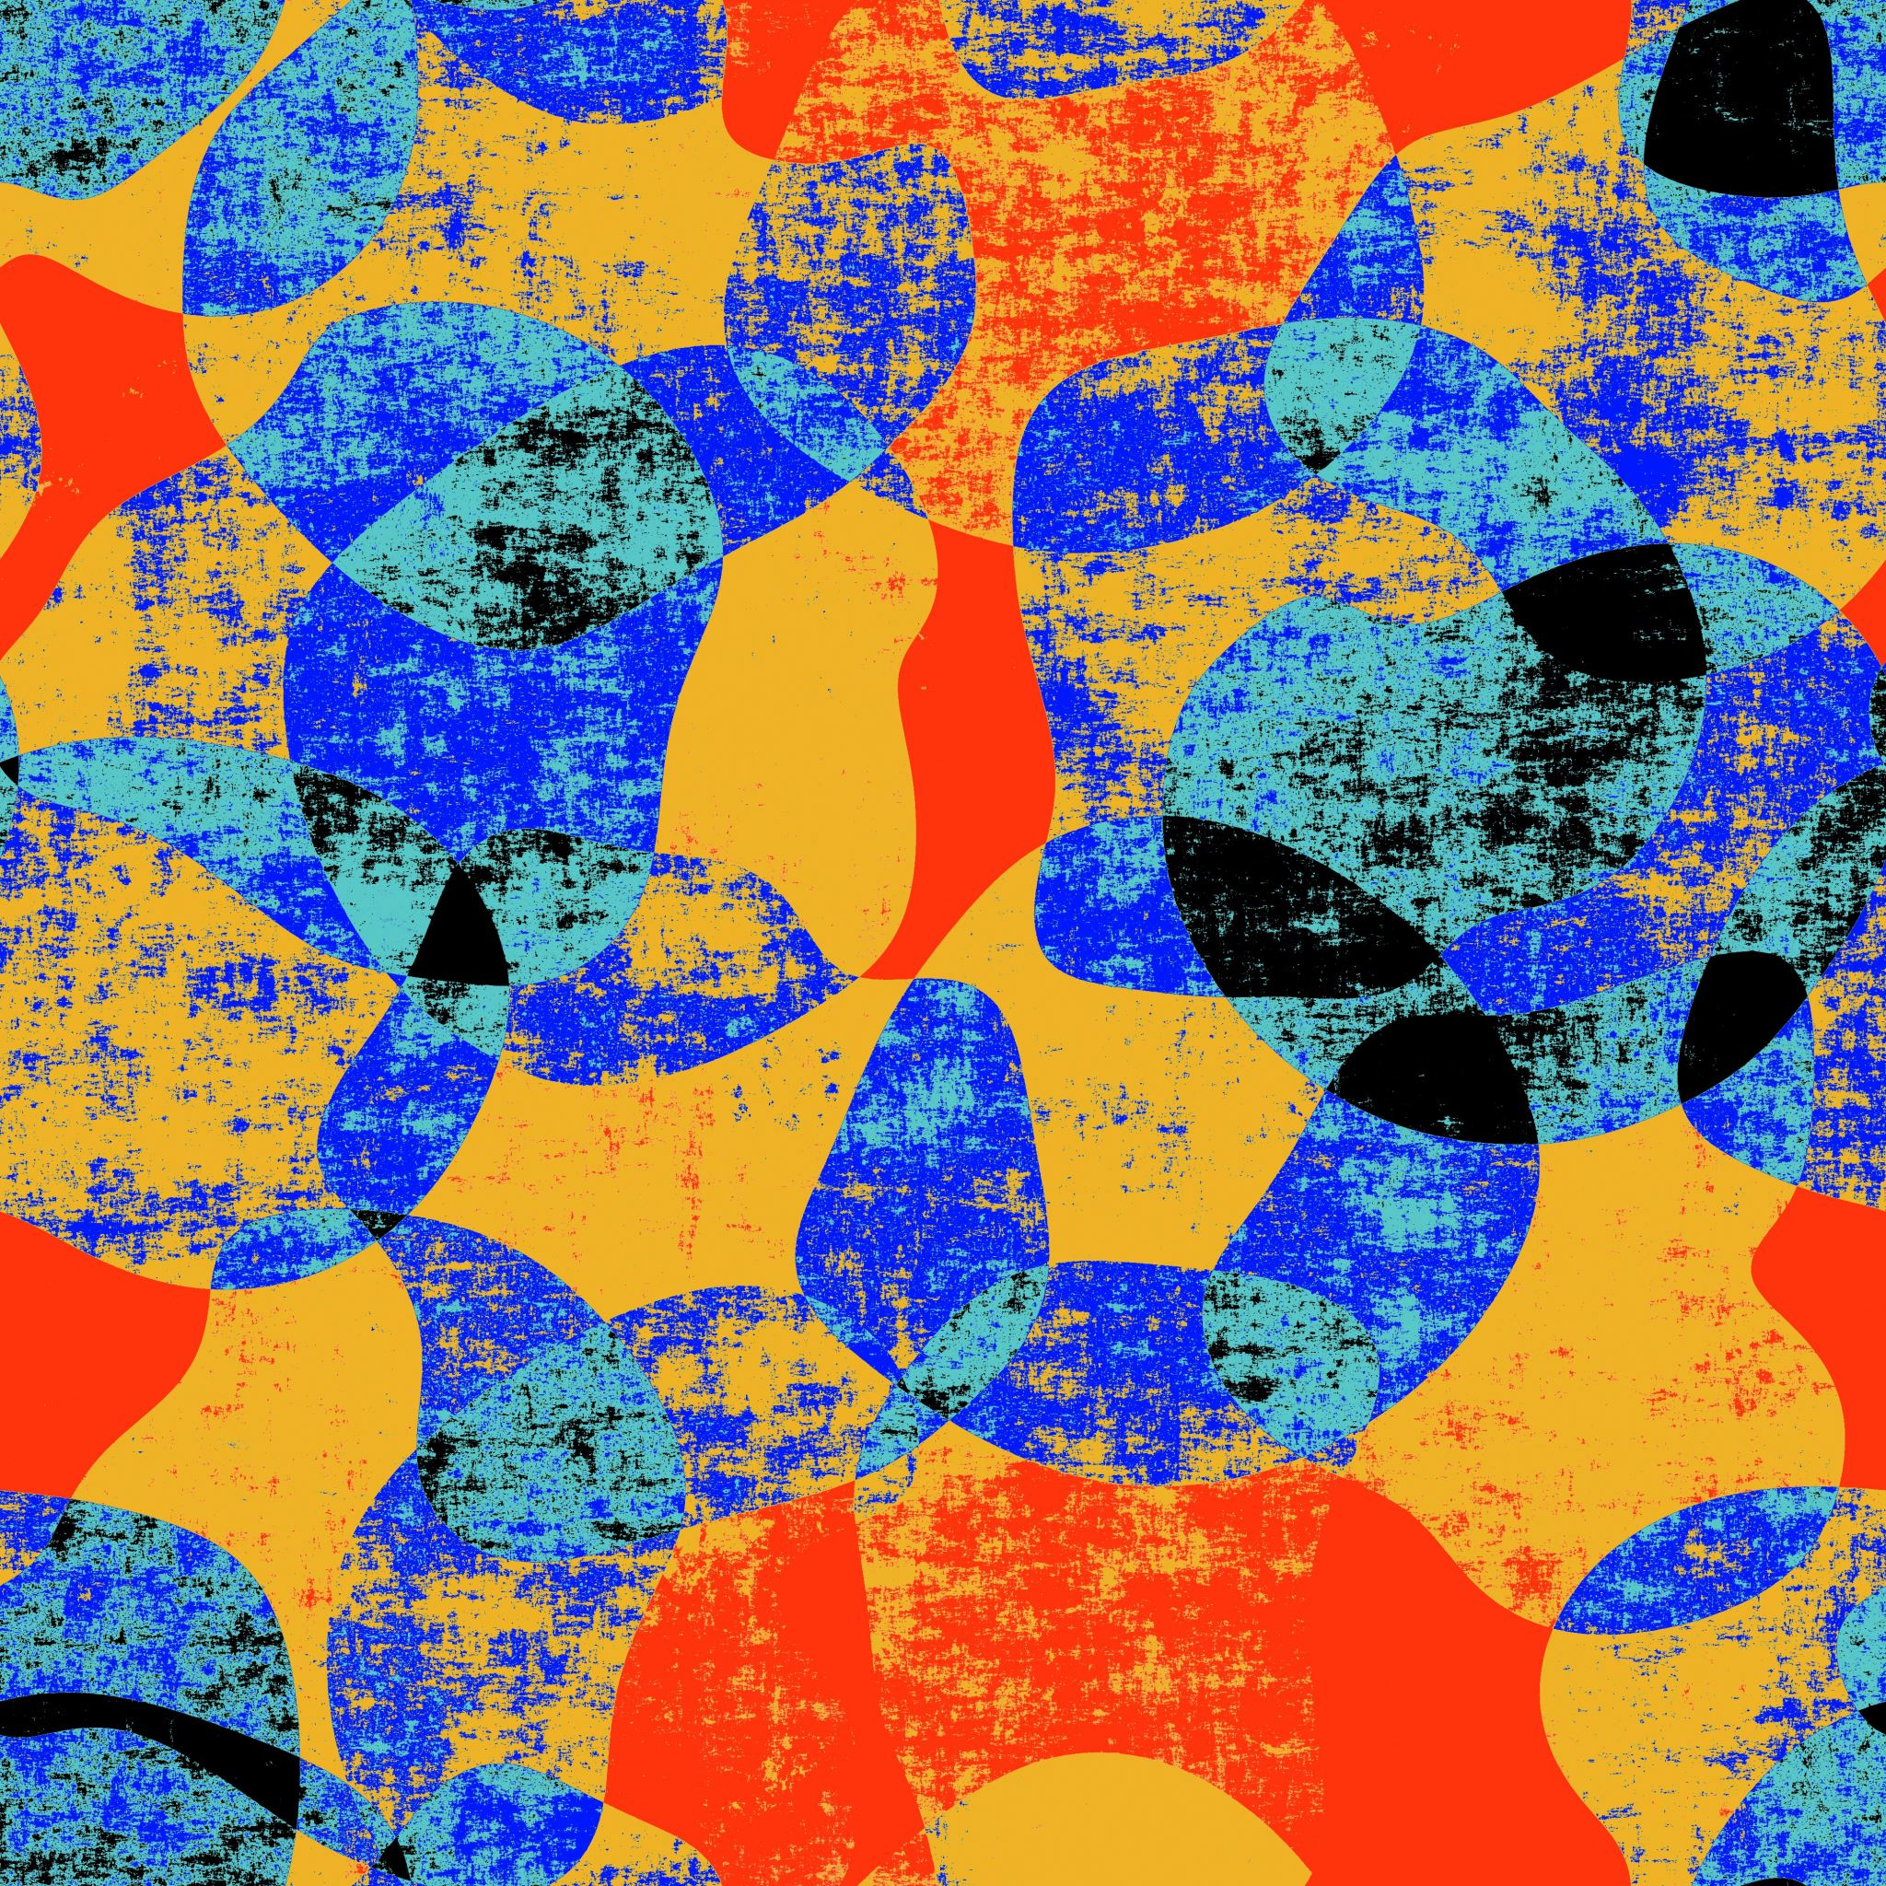
Triptan-induced enhancement of neuronal nitric oxide synthase in trigeminal ganglion dural afferents underlies increased responsiveness to potential migraine triggers
Milena De Felice,1 Michael H. Ossipov,1 Ruizhong Wang,1 Gregory Dussor,1 Josephine Lai,1 Ian D. Meng,2 Juliana Chichorro,3 John S. Andrews,4 Suman Rakhit,4 Shawn Maddaford,4 David Dodick5 and Frank Porreca1

Slide 3
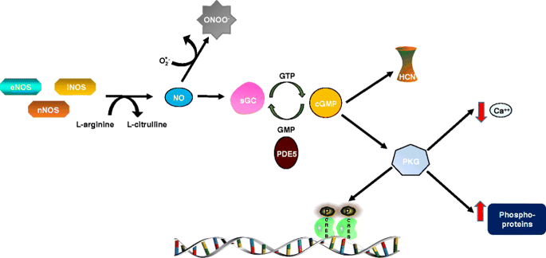

Slide 4
Abbreviations
NOS = nitric oxide synthase
nNOS = neuronal
eNOS = endothelial
iNOS = inducible
TG = trigeminal ganglion
CGRP = calcitonin gene related peptide
GTN = nitroglycerin or glyceryl trinitrate

Slide 5
Nitric oxide hypothesis of migraine
GTN causes NO release and induces migraine-like headache
other NO donors (such as SNP) cause allodynia and prime headache in migraine models
NOS inhibitors can stop migraine headache and reduce photophobia/phonophobia
possibly sensitivity to NO can trigger headache in migraine patients

Slide 6
Drug targets
NOS inhibitors
L-NMMA: non selective, for migraine and tension type headache
NO scavengers
hydroxycobalamin
sumatriptan
CGRP antagonists
NXN-323: selective for nNOS

Slide 7

Triptans (sumatriptan)
used in acute treatment of migraine
possibly scavenges NO, increases superoxide
relief in 45-70% of patients

Slide 8
Medication overuse headache
>15 headaches/month >15 days acute meds/month for 3 months
10+ doses triptan in 3 months
appear like usual migraines or increase in migraine frequency
65% migraine
27% tension type headache
8% mixed headaches

Slide 9
Triptan-induced enhancement of neuronal nitric oxide synthase in trigeminal ganglion dural afferents underlies increased responsiveness to potential migraine triggers
Milena De Felice,1 Michael H. Ossipov,1 Ruizhong Wang,1 Gregory Dussor,1 Josephine Lai,1 Ian D. Meng,2 Juliana Chichorro,3 John S. Andrews,4 Suman Rakhit,4 Shawn Maddaford,4 David Dodick5 and Frank Porreca1

Slide 10
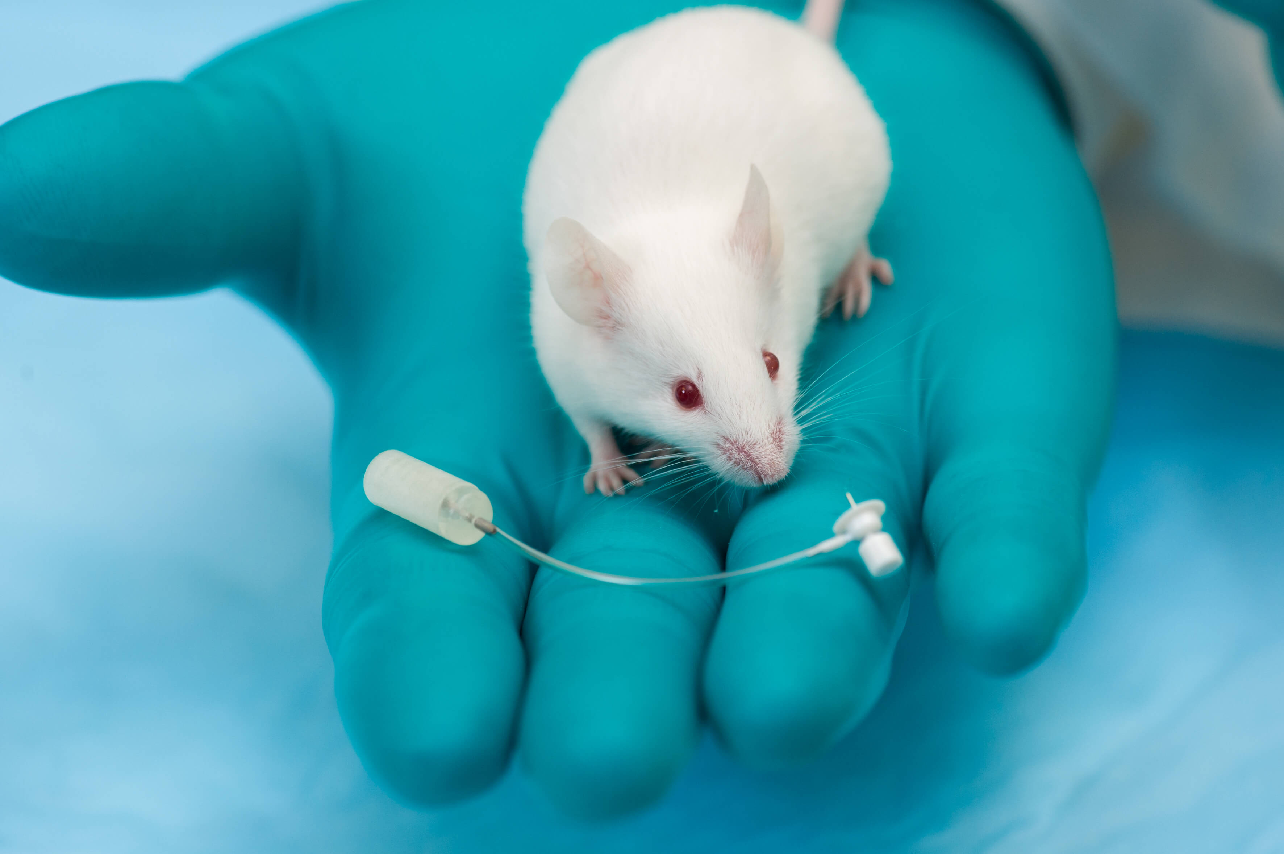

Slide 11
Sumatriptan treatment elicits long-lasting increases in neuronal NOS labelling in multiple classes of retrogradely-labelled dural afferents
low basal nNOS in TG: 13/232 cells
increased nNOS in TG after sumatriptan: 101/312 cells
Notes:
low basal nNOS in TG (13/232) increased to 101/312 after sumatriptan

Slide 12
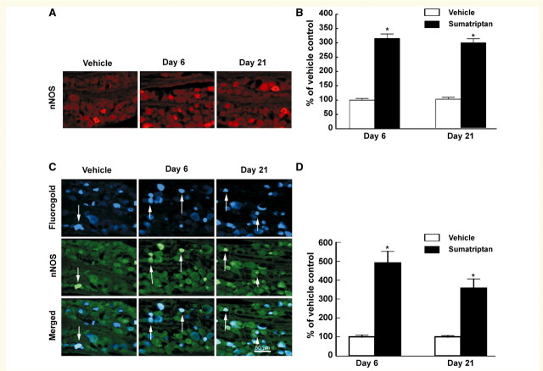
Fig. 1
Notes:
Flurogold labels dural afferents (dura → brain)

Slide 13
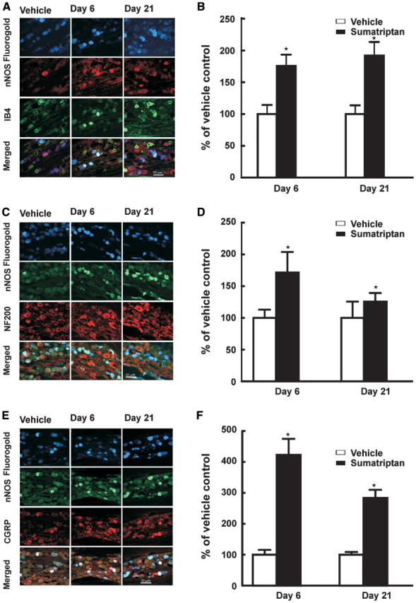
Fig. 2
Notes:
IB4 labels unmyelinated

Slide 14
Fig. 2
Notes:
NF200 labels myelinated

Slide 15
Fig. 2
Notes:
basal 8/132 CGRP & 5/132 nNOS, 6 days

Slide 16
312 dural afferents
Basal
8 nNOS labeled with CGRP
5 nNOS labeled without CGRP
Day 6
44 nNOS labeled with CGRP
61 nNOS labeled without CGRP
Day 21
37 nNOS labeled with CGRP
32 nNOS labeled without CGRP
Notes:
CGRP positive show greatest increase in nNOS expression

Slide 17
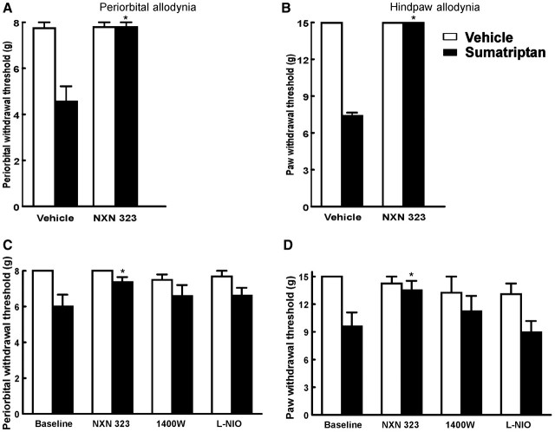
Fig. 3
Notes:
NXN 323 is selective nNOS inhibitor, 1400W is iNOS inhibitor, L-NIO is eNOS inhibitor

Slide 18
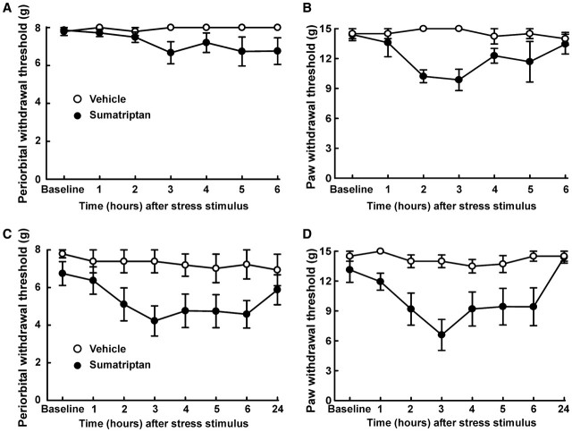
Fig. 4

Slide 19
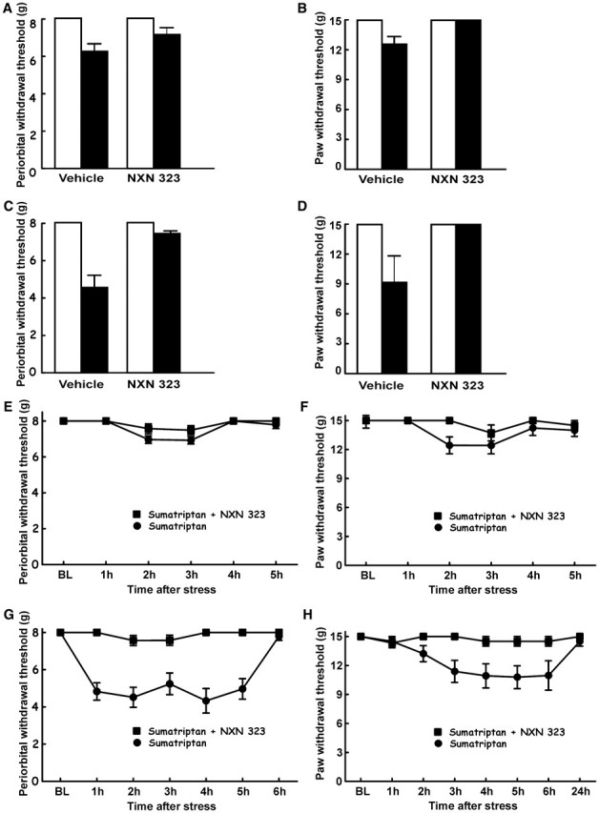
Fig. 5

Slide 20
Fig. 5

Slide 21
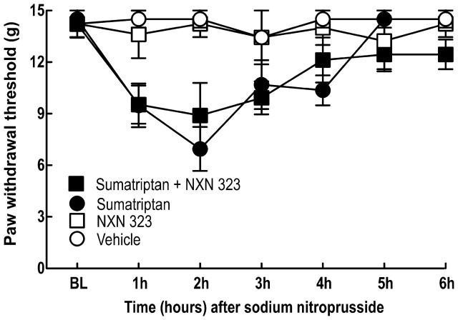
Fig. 6

