Slide 1
Molecular Dynamics Simulations for All
Presented by:
Kira Mills
PhD Student – Chemistry & Biochemistry

Slide 2
So why am I presenting at NSA?
And why should you care about MD simulations?

Slide 3
WHAT ARE WE GOING TO DISCUSS?
What is an MD simulation?
What kind of info can they give us?
How can they help with experimental work?

Slide 4
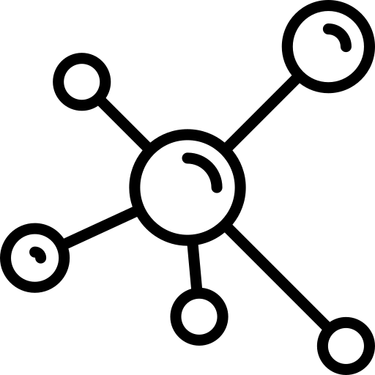
Topic One
What is an MD simulation?

Slide 5
By knowing the position of every atom in a biomolecular system, we can calculate the force each atom exerts on every other atom and, with Newton’s laws of motion, accurately predict how they’ll move

Slide 6
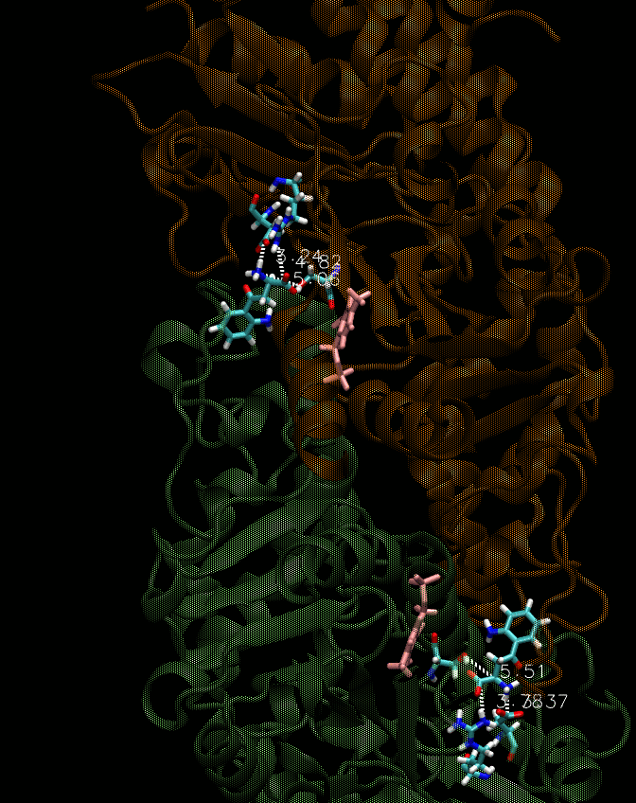
WHAT DOES THAT MOVEMENT MEAN?
“The resulting trajectory is... a three-dimensional movie that describes the atomic-level configuration of the system at every point during the simulated time interval.”

Slide 7
HOW DOES IT WORK?
Chemistry
Each atom is made up of a nucleus with electrons
These atoms interact based on size (Van der Waals) and electrostatics (dipole)
Physics
Atoms become moving spheres and bonds become harmonic springs
Forces come from interactions and we integrate Newton’s laws of motion
Biology
The simulations are created with “force fields” that are optimized so the systems act like proteins, nucleic acids, lipids, etc

Slide 8
Topic Two
What kind of information can MD simulations give us?

Slide 9
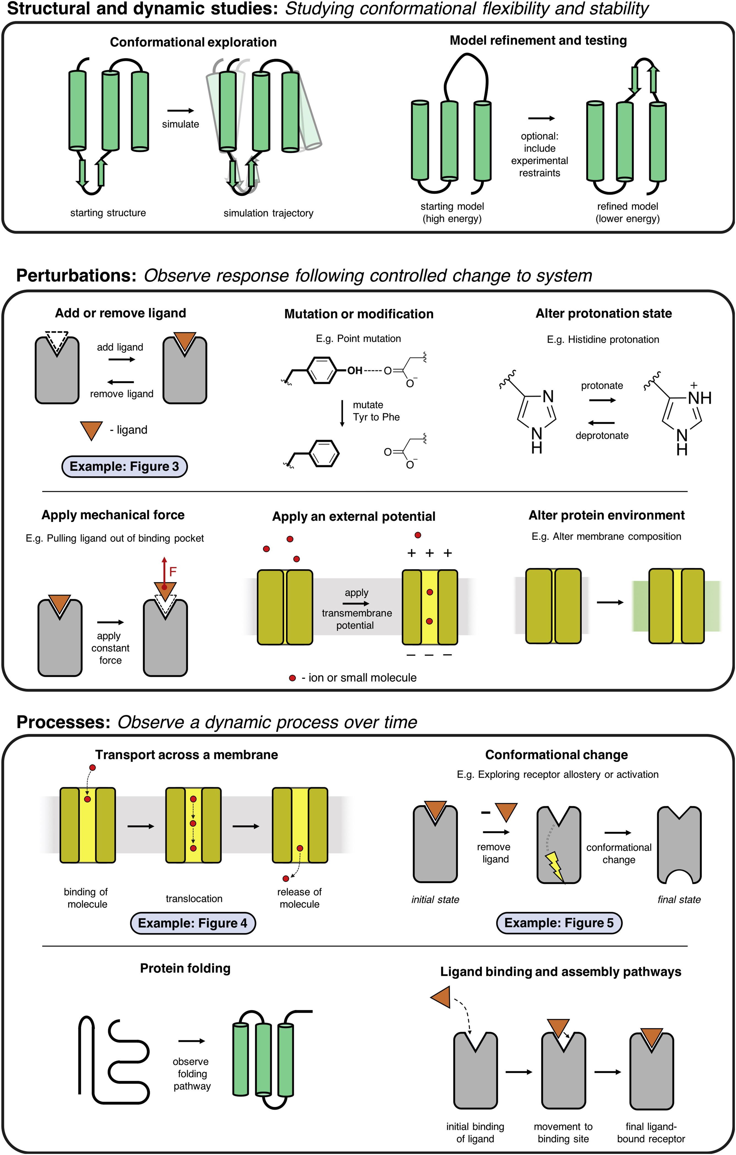

Slide 12
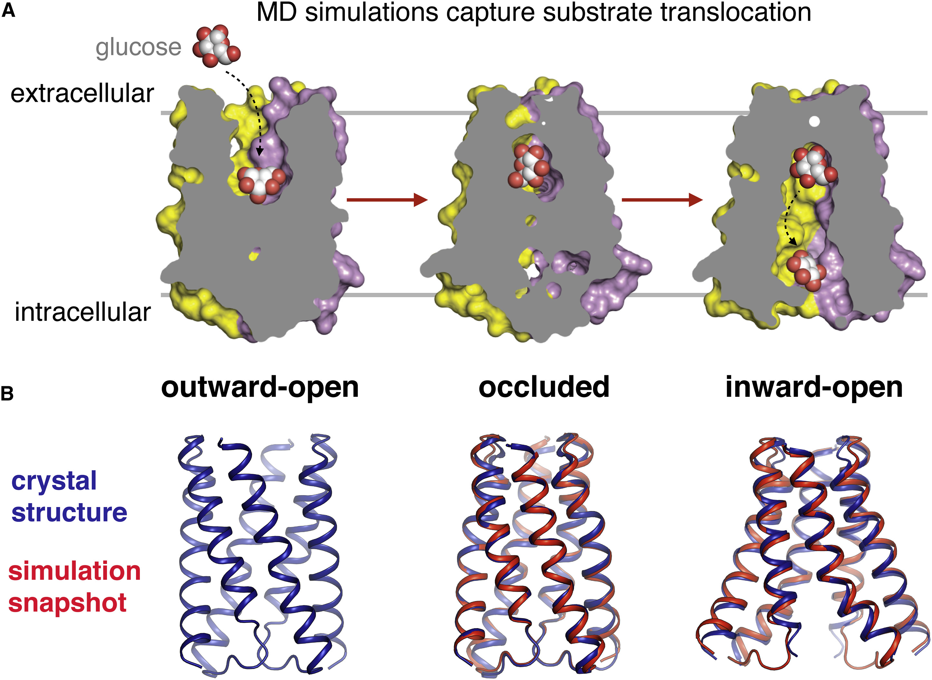
EXAMPLES OF PREVIOUS MD WORK
Movement of sugar
MD simulations showed the transition of the sugar transporter SemiSWEET from its outward-open to its inward-open state
N.R. Latorraca et al. Mechanism of substrate translocation in an alternating access transporter. Cell, 169 (2017), pp. 96-107.e12

Slide 13
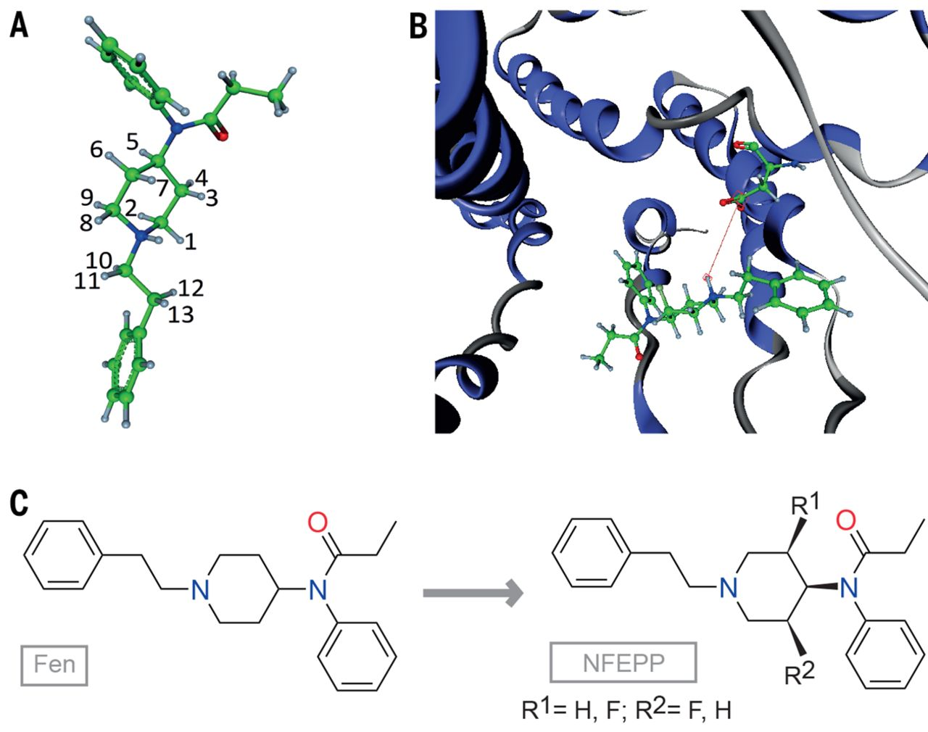
EXAMPLES OF PREVIOUS MD WORK
Development of non-toxic pain killers
MD simulations were used to observe and compare the efficacy of non-opioid pain killers with their opioid counterparts
Spahn, V et al. A nontoxic pain killer designed by modeling of pathological receptor conformations. Science, 355 (2017), pp. 966-969

Slide 14
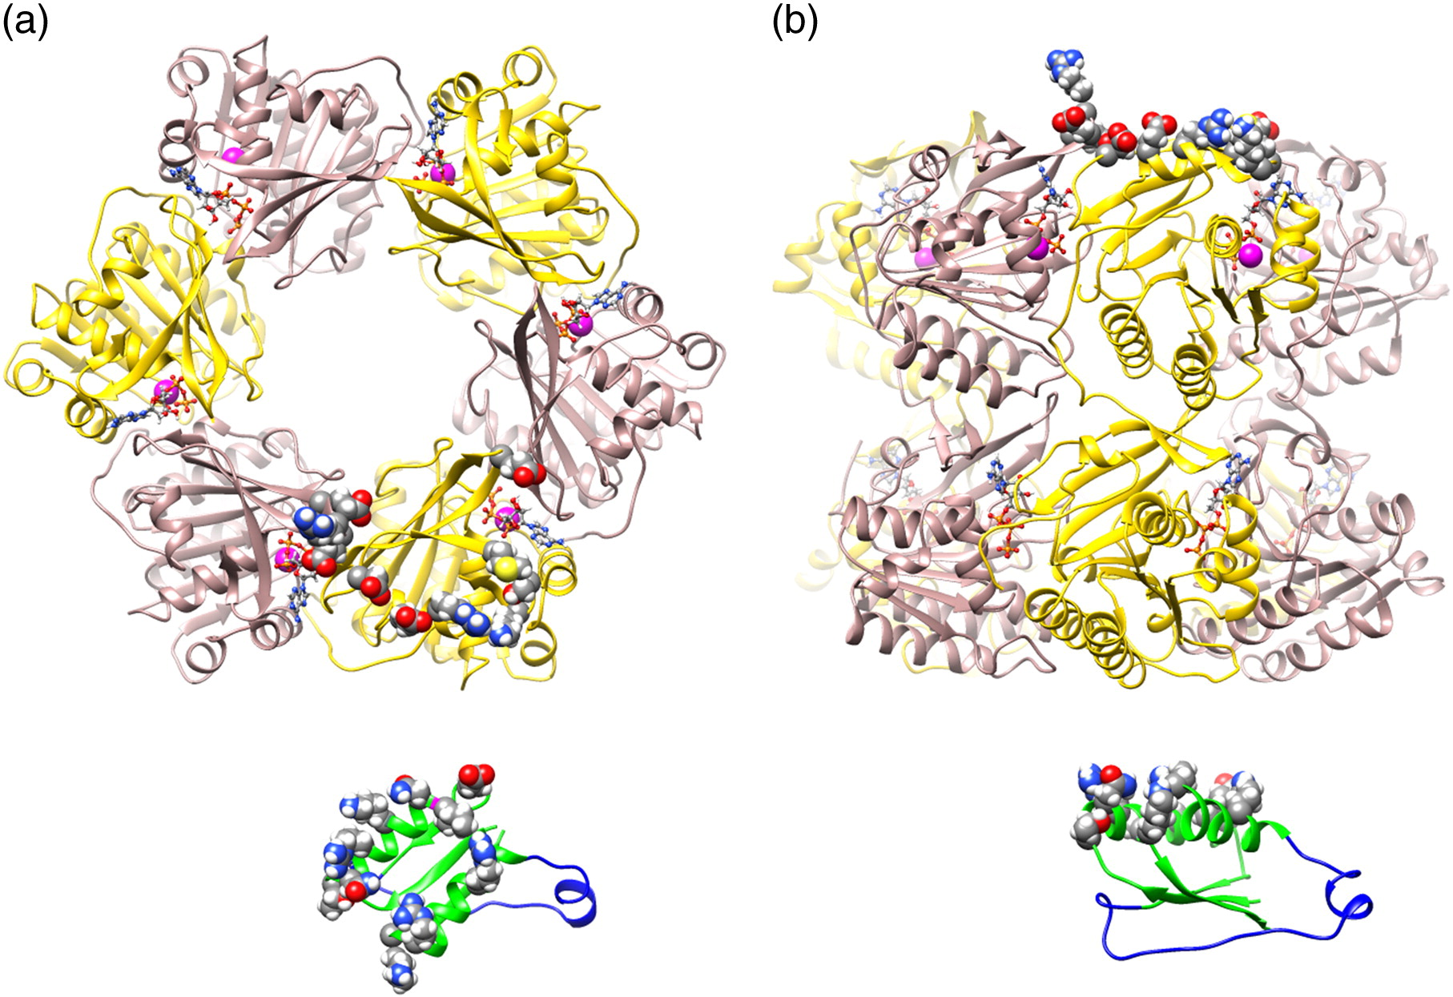
EXAMPLES OF PREVIOUS MD WORK
Studying the cyanobacterial clock
MD simulations were used to gain a better picture of the protein cycle involved in the circadian clock of cyanobacteria
Villarreal, S et al. CryoEM and MD of the Circadian KaiB-Kai-C Complex Indicates that KaiB Monomers Interact with KaiC and Block ATP Binding Clefts.. JMB, 425 (2013), pp. 3311-3324

Slide 15
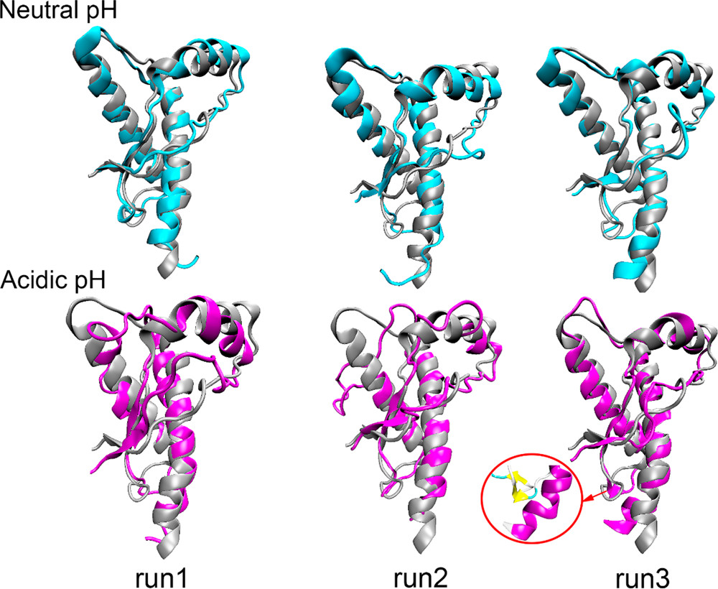
EXAMPLES OF PREVIOUS MD WORK
Prion protein becoming pathogenic at acidic pH
MD simulations were used to study how prion proteins are converted to their pathogenic and cytotoxic state in acidic environments
Zhou, S et al. PH-Induced Misfolding Mechanism of Prion Protein: Insights from Microsecond-Accelerated MD Simulations. ACS Chem, Neurosci., 10 (2019), pp. 2718-2729

Slide 16
Topic Three
How can MD simulations be used to further experimental work?

Slide 17
At the 2008 Keystone Symposium on GPCRs, there was no mention of computational methods. At the 2018 version, over half of the speakers used some form of simulation.

Slide 18





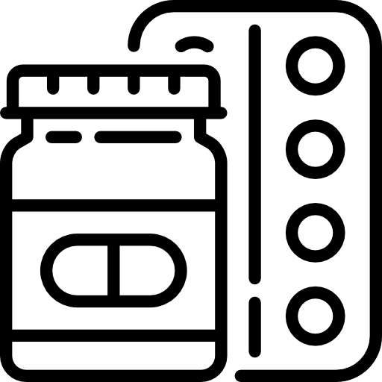
WAYS MD SIMULATIONS CAN HELP
Ligand/Protein Design
Simulations are a relatively inexpensive filter for binding energy or stability
Qualitative Understanding
Allow one to visualize the mechanism of how a biomolecule or drug works
Finding Binding Sites
In several cases, MD simulations reveal previously unobserved binding sites on druggable proteins
Explaining Specificity
MD simulations provide the opportunity to understand why certain ligands/substrates are preferred by a protein
Test a Hypothesis
Simulations are an easy way to test a hypothesis before any experimental work is done, thereby saving time and money
Drug Discovery
Easily one of the largest biochemical uses of MD simulations is to discover and optimize drugs

Slide 19
In Conclusion
MD simulations can be an invaluable tool for researchers of all fields, so being familiar with the concept is beneficial to everyone

Slide 20
THANKS!
Any questions?
You can find me at:
Kira.Mills@utdallas.edu

