Slide 1


Patterns of brain acetylcholine release predict individual differences in preferred learning strategies in rats
Neurobiology of Learning and Memory, (2003)
McIntyre, C.K., Marriott L.K., and Gold, P.E.
Associate Professor, Behavioral and Brain Sciences

Slide 2
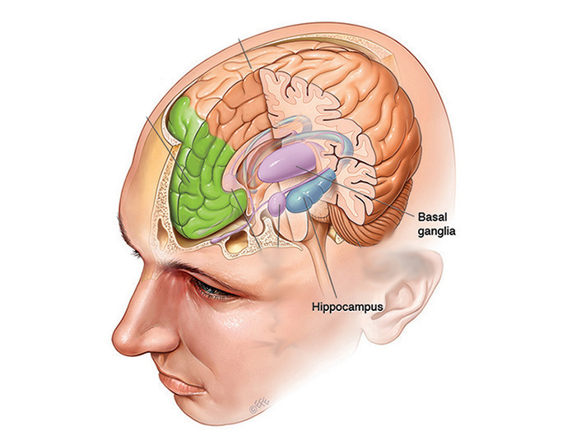
What’s the experiment?
“Acetylcholine release was measured simultaneously in the hippocampus and dorsal striatum of rats before and during training on a maze that could be learned using either a hippocampus-dependent spatial strategy or a dorsal striatum-dependent turning strategy.”

Slide 3
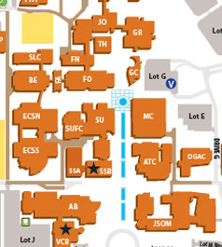
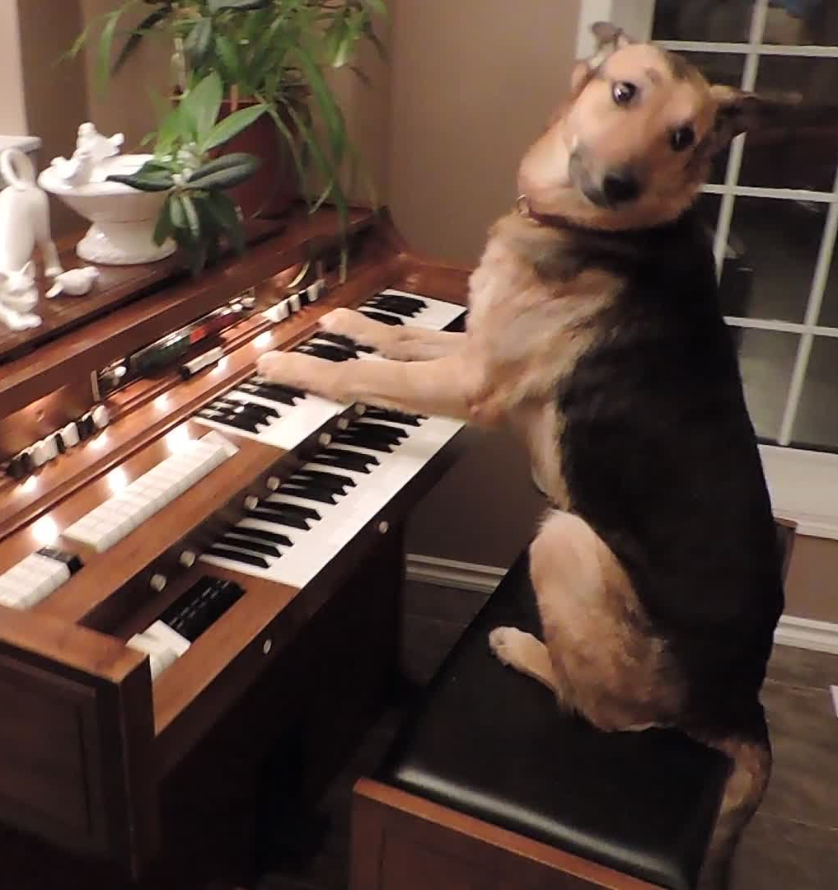
Why these parts of the brain?
Hippocampus
Dorsal Striatum
Damage to this area affects spatial memory while motor learning remains unaffected
Damage to this area affects motor response learning while spatial memory remains unaffected

Slide 4
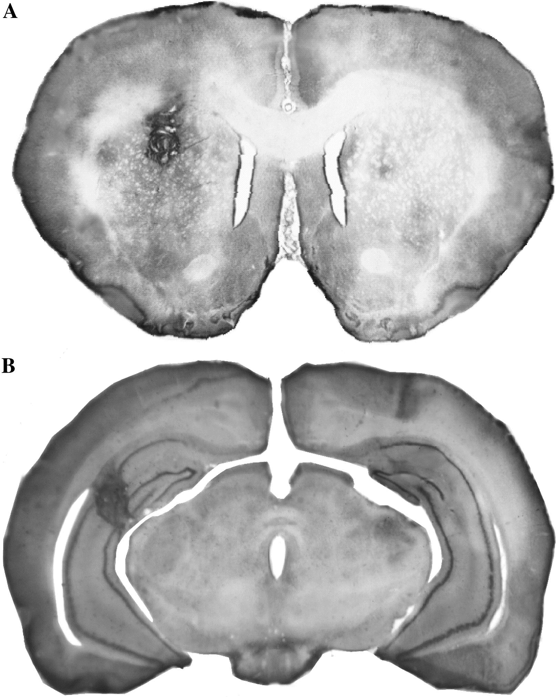
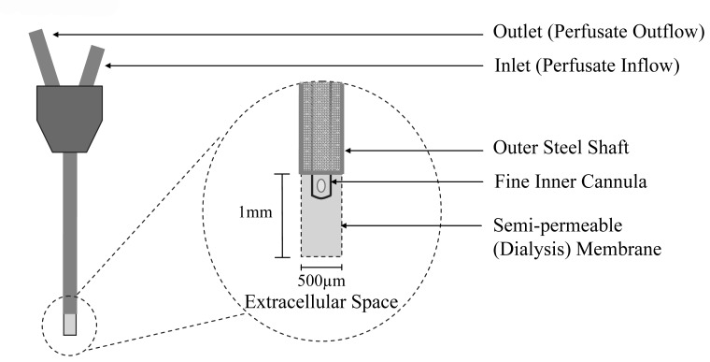
The Surgery
After the experiment was terminated, the position of the microdialysis probe was verified histologically.
Two plastic microdialysis guide cannulae were inserted and aimed at the hippocampus and dorsal striatum.
Samples were taken to measure ACh in 2 parts of the brain before exposure to the maze and during the training phase
For further info: Syslová, Kamila & Rambousek, Lukas & Bubeníková-Valešová, V & Šlamberová, Romana & Novotný, P & Kacer, Petr. (2012). Dopamine analysis in neuroscience research. Dopamine: Functions, Regulation and Health Effects. 81-112.
ACSP
CSP
D. OÃ¢Â€Â™Shea, Sean & M Smith, Imelda & Mccabe, Olive & M. Cronin, Michelle & Walsh, Dominic & T. OÃ¢Â€Â™Connor, William. (2008). Intracerebroventricular Administration of Amyloid ÃŽÂ²-protein Oligomers Selectively Increases Dorsal Hippocampal Dialysate Glutamate Levels in the Awake Rat. Sensors. 8. 10.3390/s8117428.

Slide 5
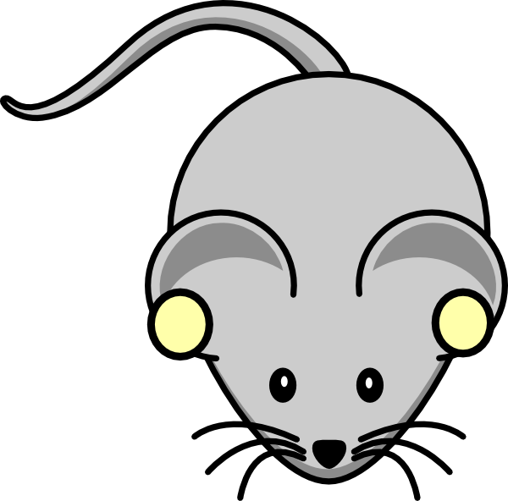
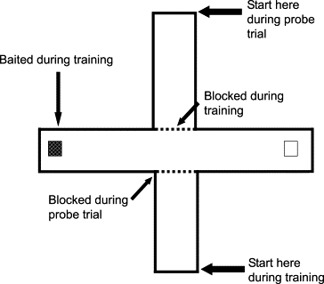
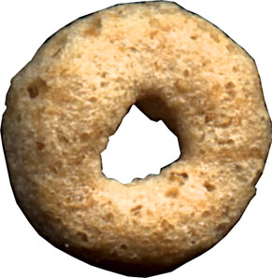
13 male Sprague–Dawley rats (+28 control rats) completed the T-maze until criterion of 9/10 successful completions were met. The rats were then put on the opposite side of the maze.
The Maze, The Training, & The Trials

Slide 6
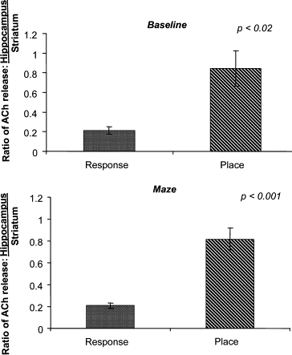
Results
Of the 28 control rats that did not have the implant, 14 used the turn response and 14 used the place response.
Of the 13 implanted rats, 7 used the turn, and 6 used the place response.
ACh increased in both brain areas of all rats during training compared to baseline
The ratio of ACh in Hippocampus compared to Dorsal Striatum was in fact higher in the rats that turned in accordance to space than the rats that turned in accordance with habit.
From samples taken during training and baseline

