Slide 1
Challenges and Opportunities in Mining Neuroscience Data
Journal of science: Perspective - Huda Akil, Maryann E. Martone, David C. Van Essen
Presented by: Tyler Short

Slide 2
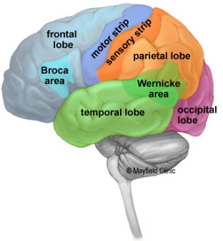
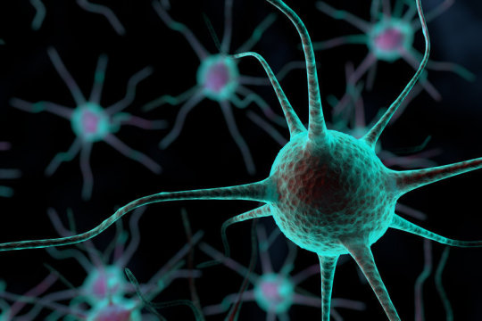
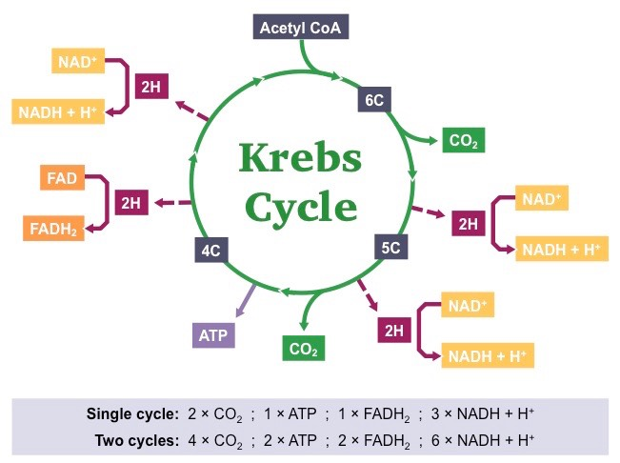
Who wants to understand the brain?
Well you can’t get there without data from various domains:
Biology
Psychology
Chemistry
Physics
Mathematics

Slide 3
Neural Choreography
Understanding complex behaviors and functions
Look at the brain!
Look at brain areas!
Look at neurons!
Look at neurotransmitters…
How do those work?
Wait… How do the neurons work?
DNA makes proteins and stuff… right?
How does transcription work?
Let’s look at molecular structures!
HOW DOES CHEMISTRY/PHYSICS MAKE SENSE OF THOSE STRUCTURES?!

Slide 4
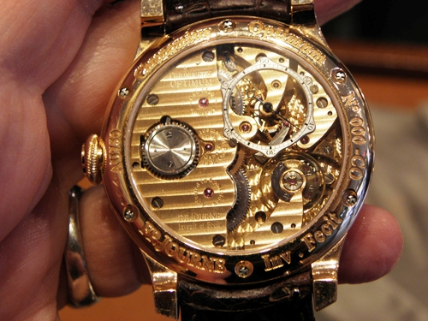
Reductionist approach of problem solving
You can’t understand a watch unless you reduce it to and understand its components
However, understanding a cog isn’t going to teach you how to make a watch
“[Neural choreography] entails the convergent use of analytical and synthetic tools to gather, analyze, and mine information from each level of analysis and capture the emergence of new layers of function (or dysfunction) as we move from studying genes and proteins, to cells, circuits, thought, and behavior.”

Slide 5
Hypothesis Driven Research & Data Intensive Discovery
Cellular and Synaptic Physiology Lab — Sven Kroener
Cortical Plasticity Laboratory — Michael P. Kilgard
Face Perception Research Laboratory — Alice J. O’Toole
Gene expression atlases from the Allen Institute for Brain Sciences
Gene Expression Nervous System Atlas (GENSAT) Project
Disease-specific human neuroimaging repositories
Academic neuroscience has yet* to foster the potential to capitalize on the forthcoming data explosion.

Slide 6

Connectomes: Macroscopic and Microscopic -Comprehensive description of neural connectivity for a specified brain region at a specified spatial scale
Anatomy
Biochemistry
Decades of effort have revealed immense amounts of information about local and long-distance connections in animal brains
Fundamental 3D framework
A wide range of tools (such as immunohistochemistry and in situ hybridization)
Electrophysiological, pharmacological, and behavioral characteristics of circuits

Slide 7
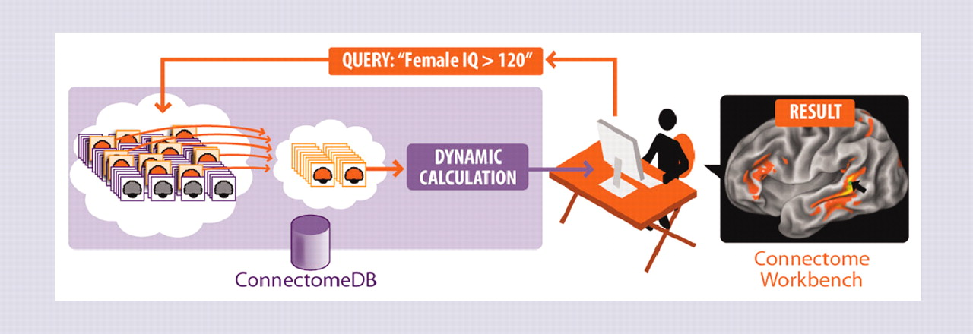
Human Connectome Project
5-year project sponsored by NIH that began in 2009 (still not officially declared complete)
Aims to characterize whole-brain circuitry and its variability across individuals
Diffusion Imaging & R-fMRI
Task-based fMRI
Extensive behavioral testing
Magnetoencephalography (MEG)
Electroencephalography (EEG)
Genotyping and/or full-genome sequencing

Slide 8
Neuroscience Information Framework
The Neurolex and accompanying NIFSTD (NIF-standardized):
Provides definitions for over 50,000 concepts, using formal language to represent brain regions, cells, subcellular structures, molecules, diseases, functions, and relations between them
NIF Data Retrieval Optimization:
Automatically expands search query to include all synonymous or closely related terms. Ex: query for “striatum” will include “neostriatum, dorsal striatum, caudoputamen, caudate putamen” and other variants.

Slide 9
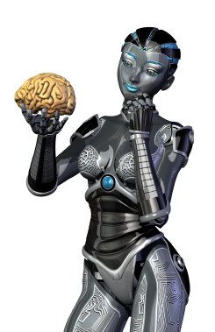
What Else Dat Thing Do?
Goal: Provide definitions that can be used by both humans AND automated agents to navigate and process information from various datasets
Assignment of a unique resource identifier
Search algorithms can distinguish among concepts that share labels
Ex: nucleus (part of cell) and nucleus (part of brain) are distinguished by unique IDs.

Slide 10
The Next Steps in Neuroscience
“Imagine that we are investigating the neurobiology of bipolar disorder…Can we create genetic mouse models of the various mutated genes and show a convergence at any of these levels? Can we capture the critical changes in neuronal and/or glial function (at any of the levels) and find ways to prevent the illness? Discovering the common thread for such a disease will surely benefit from tools that facilitate navigation across the multiple tiers of data—genetics, gene expression/epigenetics, changes in neuronal activity, and differences in dynamics at the micro and macro levels, depending on the mood state. No single focused level of analysis will suffice to achieve a satisfactory understanding of the disease. In neural choreography terms, we need to identify the dancers, define the nature of the dance, and uncover how the disease disrupts it.”

Slide 11
“You must be the change you want to see in the world.” - Mahatma Gandhi
Work for Free (Open Data)
Let Big Brother Help (Government supported databases)
Don’t Start Over (Add to Current Databases)
Help Robots (Language)
Help Robots (Data)
Make Robots (Computational Modeling & Machine Learning)
The Children! (Undergraduate and current education)
Check self ‘fore wreck self (Cultural changes)

Slide 12

Thank You!
Questions? Comments? Concerns? Discussion? .

