Slide 1
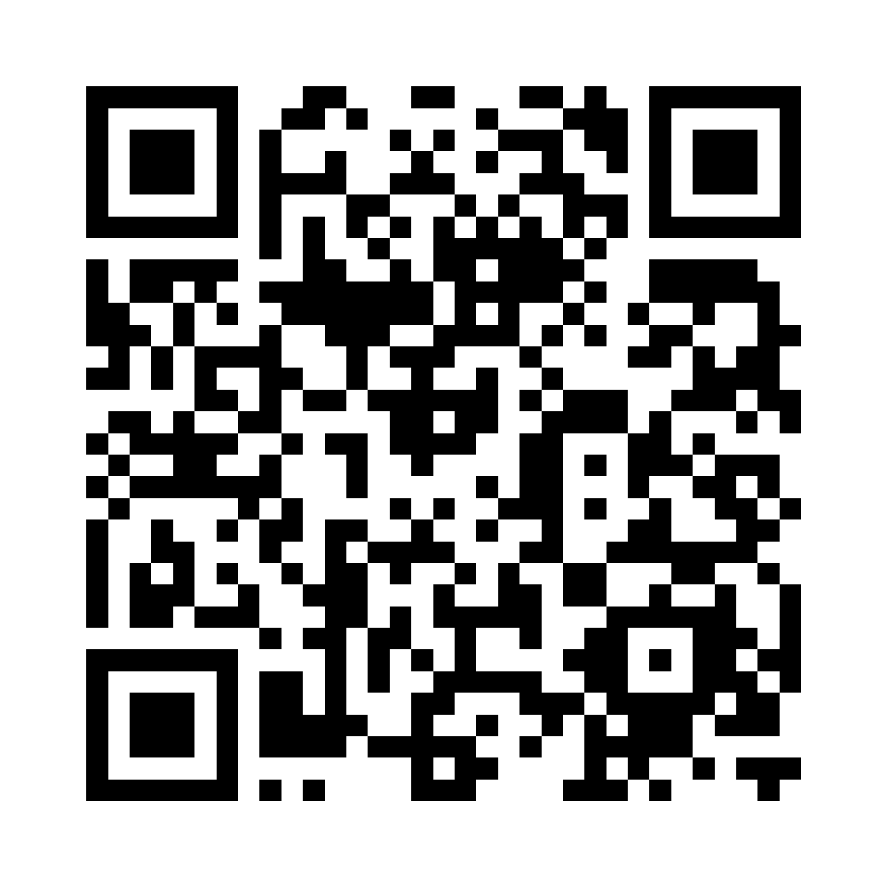
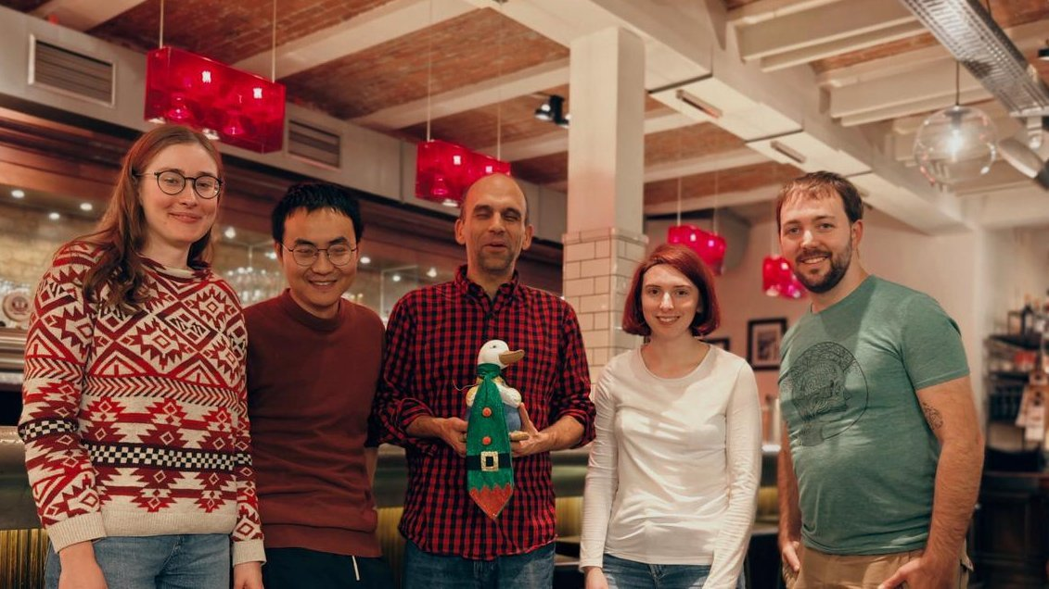
Raymundo Báez Mendoza, PhD
Lab Website
Group Leader - Social Neurobiology Lab
"Prefrontal Mechanisms of Group Behavior"
Notes:
I'm very happy to introduce the next speaker, my supervisor, Raymundo Baez Mendoza. After a bachelor's in Psychology in Mexico City, he did his master's in Tubingen and then a PhD at Cambridge under Wolfram Schultz where he studied how monkeys encode rewards in social situations. He then did his postdoc at Harvard and MassGen hospital with Ziv Williams where he continued studying neural dynamics of monkeys and their decisions in social contexts. Then, in 2022, he started his Social Neurobiology lab here at the DPZ. Now he and we continue studying the neural foundations of how humans and marmosets are able to form and maintain social relationships.

