Slide 1
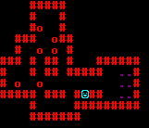
YASC (Yet Another Sokoban Clone)
By Josh Simmons

Slide 2
Project Goals
Create a Sokoban clone
Mimic original mechanics as closely as possible.
Easy to add/design new levels

Slide 3
Design
Initialize world
Main loop
Restart/Fetch level

Slide 4
Main Loop
Check for input
Check location for obstacle
Handle obstacle
Draw screen
Check for win

Slide 5
Lessons Learned
Assembler, in some cases, is preferable to higher level languages
The same techniques used for game design at a higher level apply
Level design and customization → Fun

