Slide 1
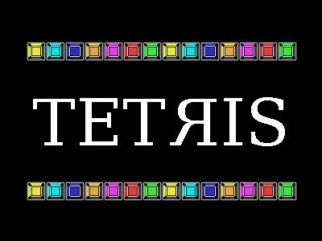
By Josh Simmons

Slide 2
Requirements
A legitimate Tetris clone.
The Tetris Company has a list of specifications that a game must follow to be called a true Tetris game.
Shapes, colors, music, etc

Slide 3
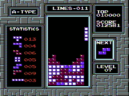
Requirements
Tetriminos
Standard shapes
L, J, I, T, O, S, Z
Standard colors
Korobeiniki, Katjusha, or Kalinka

Slide 4
Requirements
Open source
I wanted to use completely free software while making Tetris.
Linux, G++, SDL, and The Gimp

Slide 5
Challenges
The biggest challenge was getting the mechanics of Tetris down.
Graphics (SDL)
Global variables (evil)

Slide 6
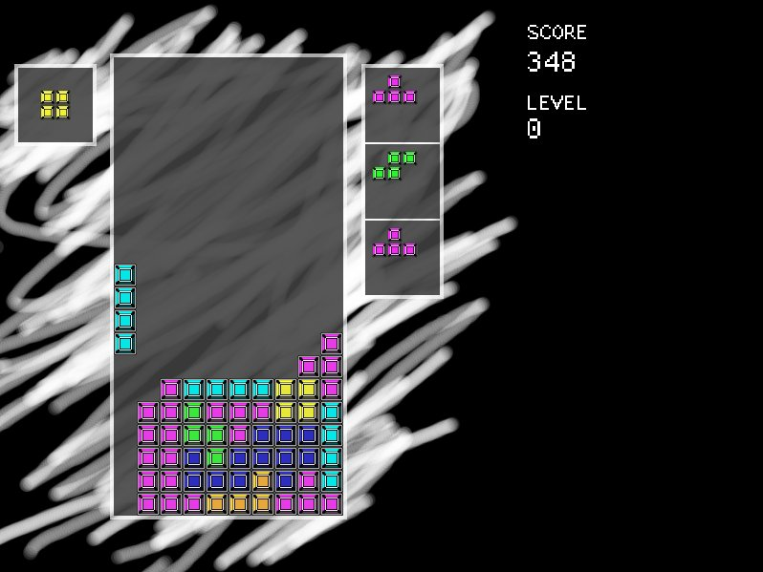
Design
Falling behavior, rotation, clearing lines
Rotation was hardest
Scoring
Speed/Timing

