Slide 1
Mini-project 2
Group: Random Nikolaj Holden 201270915
Peter Helstrup Jensen 201270802
Peter Kragelund 201270868
Martin Nielsen Fig 201270976
Christoffer Bech 201270987
Notes:
Martin

Slide 2
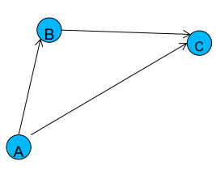
What was the assignment
Design a relay protocol: To hop or not to hop
Focus on lowering power consumption and
setting up ARQ.
Fixed package size and tx power.
Relay
Sink
Source
Notes:
Martin the king of the underworld

Slide 3
Notes:
Christoffer

Slide 4
The Relay
Power consumption when radio off: 1,37 mV
Power consumption when reciving: 192 mV
Sleep 3x handshake
Awake at least 1 handshake + fight time + datasend(currently about 4 seconds)
Notes:
Peter K

Slide 5
Notes:
Nikolaj

Slide 6
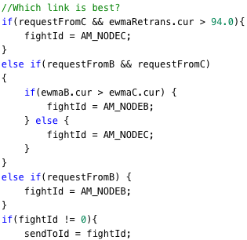
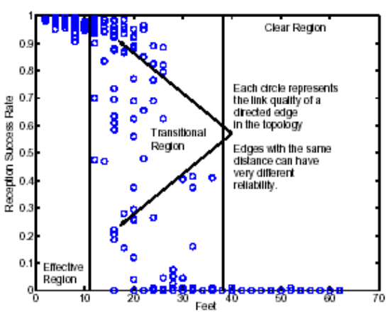
Which link is best?
Handshake every 3 second
One second fight
Agilility vs Stability
Weighted average
Notes:
Peter H

Slide 7
Demo

