Slide 1
Mini-project 2
Group: Random Nikolaj Holden 201270915
Peter Helstrup Jensen 201270802
Peter Kragelund 201270868
Martin Nielsen Fig 201270976
Christoffer Bech 201270987

Slide 2
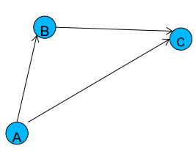
What was the assignment
Design a relay protocol: To hop or not to hop
Relay
Sink
Source

Slide 5
Demo

