Slide 1
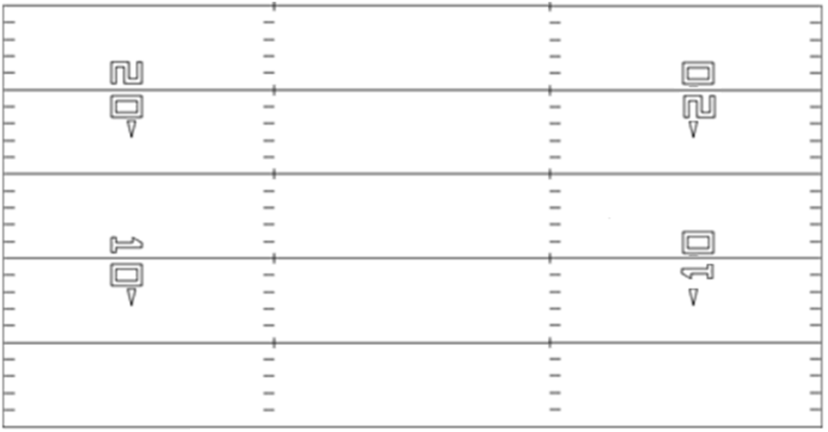
Name=Gun Lt
A
Q

Slide 2
Name=Gun Rt
Q
A

