Slide 1
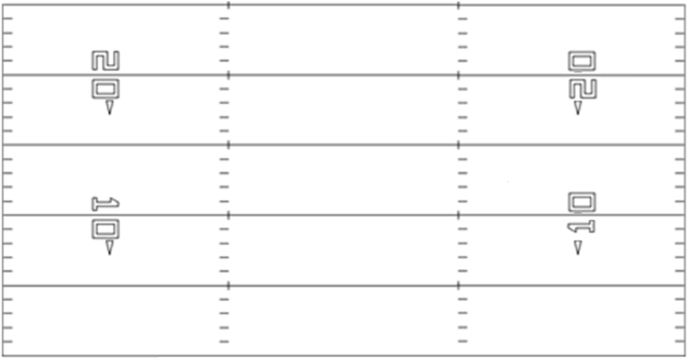
1 L Ace Rt Gun Rt Zone Read Lt
X
Z
B
Y
Q
A

Slide 2
2 R Ace Lt Gun Lt Zone Read Rt
X
Z
Y
B
A
Q

Slide 3
3 M Pro-Twin Rt Gun Rt Zone Read Lt
X
Y
B
Z
Q
A

