Slide 1
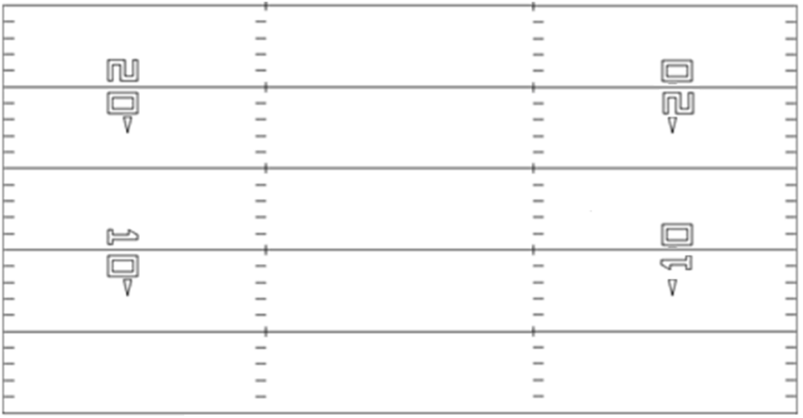
Name=Ace-Ace Rt
Core=Five Rt
X
T
G
C
G
T
Z
B
Y

Slide 2
Name=Ace-Ace Lt
Core=Five Lt
Z
T
G
C
G
T
X
Y
B

Slide 3
Name=Pro-Twin Rt
Core=Y Rt
X
T
G
C
G
T
Y
B
Z

Slide 4
Name=Pro-Twin Lt
Core=Y Lt
Y
T
G
C
G
T
X
Z
B

Slide 5
Name=Pro Wing-Split Rt
Core=Y Wing Rt
X
T
G
C
G
T
Y
Z

Slide 6
Name=Pro Wing-Split Lt
Core=Y Wing Lt
Y
T
G
C
G
T
X
Z

