Slide 1
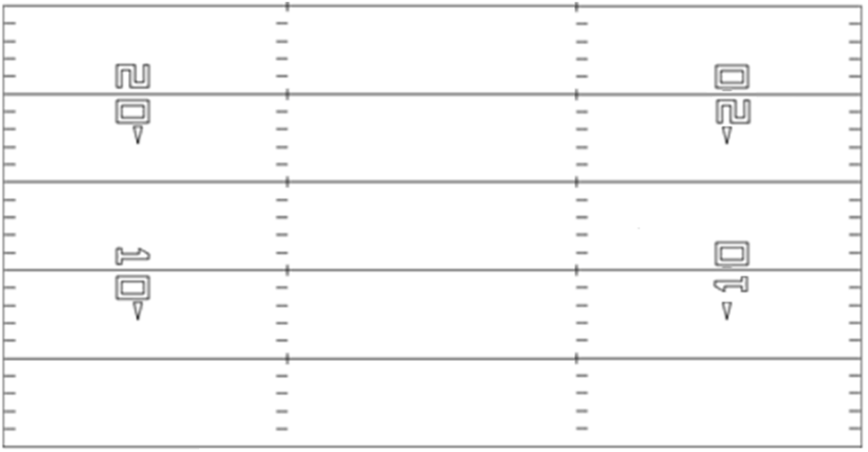
Name=Indy-Split Rt
Core=Y Rt
CoreInjection=Y
X
T
G
C
G
T
Y
B
Z

Slide 2
Name=Indy-Split Lt
Core=Y Lt
CoreInjection=Y
Y
T
G
C
G
T
X
Z
B

Slide 3
Name=Pro-Twin Rt
Core=Y Rt
CoreInjection=Y
X
T
G
C
G
T
Y
B
Z

Slide 4
Name=Pro-Twin Lt
Core=Y Lt
CoreInjection=Y
Y
T
G
C
G
T
X
Z
B

Slide 5
Name=Pro-Split Rt
Core=Y Rt
CoreInjection=Y
X
T
G
C
G
T
Y
Z

Slide 6
Name=Pro-Split Lt
Core=Y Lt
CoreInjection=Y
Y
T
G
C
G
T
X
Z

Slide 7
Name=Pro Wing-Twin Rt
Core=Y Wing Rt
CoreInjection=YB
X
T
G
C
G
T
Y
Z
B

Slide 8
Name=Pro Wing-Twin Lt
Core=Y Wing Lt
CoreInjection=YB
Y
T
G
C
G
T
X
B
Z

Slide 9
Name=Pro Wing-Split Rt
Core=Y Wing Rt
CoreInjection=YZ
X
T
G
C
G
T
Y
Z

Slide 10
Name=Pro Wing-Split Lt
Core=Y Wing Lt
CoreInjection=YZ
Y
T
G
C
G
T
X
Z

Slide 11
Name=Tight-Twin Rt
Core=Y Rt
CoreInjection=Y
X
T
G
C
G
T
Y
Z

Slide 12
Name=Tight-Twin Lt
Core=Y Lt
CoreInjection=Y
Y
T
G
C
G
T
X
Z

Slide 13
Name=Trips-Split Rt
Core=Five Rt
CoreInjection=None
X
T
G
C
G
T
Z
B
Y

Slide 14
Name=Trips-Split Lt
Core=Five Lt
CoreInjection=None
X
T
G
C
G
T
Z
Y
B

Slide 15
Name=Trips Wing-Split Rt
Core=Five Wing Rt
CoreInjection=B
Z
T
G
C
G
T
X
B
Y

Slide 16
Name=Trips Wing-Split Lt
Core=Five Wing Lt
CoreInjection=B
X
T
G
C
G
T
Z
Y
B

Slide 17
Name=Tight-Trips Lt
Core=Y Lt
CoreInjection=Y
Y
T
G
C
G
T
Z
B
X

Slide 18
Name=Tight-Trips Rt
Core=Y Rt
CoreInjection=Y
X
T
G
C
G
T
Y
Z
B

Slide 19
Name=Twin-Twin Rt
Core=Five Rt
CoreInjection=None
Z
T
G
C
G
T
X
B
Y

Slide 20
Name=Twin-Twin Lt
Core=Five Lt
CoreInjection=None
Z
T
G
C
G
T
X
Y
B

Slide 21
Name=Twin Wing-Twin Rt
Core=Five Wing Rt
CoreInjection=Y
X
T
G
C
G
T
Z
B
Y

Slide 22
Name=Twin Wing-Twin Lt
Core=Five Wing Lt
CoreInjection=Y
Z
T
G
C
G
T
X
Y
B

Slide 23
Name=Twin Wing-Twin Wing Rt
Core=Five Wing Wing Rt
CoreInjection=YB
X
T
G
C
G
T
Z
B
Y

Slide 24
Name=Twin Wing-Twin Wing Lt
Core=Five Wing Wing Lt
CoreInjection=YB
Z
T
G
C
G
T
X
Y
B

