Slide 1
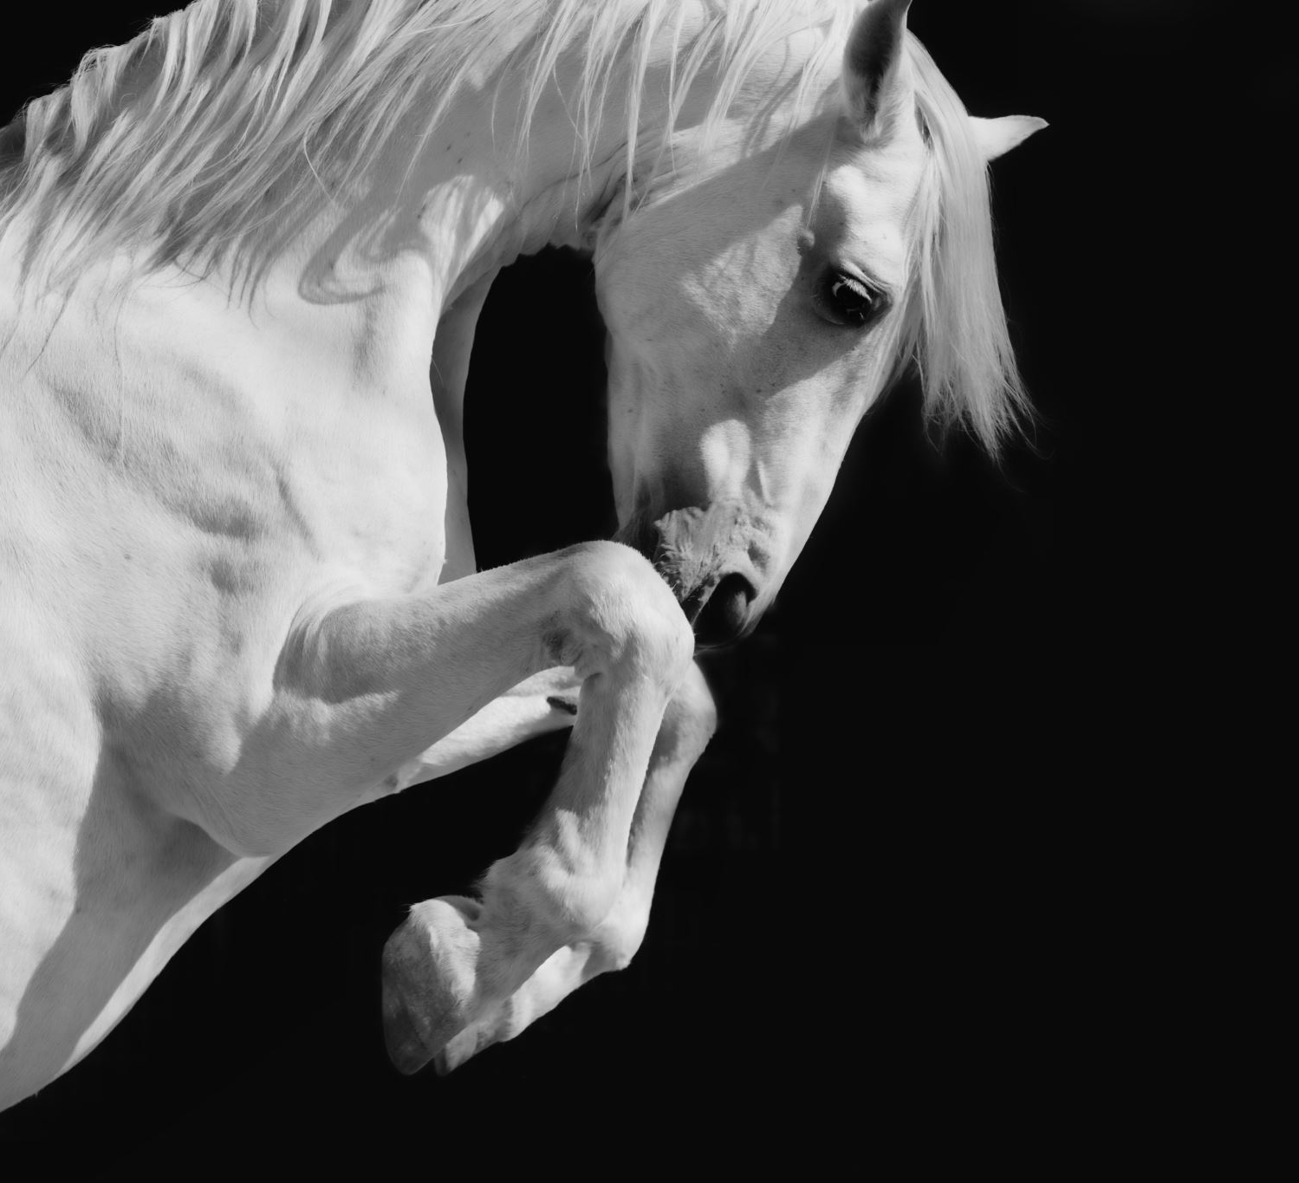
AlphaGo
創新AI碩一
111C71008
何哲平

Slide 2

What is AlphaGo

Slide 3
What is AlphaGo

Slide 4
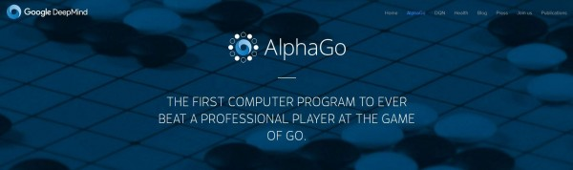
What is AlphaGo？
AlphaGo → Artificial Intelligence, Excellent at Go Chess.
Competition Record:
Year：2015 Competitor：Fan Hui, European Go Champion Record ： 5:0, AlphaGO Win → Before, No computer beaten human champion.
Year： 2016 Competitor：Lee Se-Dol, Korean Go player, 9 dan rank. Record ：4:1, AlphaGO Win → Milestone to AI world.

Slide 5
Methodology

