Slide 1
Application Case Study (25%)
Work Example(s) and Briefing

Slide 2
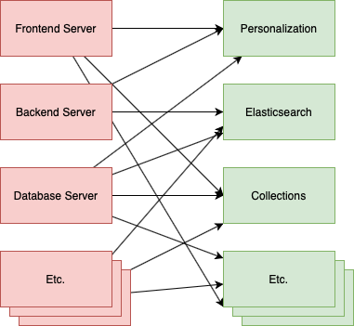
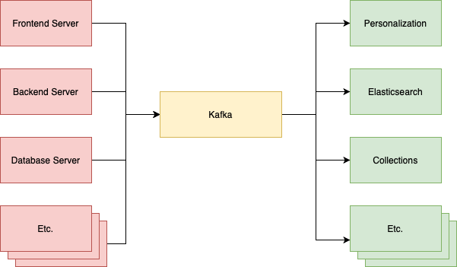
Application Case Study
Apache Kafka was developed by Linkedin in 2010.
To solve data pipeline problem.
Designed for big data streaming processing.
Capable of handling tens of thousands of requests per second
↑Before Adopting Kafka
↑After Adopting Kafka
Notes:
Apache Kafka 最初由 Linkedin 所開發為了解決 data pipeline 問題
不同於其他的訊息處理系統，Apache Kafka 是針對 big data streaming 處理而設計，可以輕易達到每秒上萬等級 requests
採用 Kafka 前 每個應用之間都需要知道彼此的 API 接口才能串接，或是如果一方暫時故障無法回應，可能就會失去資料。
當使用 Kafka 後 可以將低其元件之間的耦合，且讓資料流變的清晰可見。

Slide 3
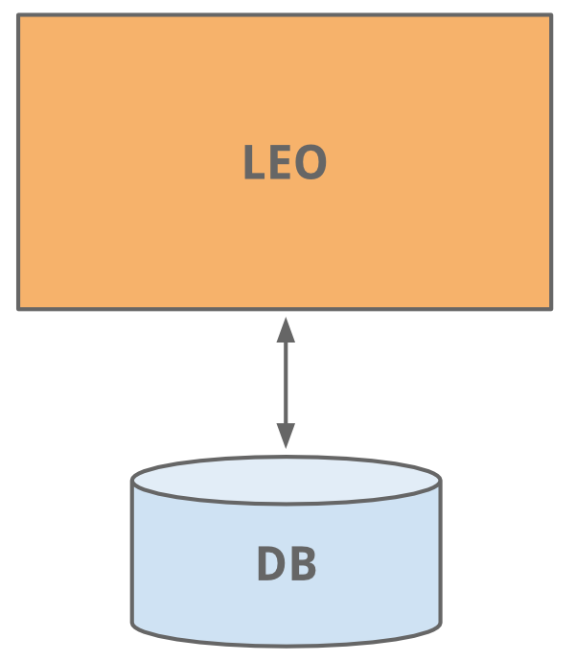
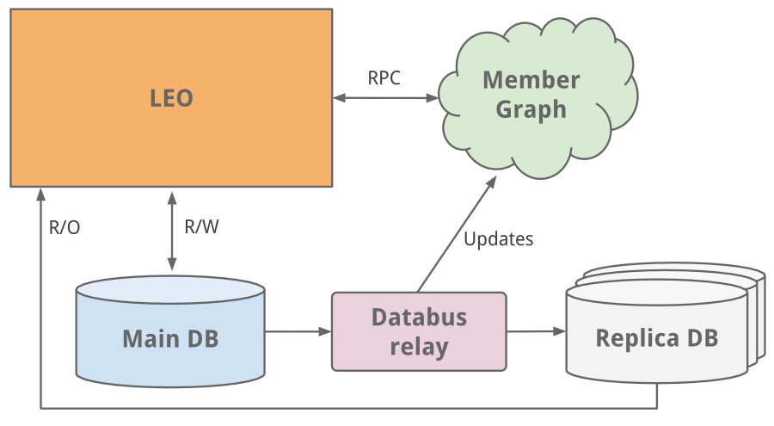
Application Case Study - LinkedIn
The early years-LEO
as a single monolithic application doing it all.
hosted web servlets for all the various pages, handled business logic, and connected to a handful of LinkedIn databases.
throw more CPUs and memory
Notes:
Leo
LinkedIn 的起步與今天許多網站的起步一樣，作為一個單一的整體應用程序來完成所有事情。 LinkedIn started as many sites start today, as a single monolithic application doing it all.
它為所有不同的頁面託管 web servlet，處理業務邏輯，並連接到少數 LinkedIn 數據庫。 It hosted web servlets for all the various pages, handled business logic, and connected to a handful of LinkedIn databases.
隨著網站的發展，Leo 也在發展，其角色和責任也在增加，自然而然地也增加了它的複雜性。負載平衡有助於啟動多個 Leo 實例。但增加的負載正在加重 LinkedIn 最關鍵的系統——其會員資料數據庫的負擔。 As the site grew, so did Leo, increasing its role and responsibility, and naturally increasing its complexity. Load balancing helped as multiple instances of Leo were spun up. But the added load was taxing LinkedIn’s most critical system - its member profile database.
我們做的一個簡單的修復是經典的垂直縮放——投入更多的 CPU 和內存！ An easy fix we did was classic vertical scaling - throw more CPUs and memory at it!

Slide 4

Application Case Study - LinkedIn
However, as the site began to see more and more traffic,
Leo was often going down in production,
difficult to troubleshoot and recover,
difficult to release new code
High availability is critical to LinkedIn.
Notes:
Leo
隨著網站流量越來越大，我們的單體應用 Leo 經常在生產環境中宕機，很難進行故障排除和恢復，也很難發布新代碼。高可用性對 LinkedIn 至關重要。很明顯，我們需要“殺死 Leo”並將其分解為許多小型功能。 As the site began to see more and more traffic, our single monolithic app Leo was often going down in production, it was difficult to troubleshoot and recover, and difficult to release new code. High availability is critical to LinkedIn. It was clear we needed to “Kill Leo” and break it up into many small functional.

Slide 5
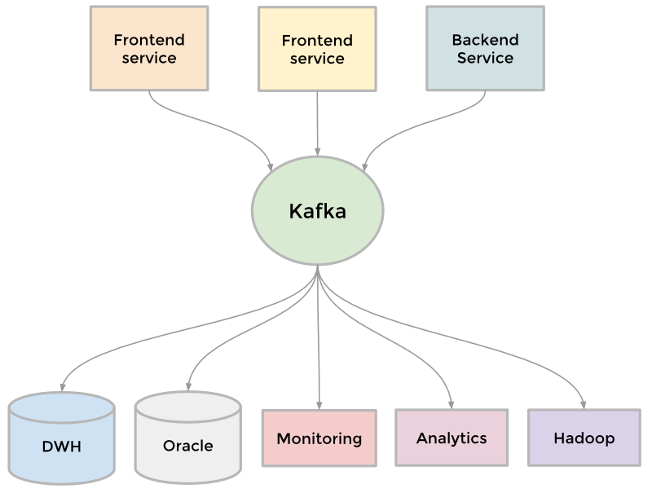
Application Case Study - LinkedIn
Demand:
sending batches of data into our Hadoop workflow for analytics
collecting and aggregating logs from every service
collecting tracking events like pageviews
keeping search system up to date whenever profile is updated.
To collect the growing amount of data → Result: the development of Kafka
Notes:
Kafka
為了收集越來越多的數據 To collect its growing amount of data
Example
需要將成批數據發送到我們的Hadoop 工作流中進行分析 we needed to send batches of data into our Hadoop workflow for analytics
收集並聚合來自每個服務的日誌 we collected and aggregated logs from every service
收集頁面瀏覽量等跟踪事件 we collected tracking events like pageviews
當有人更新個人資料時，讓搜索系統保持最新。 we needed to keep our people search system up to date whenever someone updated their profile.
結果是開發了我們的分佈式發布-訂閱消息傳遞平台Kafka 。 The result was the development of Kafka, our distributed pub-sub messaging platform.

Slide 6
Reference(s) (5%)
Title, Author(s), Publisher, and Published Date

Slide 7
Reference(s) (5%)
Title: Apache Kafka 介紹 Author: Chi-Hsuan Huang https://medium.com/@chihsuan/introduction-to-apache-kafka-1cae693aa85e Published Date: Apr 12, 2020
Title: A Brief History of Scaling LinkedIn Author: Josh Clemm https://engineering.linkedin.com/architecture/brief-history-scaling-linkedin Published Date: July 20, 2015

